Slide 1


Welcome to class
T.

Slide 2


Unit 2
كتاب ثاني وثالث
Unit 9
كتاب رابع وخامس

Slide 3





workbook
2^{nd &} 3^{rd Grade}
Pages 47 , 48
workbook
^{4th & 5th Grade}
Pages 187 , 188

Slide 4

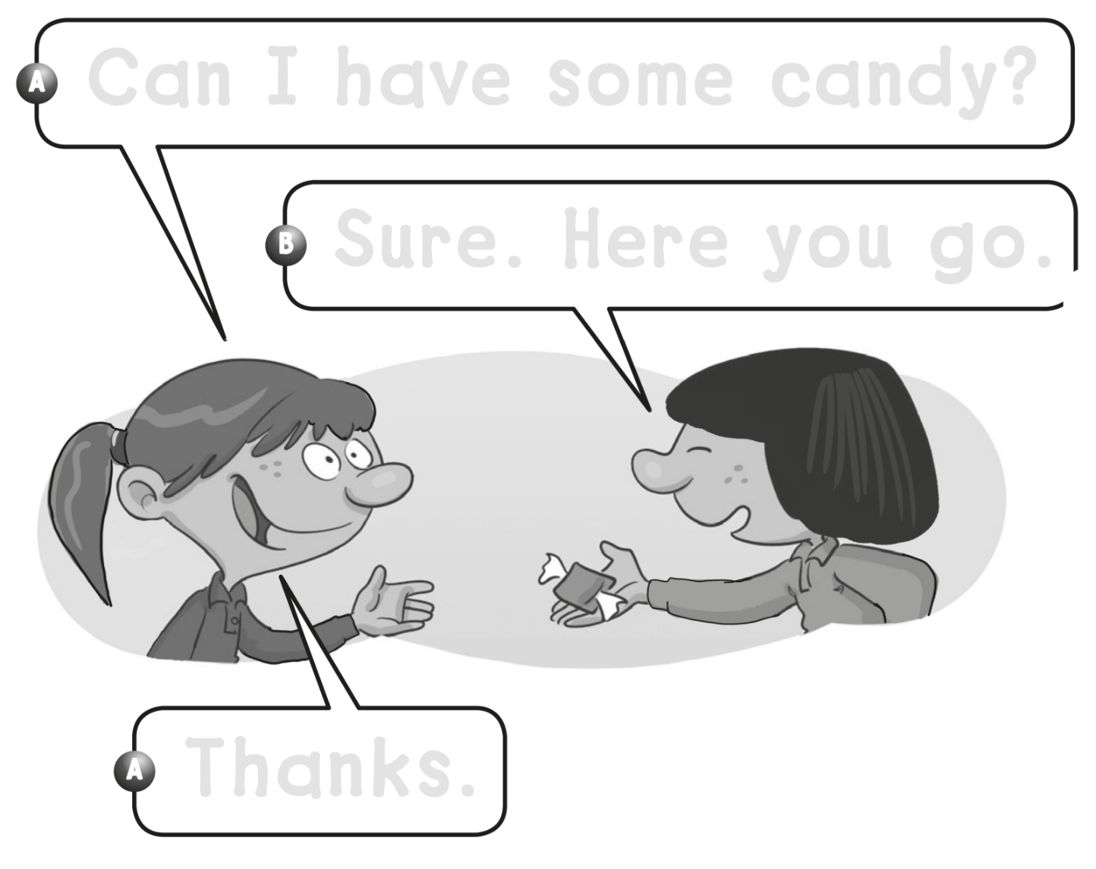

Can I have some candy ?
Sure . Here you go .
Thanks .

Slide 5
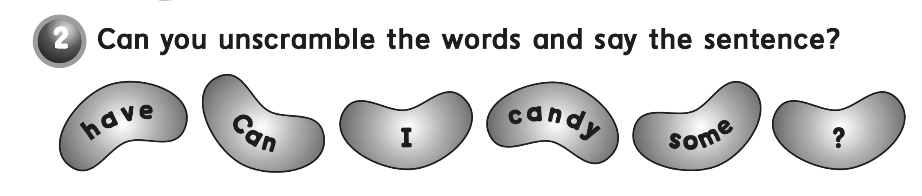
Can I have some candy ?

Slide 6
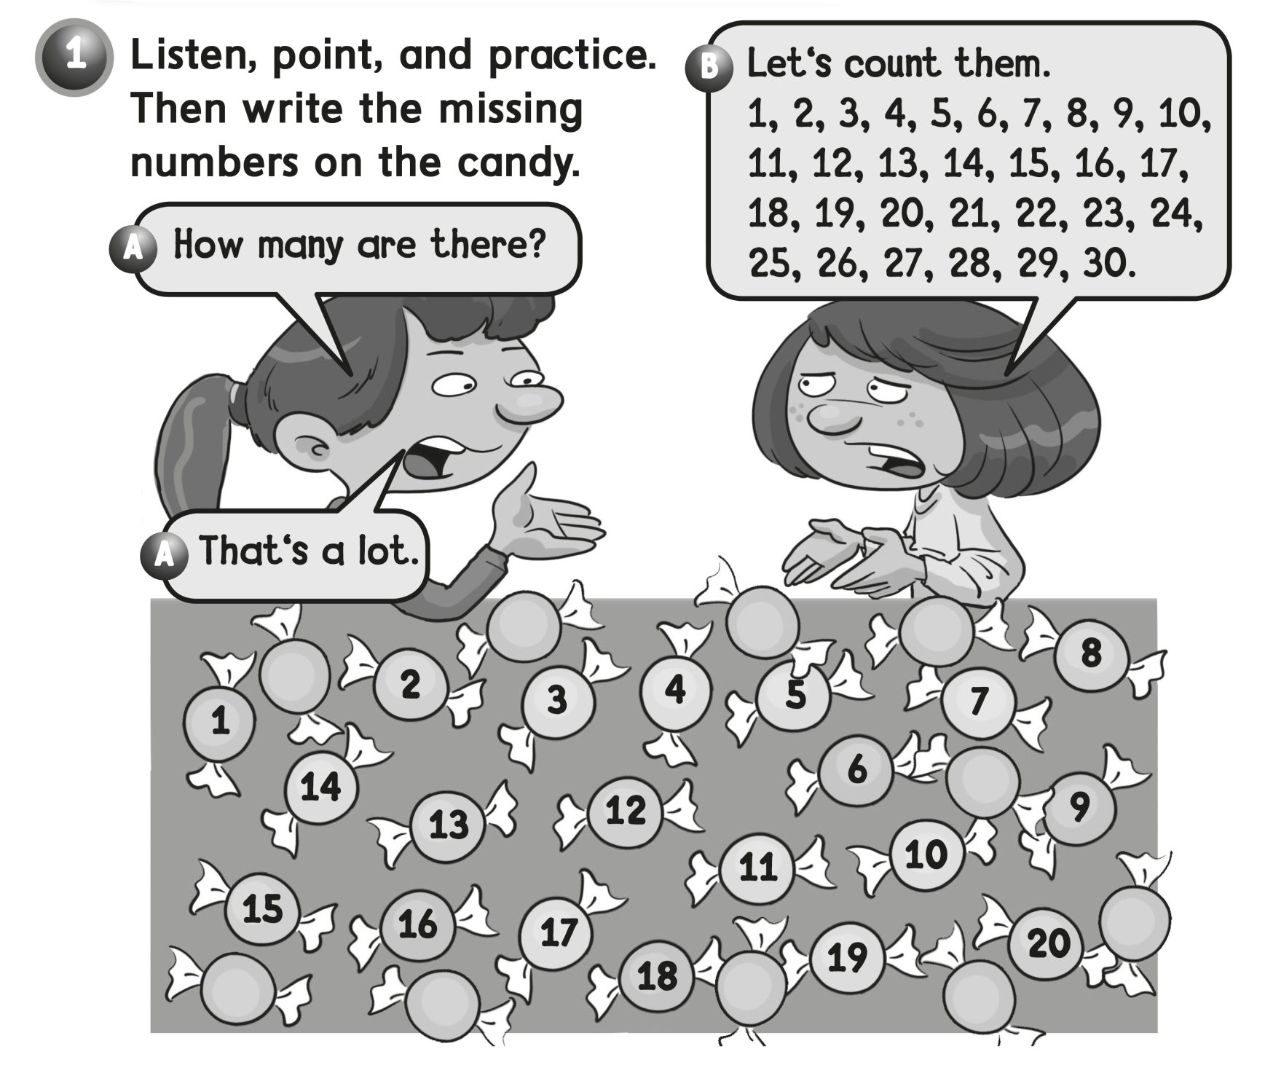

22
23
24
21
25
26
30
29
28
27

Slide 7
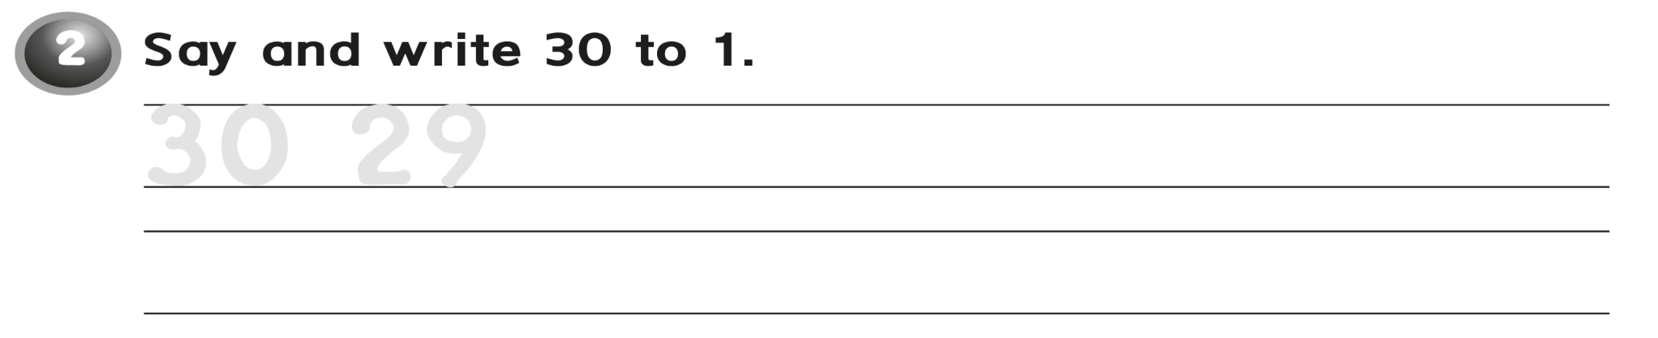
28 27 26 25 24 23 22 21
20 19 18 17 16 15 14 13 12 11 10
9 8 7 6 5 4 3 2 1 0

Slide 8
workbook
2^{nd &} 3^{rd Grade}
Pages 49 , 50
workbook
^{4th & 5th Grade}
Pages 189, 190

Slide 9
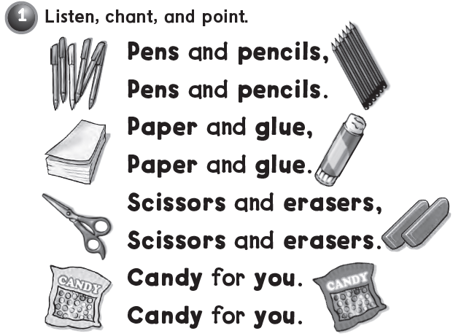


Slide 10
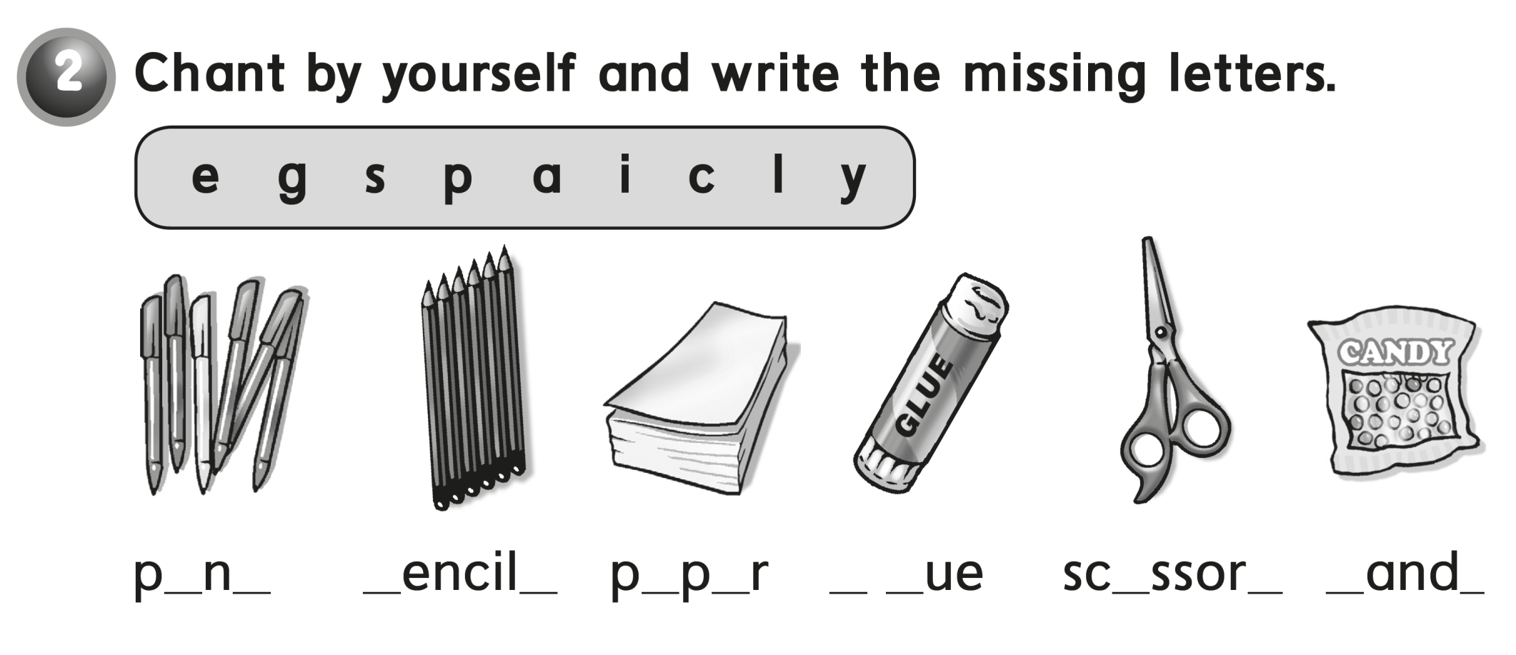
e s p s a e g l i s c y

Slide 11

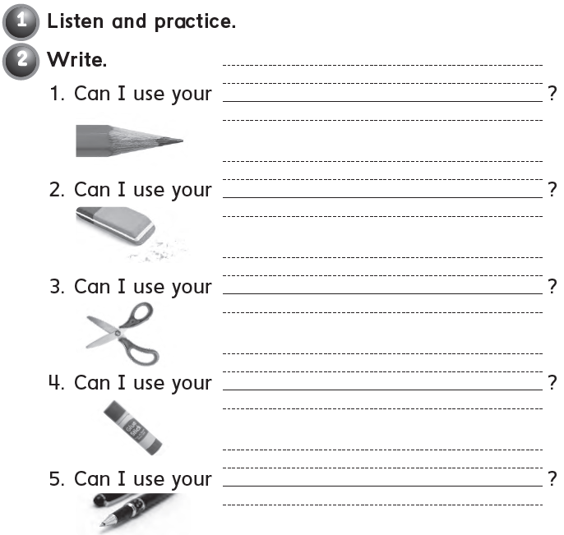
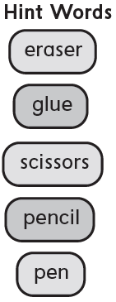
pencil
eraser
scissors
glue
pen

Slide 12
workbook
2^{nd &} 3^{rd Grade}
Pages 51, 52
workbook
^{4th & 5th Grade}
Pages 191 , 192

Slide 13

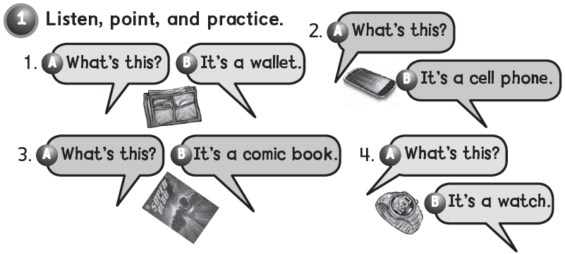

Slide 14
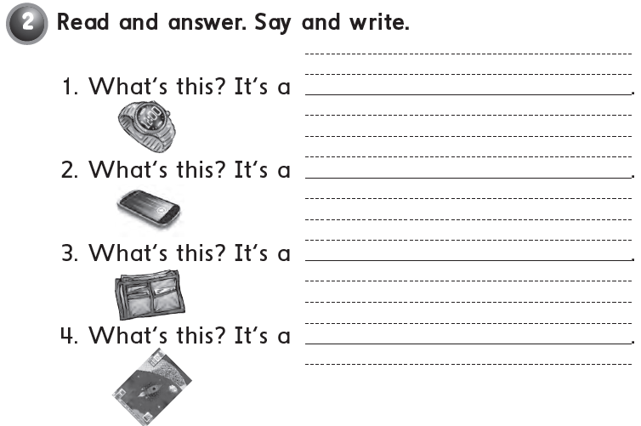
watch
Cell phone
Wallet
Comic book

Slide 15
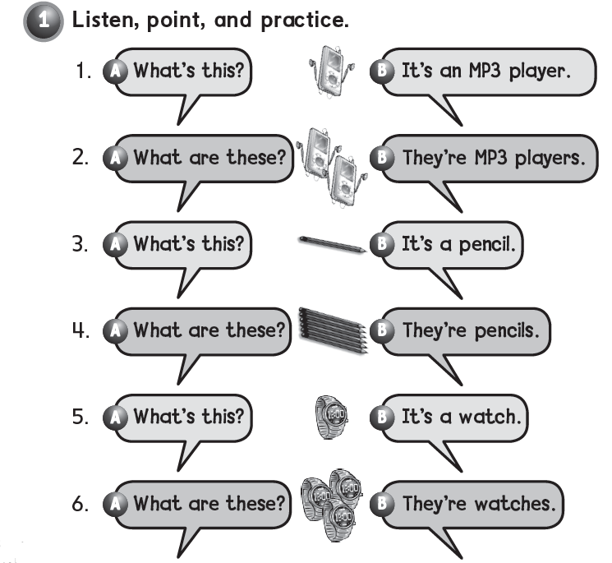


Slide 16
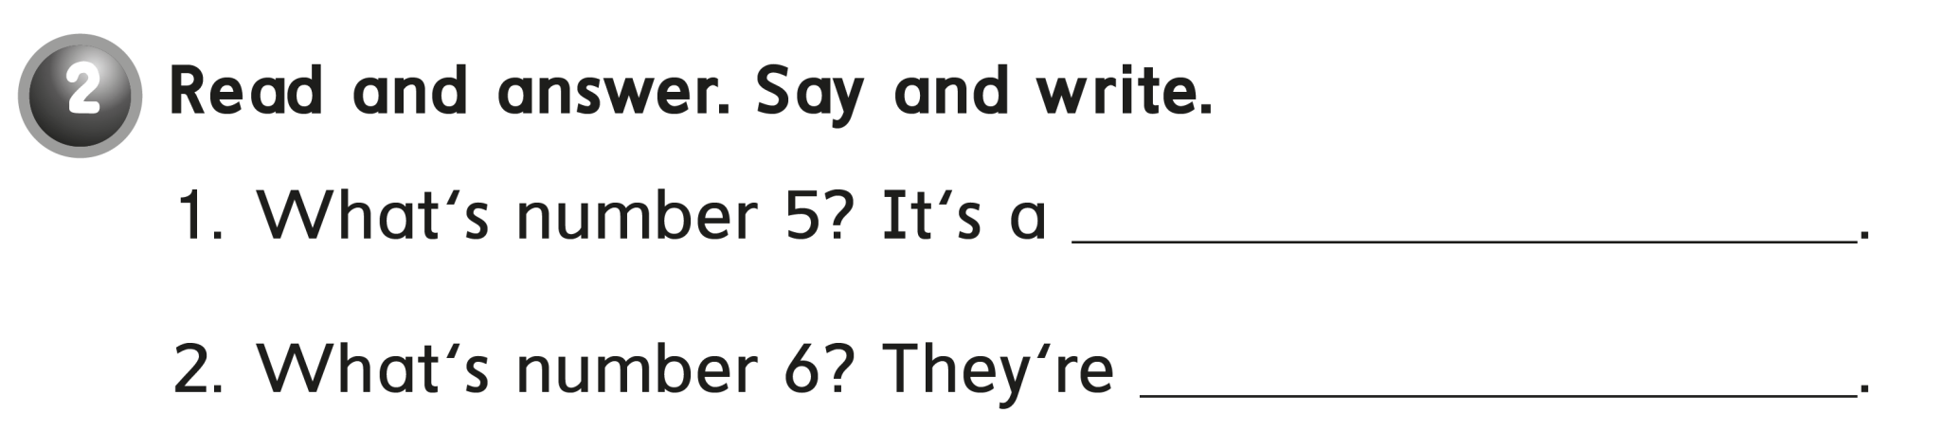
watch
watches

Slide 17
workbook
2^{nd &} 3^{rd Grade}
Pages 53 , 54
workbook
^{4th & 5th Grade}
Pages 193 , 194

Slide 18

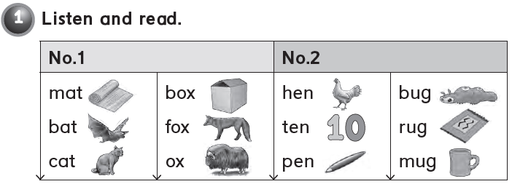

Slide 19
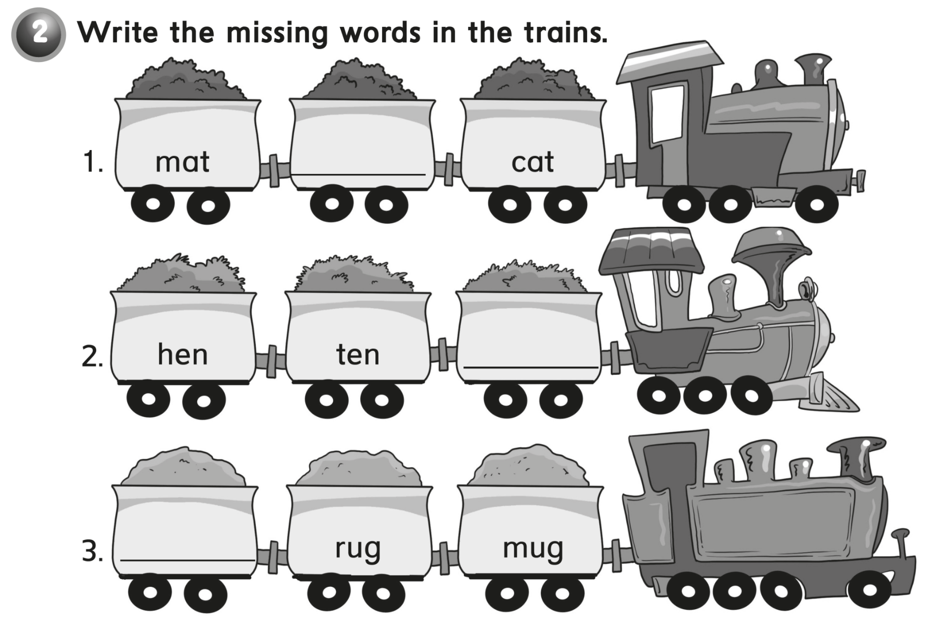
bat
pen
bug

Slide 20
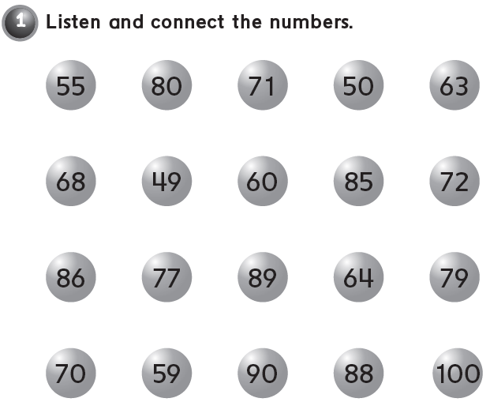

Slide 21
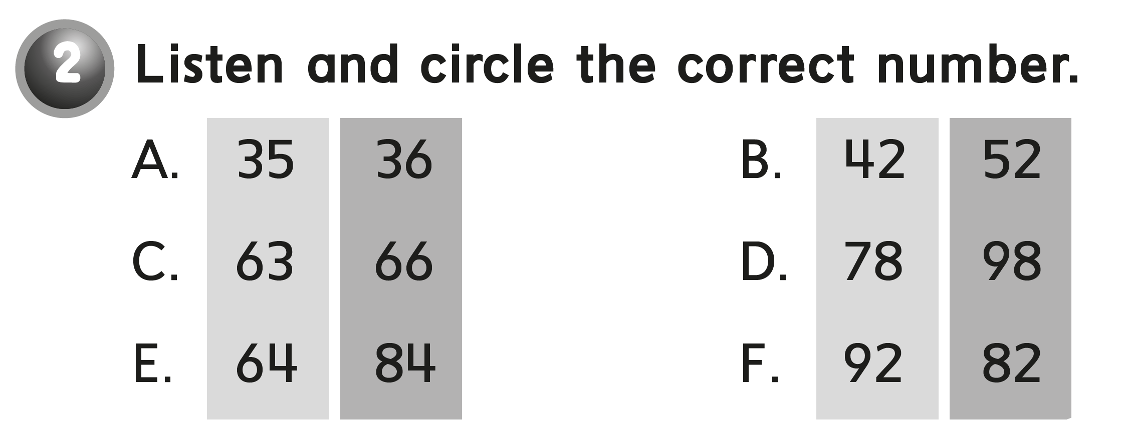

Slide 22


