Slide 1


Welcome to class
T.

Slide 2


Unit 3
كتاب ثاني وثالث
Unit 10
كتاب رابع وخامس

Slide 3




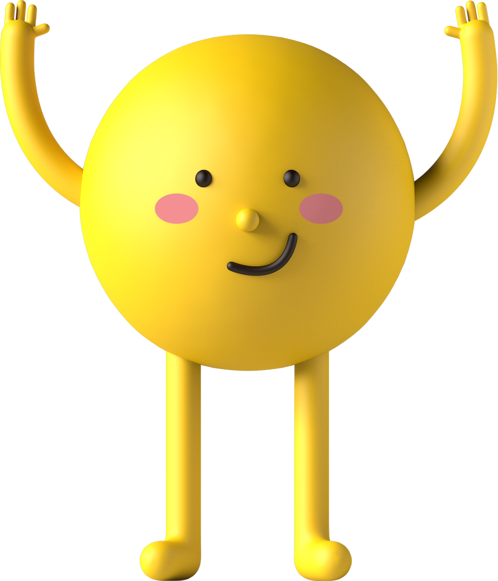
workbook
2^{nd &} 3^{rd Grade}
Pages 55 , 56
workbook
^{4th & 5th Grade}
Pages 195 , 196

Slide 4
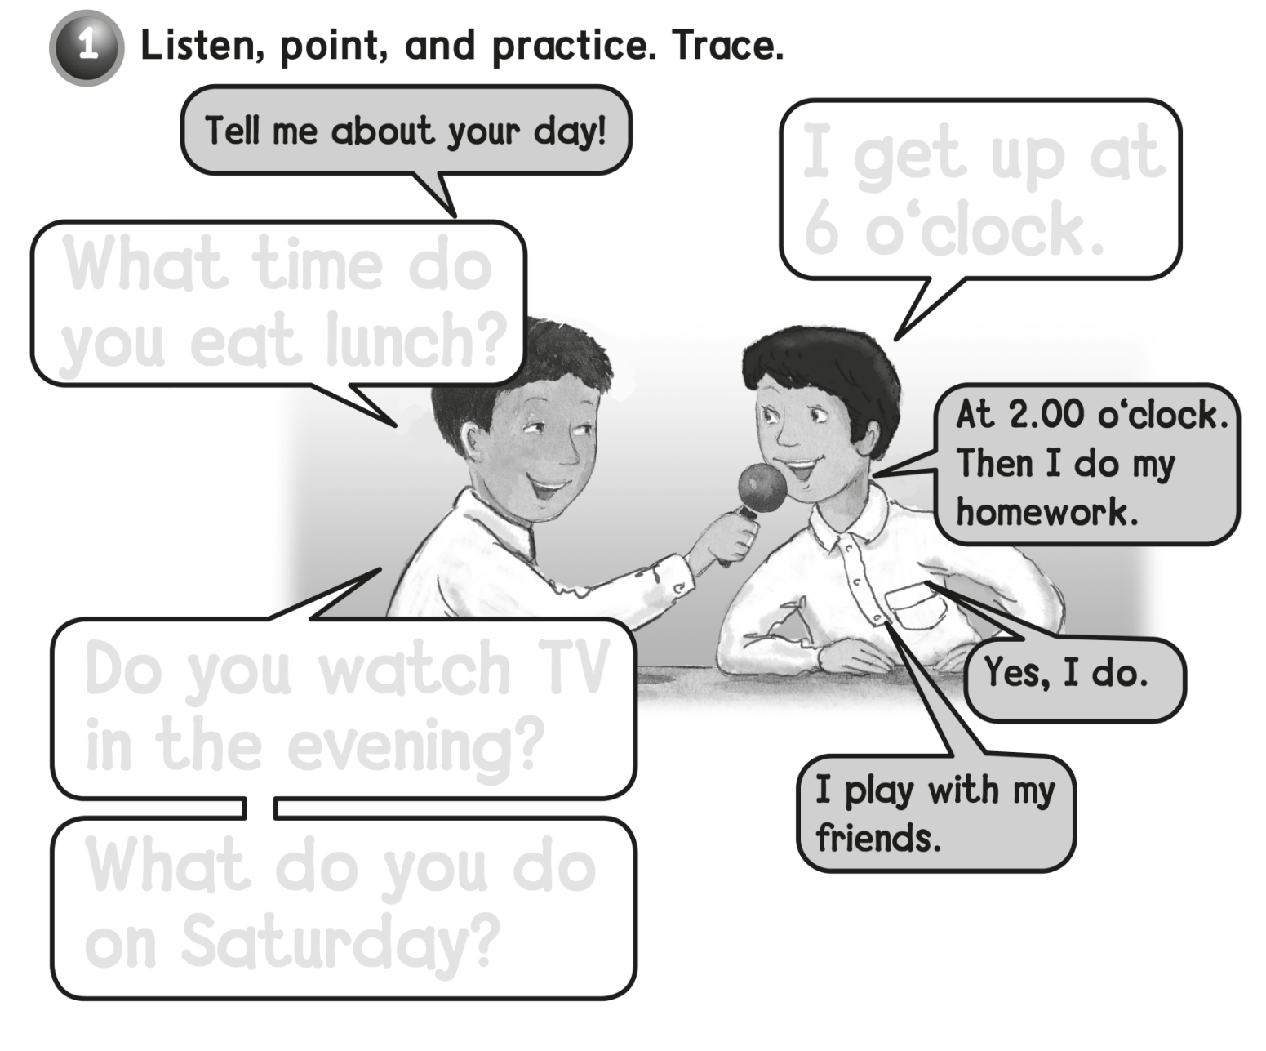

I get up at
6 o’clock
What time do
you eat lunch ?
Do you watch TV
in the evening ?
What do you do
on Saturday ?

Slide 5
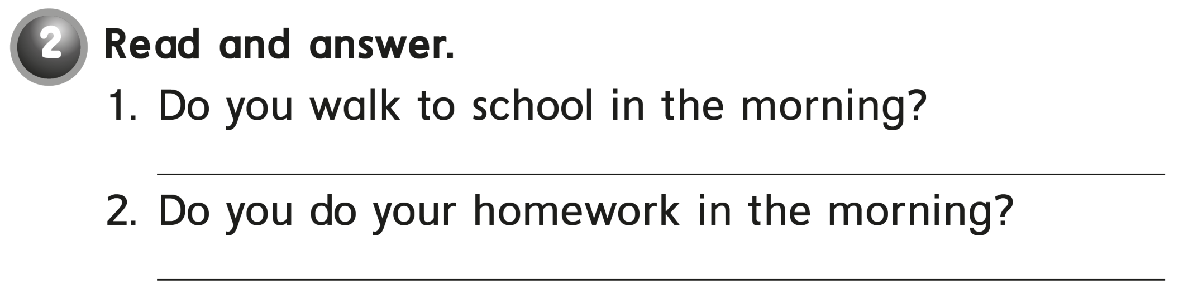
Yes , I do .
No , I don’t .

Slide 6

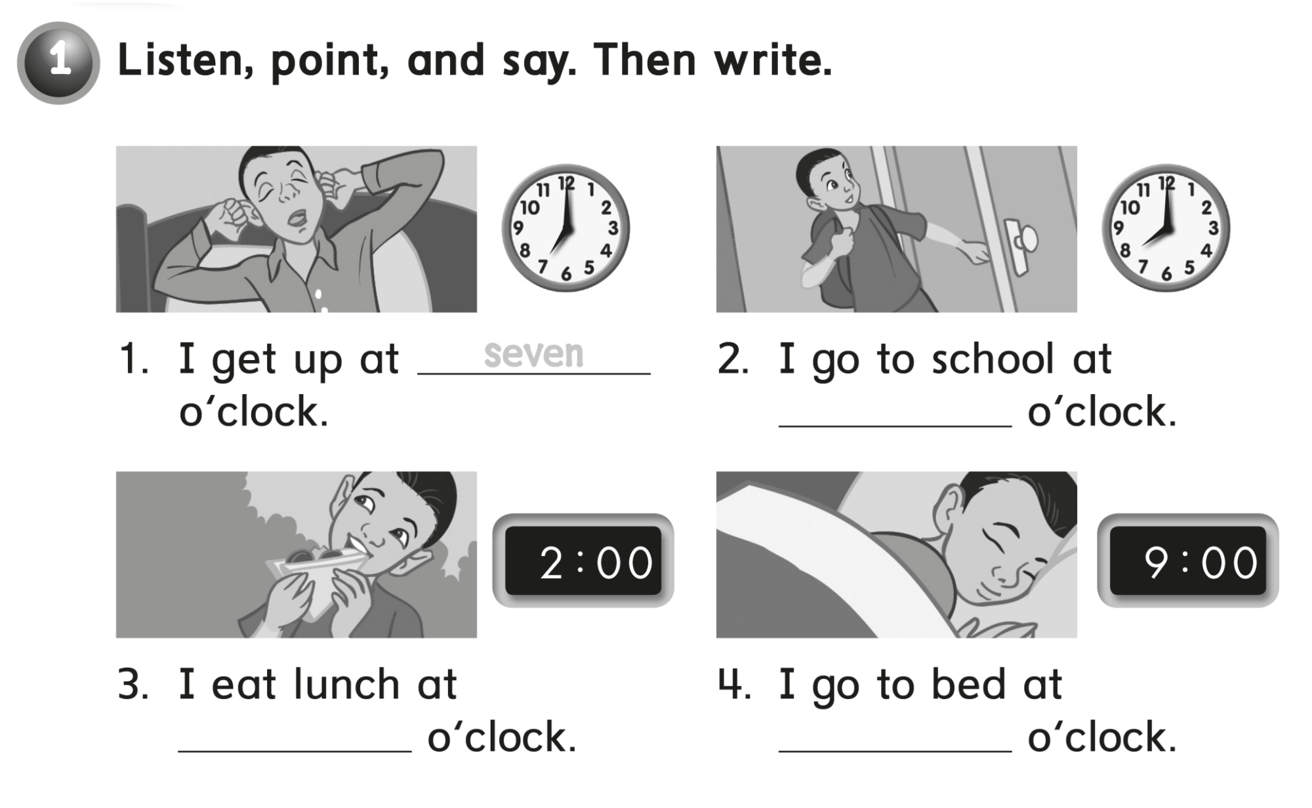
eight
two
nine

Slide 7
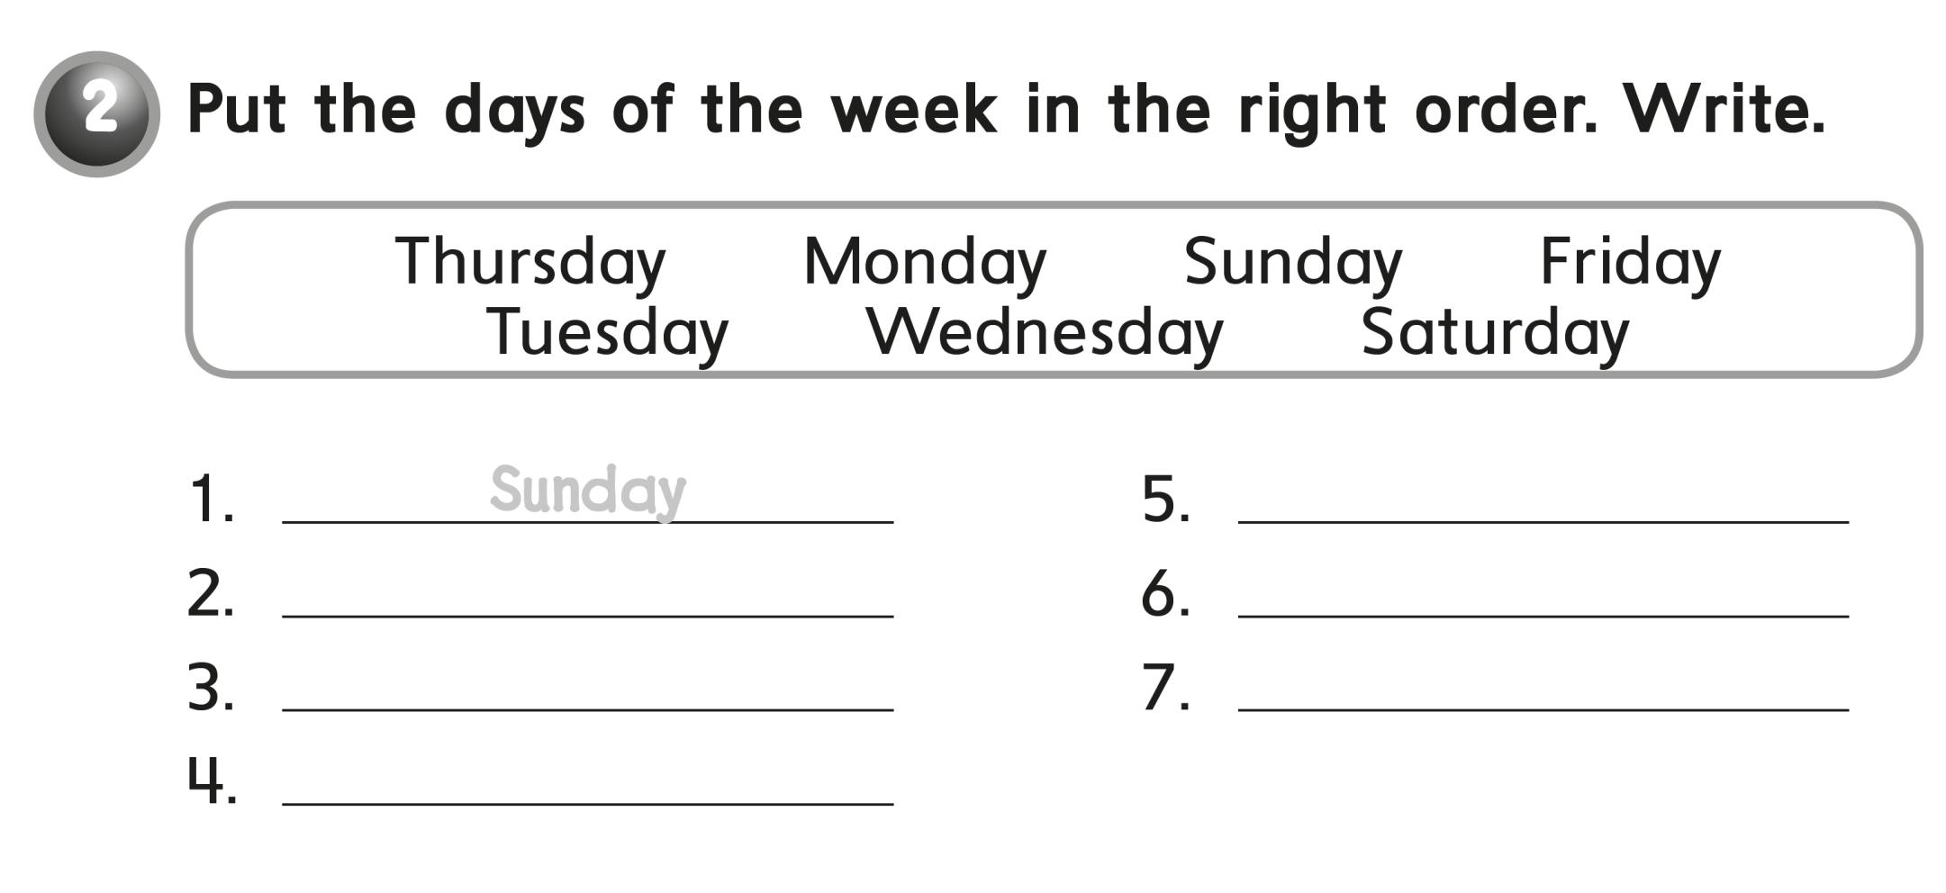
Thursday
Monday
Friday
Tuesday
Saturday
Wednesday

Slide 8
workbook
2^{nd &} 3^{rd Grade}
Pages 57 , 58
workbook
^{4th & 5th Grade}
Pages 197, 198

Slide 9
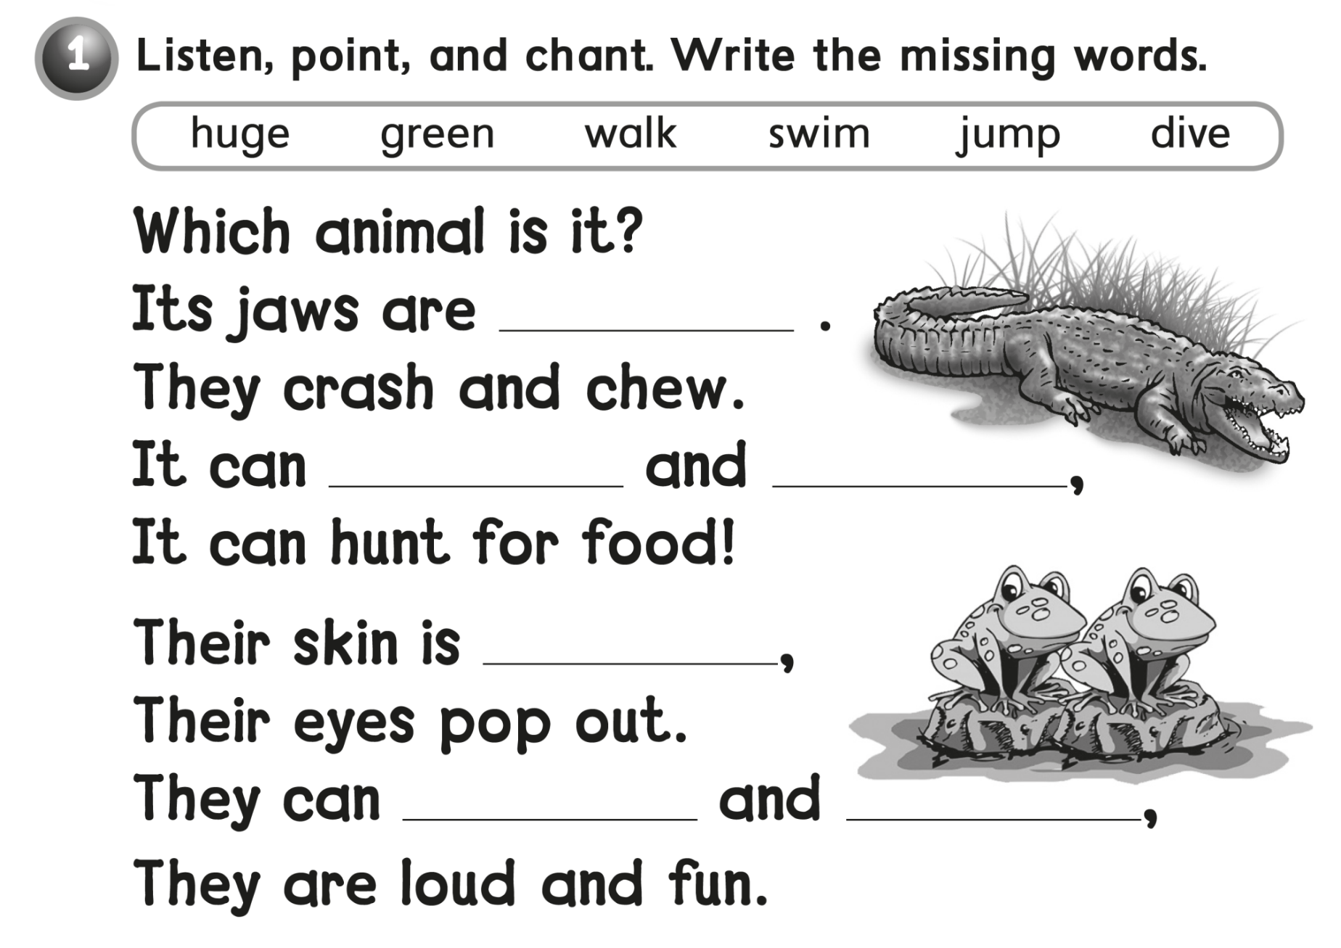

huge
walk
swim
green
jump
dive

Slide 10
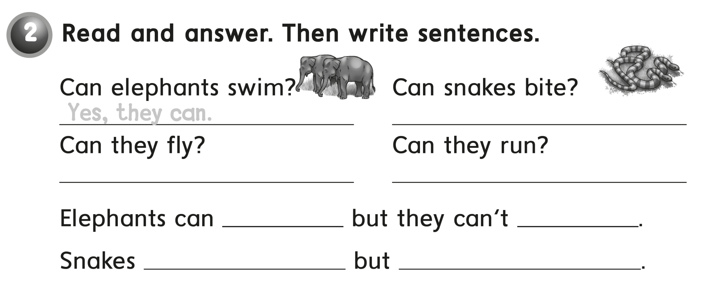
Yes , they can
No, they can’t
No, they can’t
swim
fly
Can bite
They can’t run

Slide 11
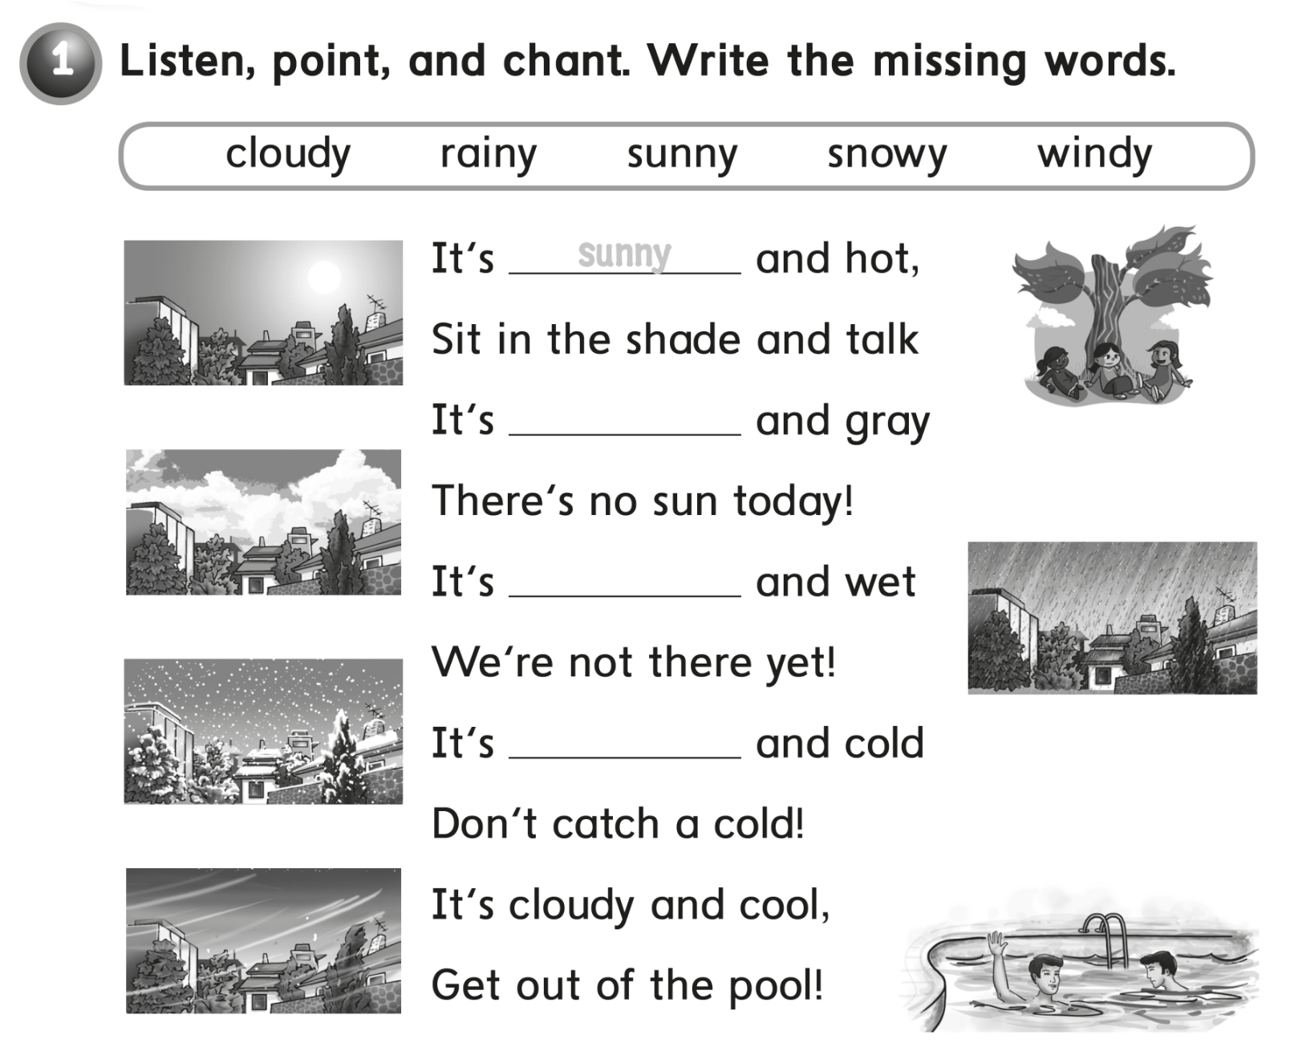

cloudy
rainy
snowy

Slide 12
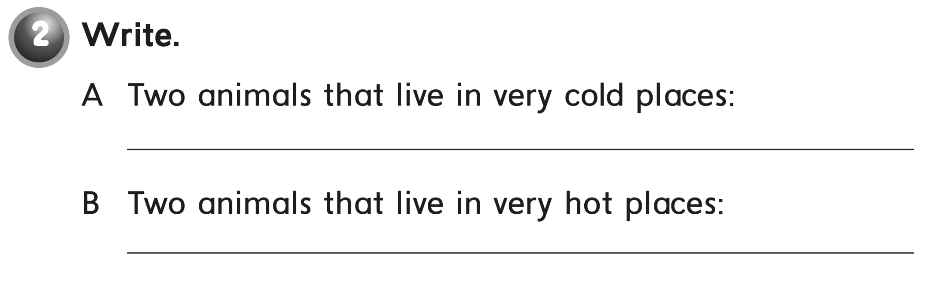
Bear - sheep
Camel - snake

Slide 13
workbook
2^{nd &} 3^{rd Grade}
Pages 59, 60
workbook
^{4th & 5th Grade}
Pages 199 , 200

Slide 14

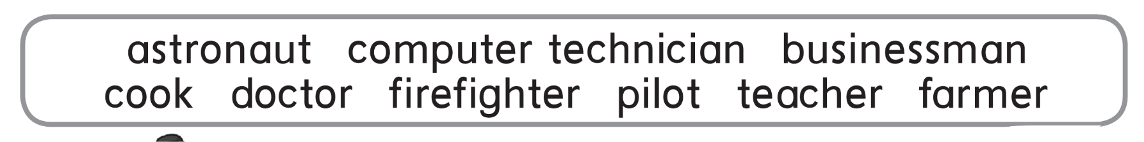

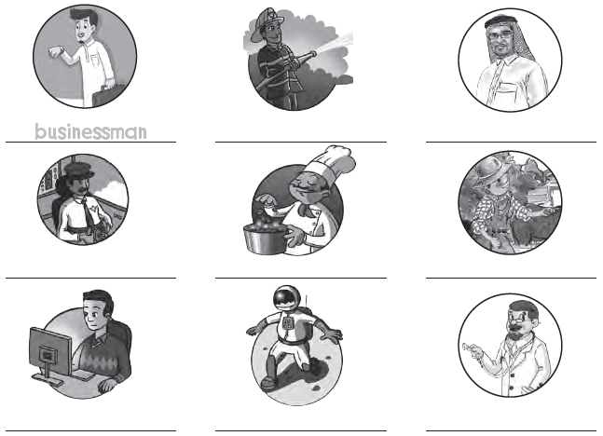
Firefighter
teacher
pilot
cook
farmer
Computer technician
astronaut
doctor

Slide 15

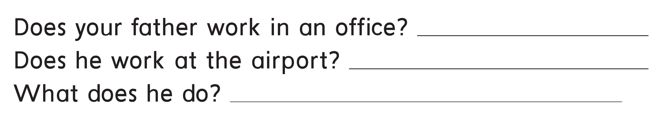
Yes , he does .
No , he doesn’t .
He is a businessman .

Slide 16
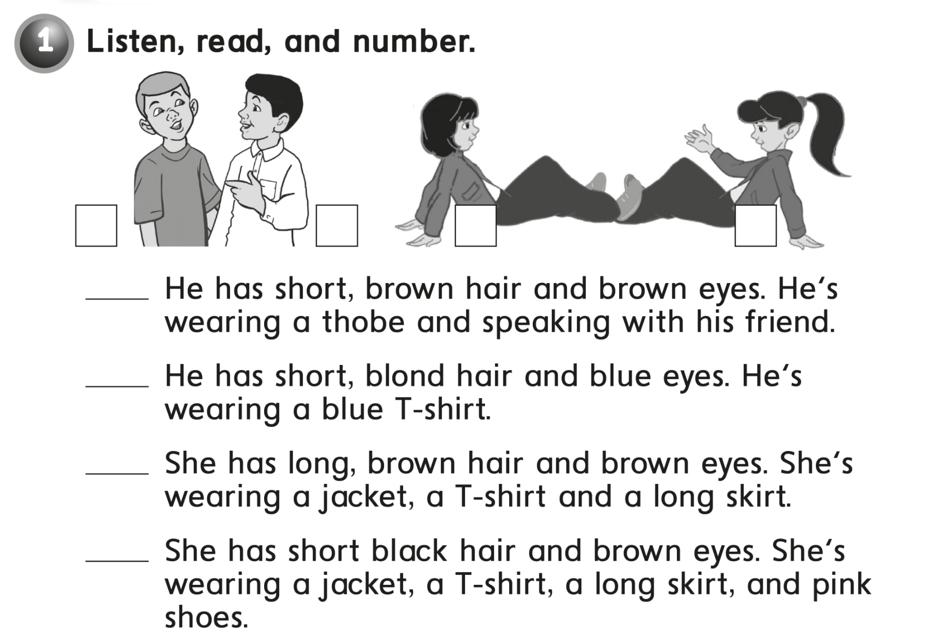

2
1
4
3
1
2
3
4

Slide 17
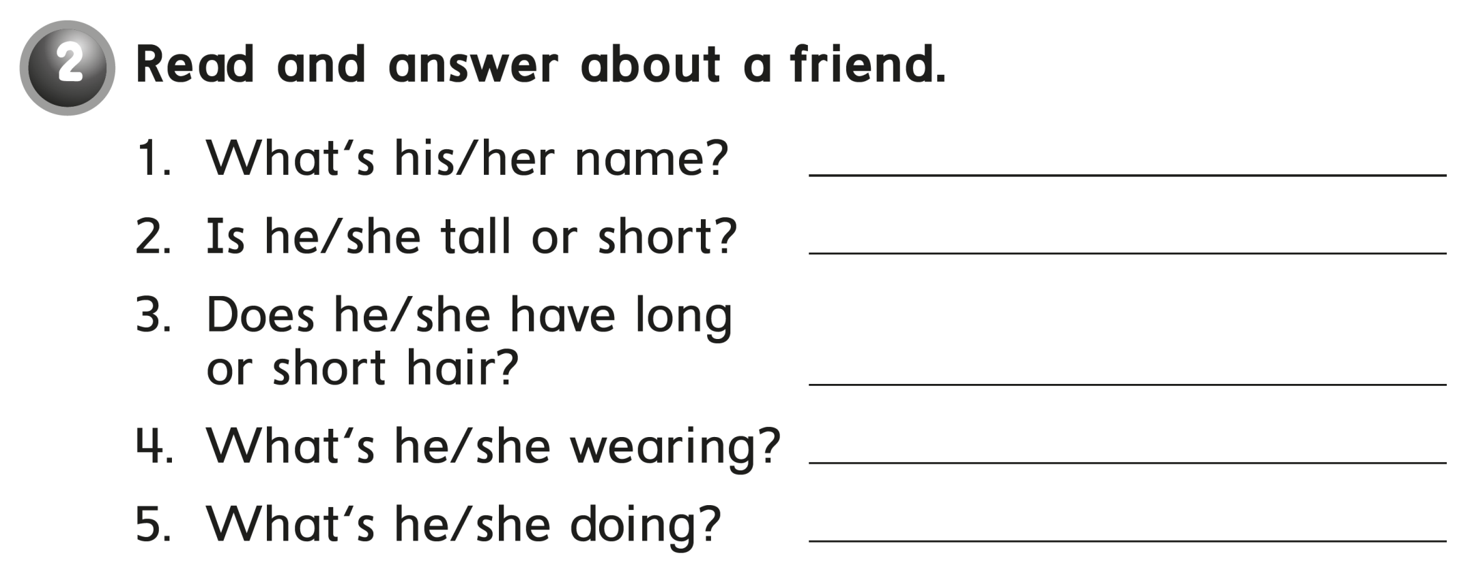
Fahad
Tall
Short hair
a blue t-shirt
He’s playing football

Slide 18
workbook
2^{nd &} 3^{rd Grade}
Pages 61 , 62
workbook
^{4th & 5th Grade}
Pages 201 , 202

Slide 19

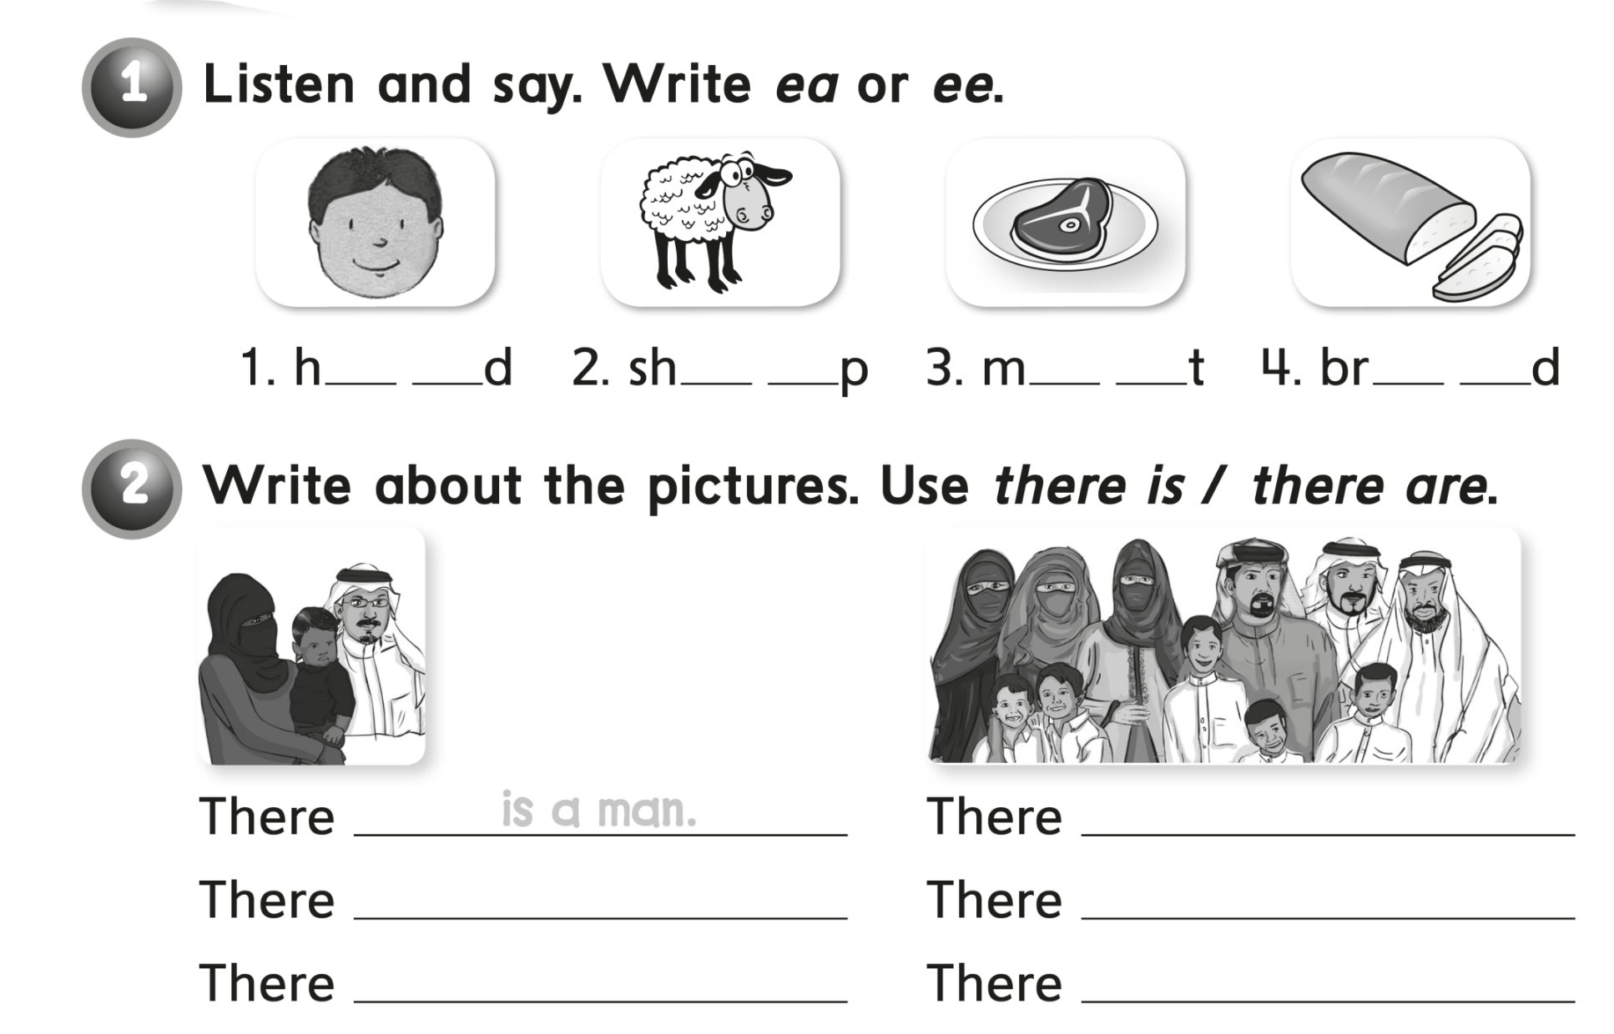
e a
e e
e a
e a
are three men
is a woman
are three women
is a child
are five children

Slide 20
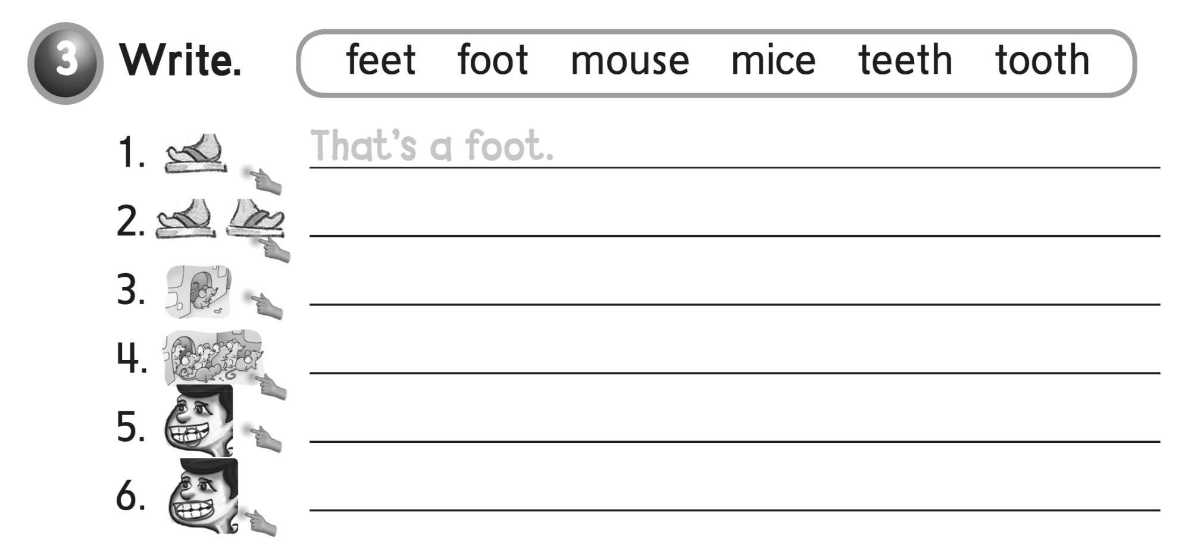
These are feet
That’s a mouse
These are mice
That’s a tooth
These are teeth

Slide 21

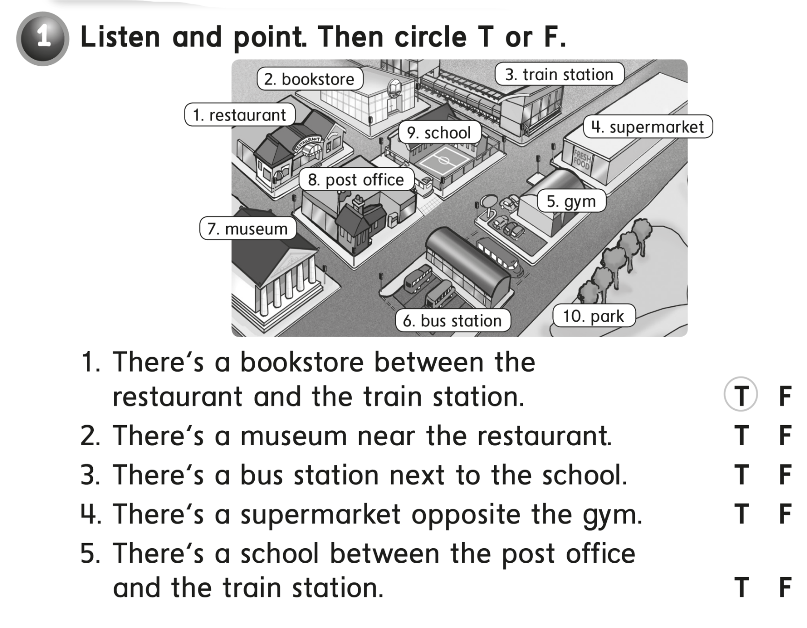

Slide 22
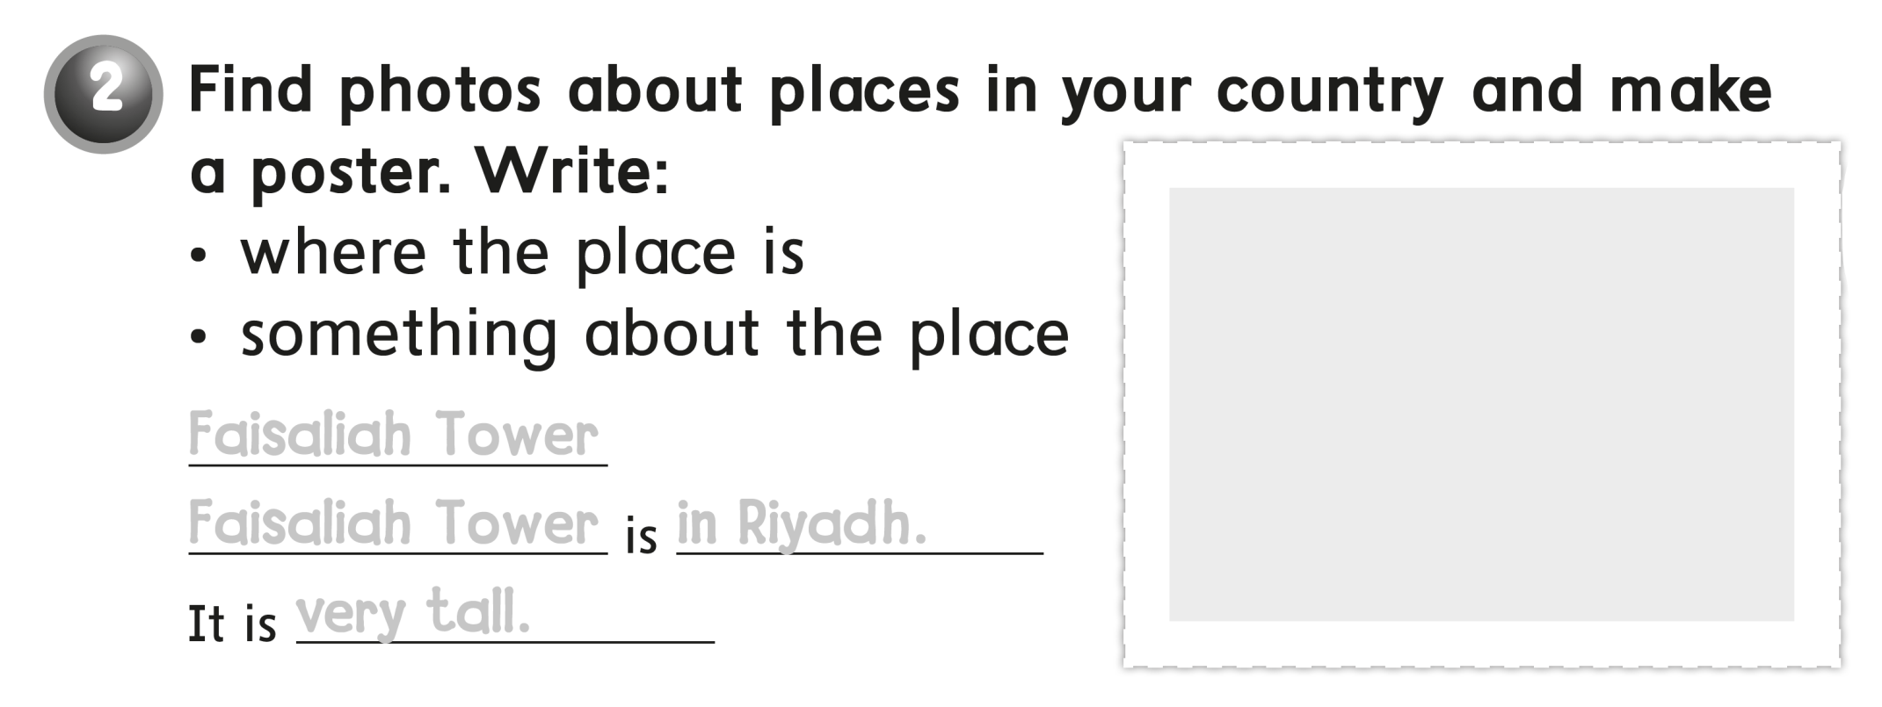
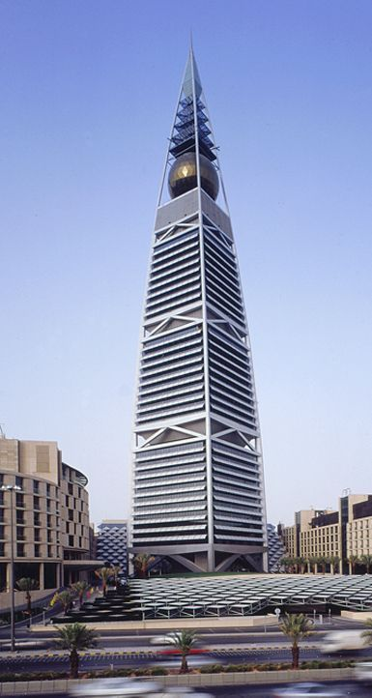
Faisaliah Tower
Faisaliah Tower in Riyadh
very tall

Slide 23


