Slide 1
Revision Unit 3
Answer the questions
Start

Slide 2


Wrong answer
Retry

Slide 3
Wrong answer
VOCABULARY

Slide 4
1- “If anything can go wrong, it might go wrong!”
A
Newton’s law
C
Murphy’s law
B
Einstein’s theory
D
Pascal’s law
Next question

Slide 5
2- filthy
A
Very clear
C
Very dirty
B
Very clean
D
Very good
Next question

Slide 6
3- get one’s payment back
A
Change
C
Crashed
B
Refund
D
Torn
Next question

Slide 7
4- flimsy
A
Thin/not strong
C
Thick
B
Brightness
D
Strong
Next question

Slide 8
5- fuzzy
A
clear
C
copy
B
event
D
Not clear
Next question

Slide 9
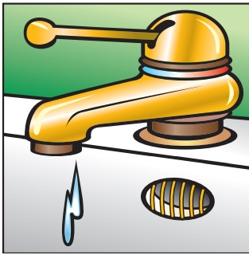
      6-
A
Leaky pipe
C
Broken doorknob
B
Dripping faucet
D
Loose floorboard
Next question

Slide 10
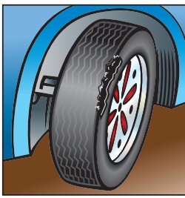
      7-
A
Flat tire
C
Worn tire
B
Dead battery
D
Dent in the body
Next question

Slide 11
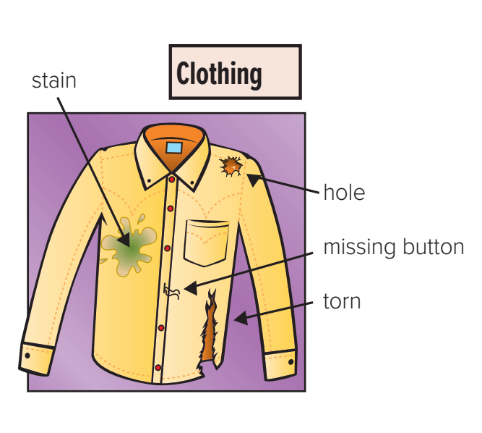
      8-
A
torn
C
hole
B
stain
D
Missing button
Next question

Slide 12
Wrong answer
Grammar

Slide 13
1- The car need to be_____.
A
repair
C
repairs
B
repairing
D
repaired
Next question

Slide 14
2- We had the house_____.
A
paint
C
painted
B
paints
D
painting
Next question

Slide 15
3- The past participle of (tear) is
A
tears
C
tore
B
torn
D
tearing
Next question

Slide 16
4- She has ______ to Japan.
A
go
C
gone
B
went
D
going
Next question

Slide 17
5- I haven’t written the report_____.
A
yet
C
already
B
just
D
ago
Next question

Slide 18
6- I can’t stand _____ the house.
A
clean
C
cleans
B
cleaning
D
cleaned
Next question

Slide 19
7- We want to come to your graduation. Don’t forget_____.
A
him
C
us
B
her
D
them
Next question

Slide 20
8- I don’t want to ask my neighbours. I don’t know_____.
A
him
C
her
B
them
D
us
Next question

Slide 21
9- I need ______ my friends.
A
to call
C
call
B
calls
D
called
Next question

Slide 22
10- The other way to write (Put away those toys) is
A
Put away them
C
Put away it
B
Put them away
D
Put it away
The End

Slide 23


Good Job!
Thank You
For Your Effort

