Slide 1
Revision Unit 4
Answer the questions
Start

Slide 2
Wrong answer
VOCABULARY

Slide 3
1- the ball of fire
A
debris
C
meteorite
B
hurricane
D
path
Next question

Slide 4
2- I have no idea
A
Excuse me
C
Gee!
B
Beats me!
D
UFOs
Next question

Slide 5
3- Anything is possible
A
You never know
C
Excuse me
B
Gee!
D
You wouldn’t know
Next question

Slide 6
4- always active, changing, developing
A
dynamic
C
asset
B
upgraded
D
enterprise
Next question

Slide 7
5- a business organization
A
sustainable
C
streamlined
B
sector
D
enterprise
Next question

Slide 8
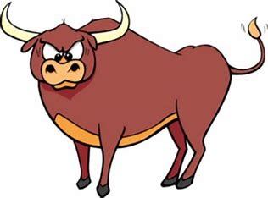
      6-
A
Ostrich
C
Bull
B
Zebra
D
Lion
Next question

Slide 9
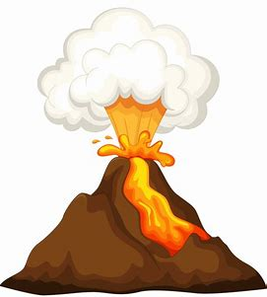
      7-
A
Earthquake
C
Hurricane
B
Flood
D
Volcano
Next question

Slide 10
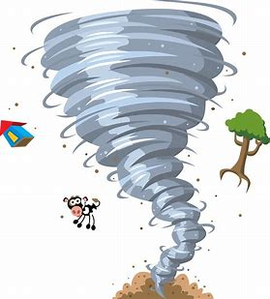
      8-
A
Tsunami
C
Wildfire
B
Tornado
D
Fog
Next question

Slide 11
Wrong answer
Grammar

Slide 12
1- I felt much better after I _____ the results of my test
A
see
C
seen
B
saw
D
had seen
Next question

Slide 13
2- Lee didn’t eat breakfast or lunch. He_____ be hungry now.
A
must
C
might
B
can’t
D
may
Next question

Slide 14
3- Pat’s joking. She ______ be serious.
A
must
C
might
B
can’t
D
may
Next question

Slide 15
4- She might have ______ the keys before going to work.
A
take
C
taken
B
took
D
taking
Next question

Slide 16
5- I like hot air balloons,_____ I’m scared of heights.
A
but
C
so
B
and
D
or
Next question

Slide 17
6- I read the science book _____ I saw the scientific documentary, too.
A
but
C
so
B
and
D
or
Next question

Slide 18
7- I was _____ exhausted from the day’s work.
A
very
C
completely
B
a bit
D
extremely
Next question

Slide 19
9- You look______ happy.
A
very
C
absolutely
B
totally
D
completely
Next question

Slide 20
8- If you freeze water, it ____ into ice.
A
turn
C
turning
B
turns
D
turned
Next question

Slide 21
10- If it rains, I _____ at home.
A
stay
C
would stay
B
stayed
D
will stay
Next question

Slide 22
11- They have to _____ to the meeting today.
A
go
C
going
B
went
D
gone
The End

Slide 23
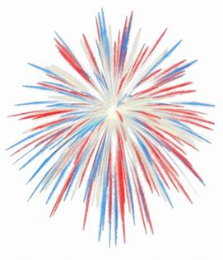

Good Job!
Thank You
For Your Effort

