Slide 1
Mega Goal 2
Unit 6
Next

Slide 2


Choose the chocolate
Start

Slide 3





























Exit

Slide 4


1- Person trying to be elected
A
Reporter
B
Announcer
C
Candidate
D
Scientist
Next

Slide 5
2- Get an image with a computer
A
Proof
B
Scan
C
Bother
D
Knocked down
Next

Slide 6
3- A plan that is designed to trick someone else
A
vision
B
content
C
hoax
D
pitied
Next

Slide 7
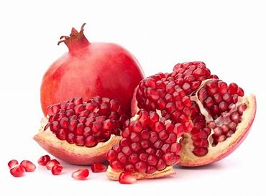
4-
A
Watermelon
B
Apple
C
Pineapple
D
pomegranate
Next

Slide 8

5-
A
Pumpkin
B
Watermelon
C
Papayas
D
Pepino
Next

Slide 9
6- He said he ____learned English.
A
have
B
has
C
is
D
had
Next

Slide 10
7- A: Are you a teacher?
B: He asked if_____ a teacher.
A
I am
B
I was
C
are you
D
you are
Next

Slide 11
8- He ____ me that he had studied English.
A
asked
B
said
C
agreed
D
told
Next

Slide 12
9- Paris is the place _____ I want to go on vacation.
A
who
B
which
C
where
D
when
Next

Slide 13
10- Do you know where ______?
A
is the bank
B
are the bank
C
the bank is
D
the bank are
Next

Slide 14
11- A: I can’t stand fast food.
B: __________. (agreement)
A
Neither can I.
B
So do I.
A
I do too.
D
Me too.
Next

Slide 15
12- A:I will go the party.
B:___________ (agreement)
A
Neither will I
B
I won’t either.
C
I would too.
D
So will I.
Next

Slide 16
13- A: I can’t swim.
B: _______. (Disagreement)
A
I can’t.
B
I can.
C
I could.
D
I couldn’t.
Next

Slide 17
14- “I like reading.”
A
Direct question
B
Reported question
C
Direct speech
D
Reported speech
Next

Slide 18
15- Could you tell me where I can get a new phone?
A
Direct question
B
Indirect question
C
Direct speech
D
Reported speech
Next

Slide 19
You eat all the chocolate
You are great players
Exit

Slide 20


You eat all the chocolate
You are great players
Exit

Slide 21

Term of use
License Agreement
This PowerPoint project, including game slides and associated content is a copyrighted to T. Talal Alhazmi.
Do not submit copies or modifications of this project to any website that requires sign in or paid subscription.
You may download the PowerPoint, make archival copies, and customize the project only for your personal use or use within your school and not for resale.
Done by T. Talal Alhazmi

