Slide 1


Good Morning

Slide 2


Slide 3

Unit -2-
I Wonder What Happened

Slide 4
11-Form,meaning and function

Slide 5
Objectives
The students will be able to :
1 – Use independent clauses with “ And , But ,Or ,So , and Yet “ .
2 – Write past sentences with dependent time clauses .
3 – Express enthusiasm with intensifiers .
4 – Express enthusiasm with adjectives .
5 – Use conditional sentences to talk about causes and results .
6 - Express necessity and lack of necessity .

Slide 6
Independent Clauses with And, But, Or, So, and Yet
The Past with Dependent Time Clauses
Expressing Enthusiasm with Intensifiers and Adjectives
Conditional Sentences with Present and Future Forms
Express Necessity and Lack of Necessity:

Slide 7
Independent Clauses with
And, But, Or, So, and Yet

Slide 8

Dependent clause
Independent
Clause
It is raining hard,
He didn’t want to walk in the rain,
He doesn’t live far away,
We could go to a restaurant,
It is raining hard, and there is a lot of lightning.
He didn’t want to walk in the rain, so he took a taxi.
He doesn’t live far away, but he always drives.
We could go to a restaurant, or we could stay home
and watch TV.
Independent clause

Slide 9

Independent clause
Dependent clause
Expresses a complete thought and can stand alone .
It doesn’t express a complete thought and can’t stand by itself as a sentence.
It must be joined to another clause, in order to avoid creating a sentence fragment.
He crashed his car.
Because he injured.

Slide 10


It is raining hard, and there is a lot of lightning.
,
Independent Clause
Coordinating conjunction
Independent Clause
for
and
nor
Coordinating conjunction
but
or
yet
Use a comma only when the coordinating conjunction joins two independent clause.
so

Slide 11
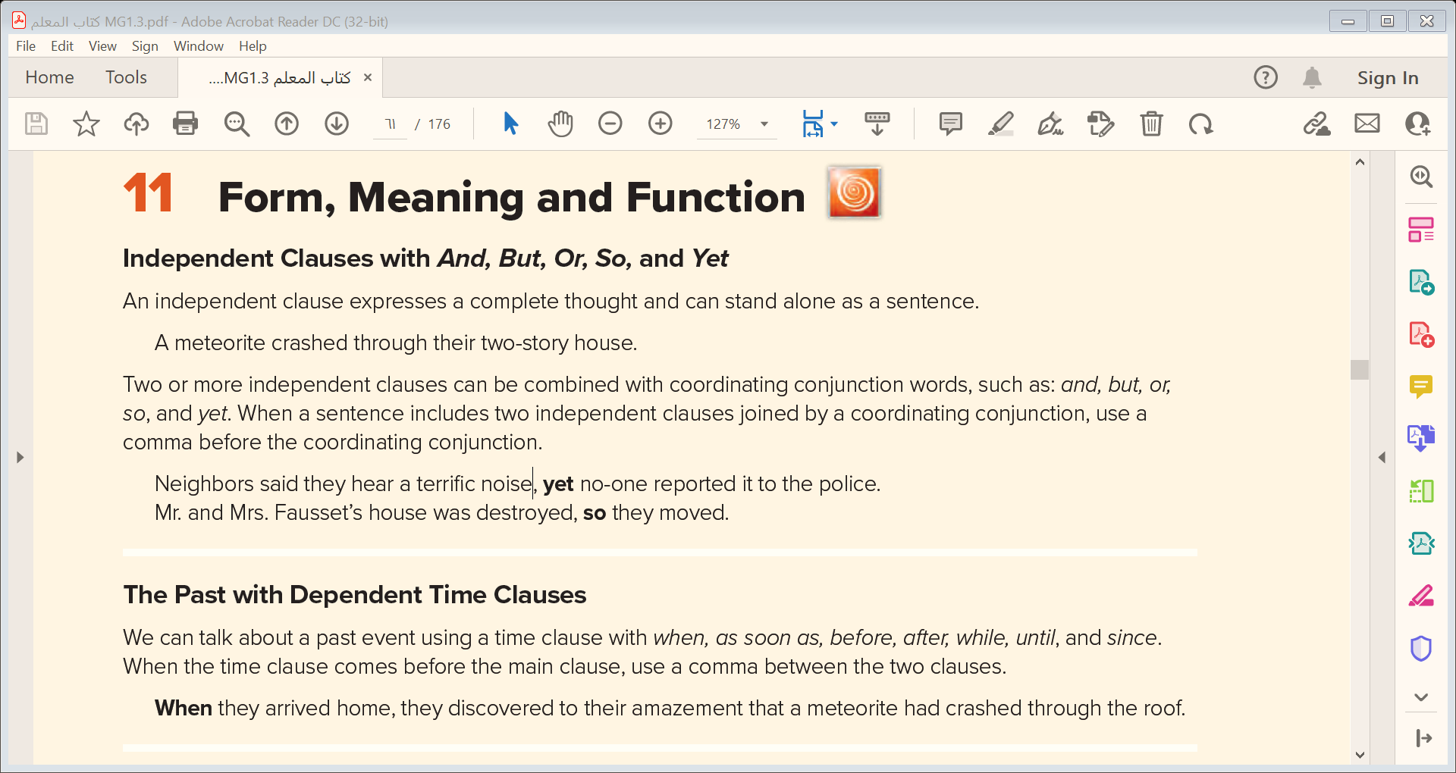

Slide 12
The Past with Dependent Time Clauses

Slide 13
Dependent
Clause
After they gathered,.
After they gathered, they started a meeting.
As soon as I lost control,
As soon as I lost control, I crashed the car.
Since it exploded, it destroyed the city.
Since it exploded,.

Slide 14
After I went to USA , I was better at communicating .
,
Time Clause ( dependent )
Main clause ( independent )
Use comma only when the time clause comes at the beginning .
The past time clause can come after or before the main clause ( independent )
when
As soon as
Subordinating Conjunctions
before
after
while
They used to join a dependent clause ( incomplete thought ) to an independent clause .
until
since

Slide 15
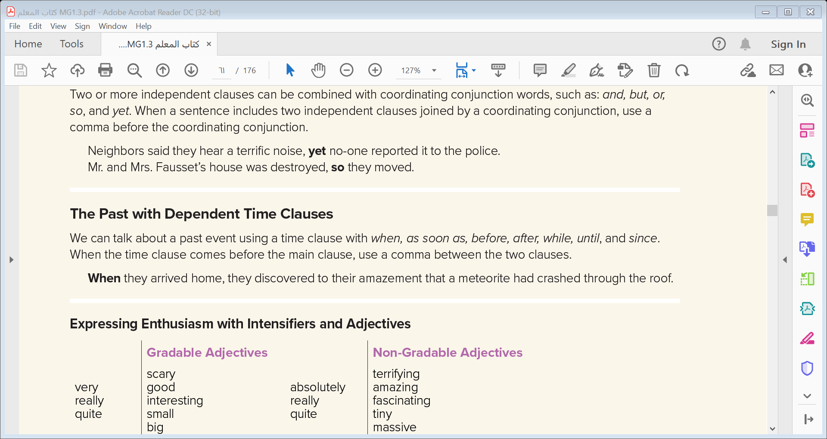

Slide 16
Classify into dependent or independent
When I teased my bull .
  My teacher taught me how to read .
It penetrated into lower levels.
After it sticked around.
Independent | Dependent
When I teased my bull .
  My teacher taught me how to read .
After it sticked around.
It penetrated into lower levels.

Slide 17

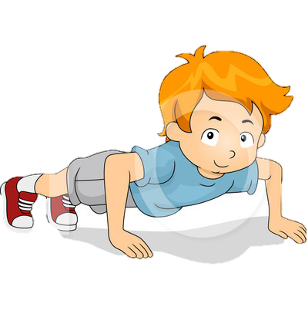
Practice Time

Slide 18
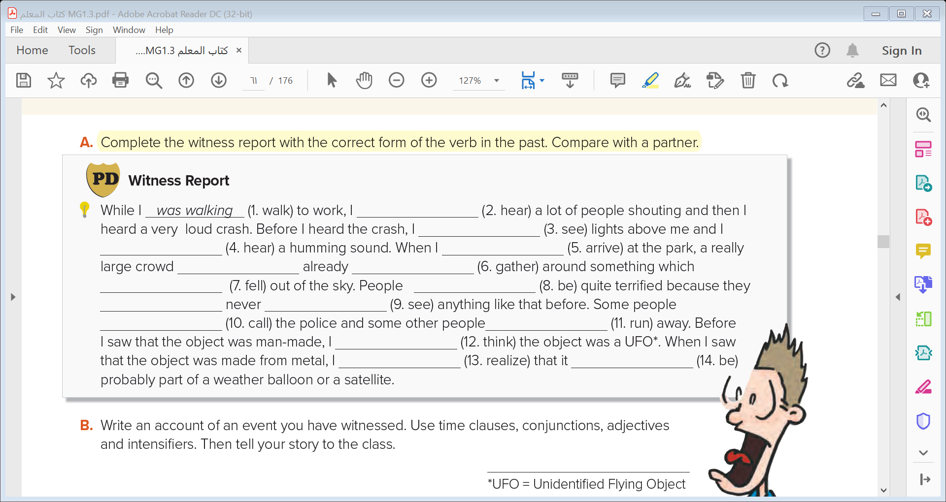
heard
had seen
had heard
arrived
had
gathered
had fallen
were
had
seen
called
ran
had thought
realized
was

Slide 19
Expressing Enthusiasm with Intensifiers and Adjectives

Slide 20
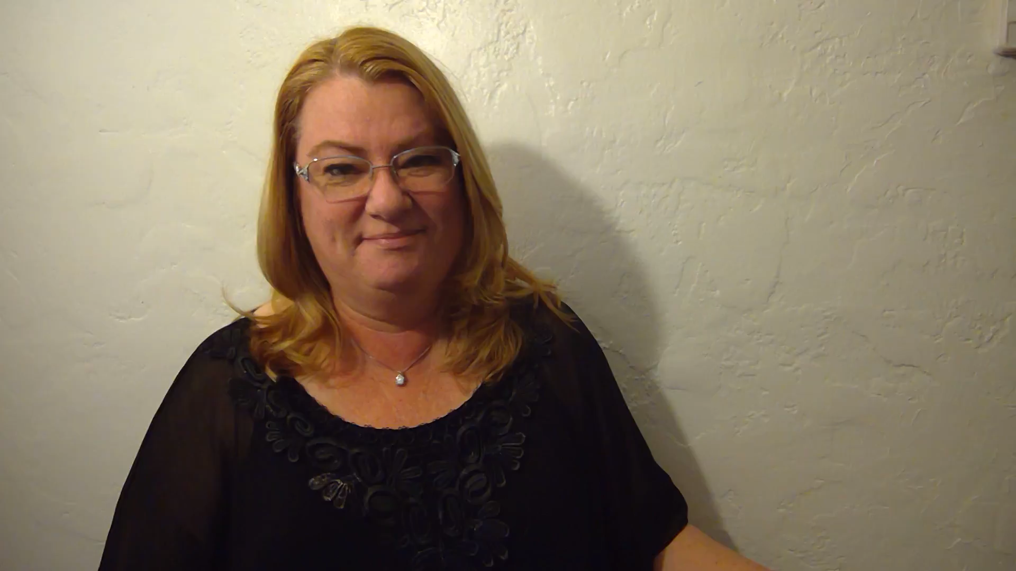
Adjectives
Gradable
Non-Gradable

Slide 21
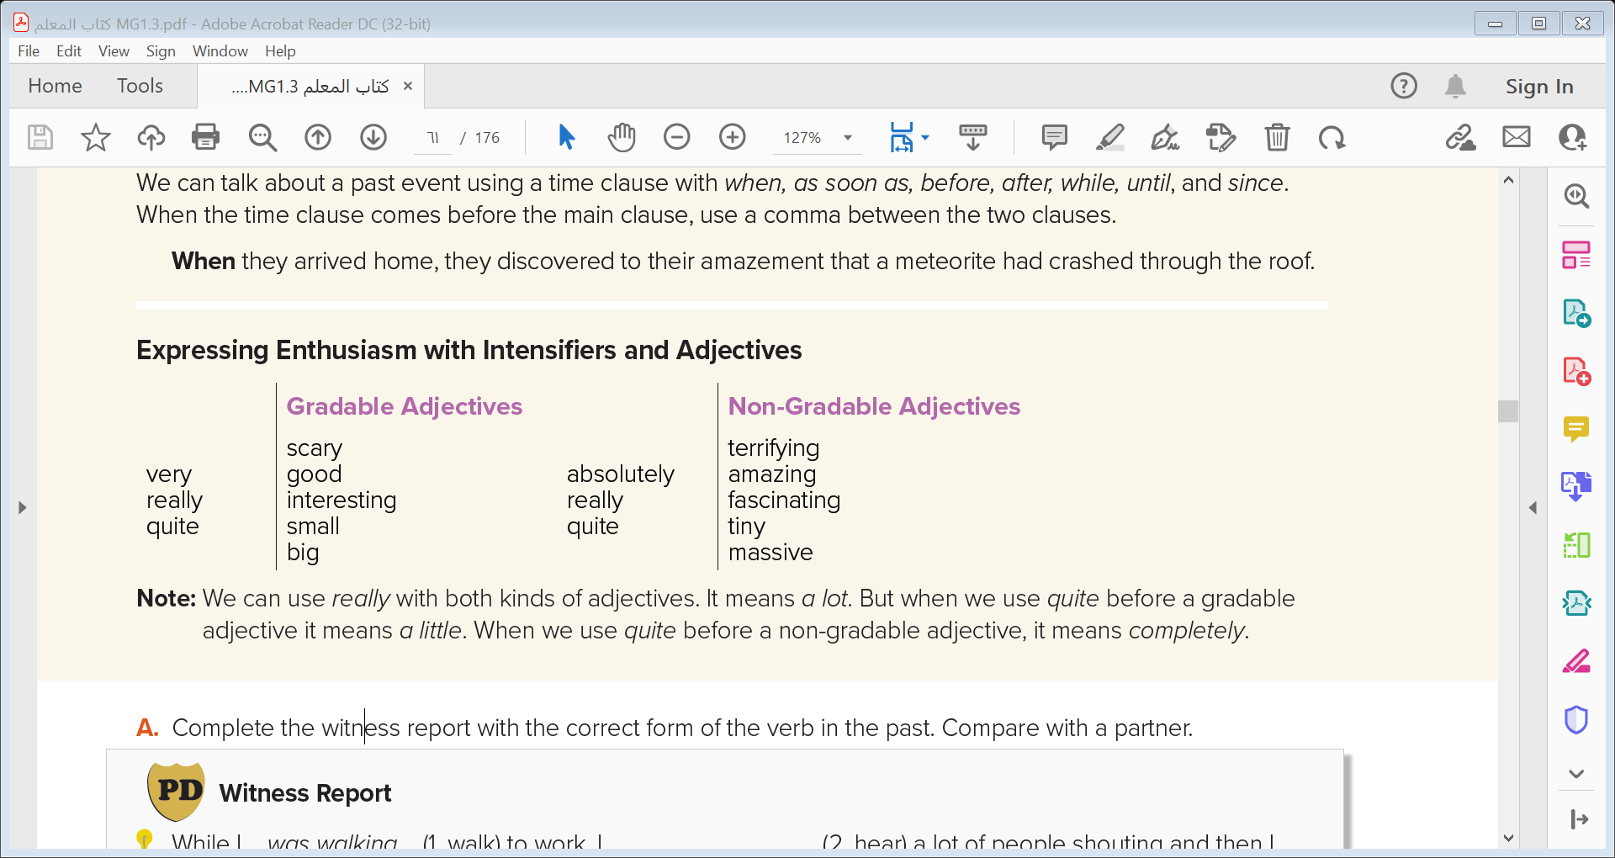
Adjectives
Gradable
Non-Gradable
scary
good
interesting
small
big
terrifying
amazing
fascinating
tiny
massive
very
really
quite
absolutely
really
quite

Slide 22



Quick Check

Slide 23
Conditional Sentences with Present and Future Forms

Slide 24


Conditional Sentences
Present Facts
Future Facts
Possibility
If you heat ice , it melts
If you leave now, you will sleep early.
If you see a meteorite falling through the sky, it may be a stony meteorite

Slide 25
Present facts
If you heat ice , it melts
If
Present simple
Present simple
,
Future facts
If you leave now, you will sleep early.
,
If
Present simple
will
infinitive
Possibility
,
If you see a meteorite falling through the sky, it may be a stony meteorite
If
Present simple
may / might
infinitive

Slide 26
Practice Time

Slide 27
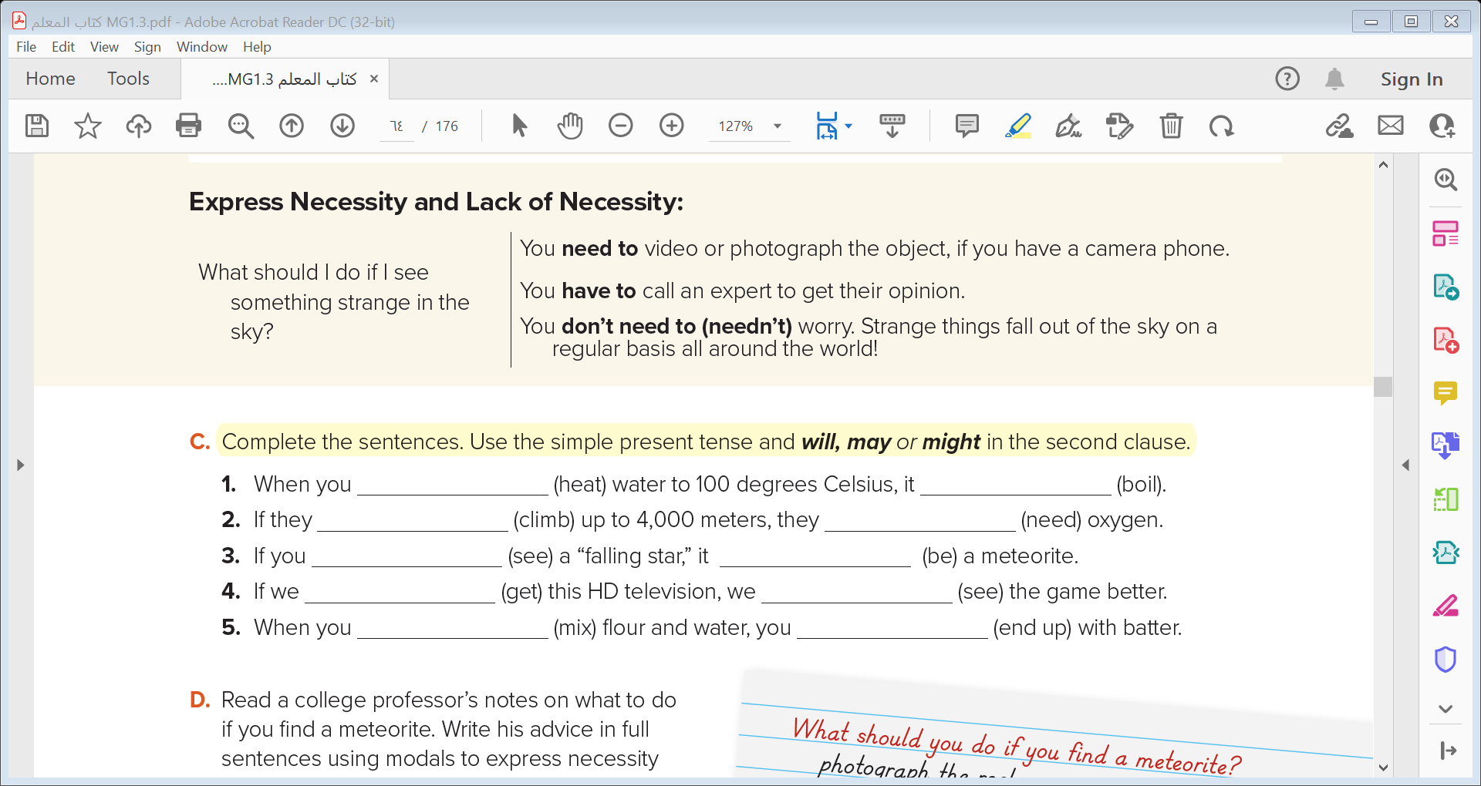
heat
boils
climb
will need
see
might be
get
will see
mix
end up/will end up

Slide 28
Express Necessity and Lack of Necessity:

Slide 29

I have to take my passport to the airport .
She has a toothache. She has to go to the dentist .
You don’t need to go to the store .
He needn’t complete the work right away. There’s plenty of time .
Notes:
Language Builder
Have to expresses strong obligation, or something that is
necessary and very important to do. There is often no choice.
For example, I have to take my passport to the airport.
Have to is used in the same way as must to express
obligation and necessity; but In American English, have to is
used more often than must.
Need to also means that something is necessary but it less
strong than have to.
Don’t need to means something is not necessary. For
example, I don’t need to take both my passport and my
national identity card to the airport.

Slide 30
Necessity
Lack of Necessity
You don’t need to go to the store .
I have to take my passport to the airport .
She has a toothache. She has to go to the dentist .
He needn’t complete the work right away. There’s plenty of time .
Notes:
Language Builder
Have to expresses strong obligation, or something that is
necessary and very important to do. There is often no choice.
For example, I have to take my passport to the airport.
Have to is used in the same way as must to express
obligation and necessity; but In American English, have to is
used more often than must.
Need to also means that something is necessary but it less
strong than have to.
Don’t need to means something is not necessary. For
example, I don’t need to take both my passport and my
national identity card to the airport.

Slide 31

Remember
have to
Has to
I
You
We
They
He
She
It

Slide 32
Practice Time

Slide 33
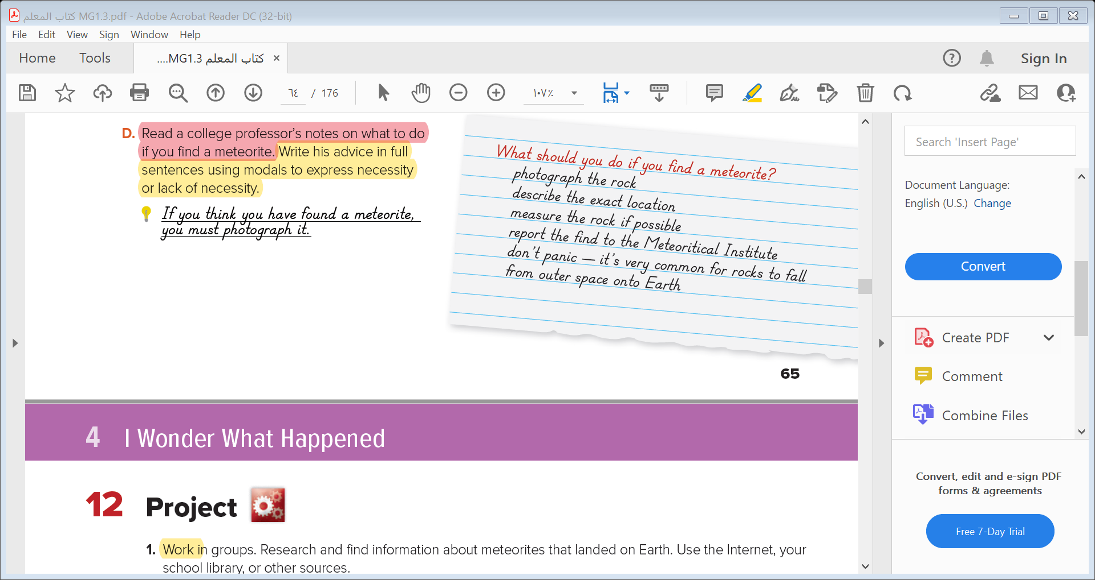

Slide 34
Mind Map
Draw mid map to our lesson today

Slide 35
Quick Check

Slide 36


