Slide 1
Unit 3
If It Haden’t Happened
Language in Context + Conversation
Mega Goal 1.3
Done by : Entisar Al-Obaidallah

Slide 2


01
Lesson Objectives
02
03
04
Read
the message silently to answer some questions about it
Listen
to a radio show for
details about regrets
Practice
Reductions could have, should have, and would have
Use
the "real talk" phrases in new sentences

Slide 3


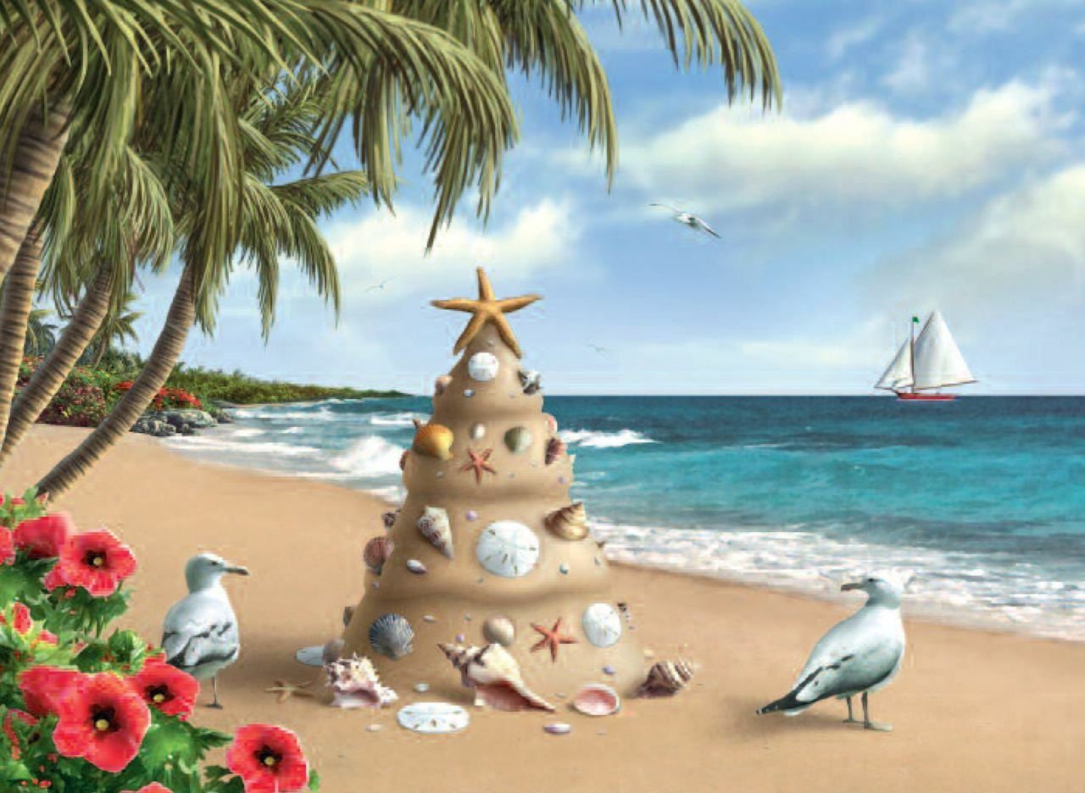
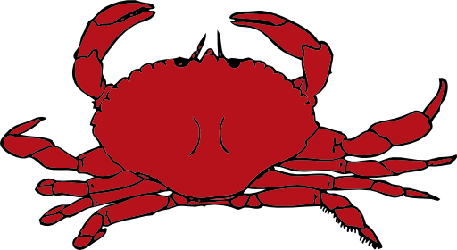

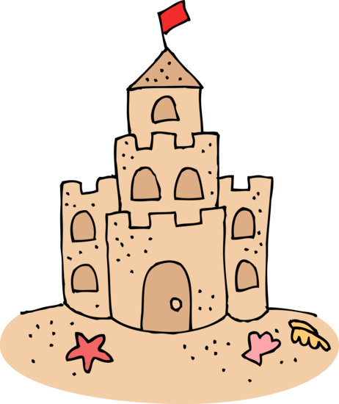

Warm Up
What do you see in this picture?
Star fish
shell
crab
seagull
jelly fish
What are things you can find at the beach?
Sandcastle

Slide 4
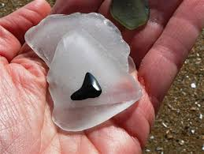
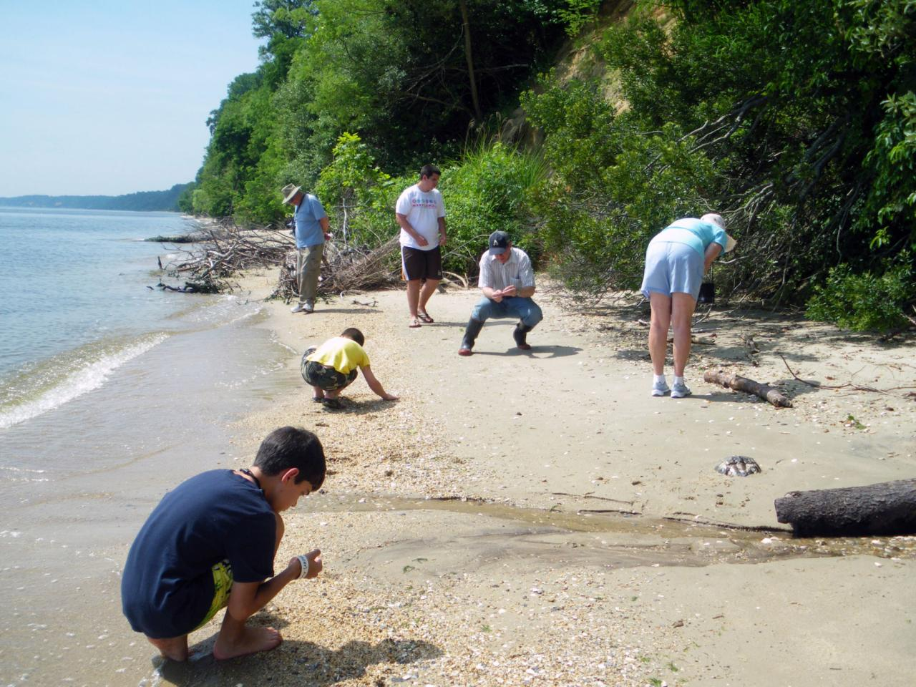
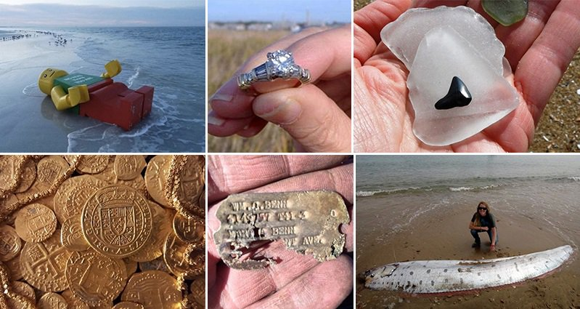
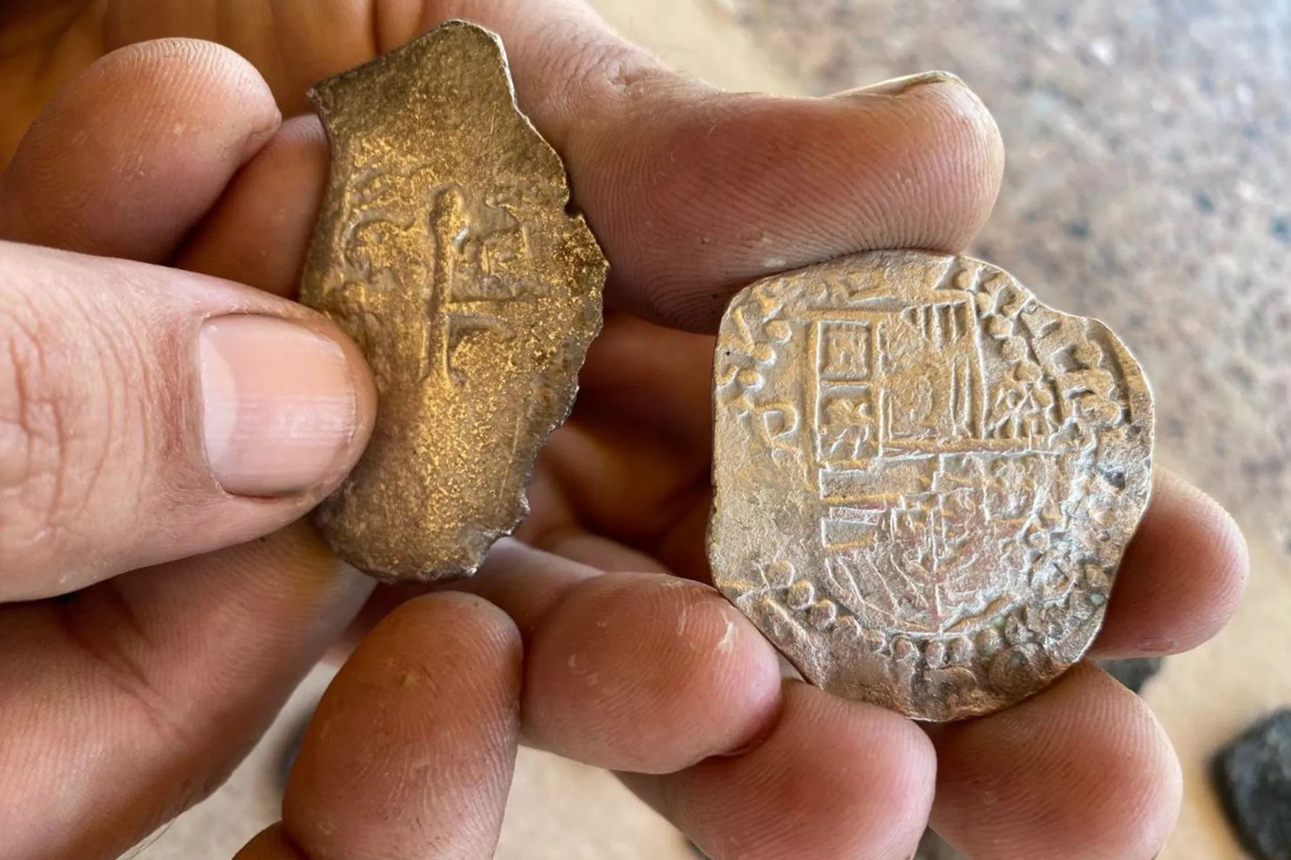
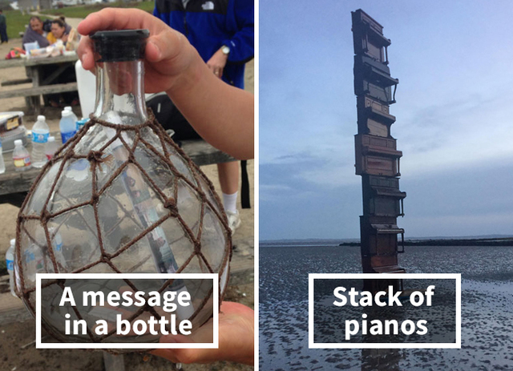
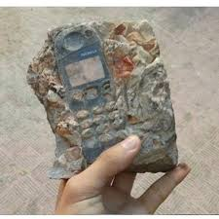
Have you ever found something strange on the beach?

Slide 5

Open
Your book p. 38

Slide 6
01
Language in Context

Slide 7
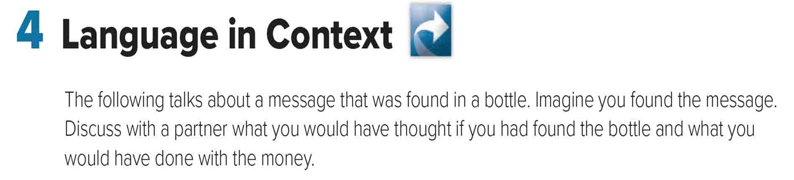

Slide 8
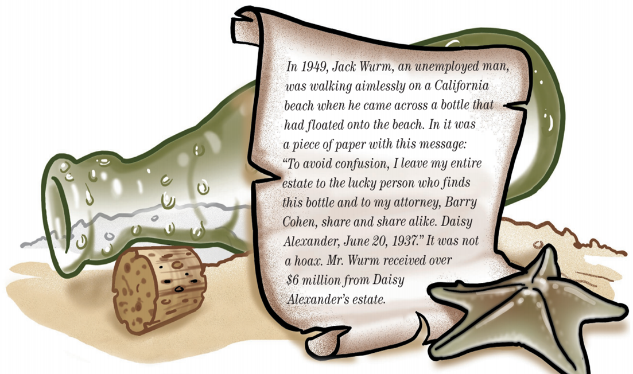
01
02
03
What happened in 1949?
Jack Wurm was walking on California beach
What did he find?
A bottle with a message inside it
Who wrote the message ? When?
Daisy Alexander in June 20, 1937
How much money did Jack receive?
Over $6 million

Slide 9
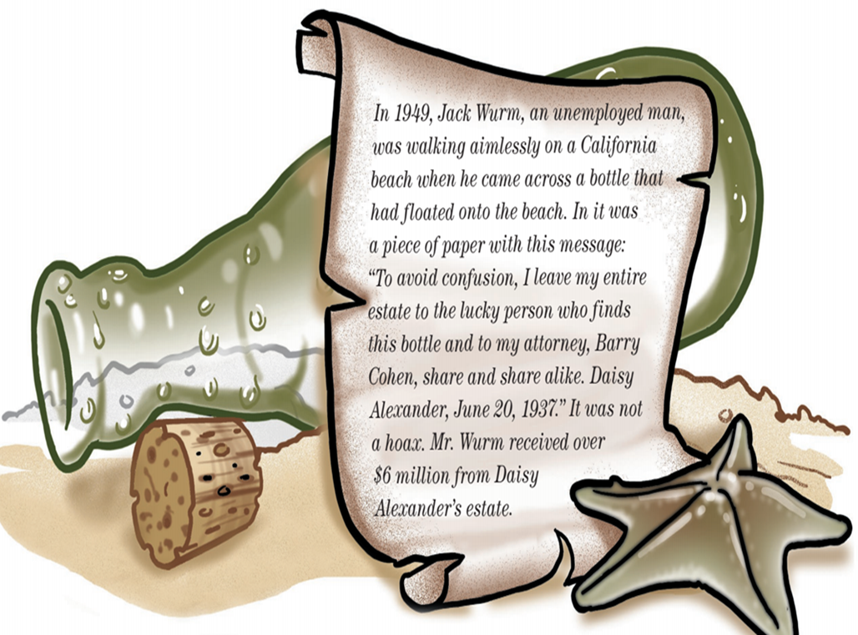
New Words
333,000.00
Without purpose
Being unclear
All the money and property
A lawyer
A joke

Slide 10
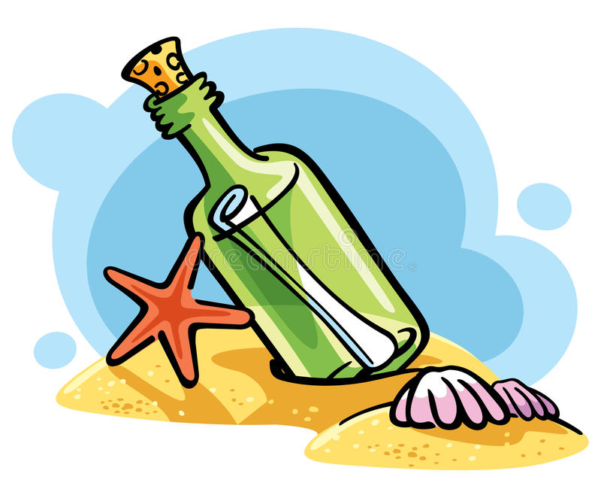

01
02
If you had found the bottle , what would you have done with the money ?
If I had found the bottle , I would have …………………………………………………………….
If I had found the bottle , I would have traveled around the world.
If I had found the bottle , I would have built a new house .
If I had found the bottle , I would have bought a new car .

Slide 11
02
Listening

Slide 12
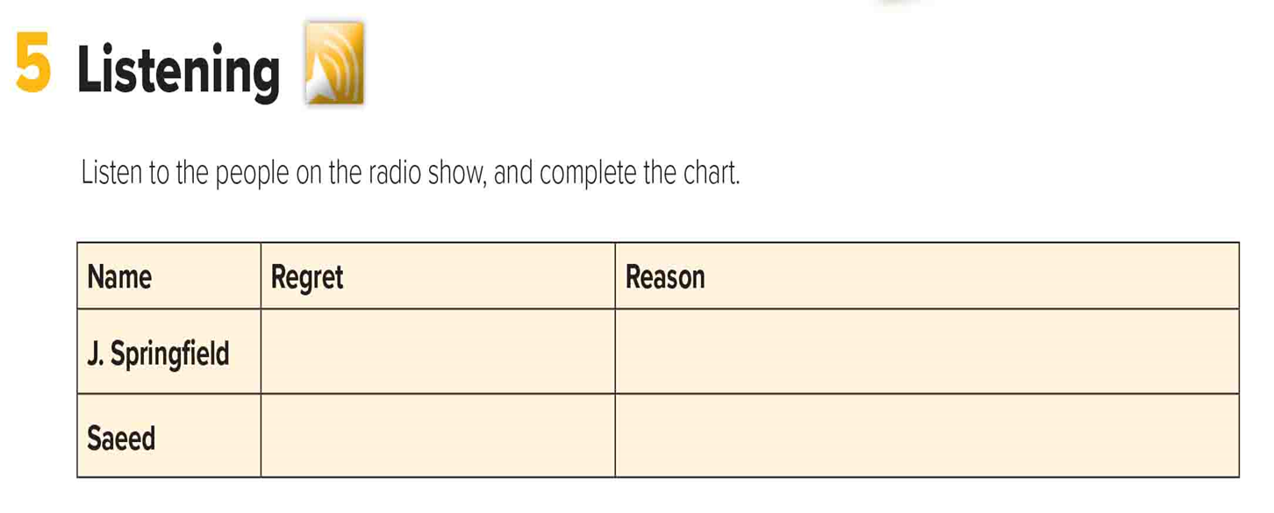

386,000 km
333,000.00
24h 37m 23s
His boss was very demanding,
so he resigned. Now he thinks
he shouldn’t have.
He doesn’t know if he’ll be able to find another job.
He loves his job, but he got fired.
He got fired because he is irritable and abrupt
when he is under pressure.

Slide 13
03
Pronounciation

Slide 14
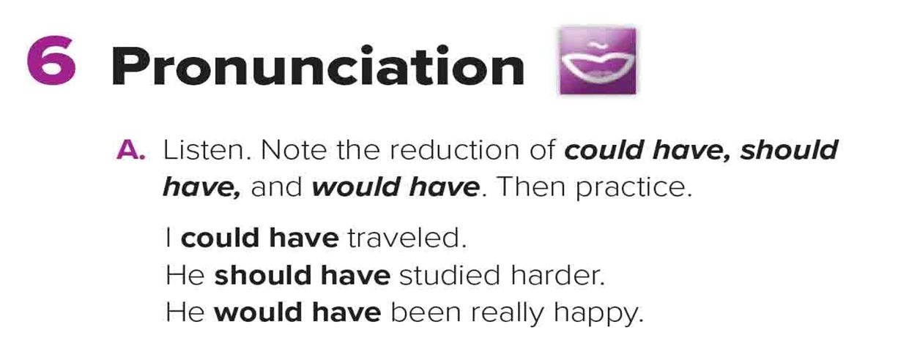
Could
have
Could’ve
Would
have
Would’ve
Should’ve
Should
have

Slide 15
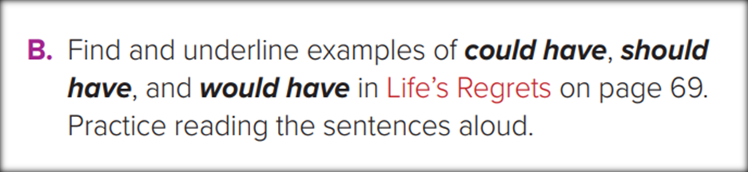
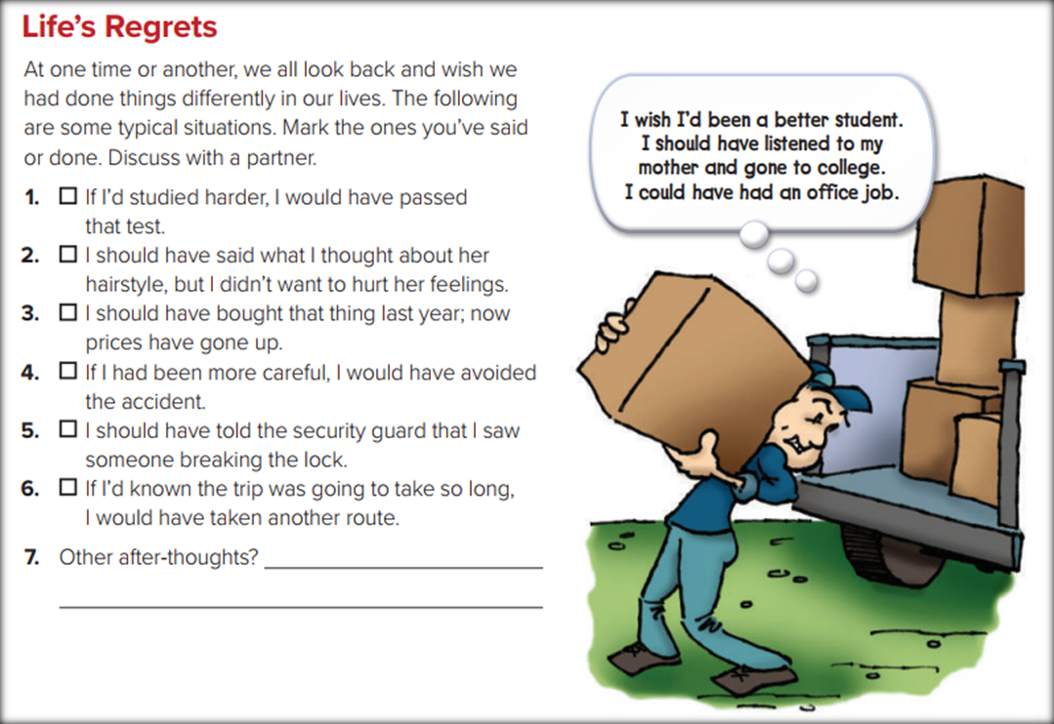

Slide 16
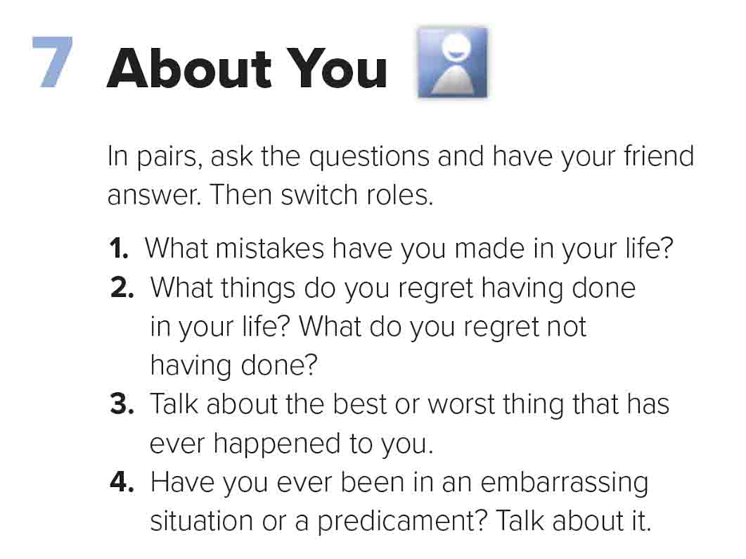

Slide 17
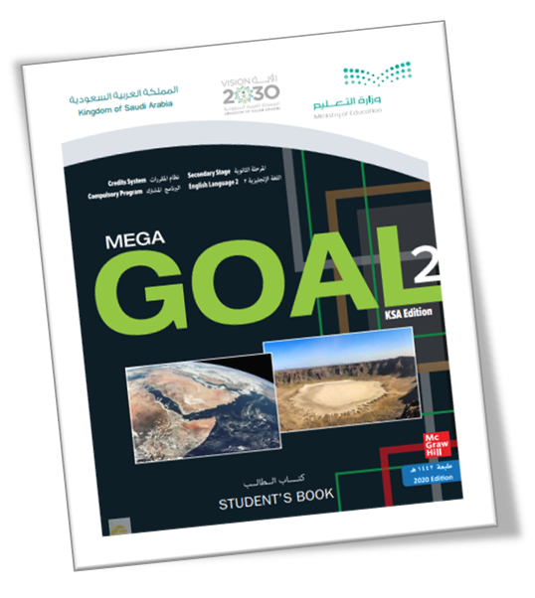

Your book p. 39

Slide 18
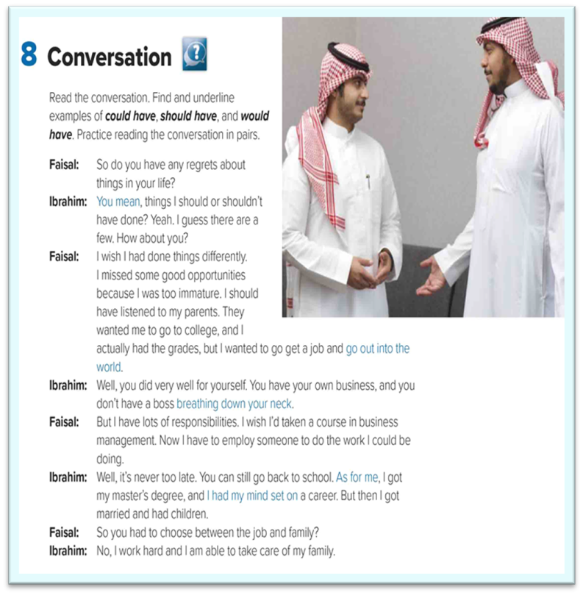
How many people are in this conversation ? Who are they?
Two: Faisal and Ibrahim
What are they talking about ?
Regrets in their life
Big numbers catch your audience’s attention
What did Faisal wish ?
He wish he had taken a course in business management

Slide 19
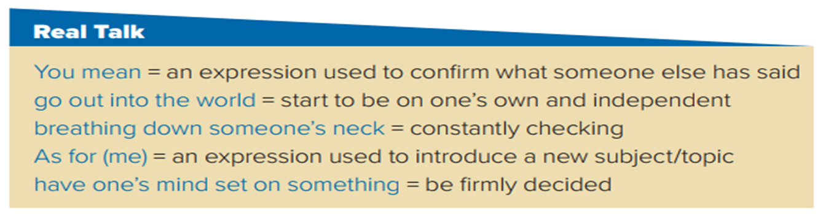
Read the words and their meaning:

Slide 20

Quick Check
https://wordwall.net/resource/13099977

Slide 21
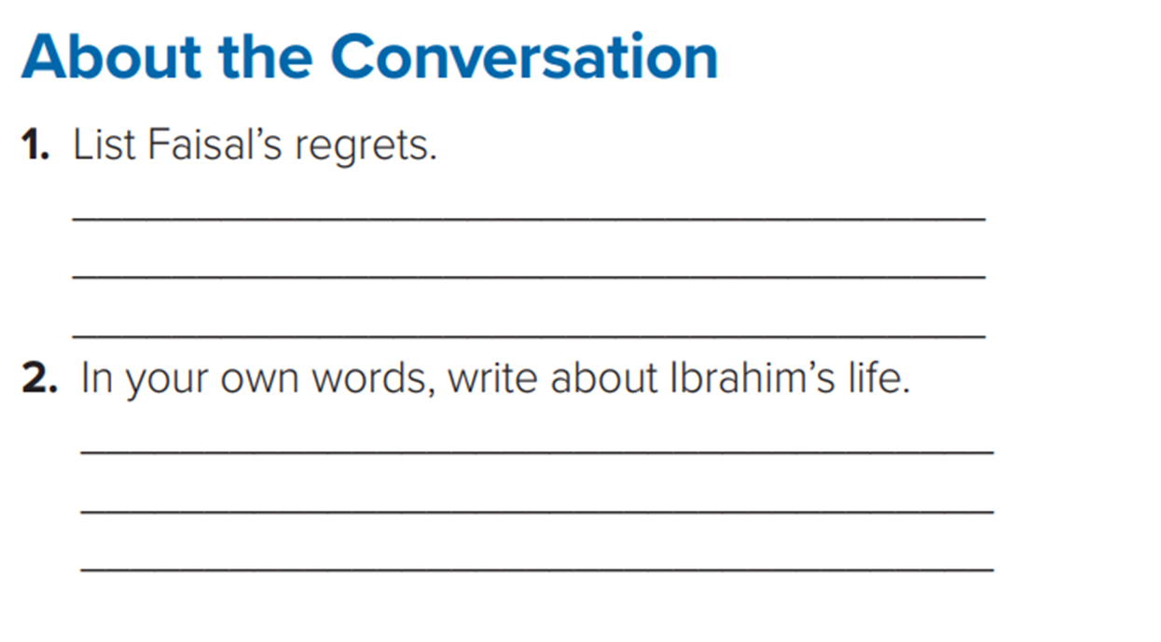
Faisal thinks that he should have listened to his parents and gone to college. He thinks that he should have taken courses in business management.
Ibrahim went to college and got a master’s degree.
Then he got married and had children.
Now he works hard and he is able to take care of his family.

Slide 22
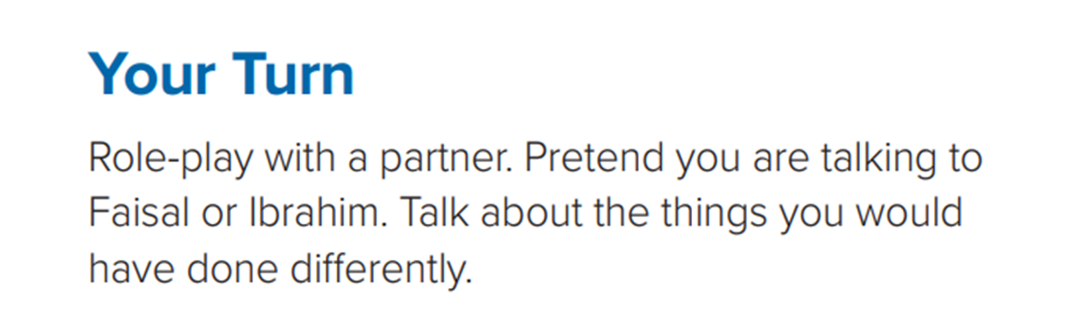

Slide 23

Thank you!

