Slide 1
Unit 3
If It Hadn't Happened
Writing
Mega Goal 1.3
Done by: Entisar Al-Obaidallah

Slide 2
Lesson Objectives
01
02
03
04
Read
Make
the advice column and answer some questions
notes in the organizer including their own advice
Write
Write
a response for an advice column
a letter of advice

Slide 3

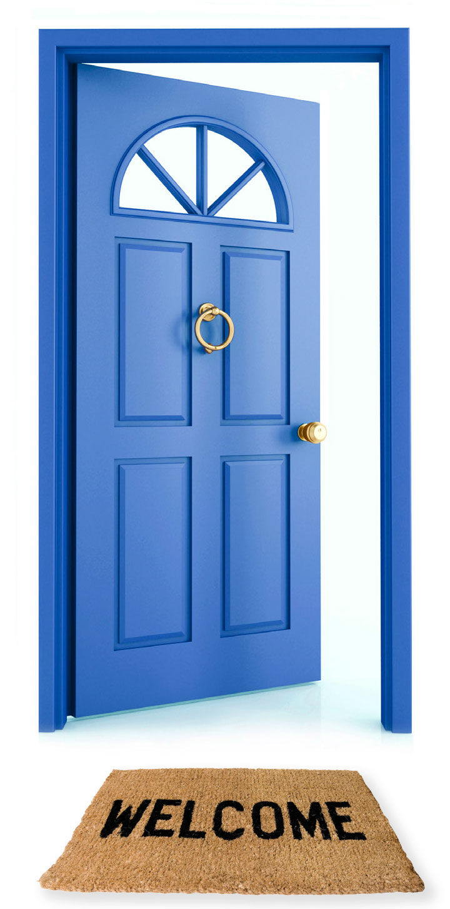




Warm Up
Find the name of each picture and take the first letter of each one to get the topic:
Fire
Room
Ice cream
Eggs
Neck
Door
Friend

Slide 4
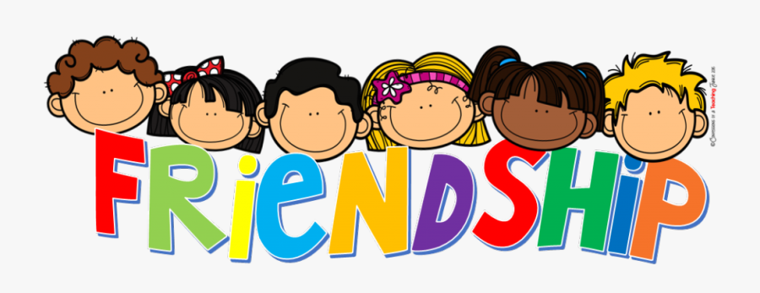
When you have problems with your friends .. What do you do?
Ask for advice
sisters
parents
brothers

Slide 5

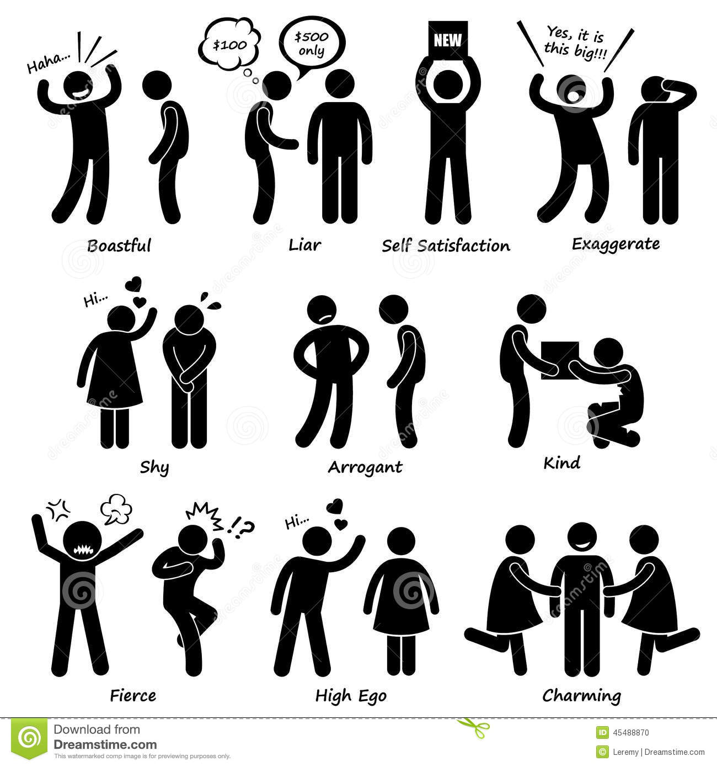
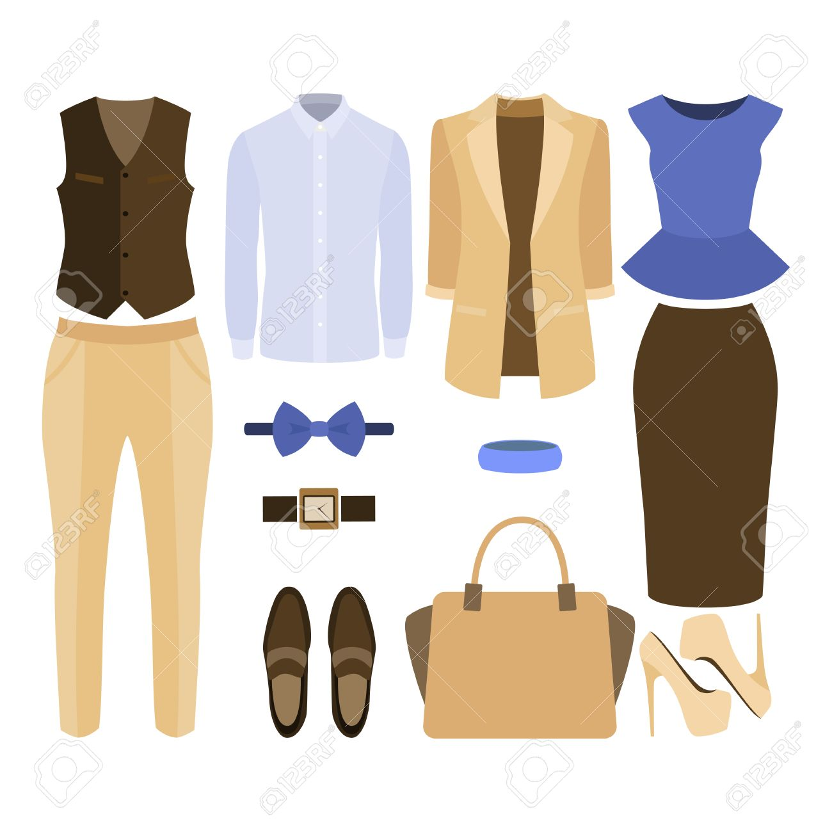
What kind of problems do friends usually have?
Friend’s behaviour
money
Exchanging things

Slide 6

Open
Your student’s book p. ( 42)

Slide 7
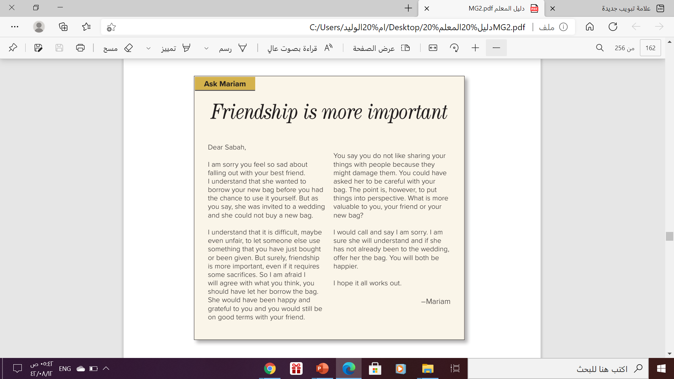

Listen and follow in your book:

Slide 8
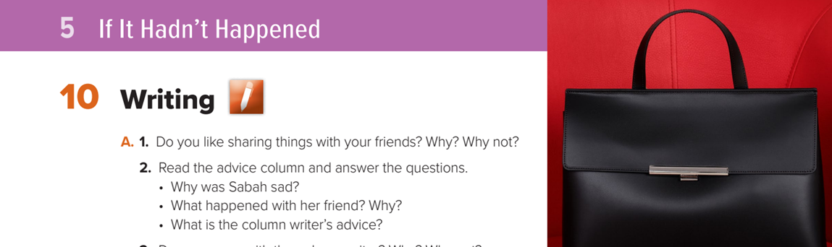
Read and answer

Slide 9
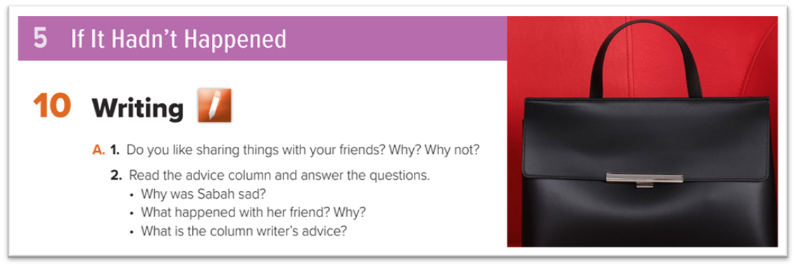
Sabah was sad because she had fallen out with her best friend.
Sabah’s friend asked to borrow her new bag because she had a wedding to go to and could not afford to buy a new bag.
The column writer advised Sabah to call her friend and apologize/say she was sorry and offer to lend her bag to her friend if she still needed it.

Slide 10
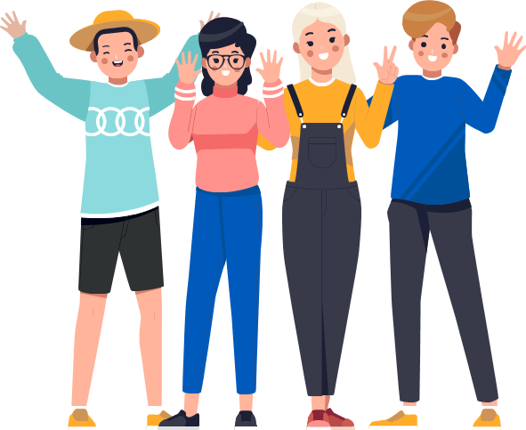
How
To write
A letter of advice

Slide 11


How to write a letter advice
opening
She read all the letter
understanding
advice
Advice her without patronizing her
Reason
conclusion

Slide 12
Your Letter Should look like this
Dear ,………………………
Show understanding of the problem and feeling:
I understand ……………………..I know how do you feel ……………
Give advice without sounding reprimanding or patronizing
Closing

Slide 13
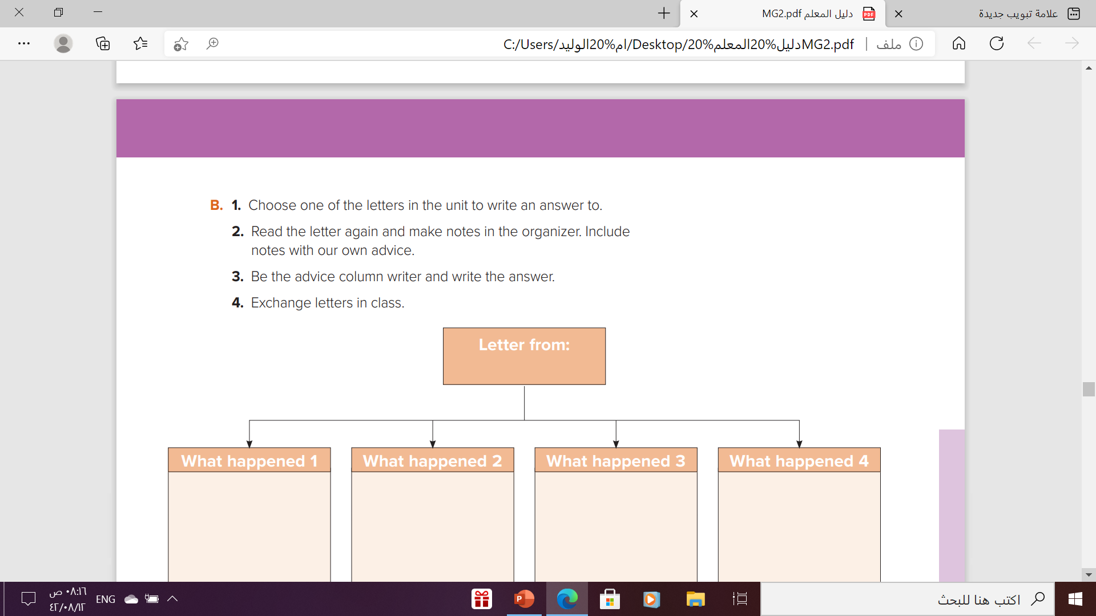

Slide 14
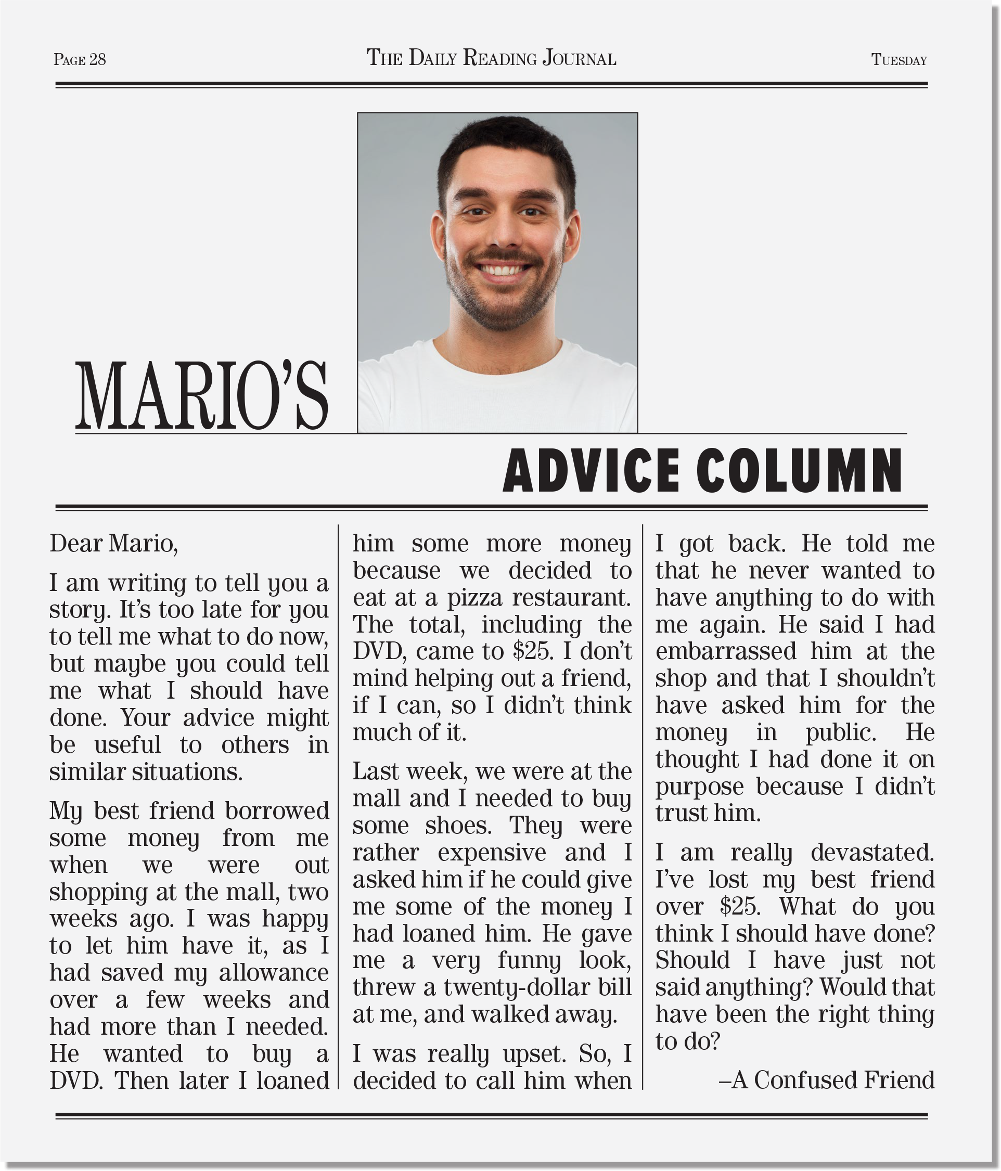
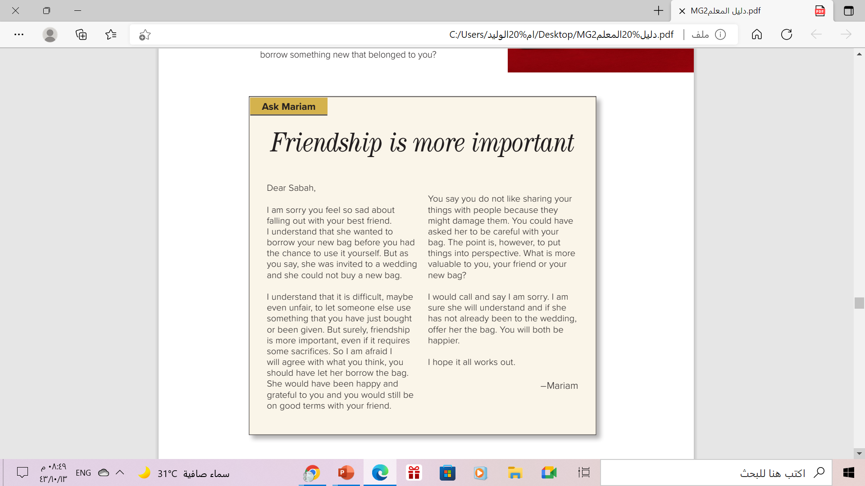
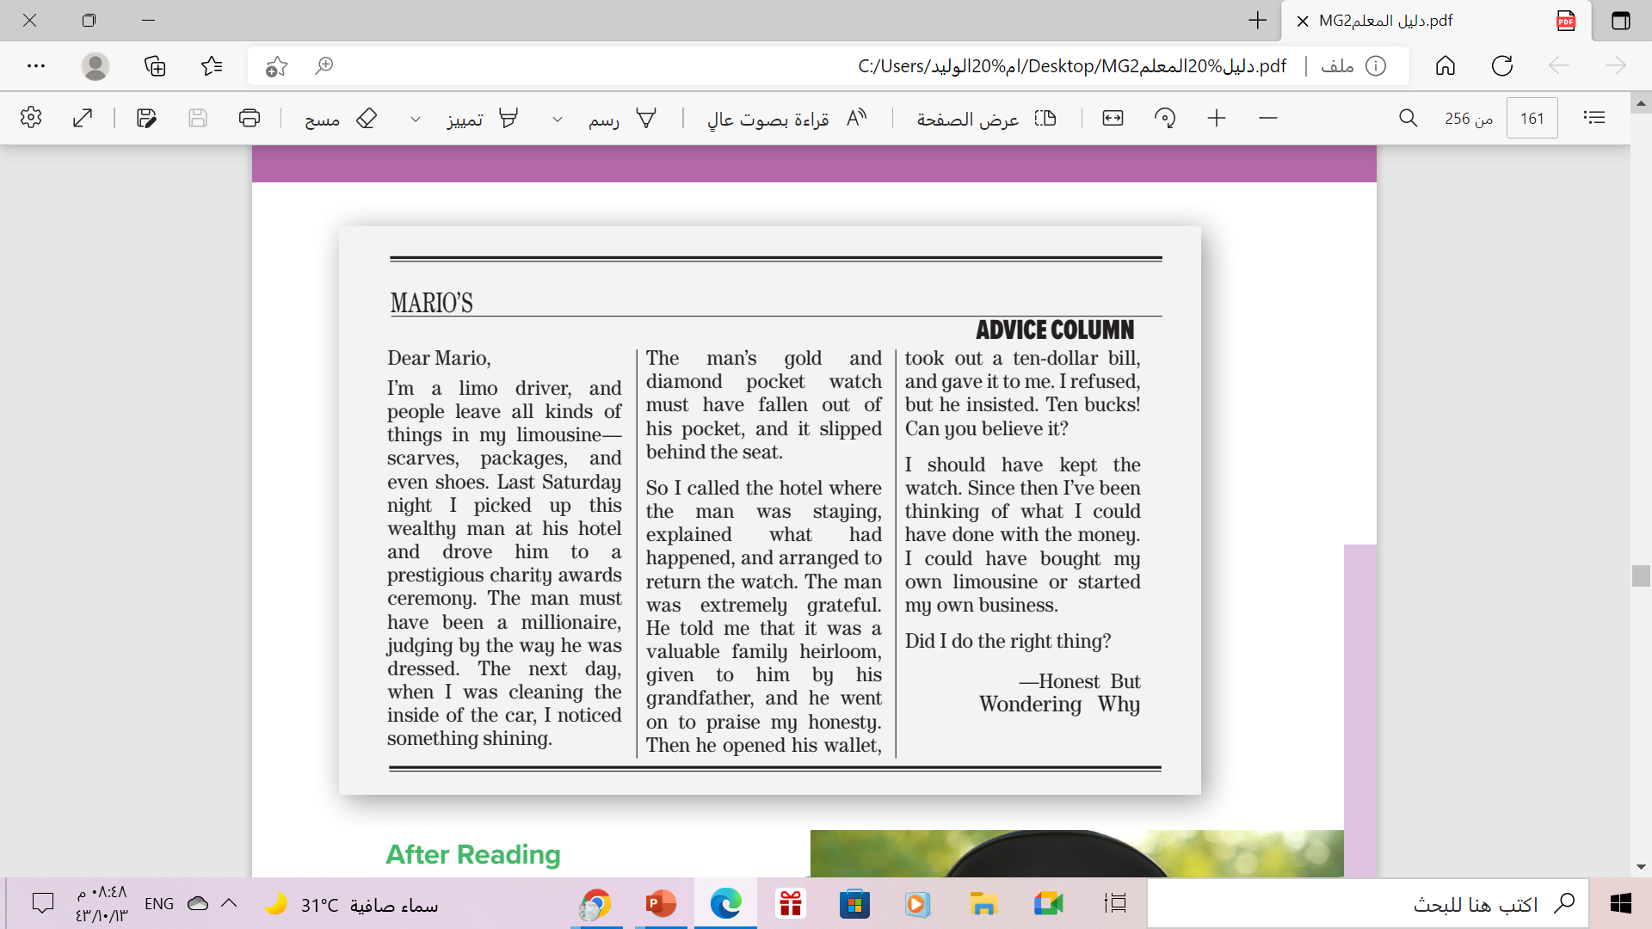
He gave me
a funny look, threw
a 20-dollar bill at me,
and walked away.
He didn’t want us to be
friends anymore because I had embarrassed him at shop .
I lent my best friend some money.
You should have told him from the beginning that you’d be asking for your money soon.
You should have asked him to return the money in private .
You should have called your friend and show him that friendship is more important than money .
You should have called your friend and apologize for your behavior

Slide 15
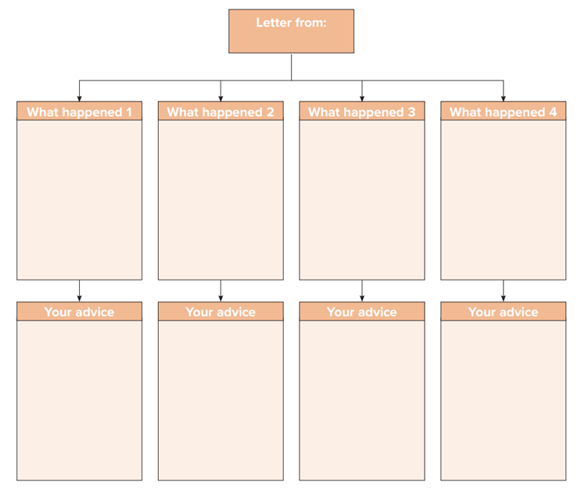
He didn’t want us to be
friends anymore because I had embarrassed him at shop .
I lent my best friend some money.
I asked him
to give me
back the
money in
public
He gave me
a funny look, threw
a 20-dollar bill at me and walked away.
You should have told him from the beginning that you’d be asking for your money soon.
You should have asked him to return the money in private .
You should have called your friend and show him that friendship is more important than money .
You should have called your friend and apologize for your behavior

Slide 16
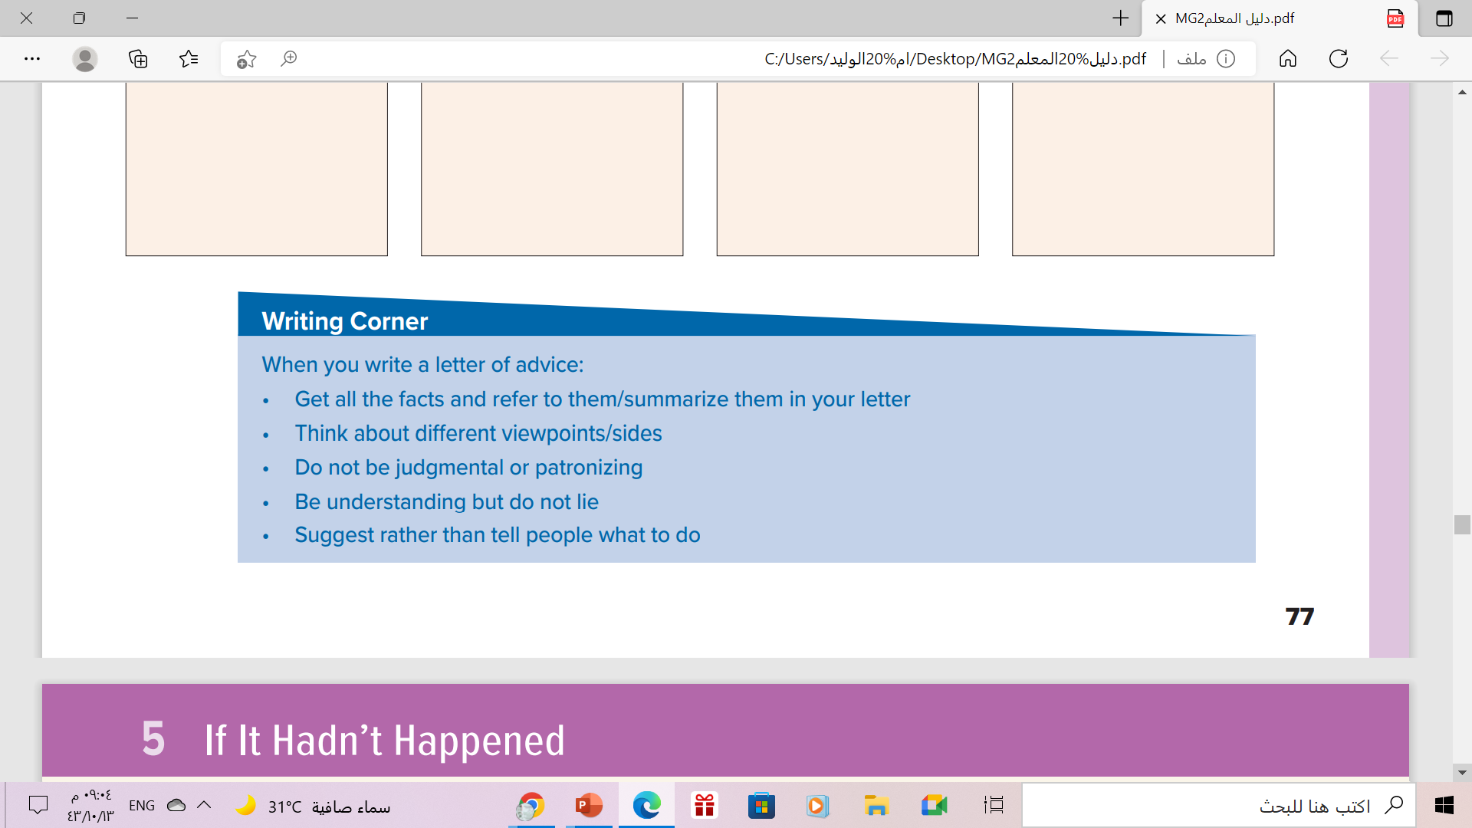
Follow these steps to write a letter of advice

Slide 17

Homework
Workbook p.(106) ,
exercise (K)

Slide 18




Slide 19

Thanks

