Slide 1


Hello My lovely students
I’m your teacher
Hanan AlShobaily

Slide 2




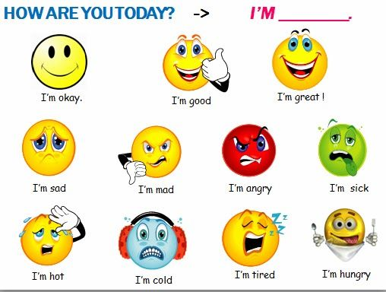
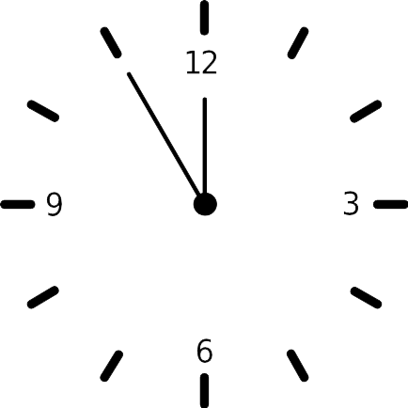
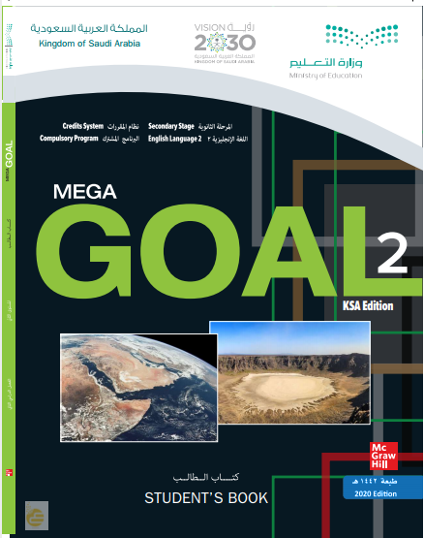


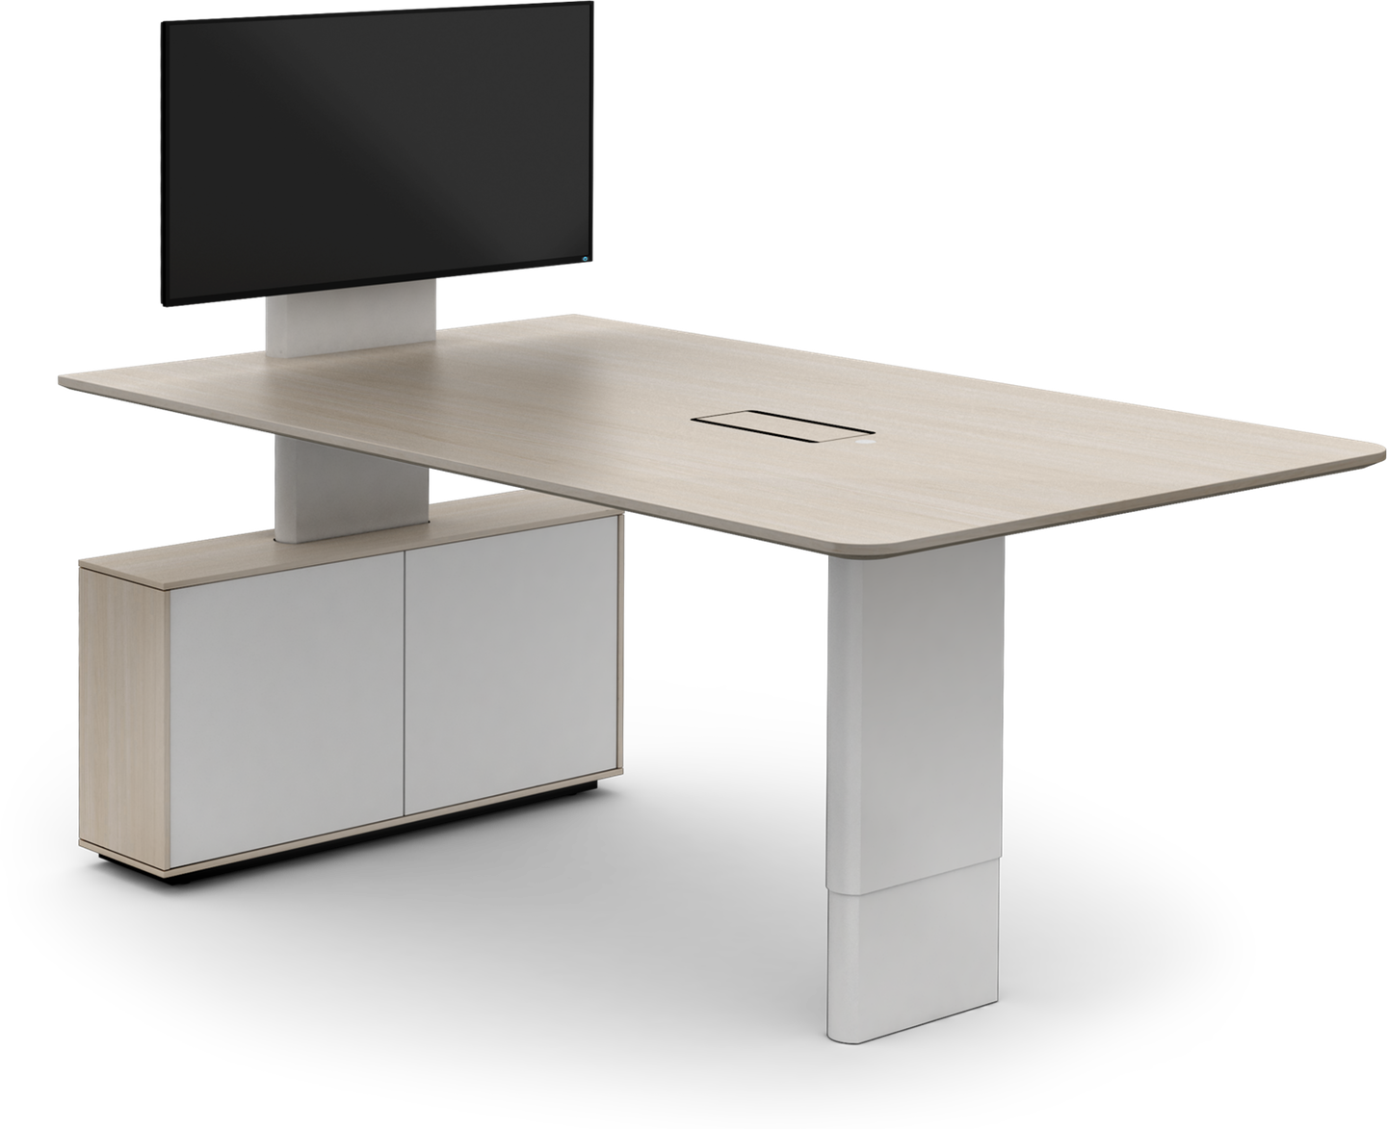
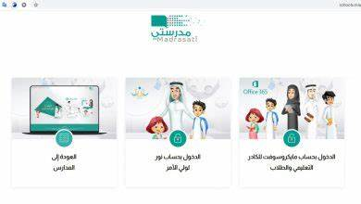







I love English

Slide 3


I love English

Slide 4




Let’s revise the previous lesson
https://wordwall.net/resource/13480120

Slide 5


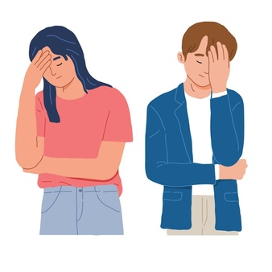
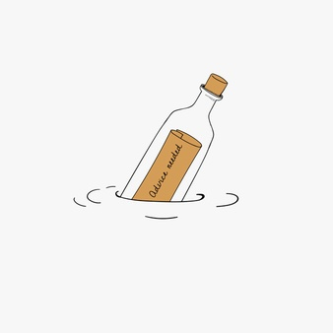
I love English
Mega Goal 2
Unit 5
(If It Hadn’t Happened)
Form, Meaning and Function
Monday
16/8/1442

Slide 6


I love English
Lesson Objectives
Students will be able to:
Write sentences about inventions using past simple.
Use the present perfect tense to describe an inventor's work.
Use time expressions "ago, for and since”.
Express ability with (can).
Use (may/ can) to express permission.
Form polite requests with (can/could).
Form correct sentences about ability and missed opportunities.

Slide 7
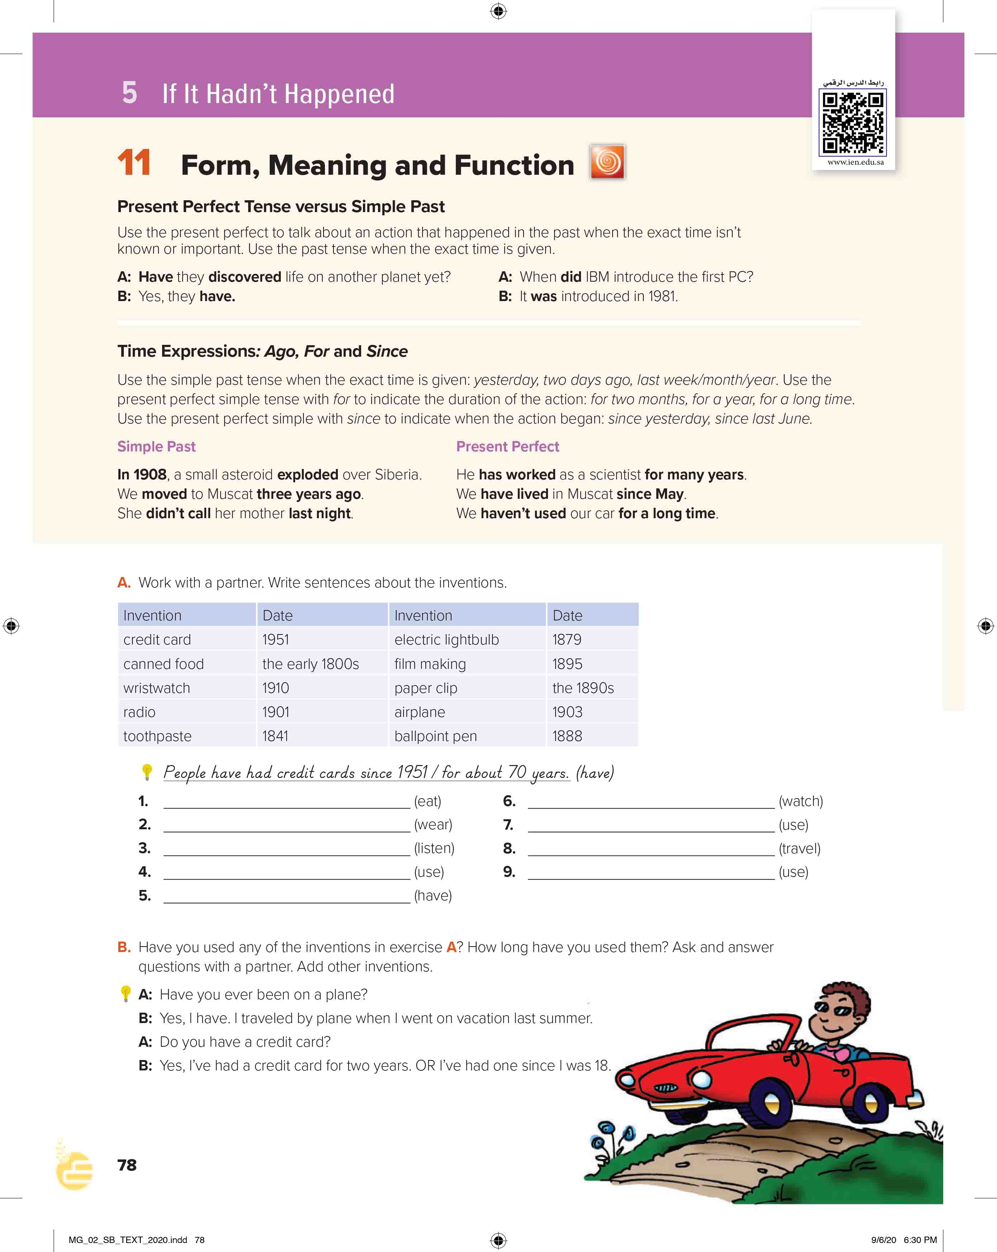

I love English
Open your Student’s book page: 78

Slide 8
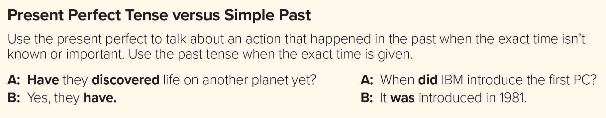


He
She
I
They
You
We
has
Present Perfect
Simple Past
have
The exact time isn’t known, or isn’t important
The exact time is given
The exact time isn’t known, or isn’t important
+
+
Form
Subject
have/has
+
p.p
Form
Subject
V-ed/v2
e.g.
He has worked over this problem.
e.g.
He worked yesterday.
Time isn’t specific
Time is specific
He
has
He
Did
worked over this problem.
he
did
not
worked yesterday.
not
work yesterday
Negative
Negative
work yesterday.
Has
He
has
he
?
?
worked over this problem
Question
.
Question

Slide 9
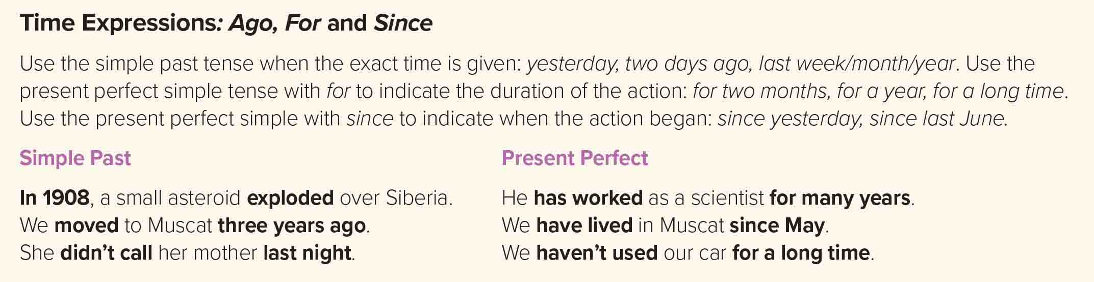
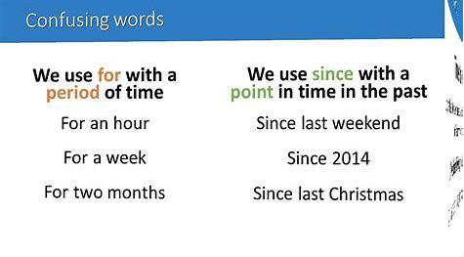
Simple Past
Present Perfect
ago / last / yesterday
for / since
e.g.
I visited my friend last week.
She didn’t go to school yesterday.
I saw that film two weeks ago.
I have worked here for eight years.
He has lived here since 1993.
e.g.
I have had this computer for a long time.
I haven’t seen her since last year.

Slide 10




Example in Quran
“So Allah caused him to die for a hundred years, then raised him up (again)”

Slide 11
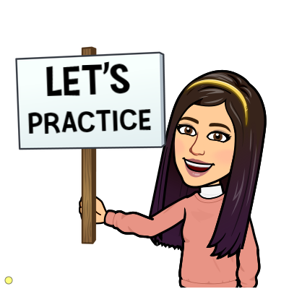
https://wordwall.net/resource/13539913

Slide 12
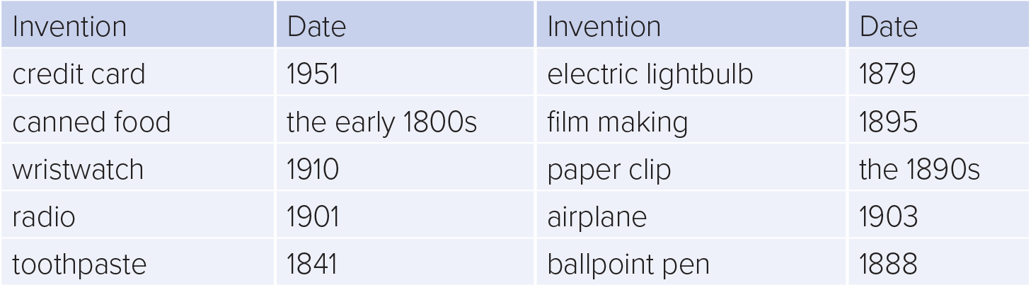
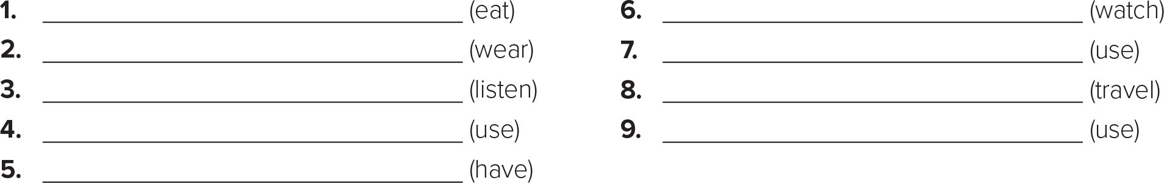
People have eaten canned food since the early 1800s
People have watched documentary films since 1895
They have worn wristwatches since 1910/for about a hundred years (a century)
They have used paperclips since the 1890s
People have listened to radio since 1901/for more than a hundred years (a century)
People have traveled by airplane since 1903
People have used toothpaste since 1841
People have used ballpoint pens since 1888 .
They have had electricity since 1879

Slide 13
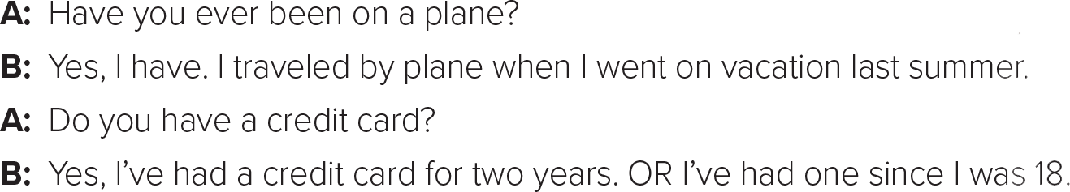
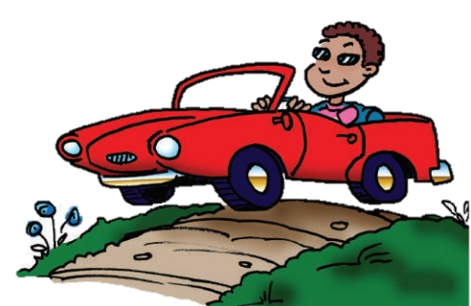

Slide 14
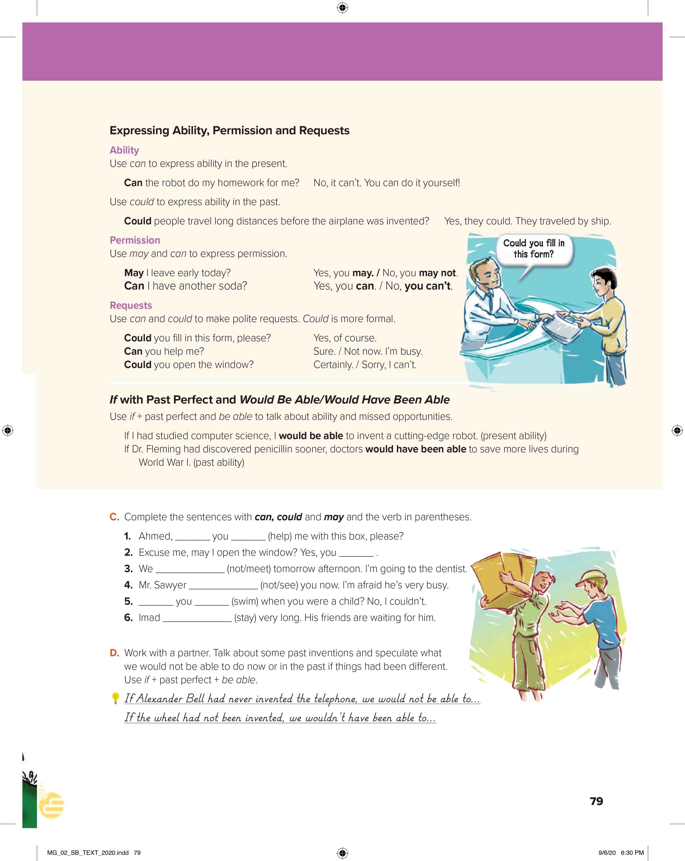
I love English
Open your Student’s book page: 79

Slide 15
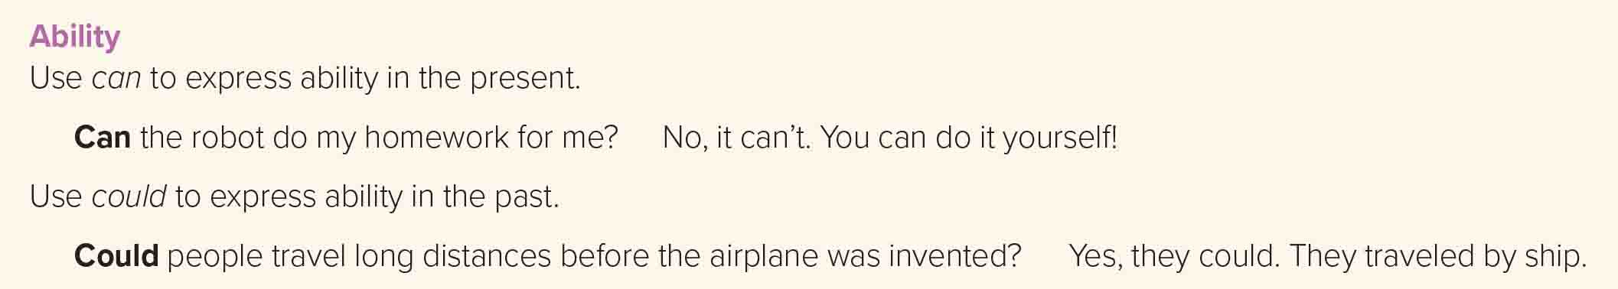
We use (can’t) to express a lack of general ability in the present.
We use (could / couldn’t) to express general ability in the past.
e.g.
Ali is strong. He can lift the heavy box.
My grandfather can’t use a smartphone.
I could speak French three years ago.

Slide 16
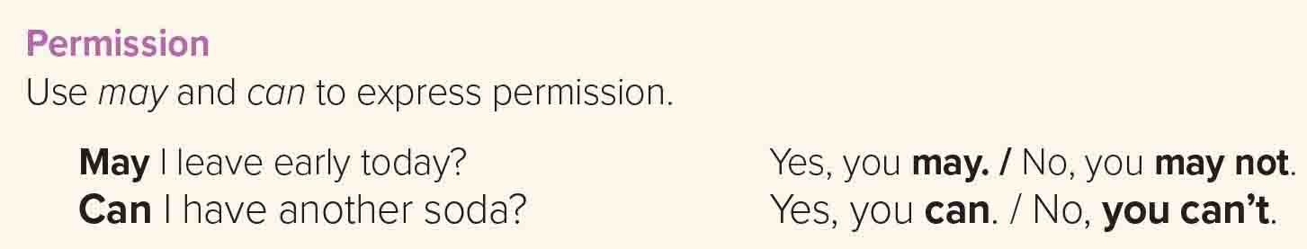
We use (can / may) to give permission.
We use (can’t / may not) to refuse permission.
e.g.
Can I use your pen, please?
May I ask you a question, please?
You can’t smoke here.

Slide 17
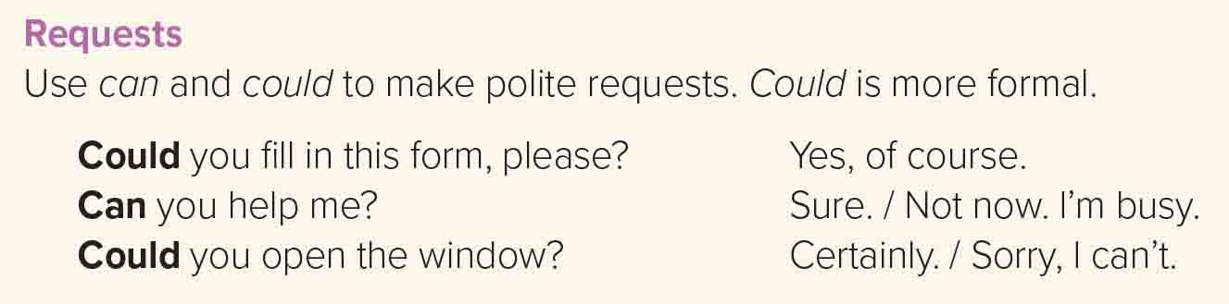
e.g.
Could you lend me this book, please?
Could I call you?
Can I sit down?

Slide 18
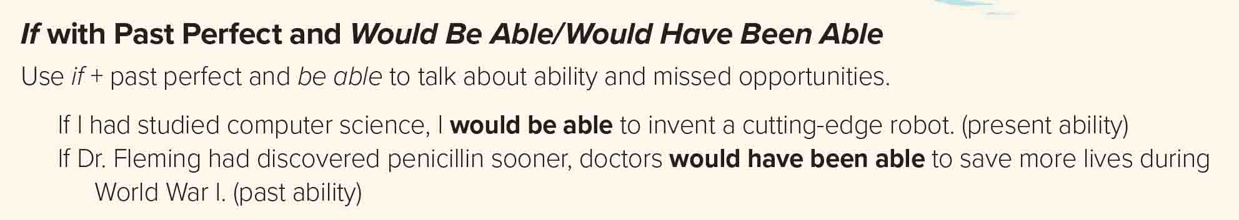
If conditional
Present ability
,
We use would be able for hypothetical ability for the present and in the future
+
Form
If
Past Perfect
+
would be able to
+
infinitive
e.g.
If I had bought a car, I would be able to travel anywhere.
If conditional
Past ability
,
+
If
Past Perfect
would have been able to
+
Form
+
infinitive
We use would have been able to describe a missed opportunity in the past
e.g.
If he had gotten a job, he would have been able to save more money.

Slide 19
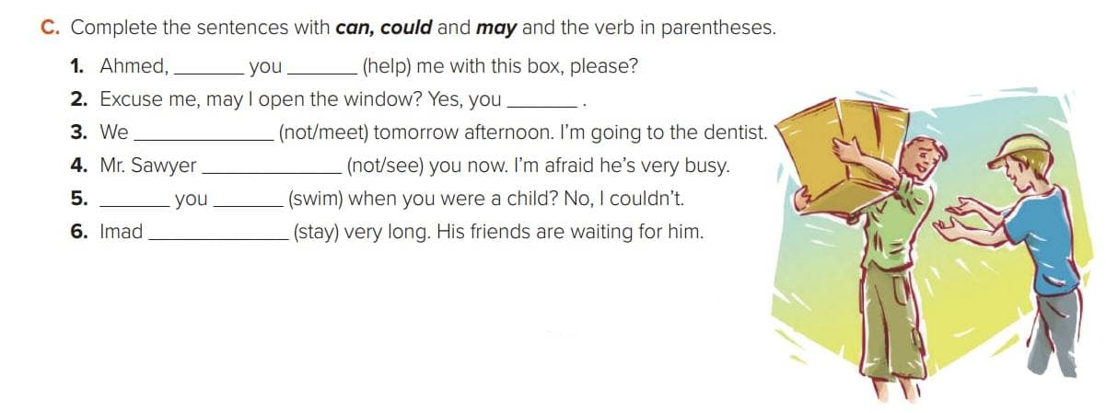
can/could
help
can
can’t meet
can’t see
Could
swim
can’t stay

Slide 20
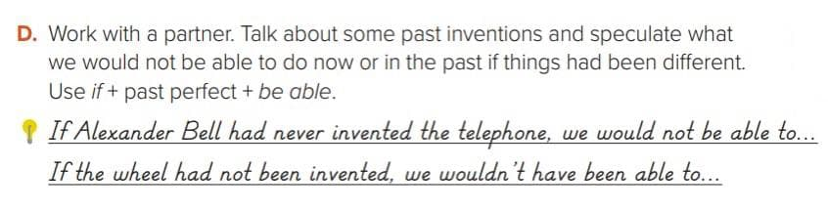

Slide 21

https://wordwall.net/resource/13540562

Slide 22

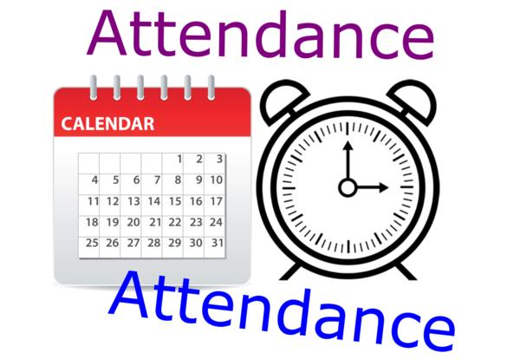
I love English

Slide 23

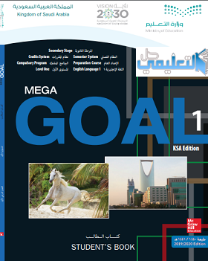


Homework
I love English
Work Book: Page 55, M

Slide 24
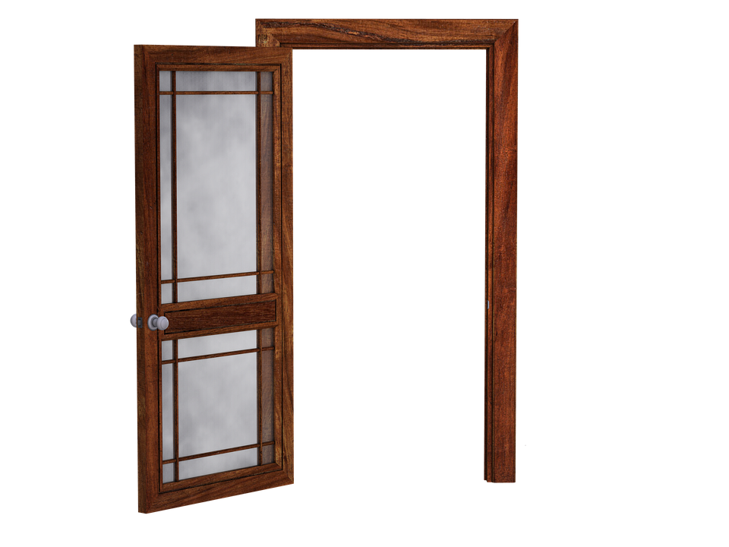
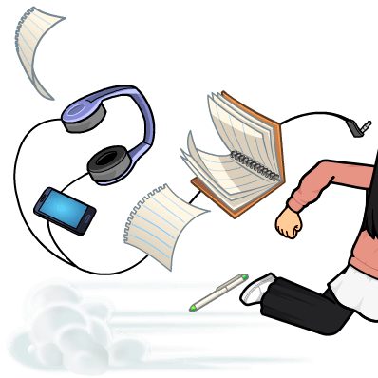
Homework
Work Book: Page 55, M

Slide 25
Homework
Work Book: Page 55, M

Slide 26
Homework
Work Book: Page 55, M

Slide 27
Homework
Work Book: Page 55, M

Slide 28
Homework
Work Book: Page 55, M

Slide 29

Homework
Work Book: Page 55, M

