Slide 1

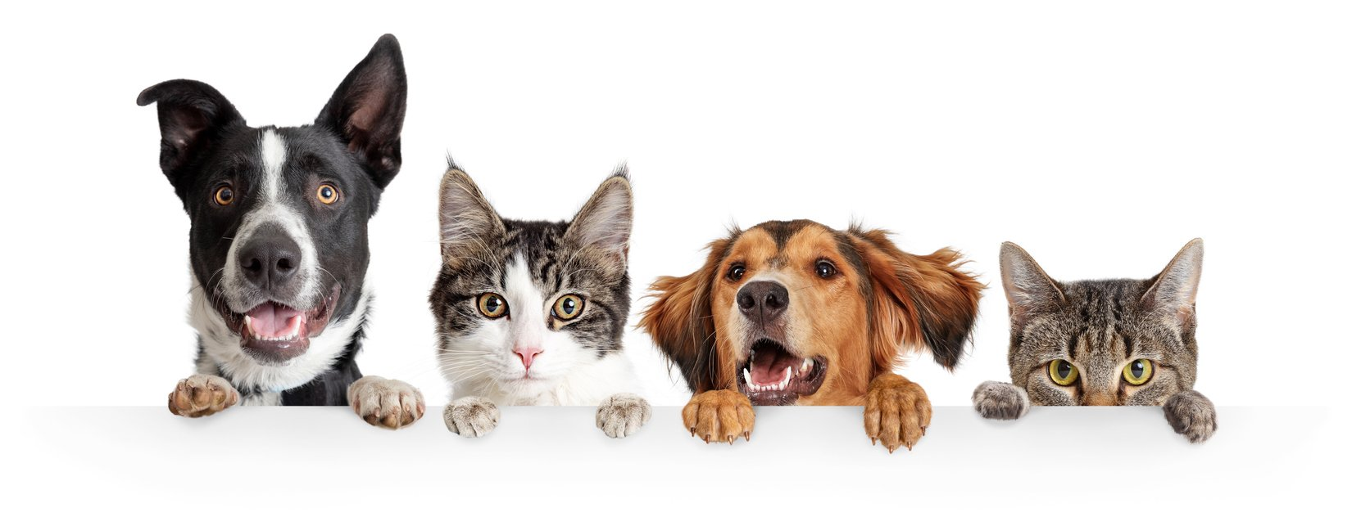
Unit3
Amazing Animals
Grammar
Mega Goal 2.3
Done By: Entisar Al-Obaidallah

Slide 2
Lesson Obectives
01
03
02
04
Deduce
Change
the correct structure of passive modals
From active to passive using modals or reporting verbs
Use
Apply
the passive with Reporting Verbs correctly
The rules to do the exercises

Slide 3

Book Open
Pages ( 36-37 )

Slide 4
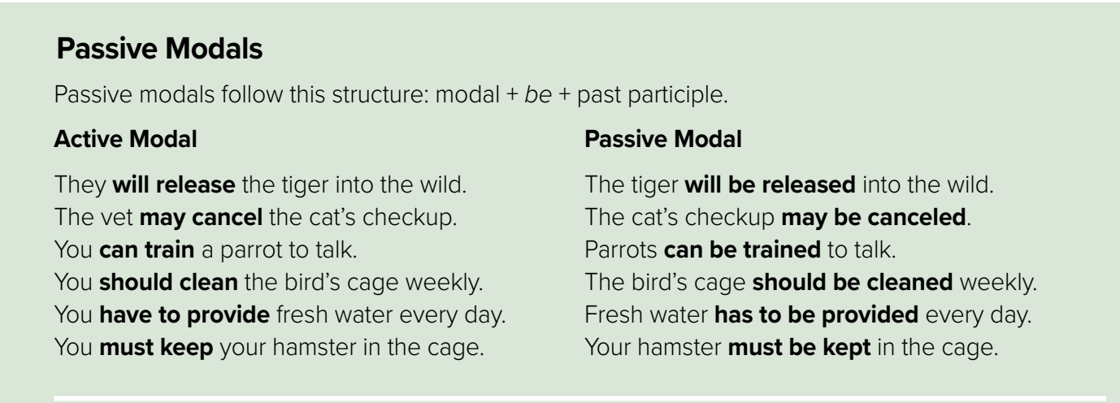

Slide 5


What are Modals ??
A modal is a type of auxiliary (helping) verb that is used to express: ability, possibility, permission or obligation.
Examples:
Will May Can Should
Have to must

Slide 6
The Structure of Passive Modals
modal
be
V.P.P(3)
Active Modal
Passive Modal
She will make a cake .
You may use the dictionary
He can solve the problem
She should eat healthy food
You have to cook the food
I must clean the house
A cake will be made .
The dectionary may be used .
The problem can be solved
Healthy food should be eaten
The food have to be cooked
The house must be cleaned

Slide 7


Change into paasive?
subject
modal
verb
object
Children should not eat chocolate
Change into Passive using this form:
object
modal
be
v. p.p3
object
modal
Add (be)
Verb P.P(3)
be
by children
not
Chocolate
should
eaten

Slide 8
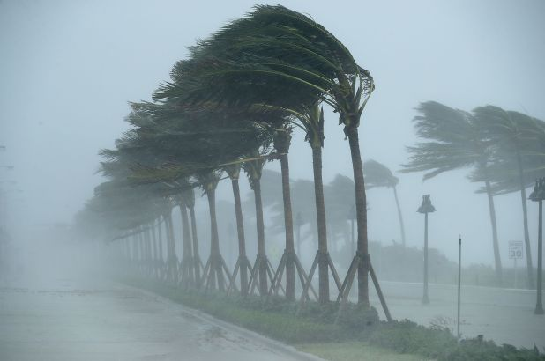
Change into passive?
subject
modal
verb
object
People can not control hurricanes
Change into Passive using this form:
object
modal
be
v. p.p3
object
modal
Add (be)
Verb P.P(3)
Hurricanes
be
controlled
not
can
by people

Slide 9
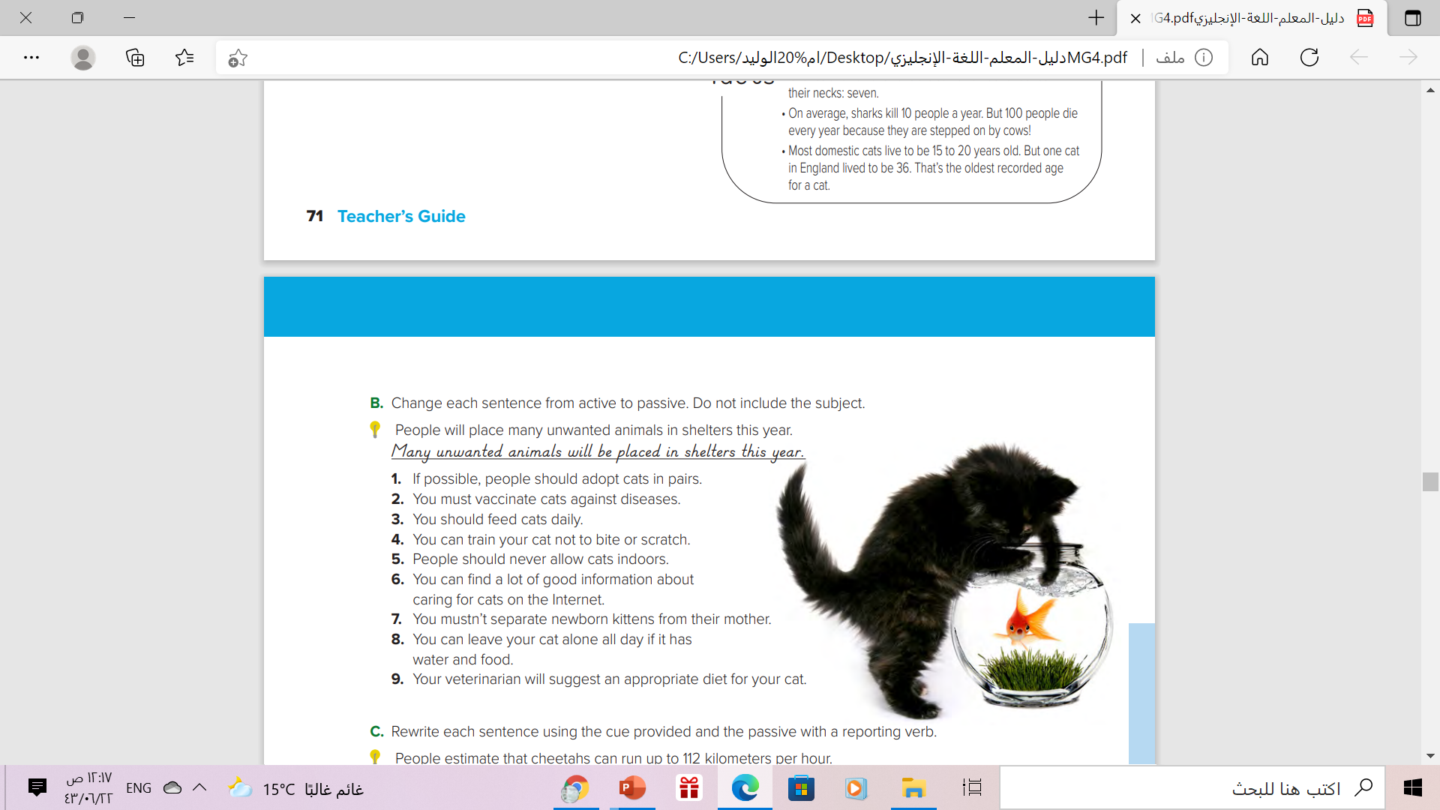
1.If possible, cats should be adopted in pairs.
2. Cats must be vaccinated against diseases.
3. Cats should be fed daily.
4. Cats can be trained not to bite or scratch.
5. Cats should never be allowed indoors.
6. A lot of good information about caring for cats can be found on the Internet.
7. New born kittens mustn’t be separated from their mother.
8. Cats can be left alone all day if they have water and food.
9. An appropriate diet for your cat will be suggested by your veterinarian

Slide 10
The Passive Verbs with Reporting Verbs

Slide 11


Slide 12

How can I write this sentence in the passive voice ??
People believe that Paris is a very romantic city

Slide 13
The Passive with Reporting Verbs
We can write it using the following form :
It
Passive Reporting Verb
that
clause
Examples:
People believe that Paris is a very romantic city
1- Begin with “It” to make it impersonal
2- Add the reporting verb in the passive
3- Add the rest of the sentence without changing anything

Slide 14

Look at this example again:
People
believe
that
Paris is very romantic city
Reporting Verb
that
clause
It
is believed
that
Paris is very romantic city
Begin with
“ It”
Change reporting verb into passive
Add the rest of the sentence

Slide 15
The Passive with Reporting Verbs
We can write it in another way using the following form :
subject
Passive Reporting Verb
to
Infinitive
Examples:
People believe that Paris is a very romantic city
1- Put the subject of subordinate clause at the beginning
2- The main verb is turned into its passive form
3- The verb of subordinate clause is used in its infinitive form

Slide 16

Present
Look at this example again:
Reporting verb
subject
helping verb
People that a very romantic city
believe
Paris
is
a very romantic city
Paris
is believed
to
be
Begin with
the subject
Change reporting verb into passive
Used in its infinitive form

Slide 17
Here is another example with Main verb
Present
Reporting verb
subject
main verb
Everybody says advertising makes money .
Omit letter (s) to make it infinitive
money
Advertising
is said
to
make
Begin with
the subject
Change reporting verb into passive
Used in its infinitive form

Slide 18
Past
Look at this example in the Past Tense
Reporting verb
subject
Main verb past
Journalist reports many people injured in the car crash.
Many people are reported to have injured in the car crash .
Begin with
the subject
Change reporting verb into passive
Use perfect infinitive form

Slide 19
Past
Here is another example in the past with helping verb
Reporting verb
subject
helping verb past
People consider Shakespeare was the best writer .
Shakespeare is considered to have been the best writer.
Begin with
the subject
Change reporting verb into passive
Use perfect infinitive form

Slide 20
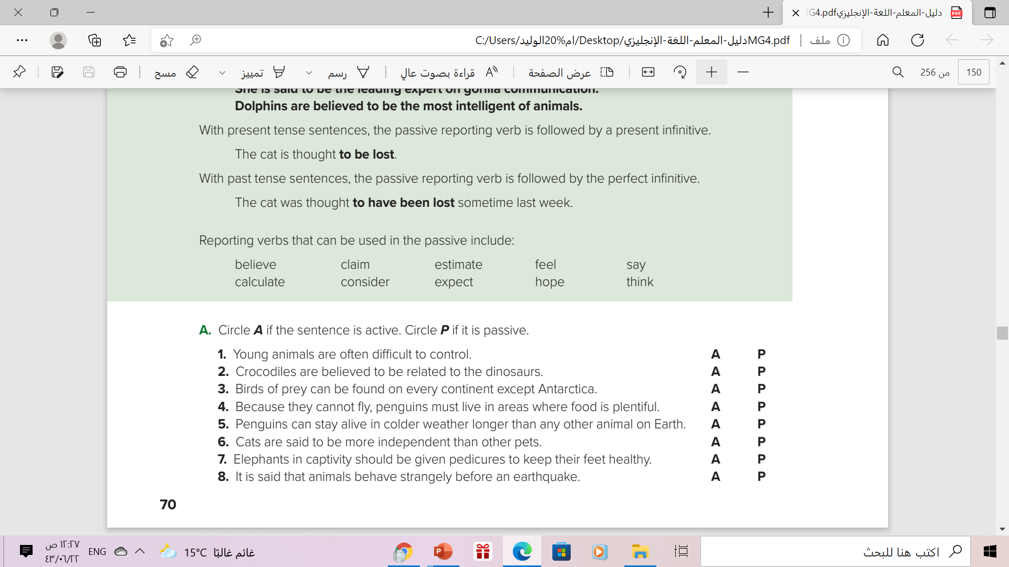

Slide 21
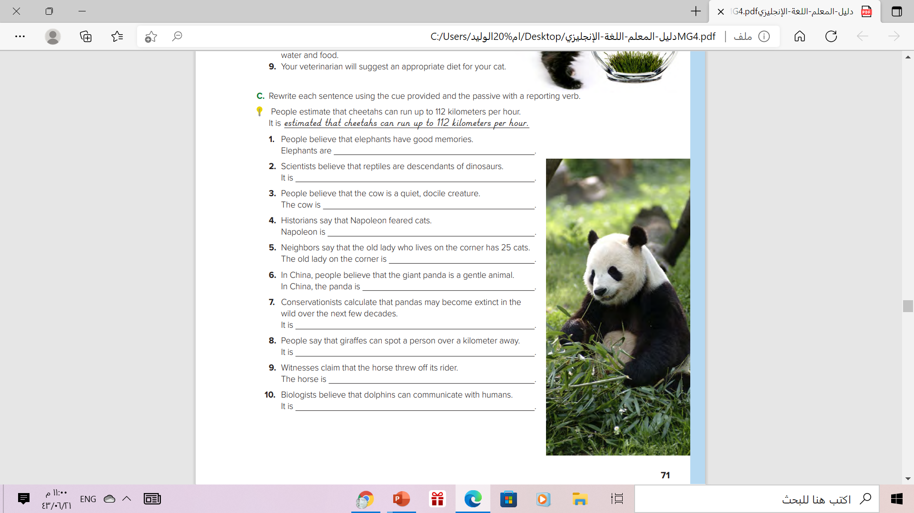
believed to have good memories.
believed that reptiles are descendants of dinosaurs
believed to be a quiet, docile creature
Said to have feared cats
said to have 25 cats
believed to be a gentle anima
calculated that pandas may become extinct in the wild over the next few decades
said that giraffes can spot a person over a kilometer away
claimed to have thrown off its ride
believed that dolphins can communicate with humans

Slide 22
Homework
Workbook , page( 102 ) ,
exercise ( C )

Slide 23


Slide 24

THANKS

