Slide 1


Slide 2

Unit -3-
If It Hadn’t Happened
Good Morning

Slide 3
Unit -3-
If It Hadn’t Happened

Slide 4
10-Writing

Slide 5

Objectives
The students will be able to :
read the advice column and answer some questions .
make notes in the organizer including their own advice .
write a response for an advice column .
write a letter of advice .

Slide 6


Revision

Slide 7
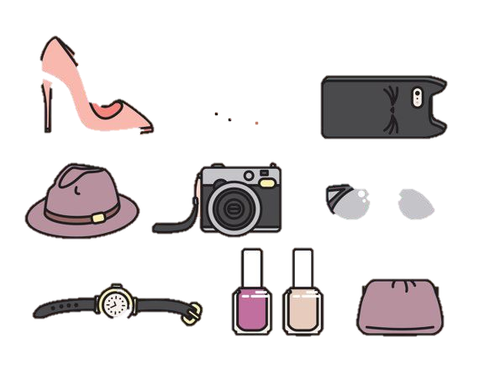
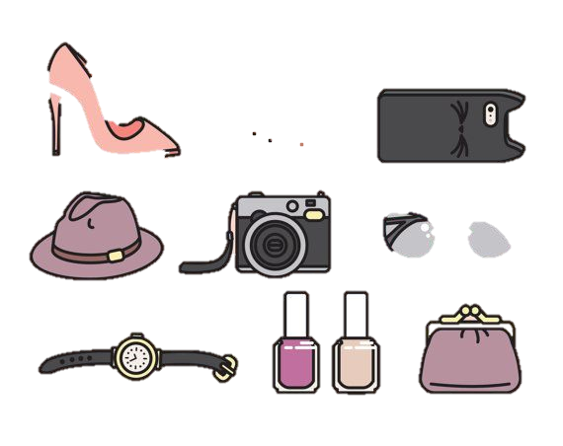
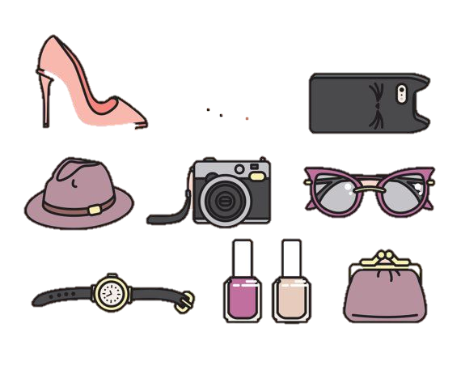
Warm Up
1. Do you like sharing things with your friends? Why? Why not?

Slide 8

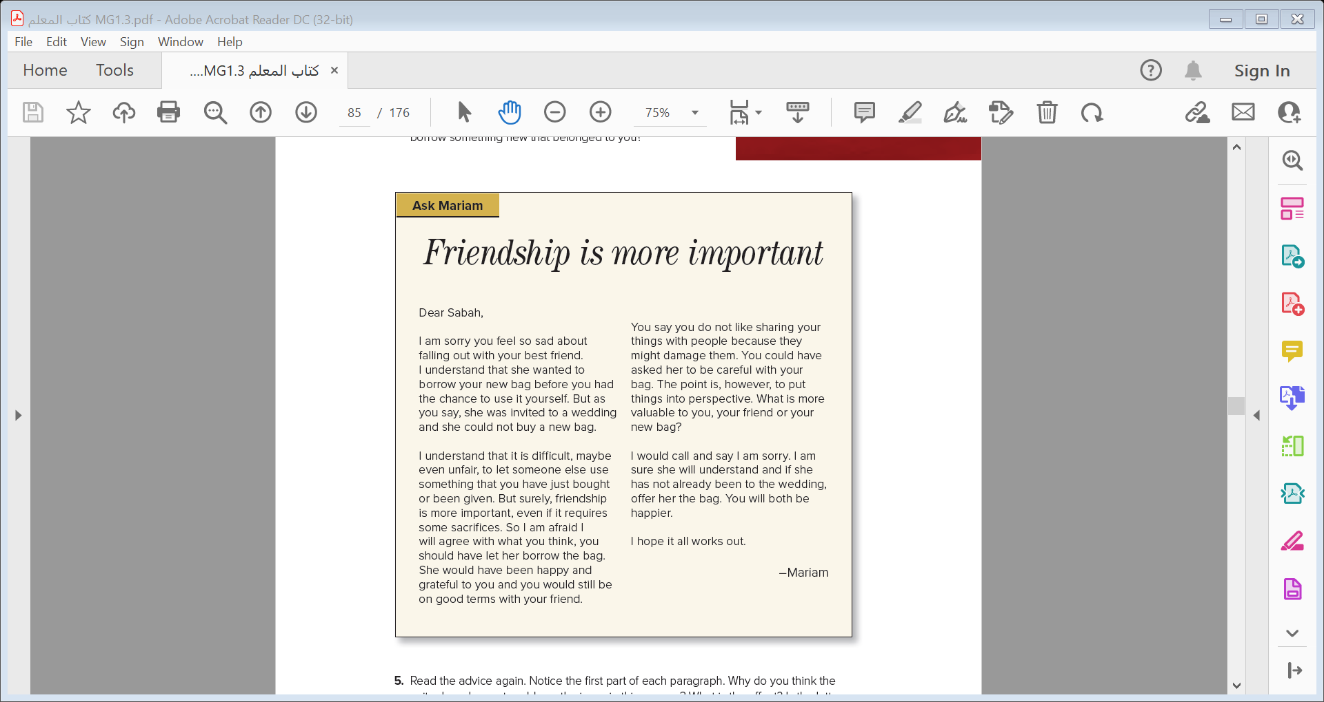
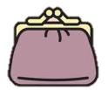
1- What is the title ?
2- Who wrote the letter of advice ?
3- Who asked for the advice ?

Slide 9
2. Read the advice column and answer the questions.
• Why was Sabah sad?
• What happened with her friend? Why?
• What is the column writer’s advice?
Sabah was sad because she had fallen out with her best
friend.
• Sabah’s friend asked to borrow her new bag because she had a wedding to go to and could not afford to buy a new bag.
• The column writer advised Sabah to call her friend and apologize/say she was sorry and offer to lend
her bag to her friend if she still needed it.

Slide 10

3. Do you agree with the column writer? Why? Why not?
4. What would you have done if your friend had wanted to borrow something new that belonged to you?
How to write a letter advice
5. Read the advice again. Notice the first part of each paragraph. Why do you think the
writer has chosen to address the issue in this manner? What is the effect? Is the letter
reprimanding or friendly? How would you feel if you were Sabah?

Slide 11
How to write a letter advice
Opening
understanding
She has read the letter very carefully
Conclusion
Reason
advice her without patronizing her

Slide 12


Dear ,………
Show understanding of the problem and feeling:
I understand ……………
I know how you feel ……………
Give advice without sounding reprimanding or patronizing
Closing

Slide 13
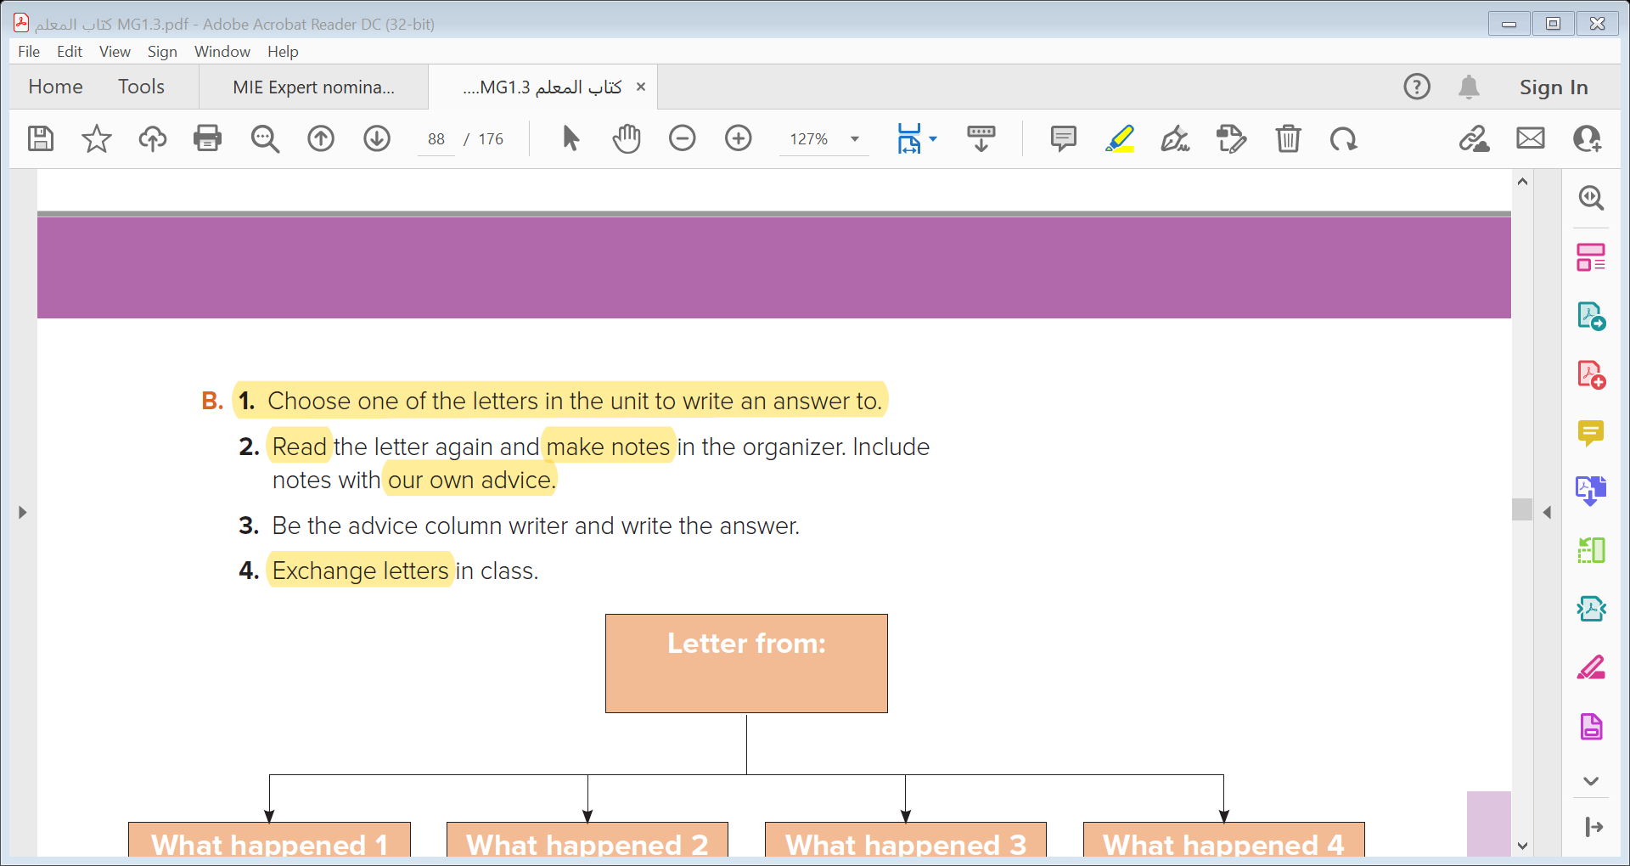
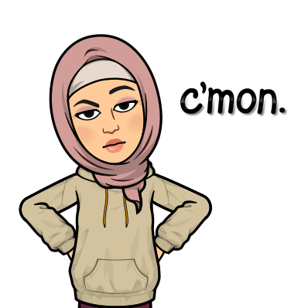

Slide 14
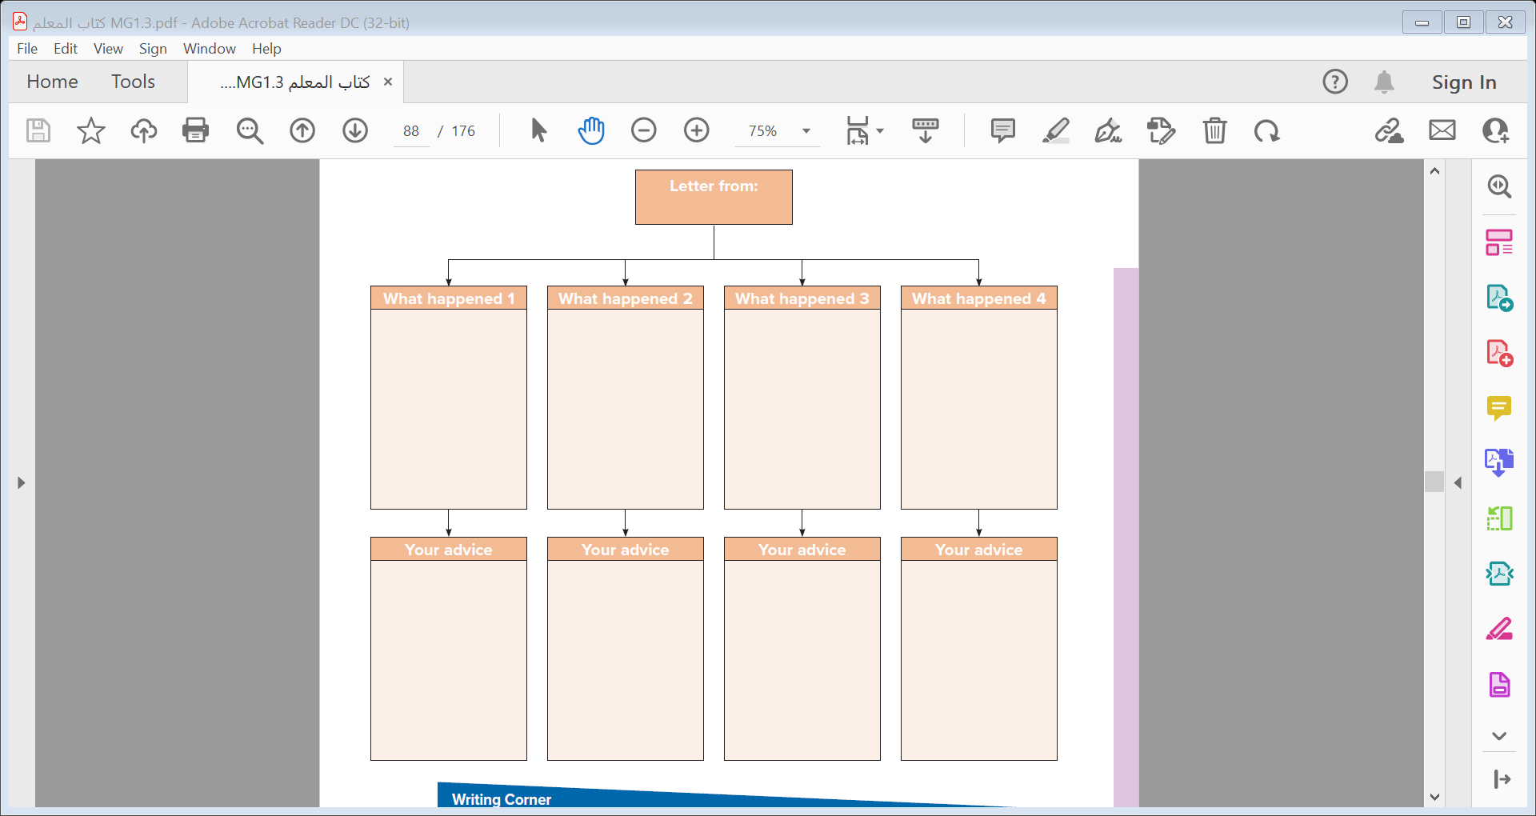
A confused Friend
He asked his friend to give him back the money in public but his friend was embarrassed by that
He lent his friend money.
His friend threw a twenty-dollar bill at him and walked away
The writer wishes he didn’t do that with his friend
I think that was great to lend him the money .
If I were you, I would call him and apologize for my behavior
He shouldn’t do that till he understands what you said .
You shouldn’t blame yourself for that . One day, you will meet again and become good friends .

Slide 15
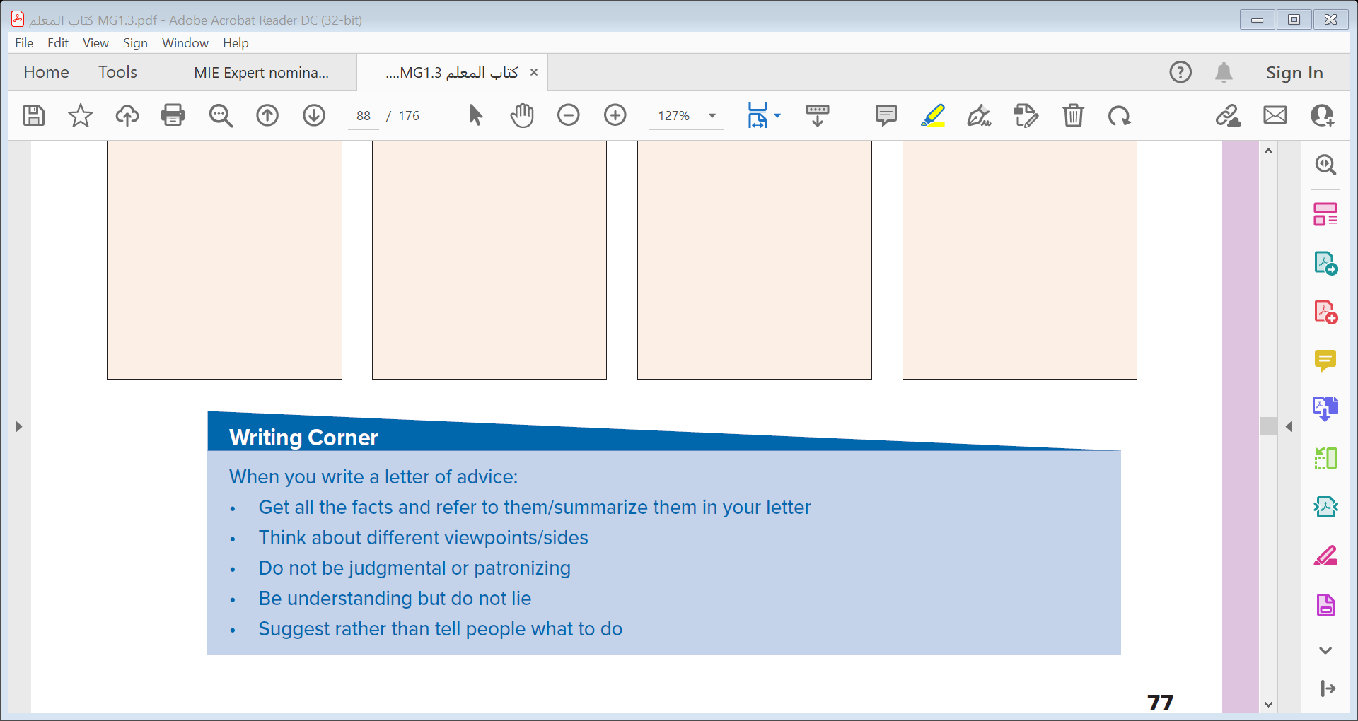


Slide 16


