Slide 1


Slide 2

Unit -3-
If It Hadn’t Happened
Good Morning

Slide 3
11-Form,meaning
and function
Unit -3-
If It Hadn’t Happened

Slide 4
11-Form,meaning
and function

Slide 5
Present Perfect Tense versus Simple Past
Time Expressions: Ago, For and Since
Expressing Ability, Permission and Requests
If with Past Perfect and Would Be Able/Would Have Been Able

Slide 6


Objectives
The students will be able to :
1 – write sentences about inventions using past simple .
2 – use the present perfect tense to describe an inventor's work .
3 – use time expressions "ago, for and since .
4 – express ability with (can) .
5 – use (may/ can) to express permission .
6 - form polite requests with (can/could) .
7 - form correct sentences about ability and missed opportunities .

Slide 7
Lets Check What You Know
Has painted
broke
painted
Have broken
Past simple | Present Perfect Simple
has painted
painted
Have broken
broke

Slide 8

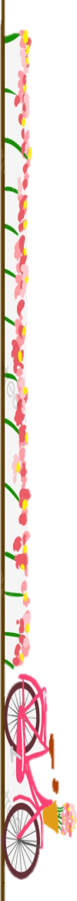
Present Perfect Tense
Simple Past
Present Perfect Tense versus Simple Past

Slide 9


Present Perfect Tense
Simple Past
A: Have they discovered life on another planet yet?
B: Yes, they have
A: When did IBM introduce the first PC?
. B: It was introduced in 1981.
Use the present perfect to talk about an action that happened in the past when the exact time isn’t known or important.
Use the past tense when the exact time is given.

Slide 10

Subject + has /have + V3
Form
Simple Past
They have discovered life on another planet
Subject + has /have + not + V3
Negative
They have not discovered life on another planet
Question
Has / Have + subject + V3 + ?
Have they discovered life on another planet yet?
Present Perfect Tense
Have discovered
Now

Slide 11
Form
Subject + V-ed ( v2 )
She focused in her work
Negative
Subject + did + not + V1
She did not focus in her work
Question
Did + subject + V1 + ?
Did she focus in her work?
focused
Simple Past
Now

Slide 12
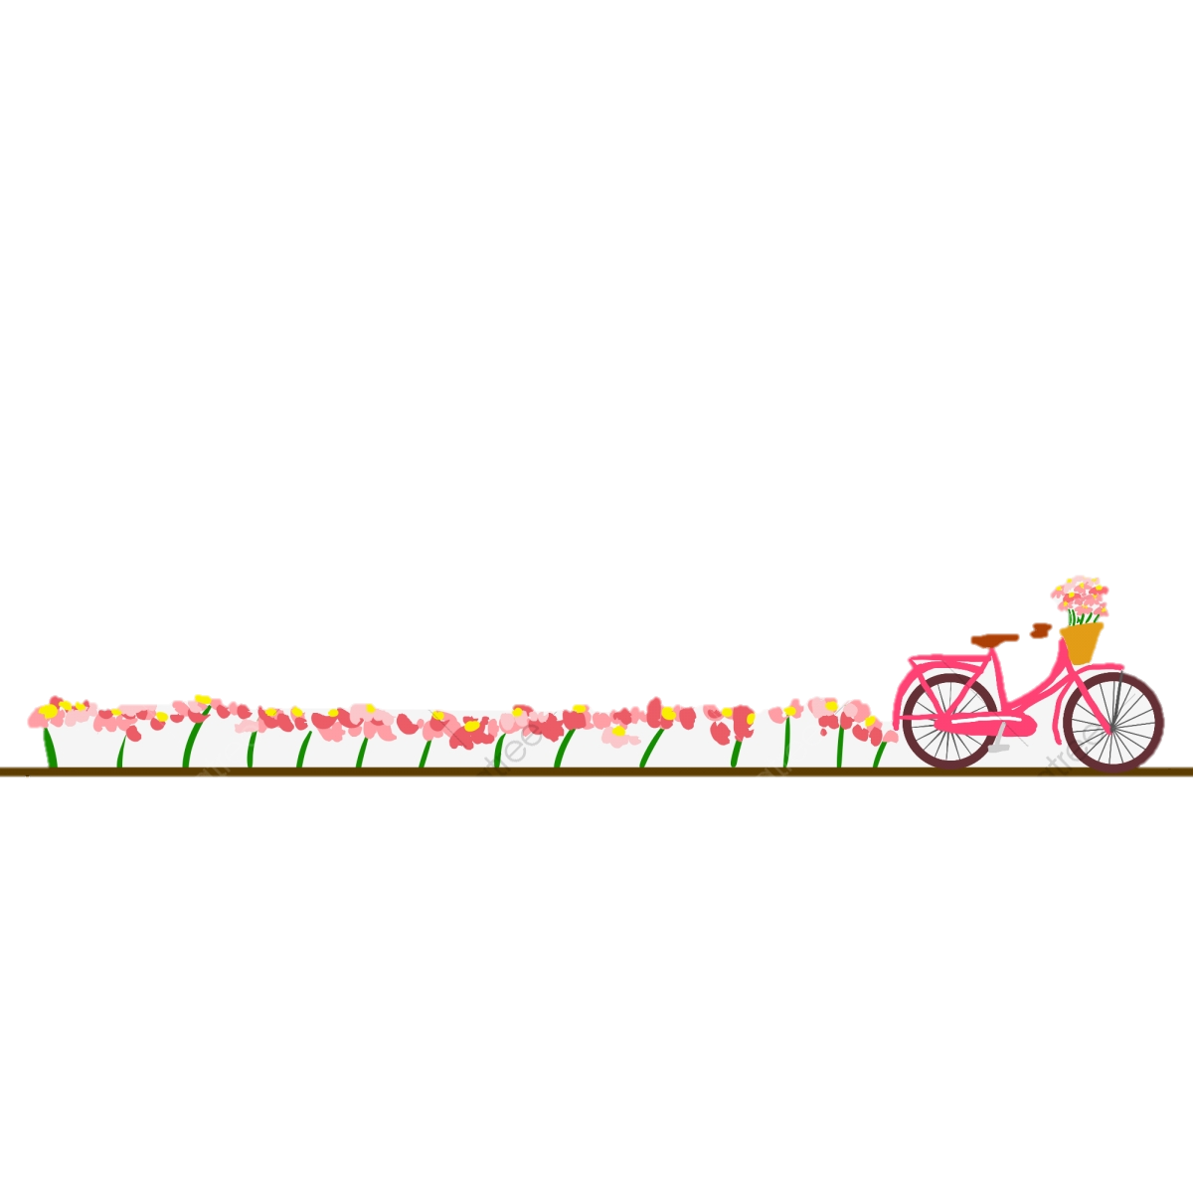
Present Perfect Tense
Simple Past
Time Expressions: Ago, For and Since

Slide 13
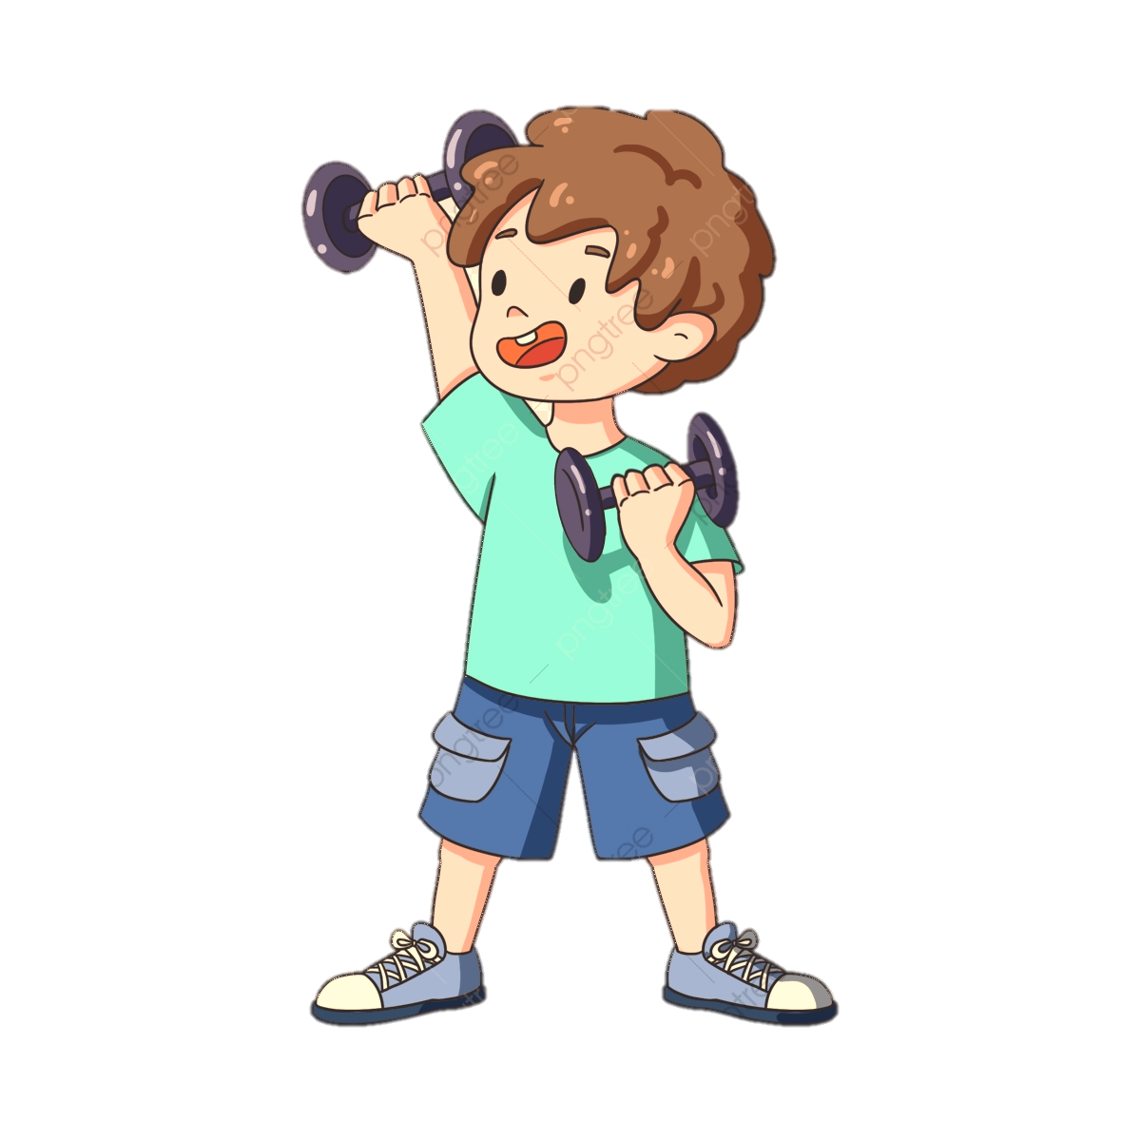
Practice Time
Present Perfect Tense
Simple Past
He has worked as a scientist for many years.
We have lived in Muscat since May.
. We haven’t used our car for a long time.
In 1908, a small asteroid exploded over Siberia.
We moved to Muscat three years ago.
She didn’t call her mother last night.
Use the present perfect simple tense with for to indicate the duration of the action: for two months, for a year, for a long time.
Use the present perfect simple with since to indicate when the action began: since yesterday, since last June.
Use the simple past tense when the exact time is given: yesterday, two days ago, last week/month/year.

Slide 14


Practie Time

Slide 15
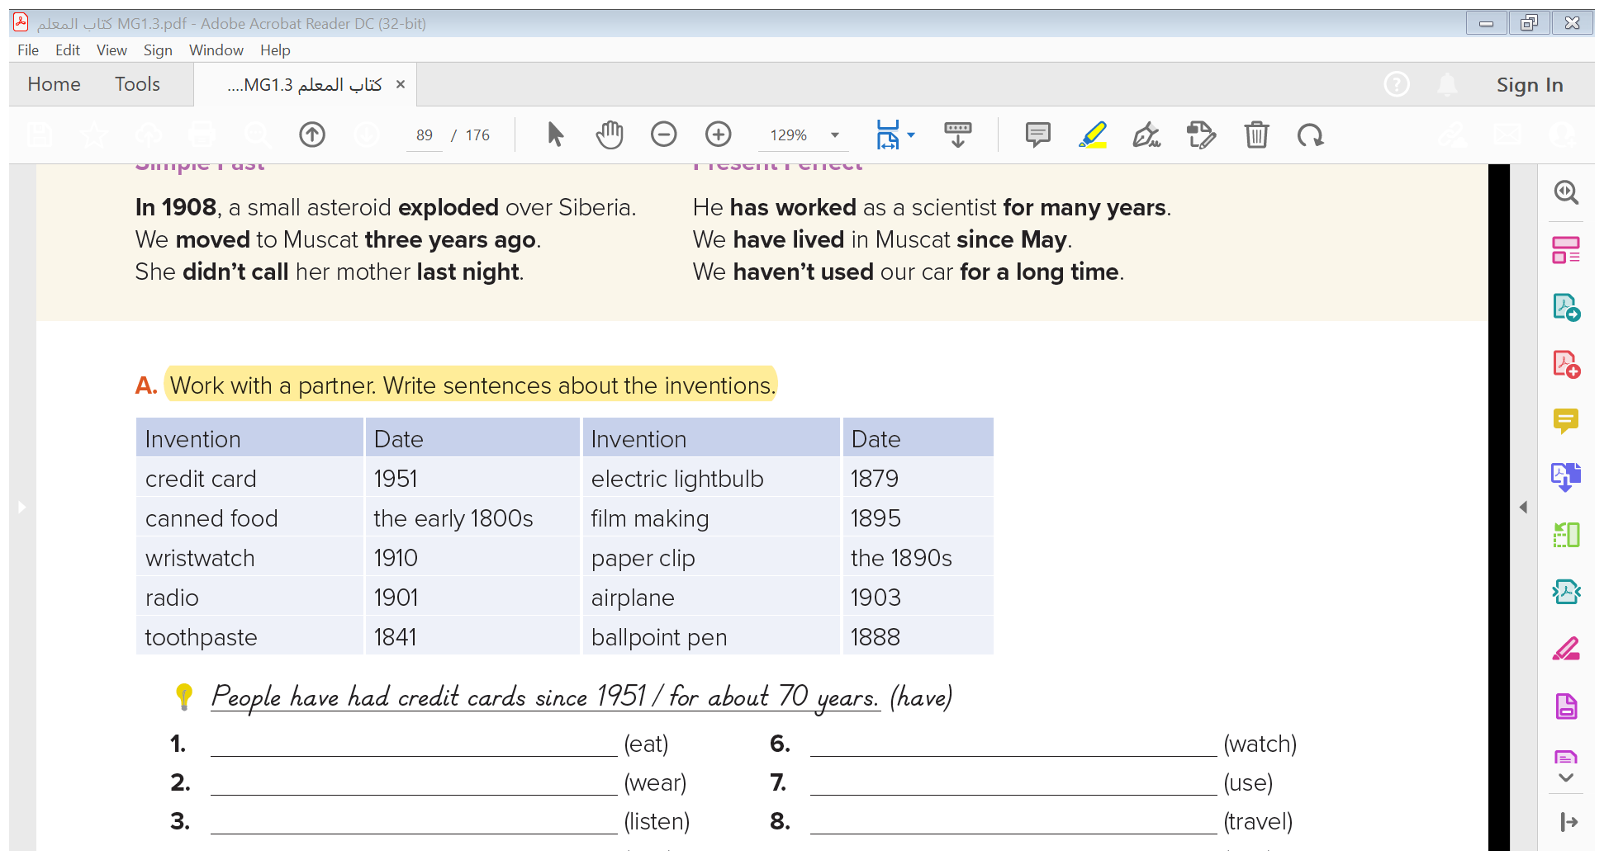

1- People have eaten canned food since the early 1800s .
2- They have worn wristwatches since 1910/for about a hundred years (a century) .
3- People have listened to radio since 1901/for more than a hundred years (a century) .
4- People have used toothpaste since 1841 .
5- They have had electricity since 1879 .
6- People have watched documentary films since 1895 .
7- They have used paperclips since the 1890s .
8- People have traveled by airplane since 1903 .
9- People have used ballpoint pens since 1888 .

Slide 16

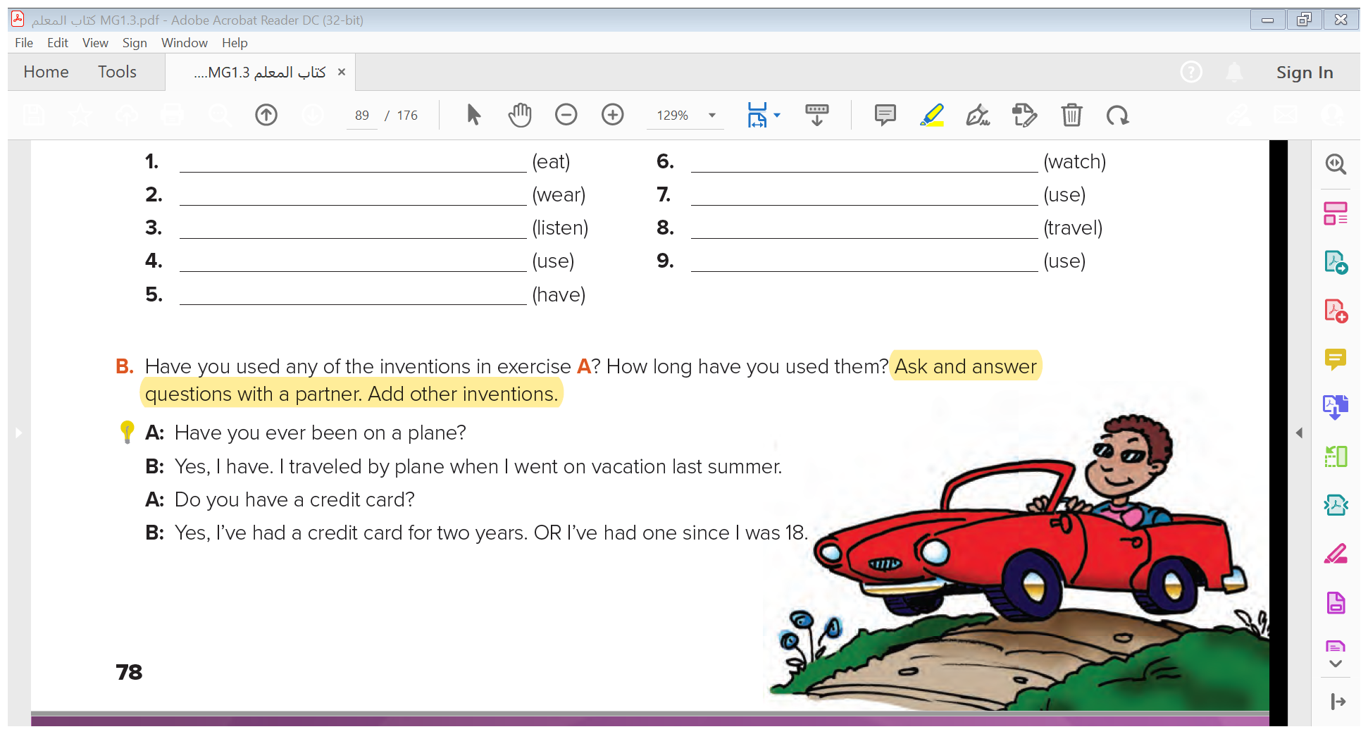


Slide 17


Quick Check

Slide 18
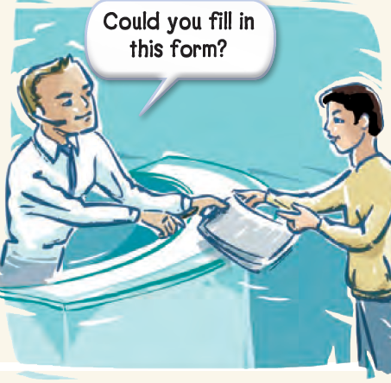
Ability
Permission
Requests
Expressing Ability, Permission and Requests

Slide 19
Practice Time
Ability
Permission
Requests
Present
May I leave early today?
Yes, you may.
No, you may not
.
Can I have another soda?
Yes, you can.
No, you can’t
Could you fill in this form, please?
Yes, of course.
Can you help me?
Sure. / Not now. I’m busy.
Could you open the window?
Certainly. / Sorry, I can’t.
Can the robot do my homework for me?
No, it can’t. You can do it yourself!
Past
Could people travel long distances before the airplane was invented?
Yes, they could. They traveled by ship.
Use can and could to make polite requests.
Could is more formal.

Slide 20
Practice Time

Slide 21
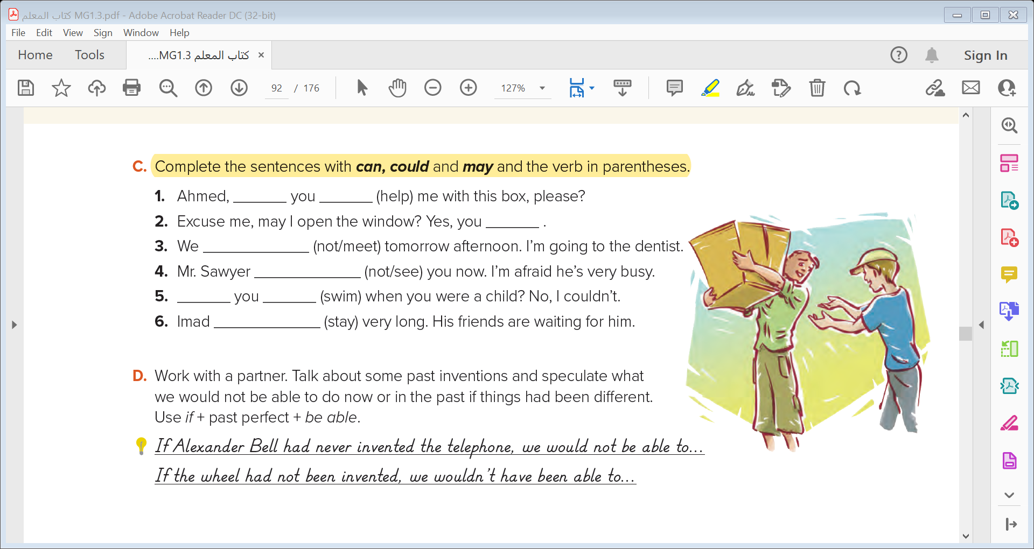
help
can/could
may
can’t meet
can’t see
Could
swim
can’t stay

Slide 22
If with Past Perfect and Would Be Able/Would Have Been Able

Slide 23

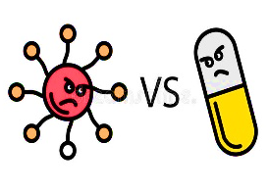
If I had studied computer science, I would be able to invent a cutting-edge robot
If Dr. Fleming had discovered penicillin sooner, doctors would have been able to save more lives during World War I.

Slide 24

Practice Time
If conditional
Present ability
,
If
Past perfect
would be able to
infinitive
If I had studied computer science, I would be able to invent a cutting-edge robot
Past ability
If conditional
,
If
Past perfect
would have been able to
infinitive
If Dr. Fleming had discovered penicillin sooner, doctors would have been able to save more lives during World War I.

Slide 25

Practice Time

Slide 26
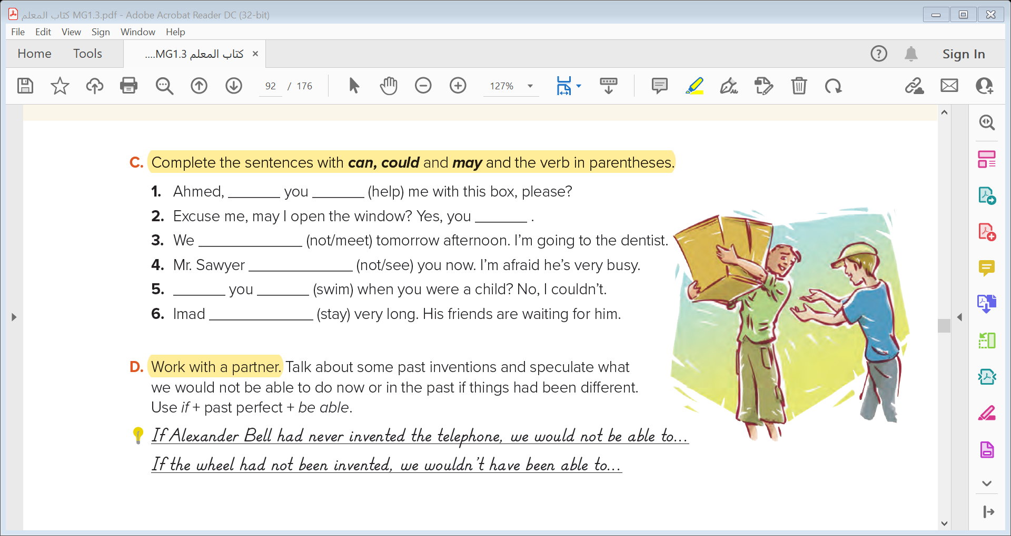

Slide 27
Quick Check

Slide 28


