Slide 1


Super Goal 4
Unit 5 - What’s the weather like?
Pronunciation & Conversation
By: Sara Alamri

Slide 2

Objectives
Produce
the |l|
sounds
Answer
the questions
01
02
03
04
Practice
the conversation
Make
predictions

Slide 3

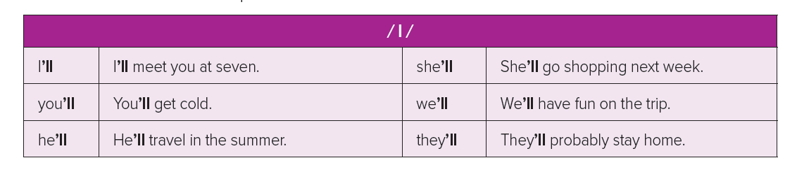
5 Pronunciation
Listen to the |l| sound. Then practice

Slide 4

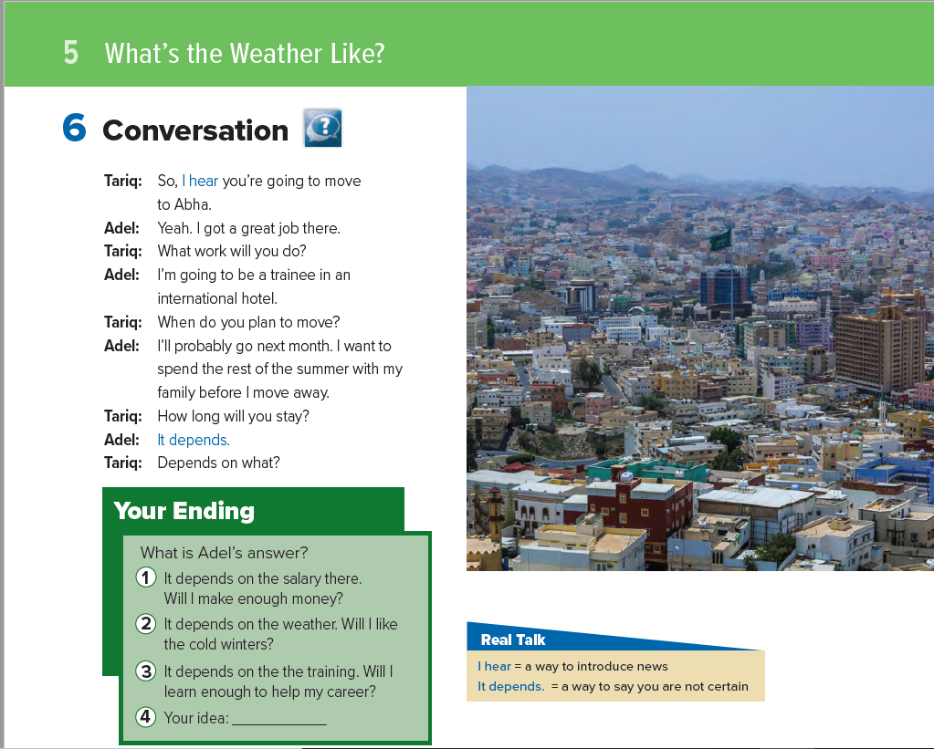

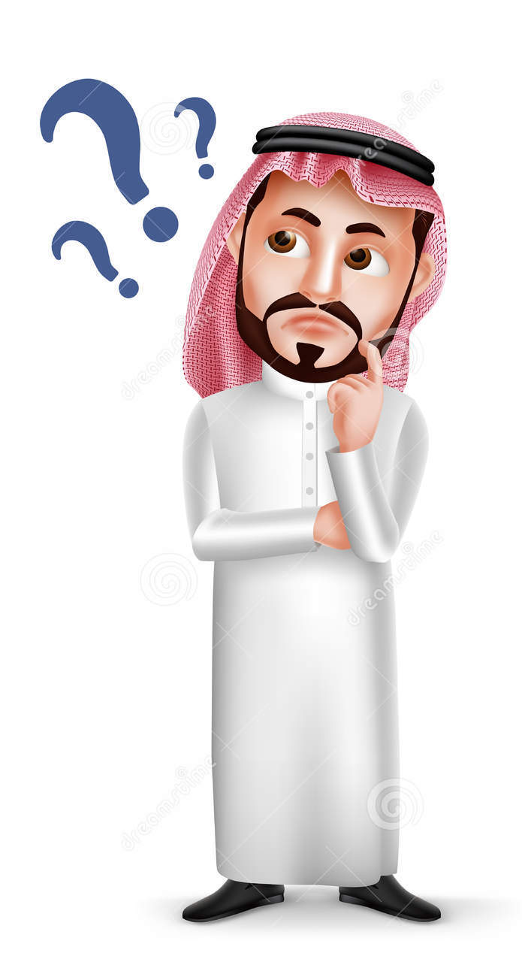

Conversation
44
Books open @
Listen & read a long
Who says?
I got
a great job
I hear you’re
going to move

Slide 5


Conversation
44
Books open @
Listen & read a long
﴿ هُوَ الَّذِي جَعَلَ لَكُمُ الْأَرْضَ ذَلُولًا
فَامْشُوا فِي مَنَاكِبِهَا وَكُلُوا مِن رِّزْقِهِ ۖ وَإِلَيْهِ النُّشُورُ﴾
How long will he stay?
What is Adel going to do there?
When will Adel go to Abha?
Why isn’t he going immediately?

Slide 6
Conversation
44
Books open @
Listen & read a long
Use the expressions
in meaningful sentences
I hear
It depends

Slide 7


