Slide 1


Slide 2
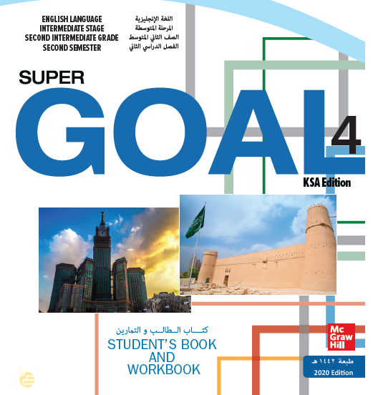

Slide 3


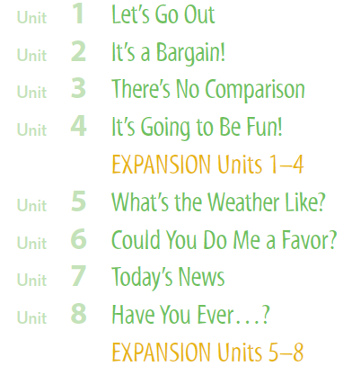

Slide 4

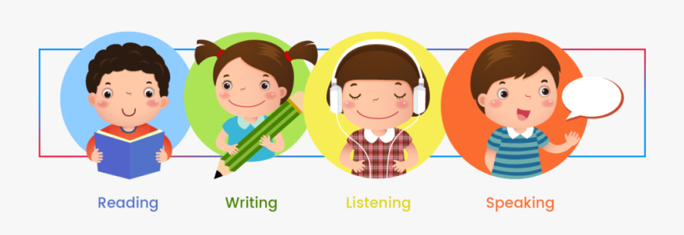

Slide 5
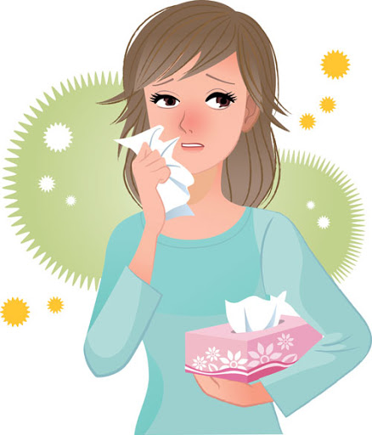
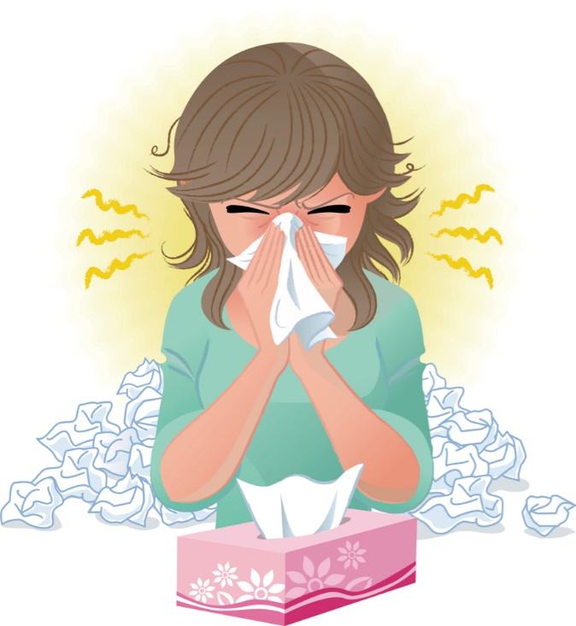
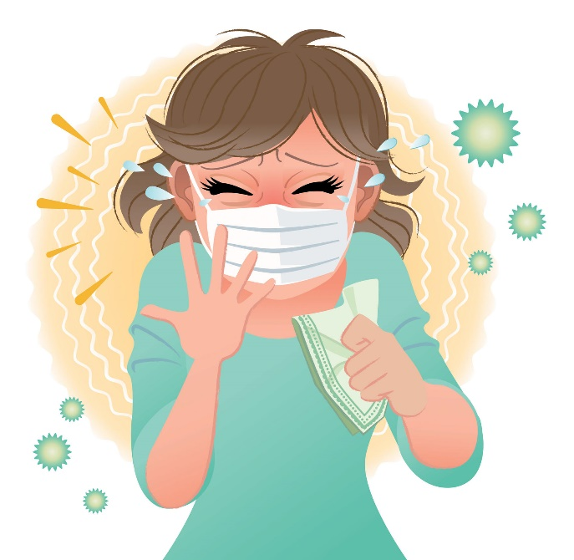
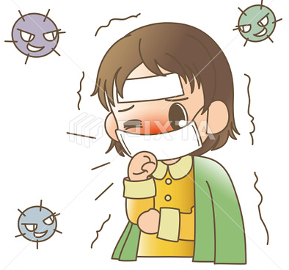
Covid 19
☺Avoid gathering !
☺We must wear a mask before
going out.
☺Social distancing is not a
choice, it is a must!
☺Keep a distance of 2 meters
to avoid accountability
☺wash hands constantly.

Slide 6
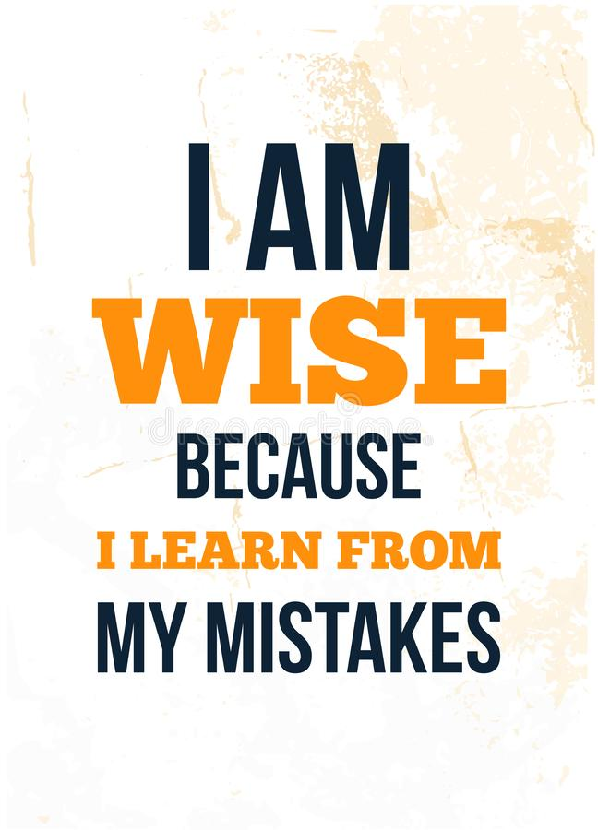

Slide 7
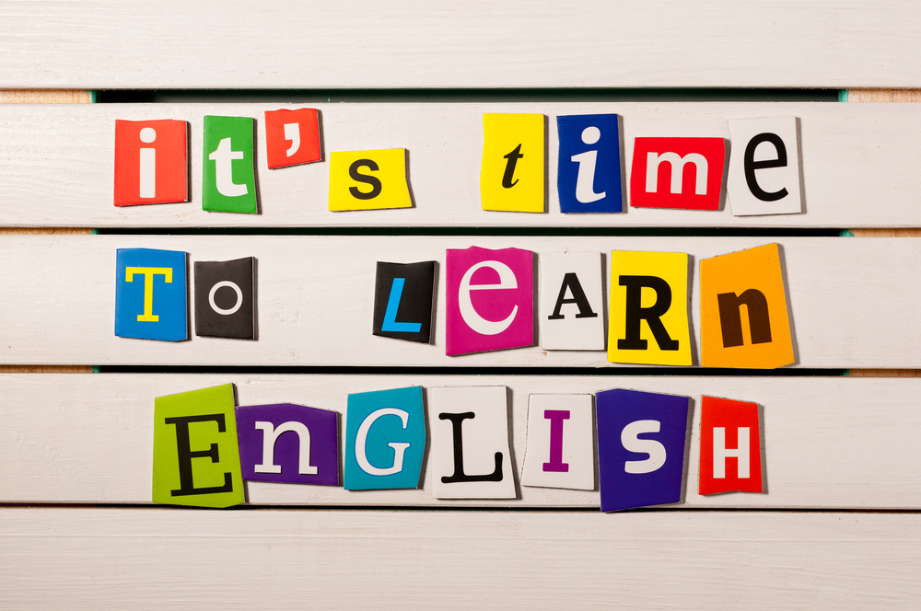

Slide 8
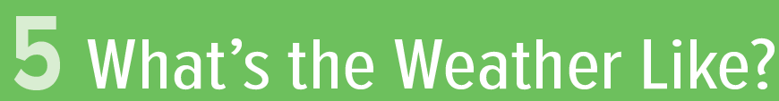

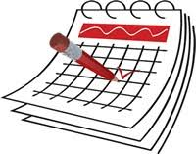


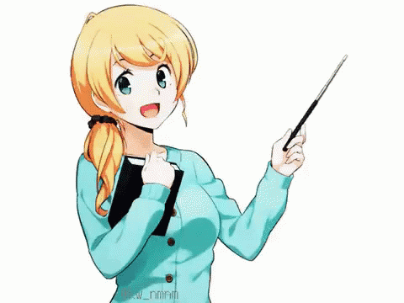
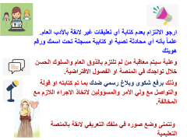
Today: Monday
Date:
2-8-1442 H
March 15th \ 2021
everyone,
How is everything going?

Slide 9
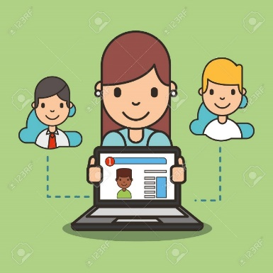



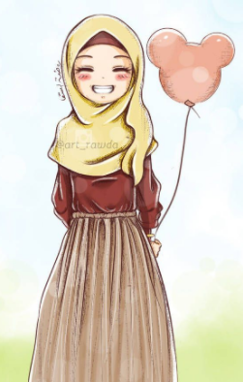
ارجو الالتزام بعدم كتابة أي تعليقات غير لائقة بالأدب العام. علماً بأنه أي محادثة نصية او كتابية مسجلة تحت اسمك ورقم هويتك
وعلية سيتم معاقبة من لم تلتزم بالذوق العام والسلوك الحسن خلال تواجدك في المنصة او الفصول الافتراضية.
وذلك برفع شكوى وبلاغ رسمي ضدك بما تم كتابته او قولة والتواصل مع ولي الأمر والمسؤولين لاتخاذ الاجراء اللازم مع المخالفة.
ونتمنى وضع صوره في ملفك التعريفي لائقة بالمنصة التعليمية

Slide 10
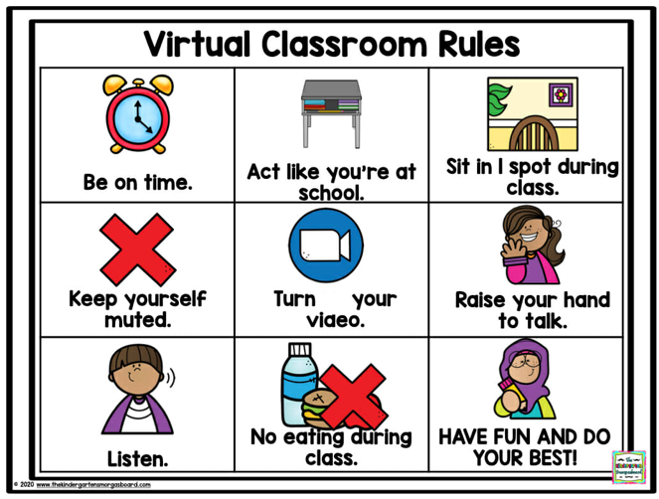
off

Slide 11



☺
♥
Use Conditional Sentences with Present and Future Forms
….
..

Slide 12
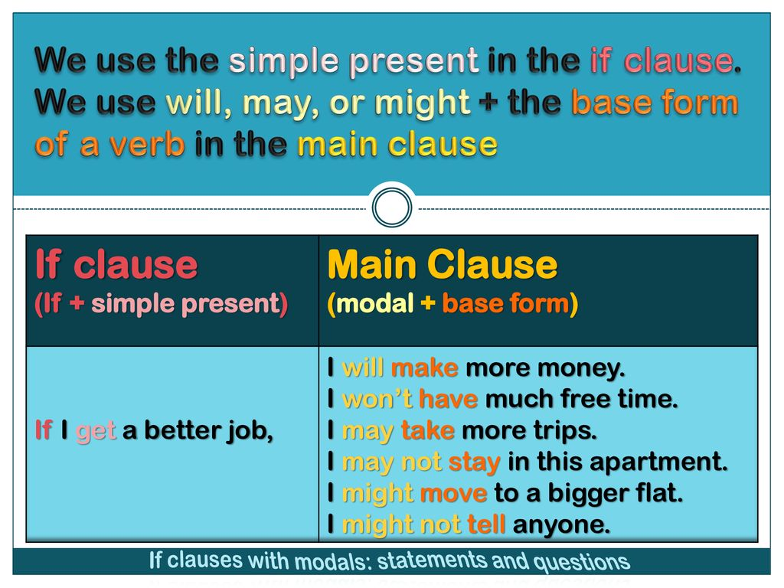

Slide 13

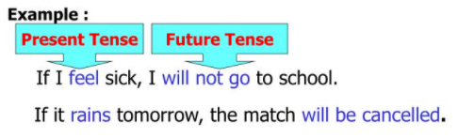


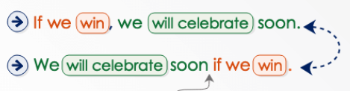

Slide 14
when we use if to talk about present facts,
if means whenever.
The verb forms in the if-clause and the main clause.
(simple present + simple present)
☻ When we use if to talk about the future, if means
something may or may not happen.
the verb forms in the if-clause and the main clause.
(simple present + will/won’t)
☺we use the simple present in the if-clause even though we are talking about the future.
☻ the difference in meaning between
an if-clause +may/might (the second event is not certain to happen if the event in the if-clause happens) and
an if-clause + will (the second event is certain to happen if the event in the if-clause happens).

Slide 15
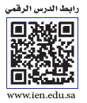
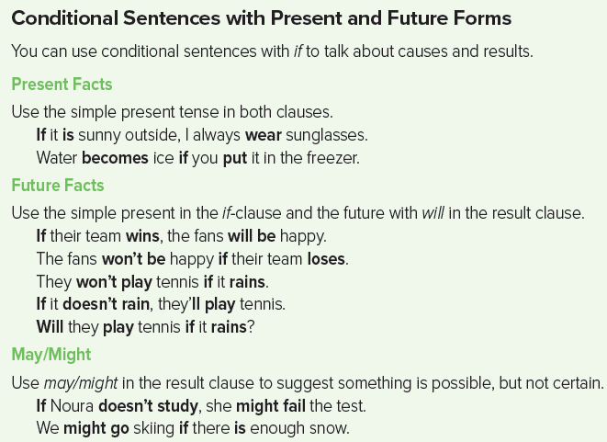
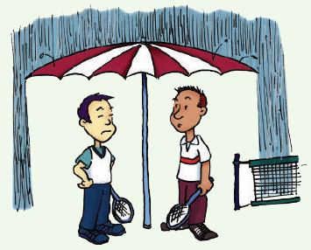
Page 47
if-clause + will
if-clause +may/might

Slide 16
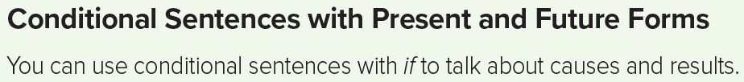
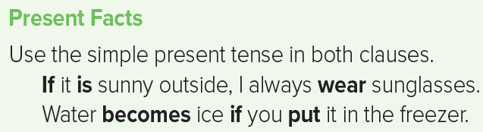
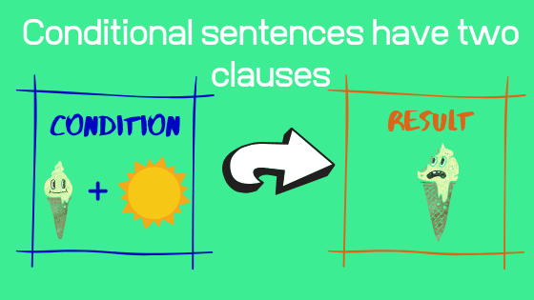
Page 47

Slide 17
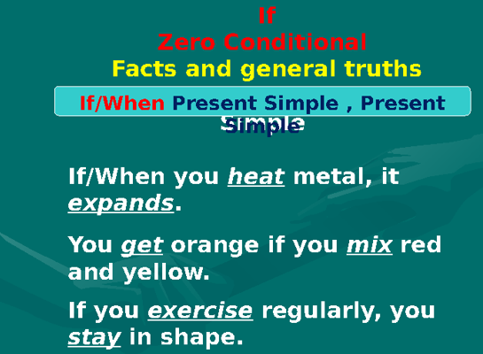

Slide 18
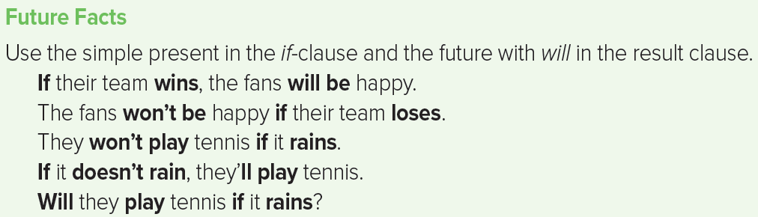
Page 47

Slide 19
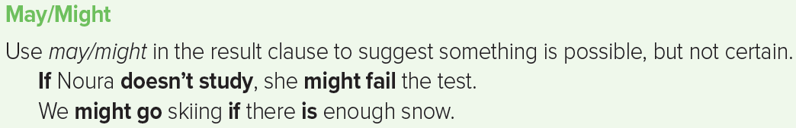
Page 47

Slide 20
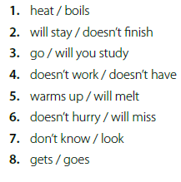
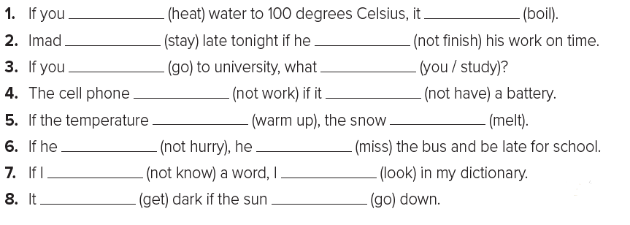
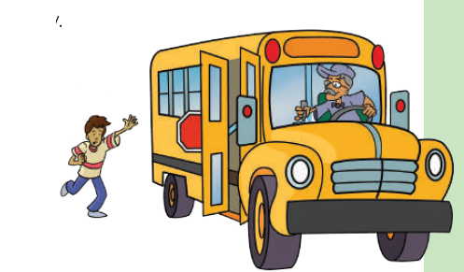
Page 47
heat
boils
will stay
doesn’t finish
go
will you study
doesn’t work
doesn’t have
warms up
will melt
doesn’t hurry
will miss
don’t know
look
gets
goes

Slide 21
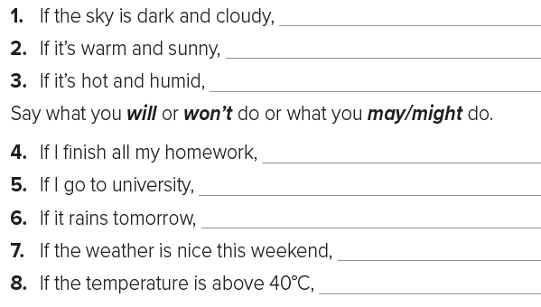
Page 47
If the sky is dark and cloudy, I feel tired and depressed.
If it’s warm and sunny, I’m in a lively mood.
If it’s hot and humid, I don’t feel very active.
If I finish all my homework, I might watch a film on TV.
If I go to university, I may study engineering.
If it rains tomorrow, I won’t walk home from school.
If the weather is nice this weekend, I may go
to the beach
If the temperature is above 40°C, I’ll turn on
the air conditioner

Slide 22


أتمنى الاهتمام بمتابعة الدروس في قتوات عين الرسمية من وزارة التعليم
T.Noureyah Alghamdi
The end

Slide 23
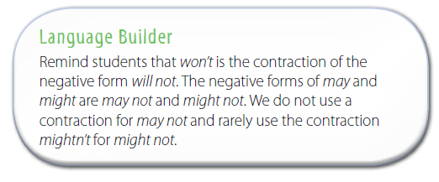

Slide 24

