Slide 1
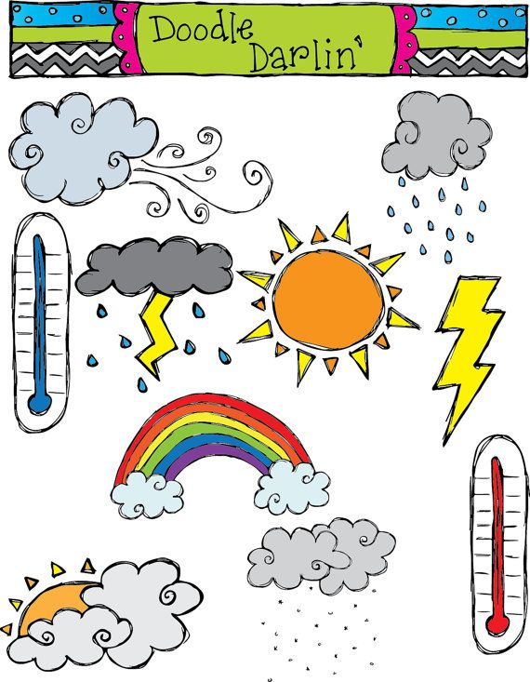
What is the weather like ?
Reading

Slide 2
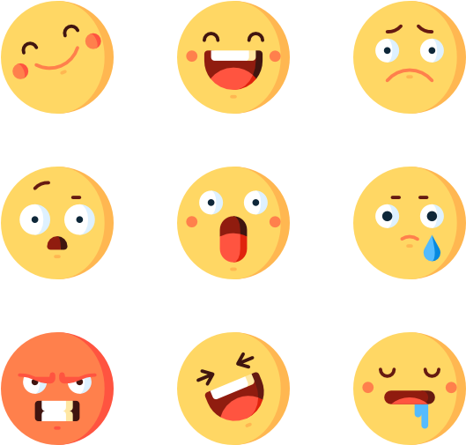
What’s your mood today?

Slide 3
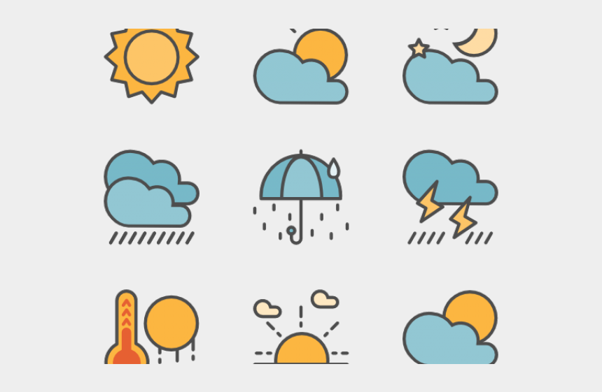
What is the weather like today ?
Does the weather change your feelings ?

Slide 4
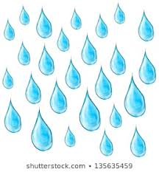
How do you feel when it’s raining?

Slide 5
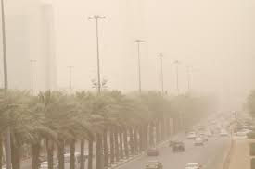
Which weather makes you bored/angry?

Slide 6
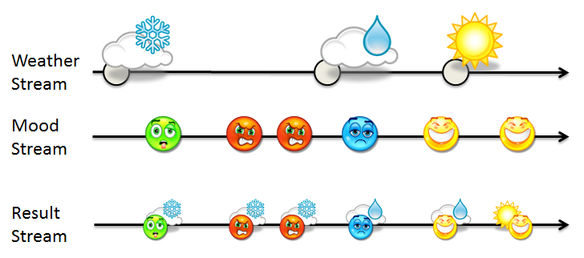

Slide 7
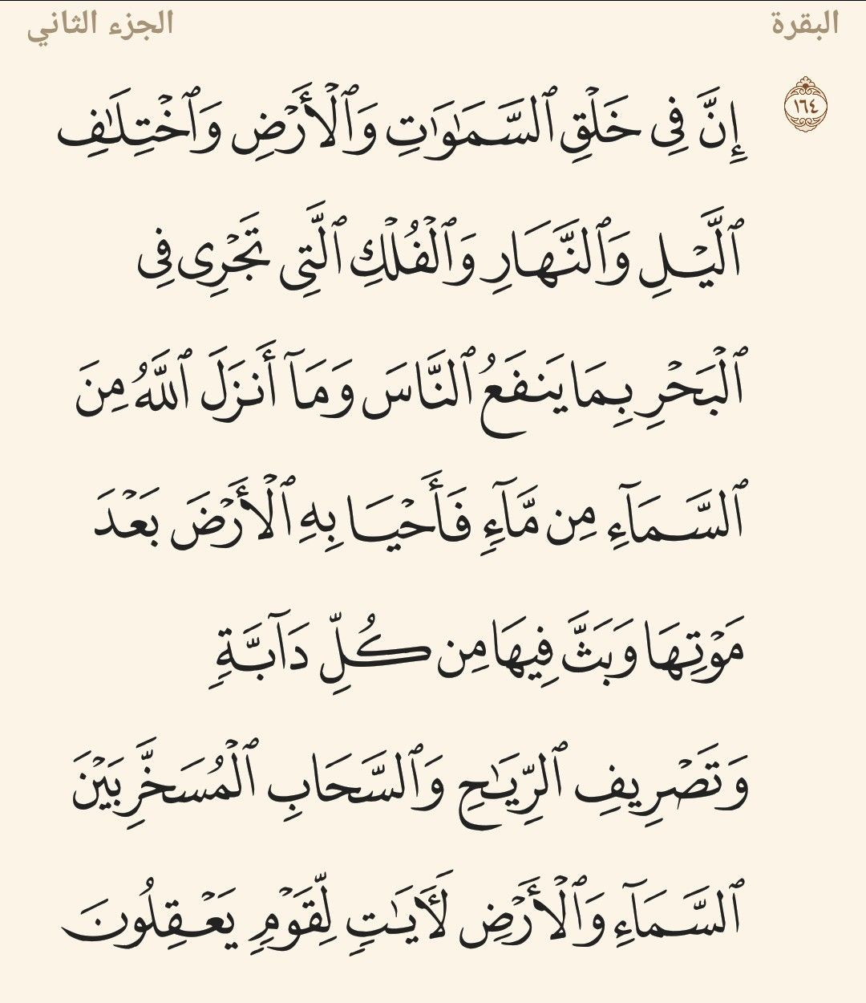

Slide 8
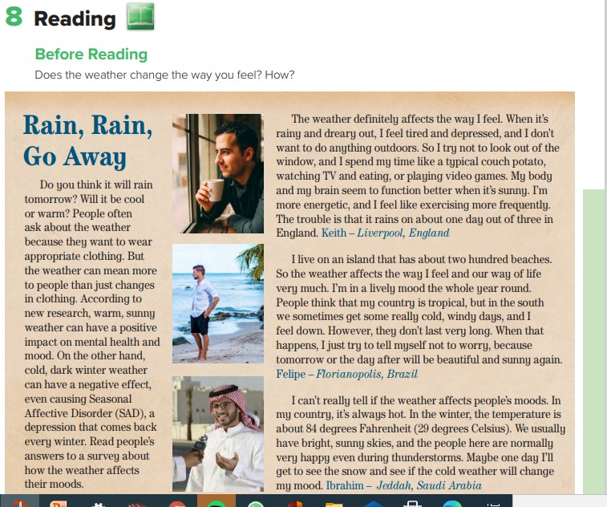
P 45

Slide 9
Objectives
Answer List questions about a text
List effects of weather on people
Practice Sentence formation

Slide 10
P 45

Slide 11
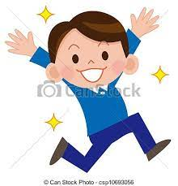
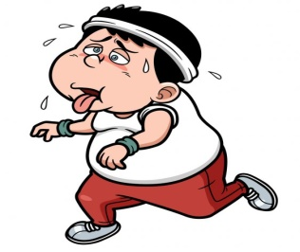
Warm up
depressed,
down,
energetic,
happy,
in a lively mood,
tired.
Can you elicit their meanings?
Do you ever have any of these feelings? When?

Slide 12
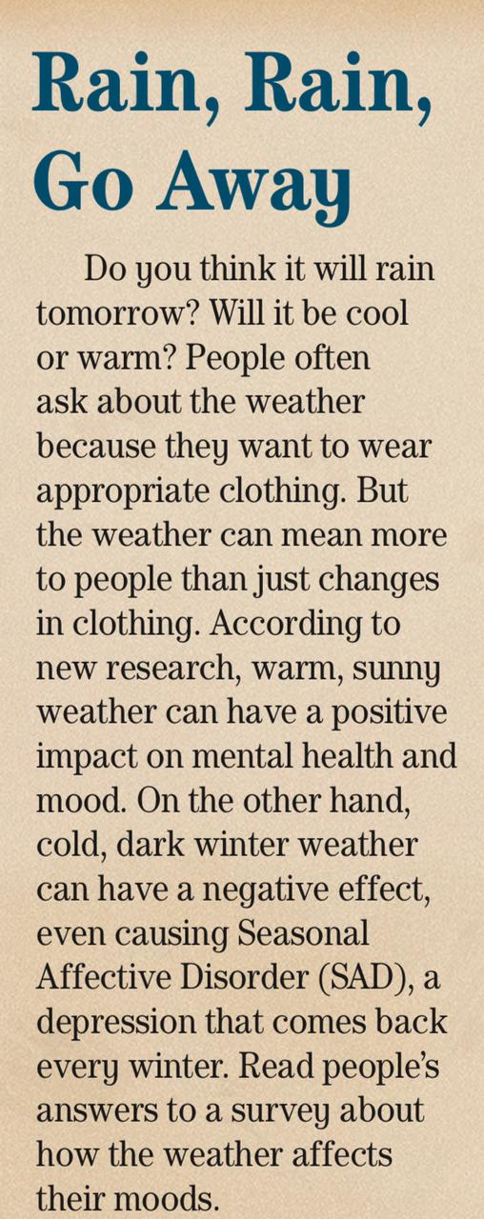
Does warm, sunny weather have a positive effect on mental health and mood?

Slide 13
When does Keith feel tired and depressed?
What does he do when it's rainy and gloomy?

Slide 14
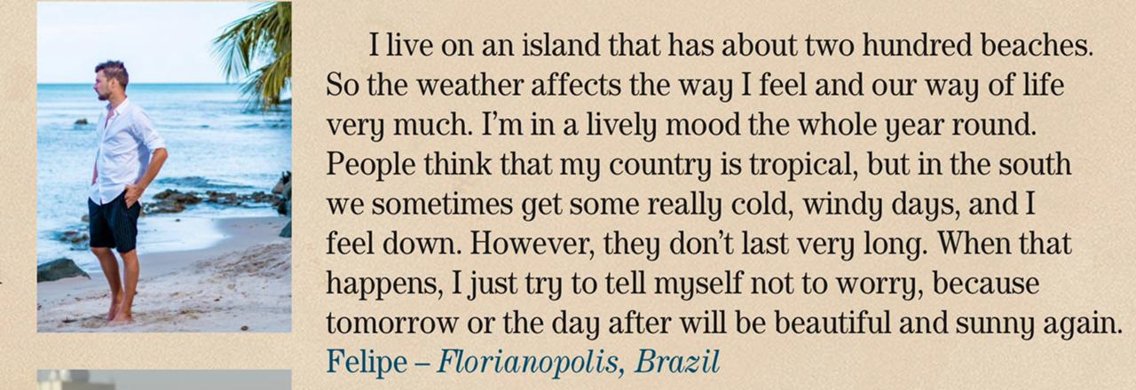
How do people who live on an island feel?

Slide 15
Describe the weather in Ibrahim's city.

Slide 17
He feels energetic and likes exercising more frequently.
He feels tired and depressed and
doesn’t want to do anything outdoors.
He’s in a lively mood.
He feels down.
The weather is always hot and
sunny, and people are normally happy.
He has never been in snow and cold
weather, so he doesn’t know their effect.

Slide 18
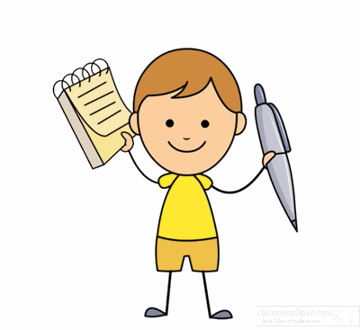
Your comments

