Slide 1


Slide 2







Today: Tuesday
Date:
11-9-1443 H
12th of April \ 2022
everyone,
How is everything going?

Slide 3
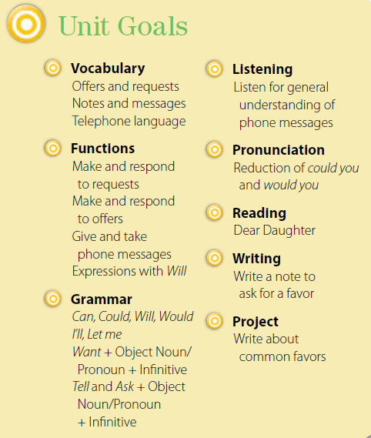

Slide 4
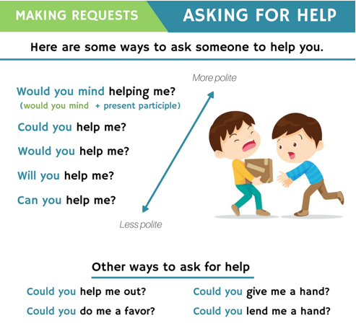

Slide 5


Do some favors for someone
Farah, could you open the door for me?
Alaa, would you give me a pen please?
Sara, can you help me? I want to move my desk.
Rana, will you erase the board please?
☻sharpen my pencil, put the books
, throw this paper away , and hand out these papers

Slide 6



☺
♥
Make and respond to offers
Make and respond to requests
..

Slide 7


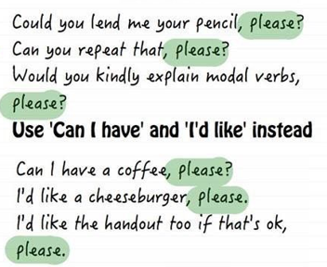




Slide 8

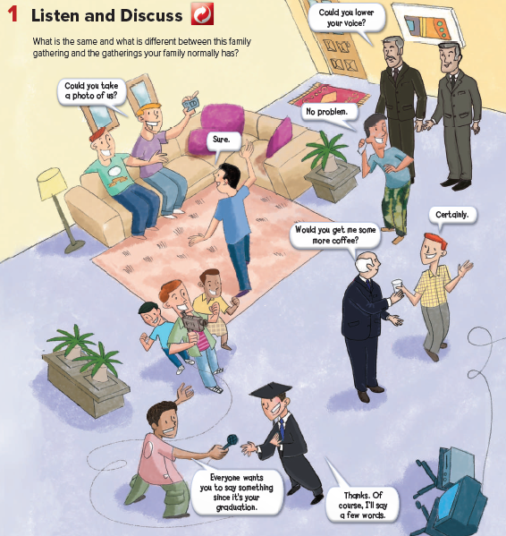



Page 48
What can you see?
Where are these people?
What items you can see
This boy wants the
other boy to take
a picture of him alone.
(False).

Slide 9
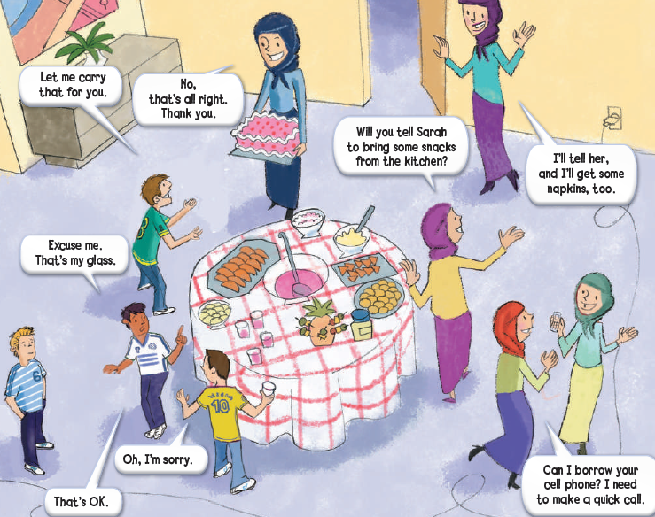
Page 49

Slide 10
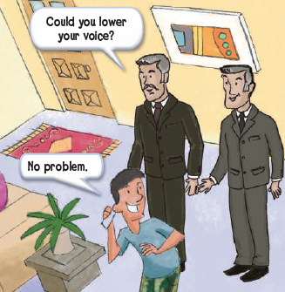

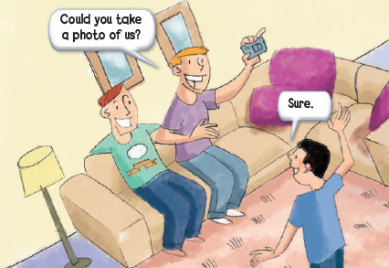
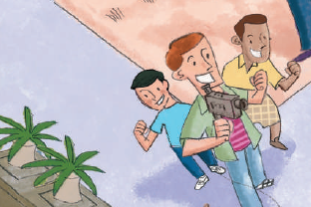
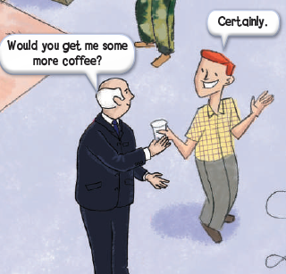
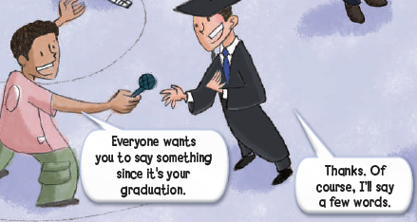
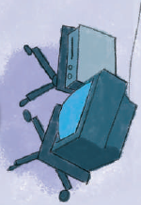
Page 48

Slide 11

☻
The thing drops near your foot.
What should one of you say?
Let me get that for you, and some one will pick it up.
Page 49
Requests
Could you take a photo of us?
Would you get me some more coffee?
Will you tell Sarah to bring some snacks from the kitchen?
Everyone wants you to say something since it’s your graduation.
Could you lower your voice?
Can I borrow your cell phone?
Offers
Let me carry that for you.
I’ll tell her, and I’ll get some napkins, too.

Slide 12
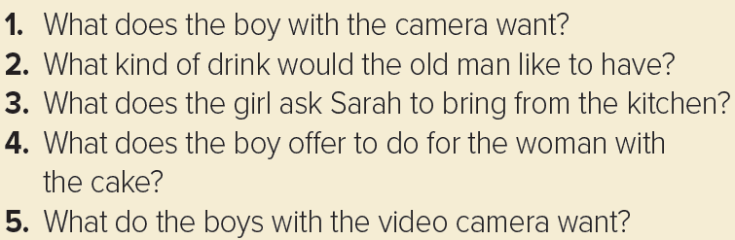
Page 49
1. He wants the boy to take a picture of him with his friend.
2. He’d like to have some coffee.
3. She wants her to bring some snacks from the kitchen.
4. He offers to carry the cake.
5. They want the boy to say something since it’s his graduation.

Slide 13




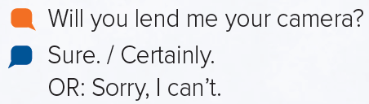


Page 49
Will you get me something to eat?
how to refuse as well as accept an offer.
No, thanks and That’s OK, I don’t want any as

Slide 14
request
Could you do me a favor
هل يمكنك ان تسدي لي معروفا
offer
Let me clean it for you
دعيني انظفها عنك
request
Will you tell Salma to set the table please
هلا يمكن ان تخبري سلمى ان تجهز الطاوله من فضلك
Let me take you a photo
هل اخذ لكم صوره
offer

Slide 15








Assign page 111 for practice read and draw.
Ex A and B

Slide 16




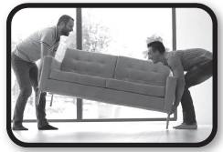




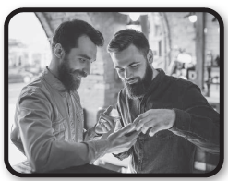


Page 111
Could you take a photo of me?
Let me help you carry that.
Of course, I’ll say a few words.
Can I borrow your cell phone?
I’ll tell her.

Slide 17

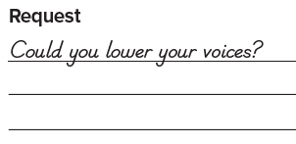
Page 111
Let me help you carry that.
Of course, I’ll say a few words?
Can I borrow your cell phone?
I’ll tell her.

Slide 18



Slide 19

