Slide 1





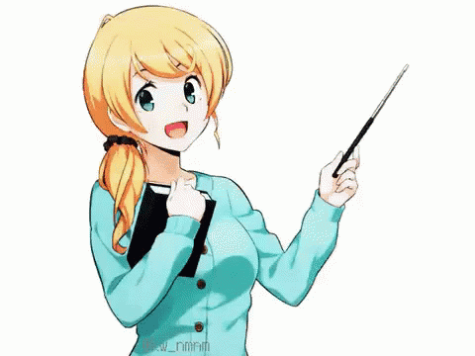

Today: Sunday
Date:
16-9-1443 H
17th of April \ 2022
everyone,
How is everything going?

Slide 2
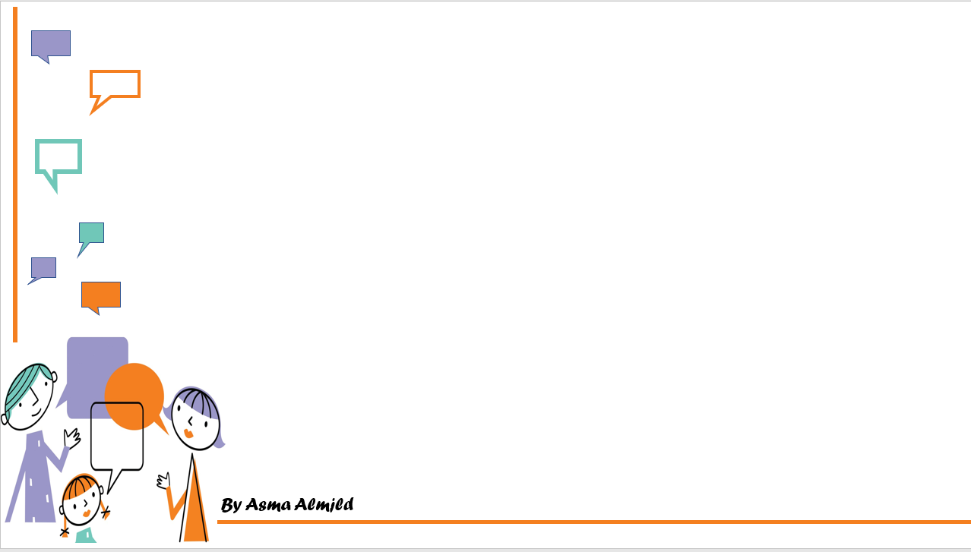
Could You Do Me a Favor ?
conversation

Slide 3
Objectives
Read the conversation correctly
Answer the question in the book

Slide 4
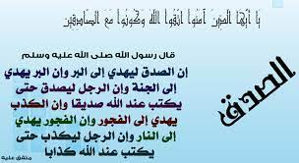

Slide 5

How can people communicate in the past ?

Slide 6

Name five ways that you can connect with your friends by?

Slide 7
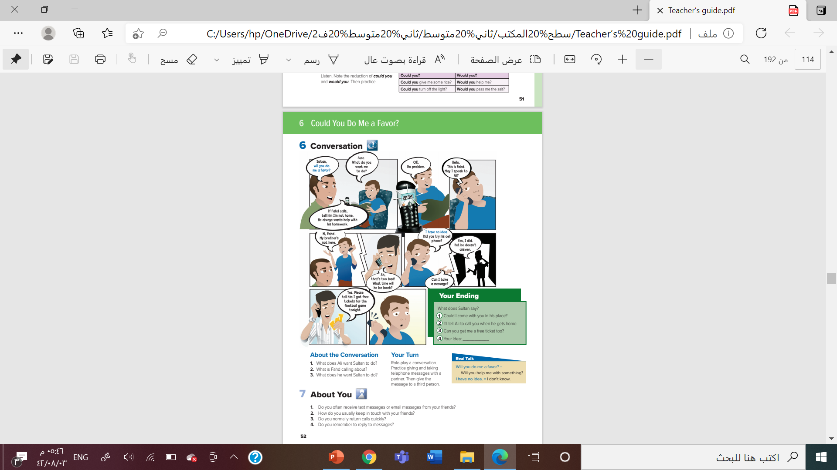

How many characters in this conversation?
What is the relationship between the two boys in the first picture?
What is the relationship between Ali and Fahd?
@page 52

Slide 8

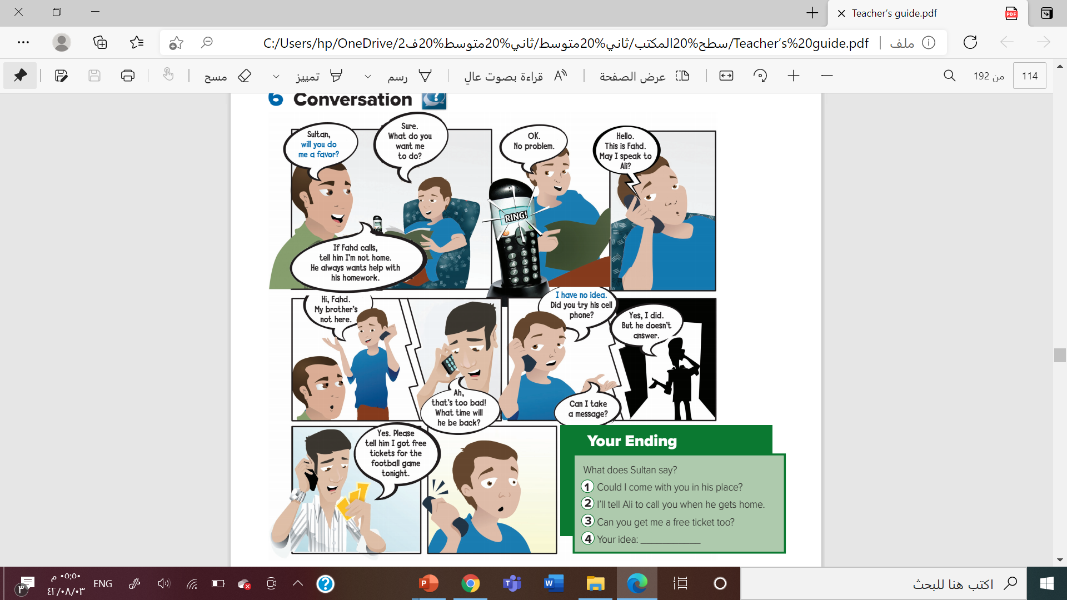


Slide 9
Why is Fahd calling?
Why do you think Ali doesn’t want to talk to Fahd?
Was it right for Ali to ask his brother to lie for him?
Do you think Ali will regret that he didn’t speak to Fahd?
Do you think Ali would be happy about what Sultan says?

Slide 10
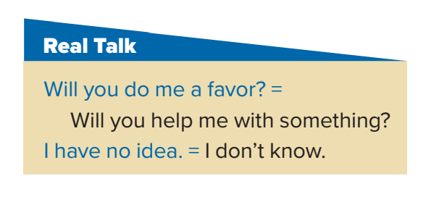
Who says Will you do me a favor?
Why does Ali say it?
What is Sultan’s response to the question?
What could Sultan say if he is not sure he will do the favor?

Slide 11
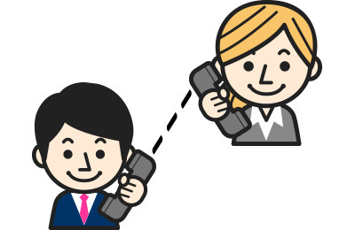
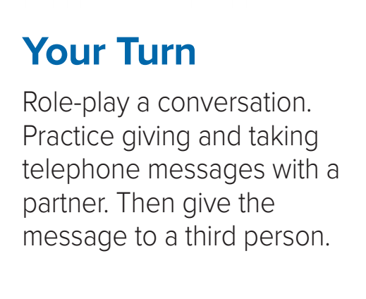
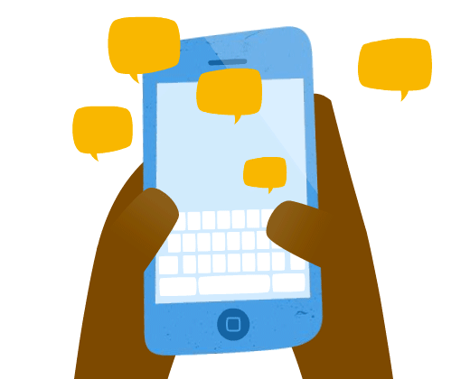

Slide 12
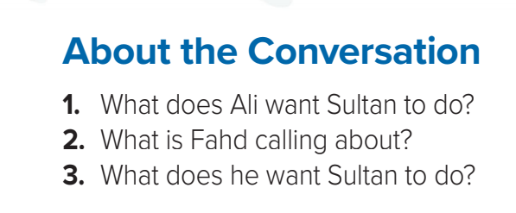
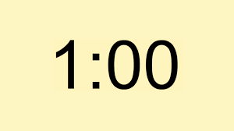
1. Ali wants Sultan to tell Fahd that he isn’t home if Fahd calls
2. He’s calling to tell Ali that he has free tickets to a football game
3. He wants Sultan to tell Ali about the free tickets

Slide 13
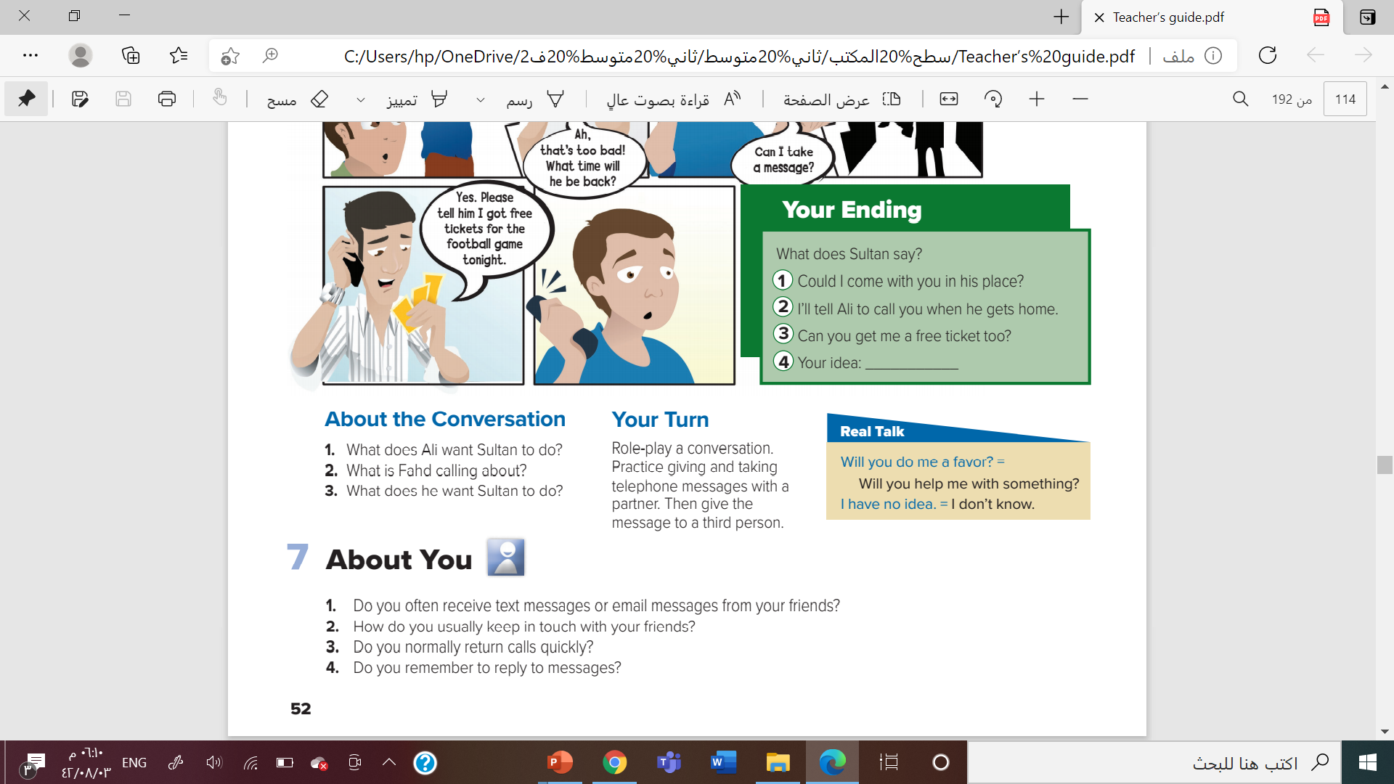
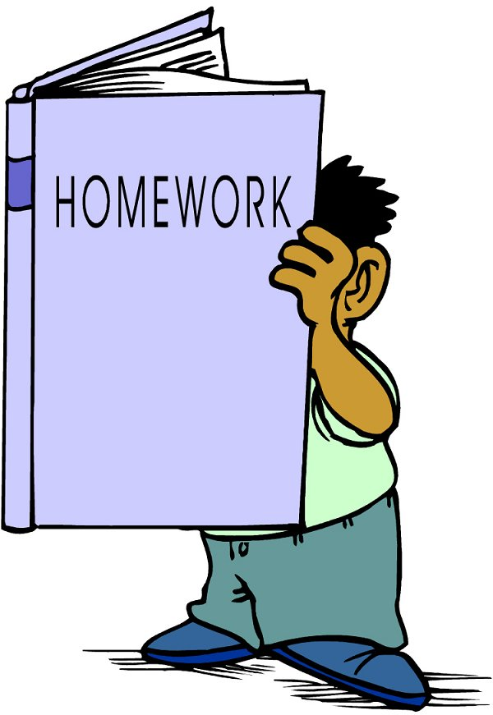


Slide 15


