Slide 1
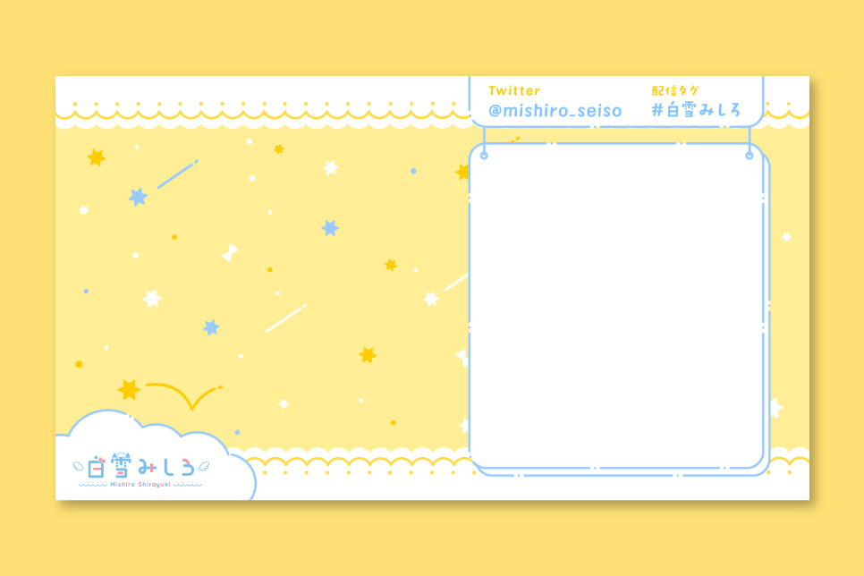
SUPER GOAL 4
UNIT 6
COULD YOU DO ME A FAVOR?
L9: WRITING & PROJECT
P: 54
ET: NJOUD

Slide 2


Slide 3

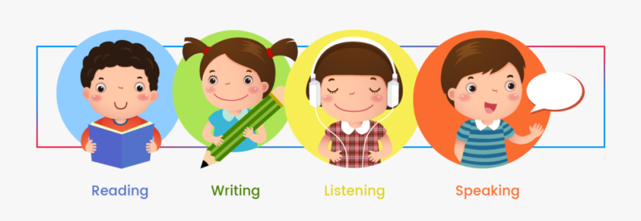

Slide 4


LEARNING OBJECTIVES
write a note to ask about a favor
Practice thanking someone for doing a favor
Write about common favors
Practice the use of "please"
Practice how to apologize

Slide 5



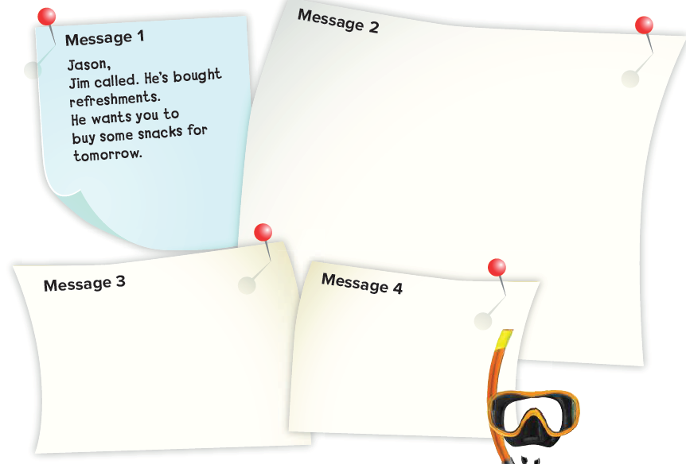
Page 54
Jason,
Andy called. He wants you to pick him up at 8 a.m. His address is 27 Park Drive. Go south on Main St. At the lights, turn right onto 10th Ave. Then turn left onto the second street. It’s the blue house on the right.
Jason,
Charles called. He wants you to bring another pair of flippers and an extra mask tomorrow.
John called. He wants you to bring your brother’s
volleyball net tomorrow.

Slide 6



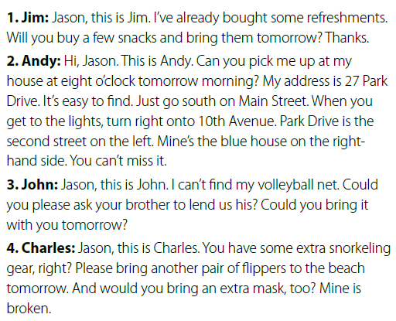

Page 51

Slide 7
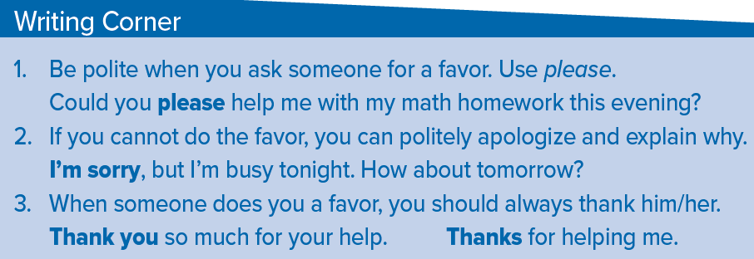
Page 54
It’s important to use the word please when asking people for a favor.
It is also important to say thank you to show your appreciation when someone does you a favor. Elicit from students the common response to thank you. (You’re welcome.)

Slide 8
Page 54
accept, and ask for a favor
A:Could you please hold my book for me?
B:Thank you for your help.
refuse, and ask another favor
A:Could you please help me fill the markers after class?
B:I’m sorry, but I’m busy. Maybe tomorrow.

Slide 9

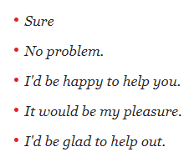

Page 54
May I use your telephone?
I lost mine.
Can I borrow your pen, please?
I forget mine.
Could you lend me 50 SAR please?
May I use your computer tonight?
Can I borrow some money, please?

Slide 10

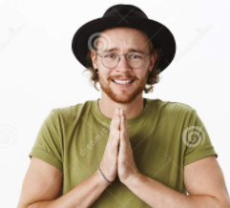

Page 54
Will you lend me your notes?
Could you stop at the supermarket after work?
Please buy some milk.

Slide 11
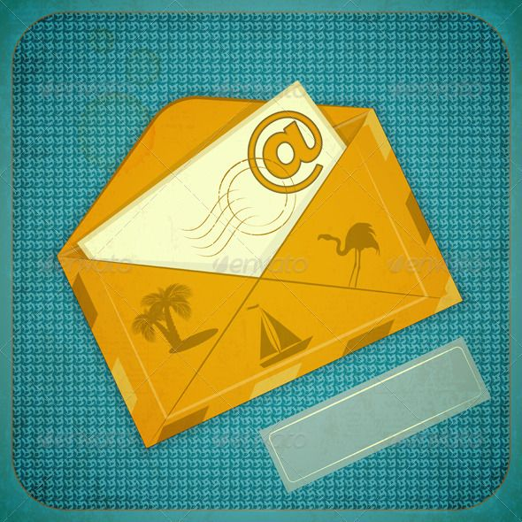

Assign page 114 for practice writing Ex H

Slide 12


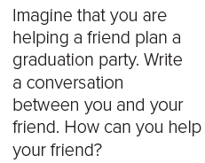
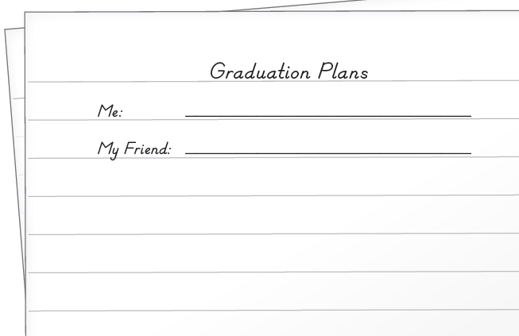
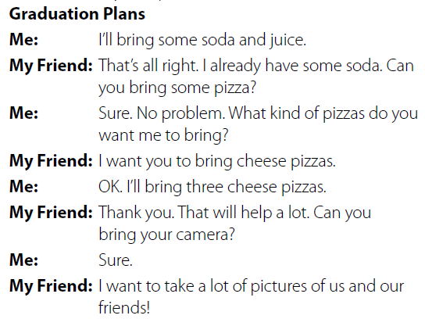
Page 114

Slide 13


