Slide 1
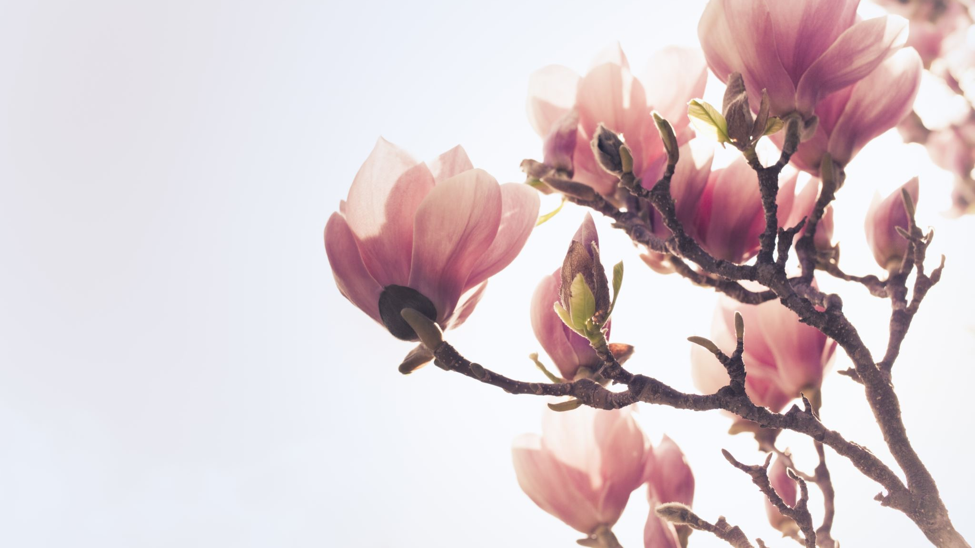
Unit 14 writing
Page:128

Slide 2
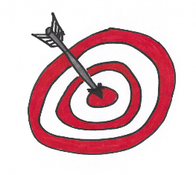
Write a note to ask about a favor
Write about common favors
Practice the use of please
Practice how to apologize
Practice thanking for doing a favor

Slide 3
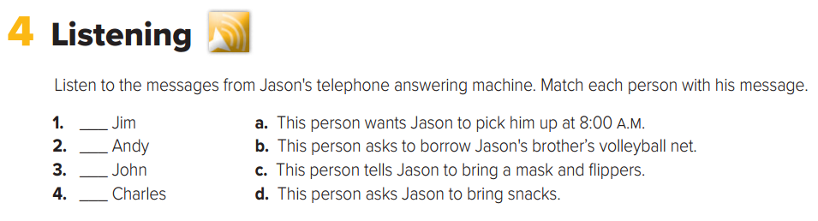



Slide 4
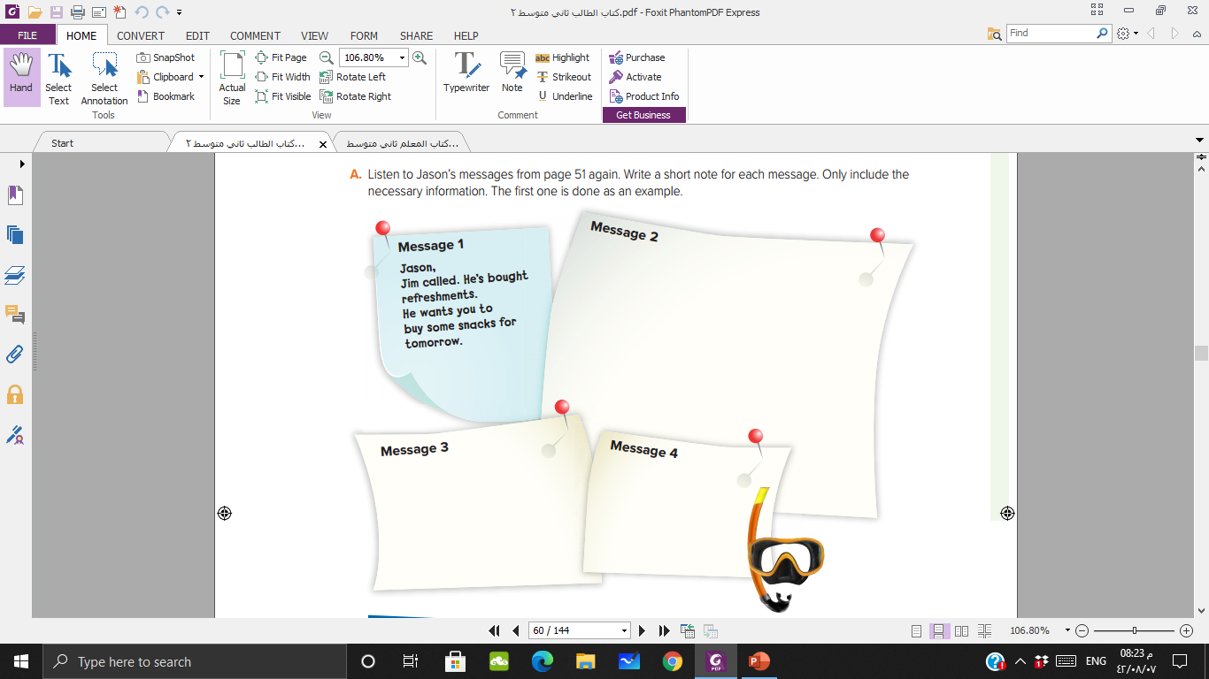
Andy called. He wants you to pick him up at 8 a.m. His address is 27 Park Drive. Go south on Main St. At the lights, turn right onto 10th Ave. Then turn left onto the second street. It’s the
blue house on the right.
John called. He wants you to bring your brother’s volleyball net tomorrow.
Charles called. He wants you to bring another pair of flippers and an extra mask tomorrow.

Slide 5


Slide 6
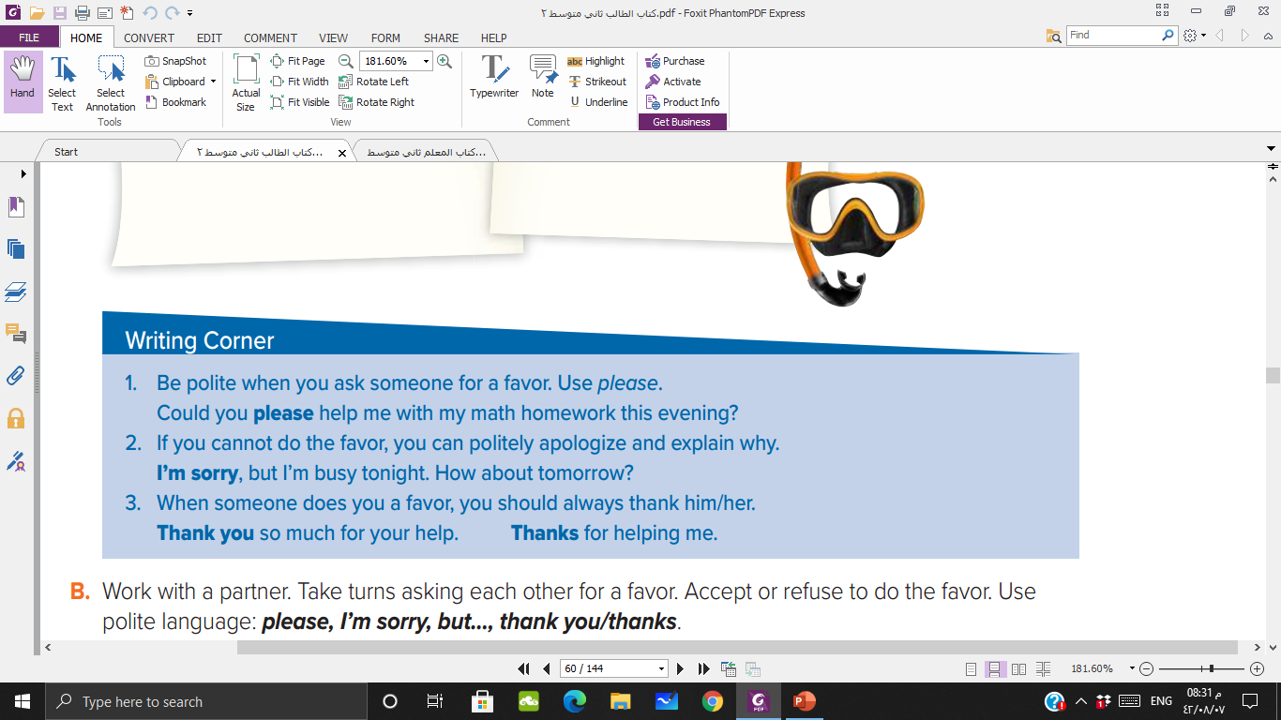

Slide 7
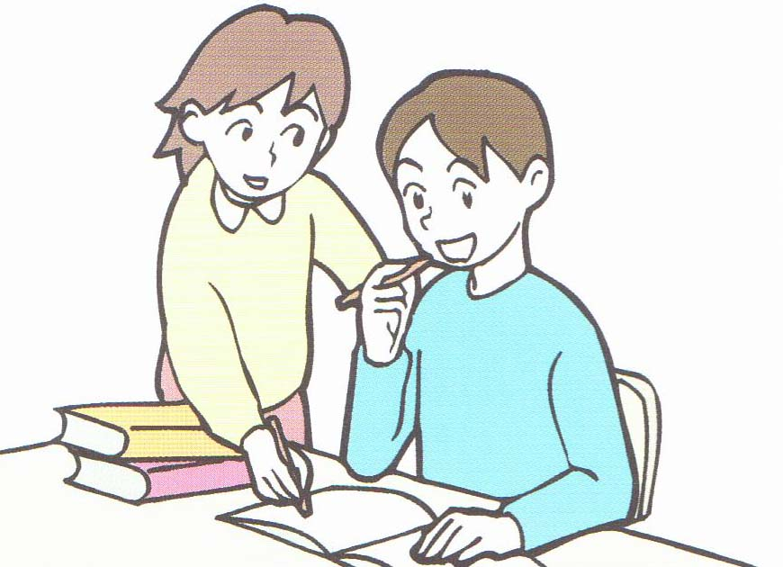
Sure, I can
Could you please help me in this math homework?
Thank you so much for your help

Slide 8
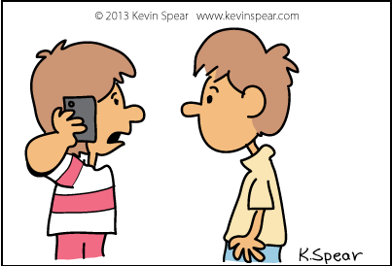
Of course
Could I use your phone please?
Thank you. You are very kind

Slide 9
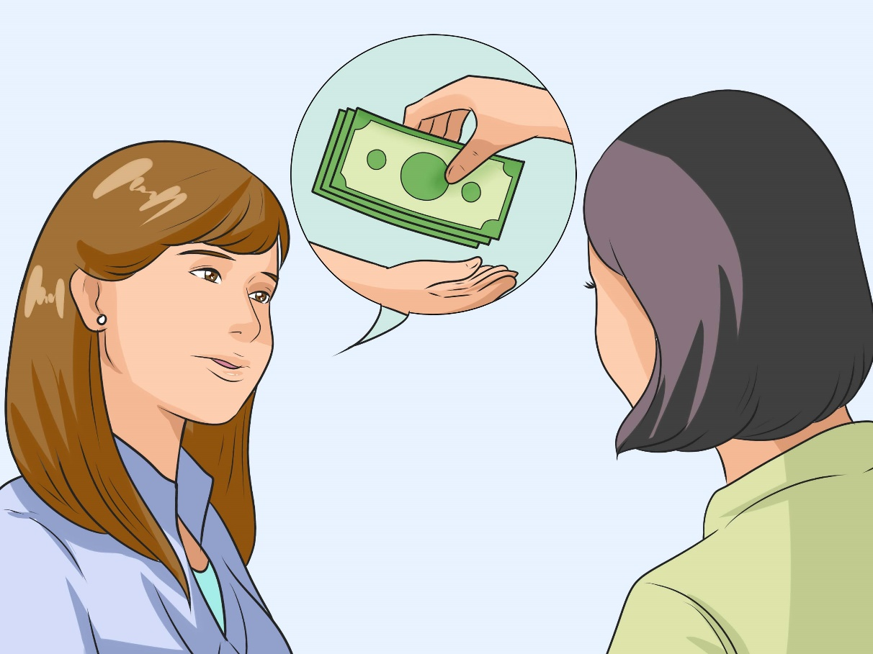
I’m sorry. I can’t
Can you lend me some money?

Slide 10
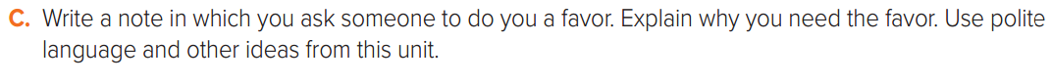

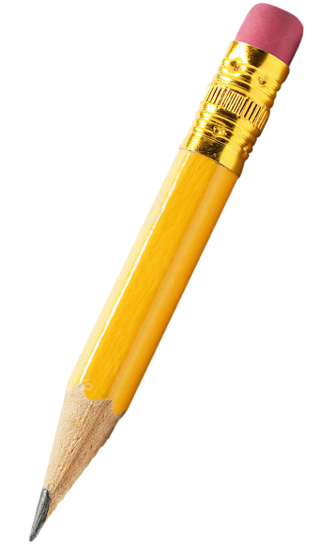

Slide 11


