Slide 1

UNIT 14
Form, meaning and function
Page : 129

Slide 2


Slide 3

Practice the functions of “will”

Slide 4

Request
Offer
Promise
Threat
Refusal
Deduction
Instant decision
Farewell
Usage of will

Slide 5


Will you help me?

Slide 6


I’ll help you carry that

Slide 7


I’ll be careful. I won’t do that again

Slide 8


Stop do that or I’ll tell your mother

Slide 9


She won’t listen to me

Slide 10

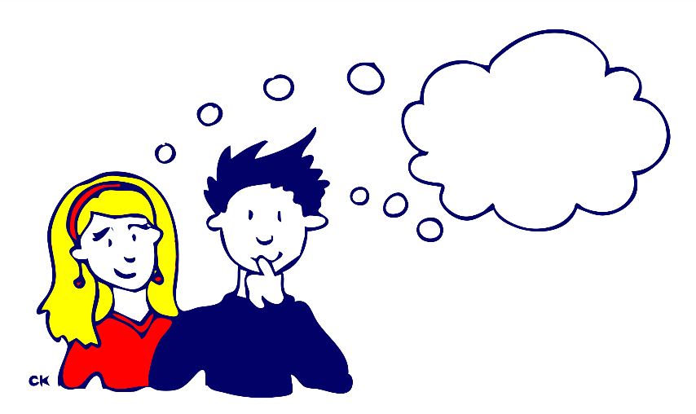
I suppose it will be a formal event

Slide 11


I’ll wear my blue dress

Slide 12


I’ll see you tomorrow

Slide 13
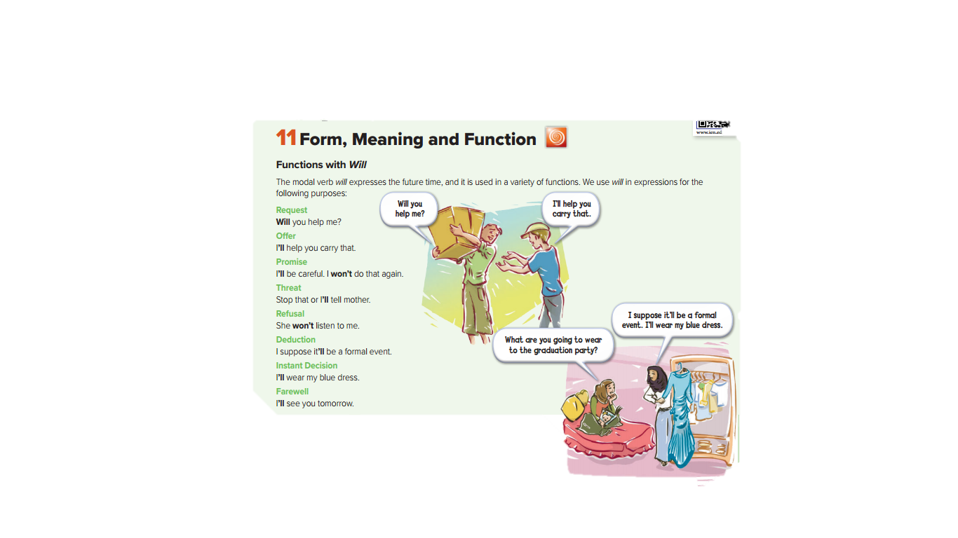

Slide 14
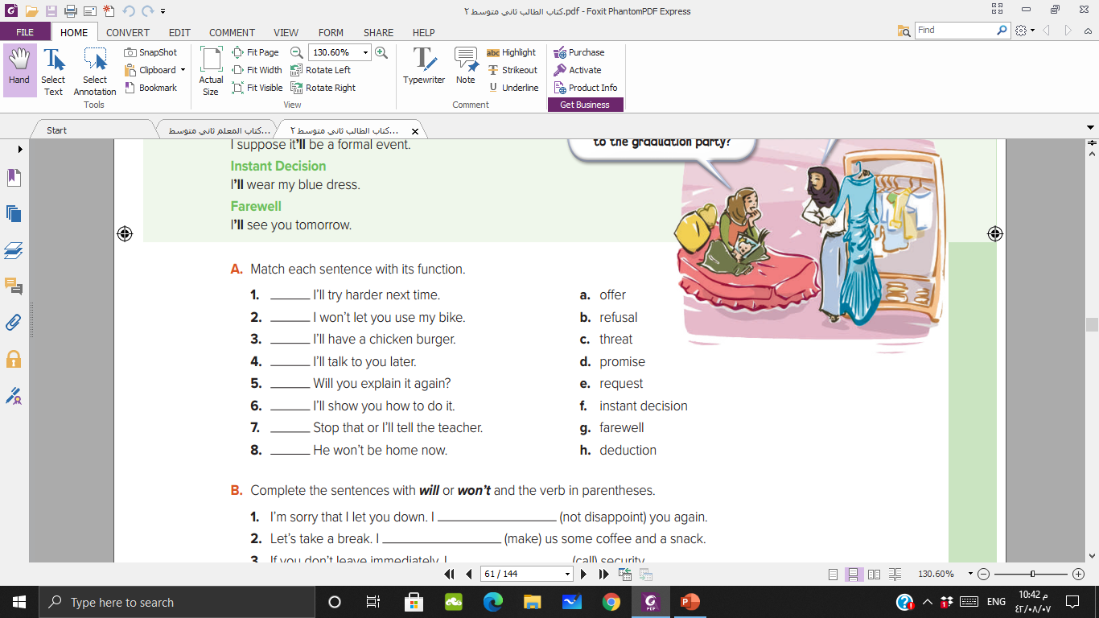
d
b
f
g
e
a
c
h

Slide 15
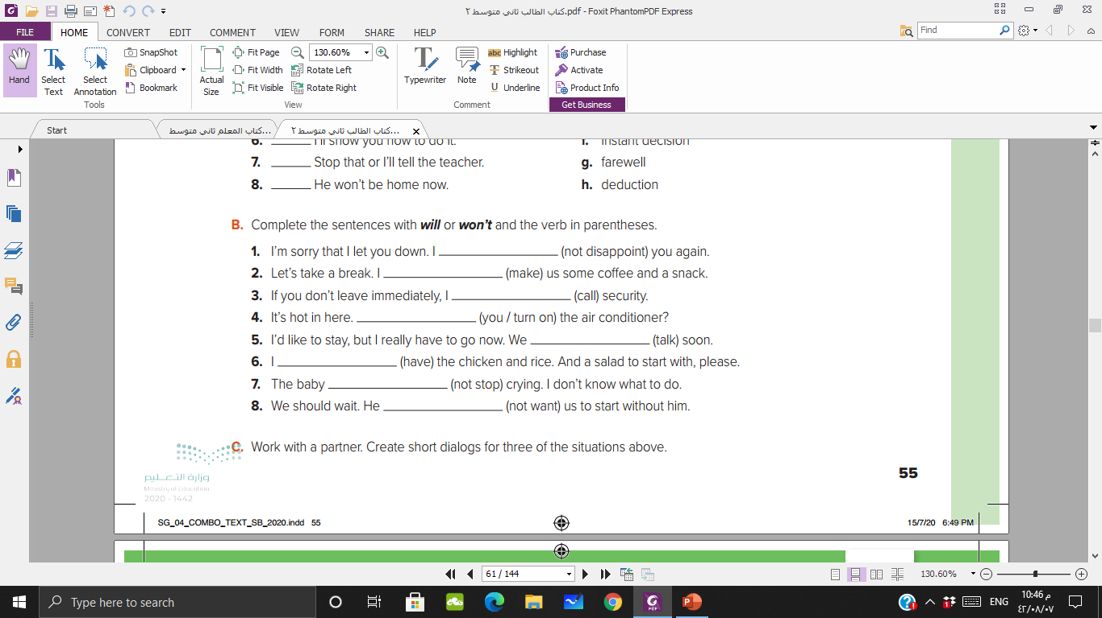
won’t disappoint
will make
will call
Will you turn on
will talk
will have
won’t stop
won’t want

Slide 16

Use “will” to finish the lesson and leave the class

Slide 17


