Slide 1
Unit 14 Could you do me a favor?

Slide 2
Make and respond to the requests
Make and respond to the offers

Slide 3
Pleas do me a favor, Smile!

Slide 4
Where are the people?
In a family house

Slide 5
Name the items you can see
Camera
Cell phone
Cake
Video camera
TV

Slide 8
What is the boy doing? Why?
Notes:
1- He is giving his camera to a boy, because he wants him to take a picture of them

Slide 9
What is the man holding?
What does he want?
Notes:
1- An empty glass
2- he wants the boy to get him some coffee

Slide 10
What is the boy doing?
Why are the men annoyed?
Notes:
1- He is talking on his cellphone
2- he is talking very loudly

Slide 11
Why is he giving the microphone to the boy?
Notes:
1- he wants him to speak since it’s his graduation

Slide 12
What is the girl carrying?
What does the boy want to do?
Notes:
1- a cake
2- he wants to help her carry the cake

Slide 13
What are the girls doing?
What does one girl want the other to do?
Notes:
1- getting the food ready to eat
2- tell Sarah to bring snacks

Slide 14
What is one of the boys going to do?
What’s the problem?
Notes:
1- take a drink
2- he has somebody else’s glass

Slide 15
What’s the girl with the phone in her hand doing?
What does the other girl want?
Notes:
1- texting or talking on the phone
2- she wants to use the phone

Slide 16
Request
Could / can
Would / will
Offer
Let me
I will

Slide 18
1- He wants the boy to take a picture of him with his friend.
2- He’d like to have some coffee
3- She wants her to bring some snacks from the kitchen.
4- He offers to carry the cake.
5- hey want the boy to say something since it’s his graduation.

Slide 19
I will protect Saudi Arabia.

Slide 20
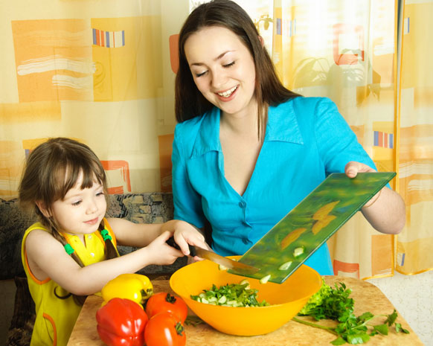
Can you help me?

Slide 22
Homework

