Slide 1

Unit 7 Grammar
Tr. Nora Khalid

Slide 2

Use past progressive in sentences and questions
Link pictures to conversation
Combine longer action with shorter one using “when”
Practice syllables stress

Slide 3
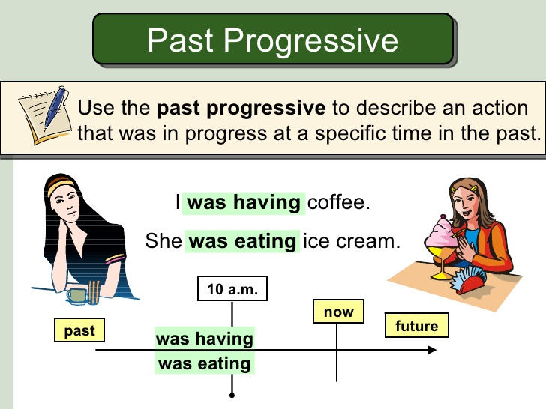

Slide 4
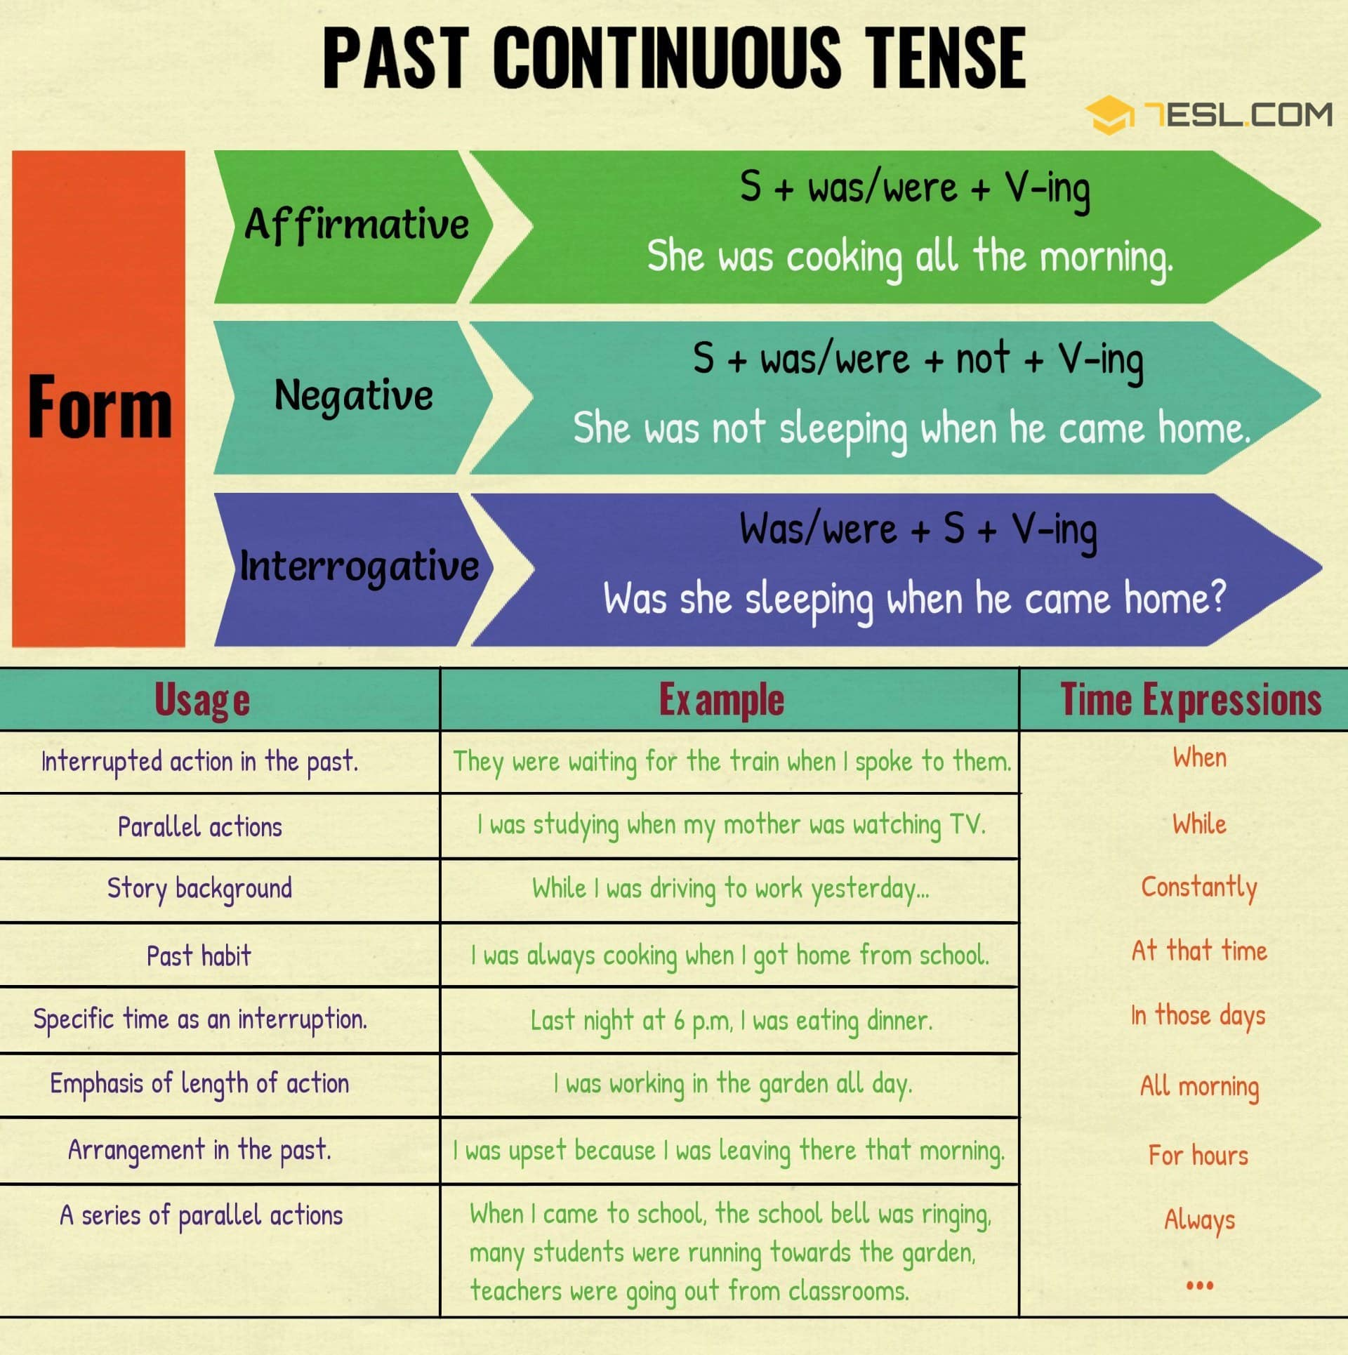

Slide 5
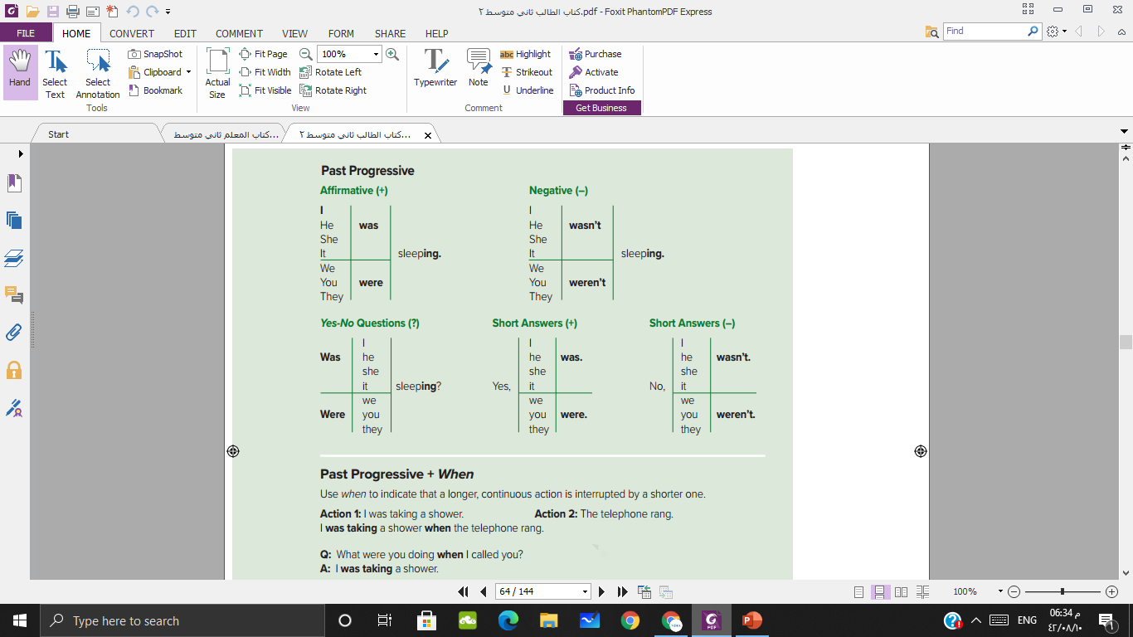

Slide 6
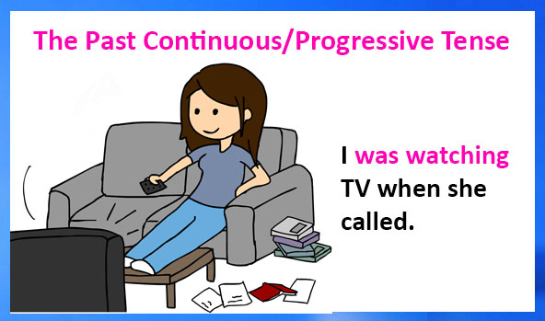

Slide 7
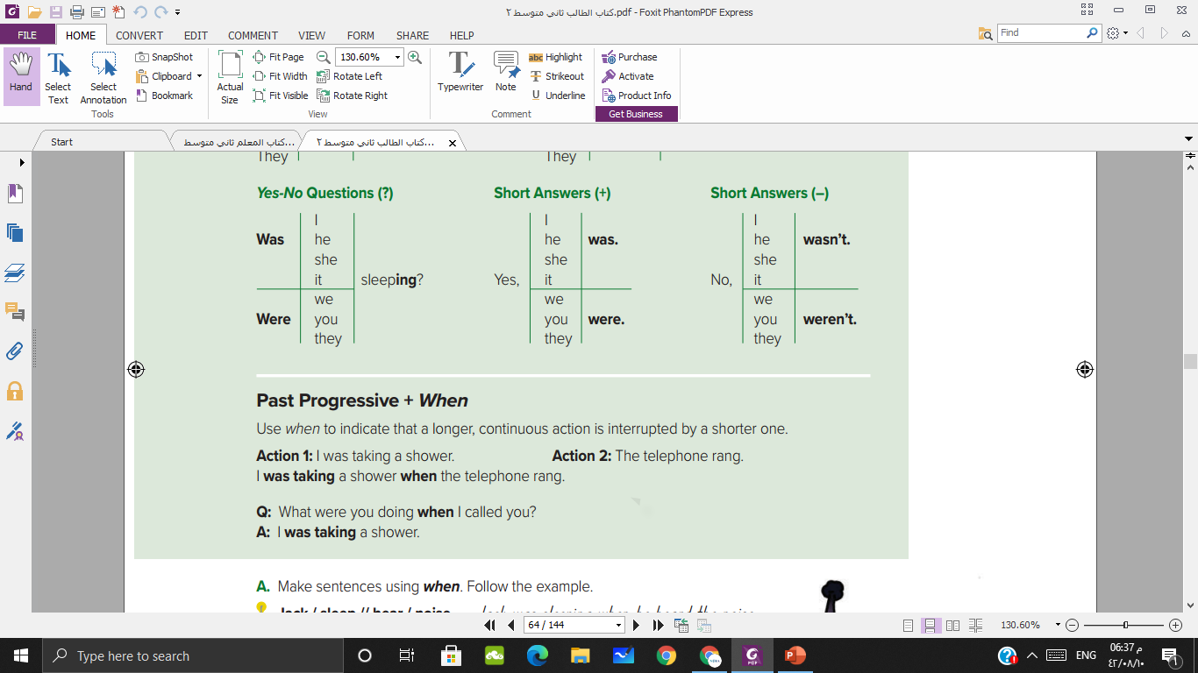

Slide 8
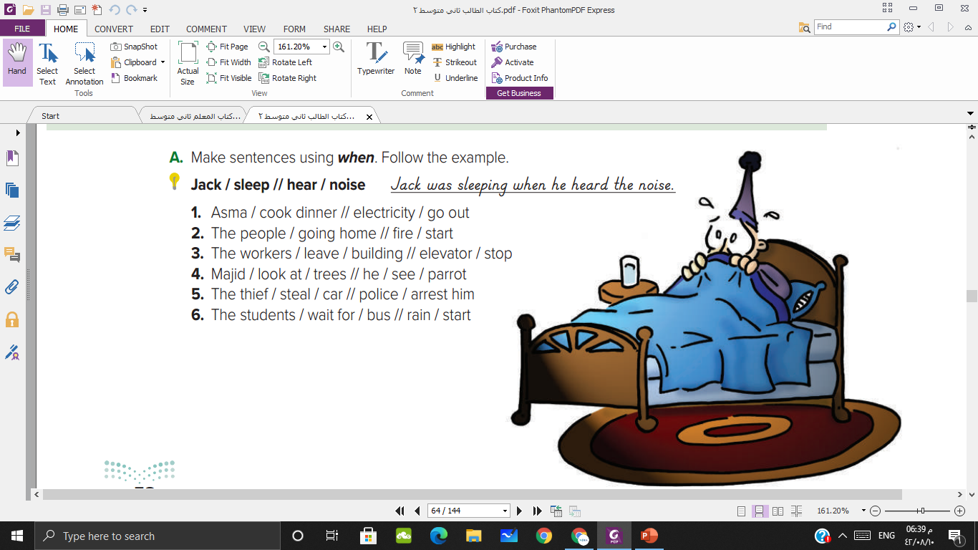
Asma was cooking dinner when the electricity went out.
The people were going home when the fire started.
The workers were leaving the building when the elevator stopped.
Majid was looking at streets when he saw a parrot.
The thief was stealing a car when the police arrested him.
The student was waiting for a bus when the rain started.

Slide 9
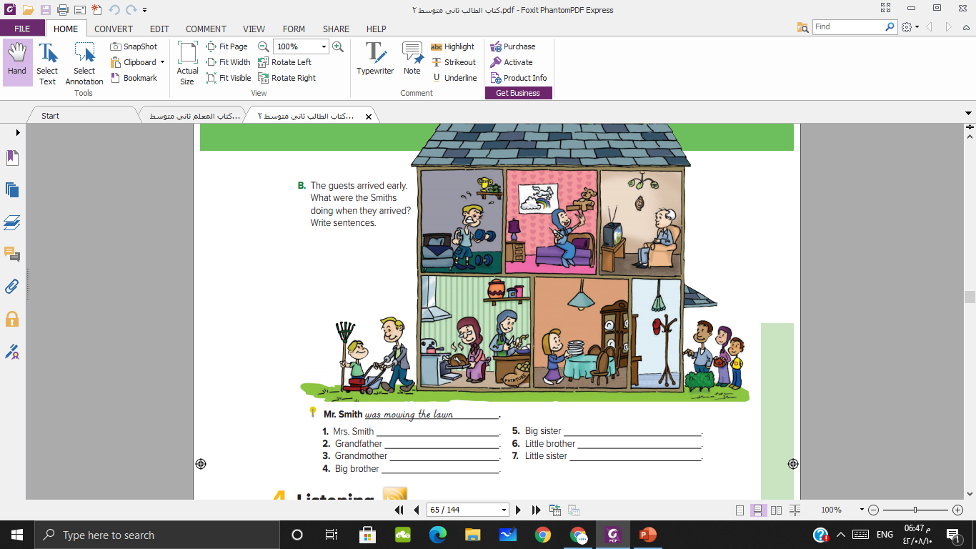
was talking on the phone.
was peeling potatoes.
was watching TV.
was working in the yard
was cooking a turkey.
was setting the table.
was lifting weights

Slide 10
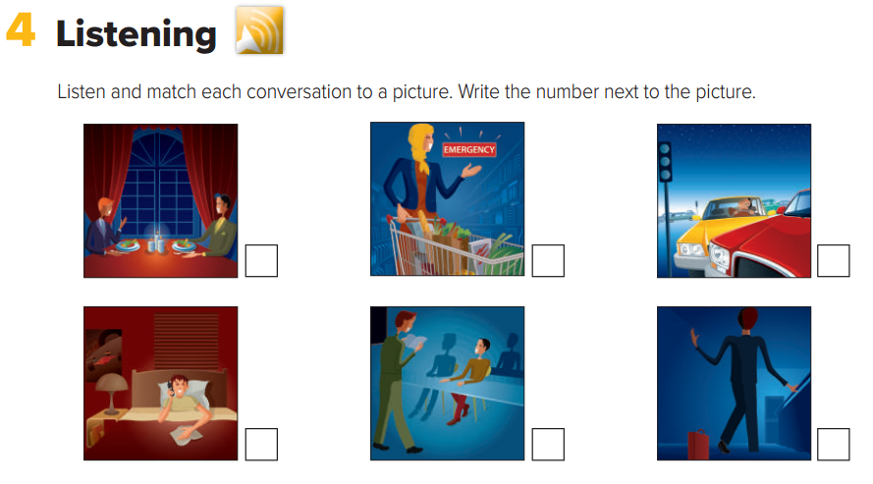

2
5
4
1
6
3

Slide 11
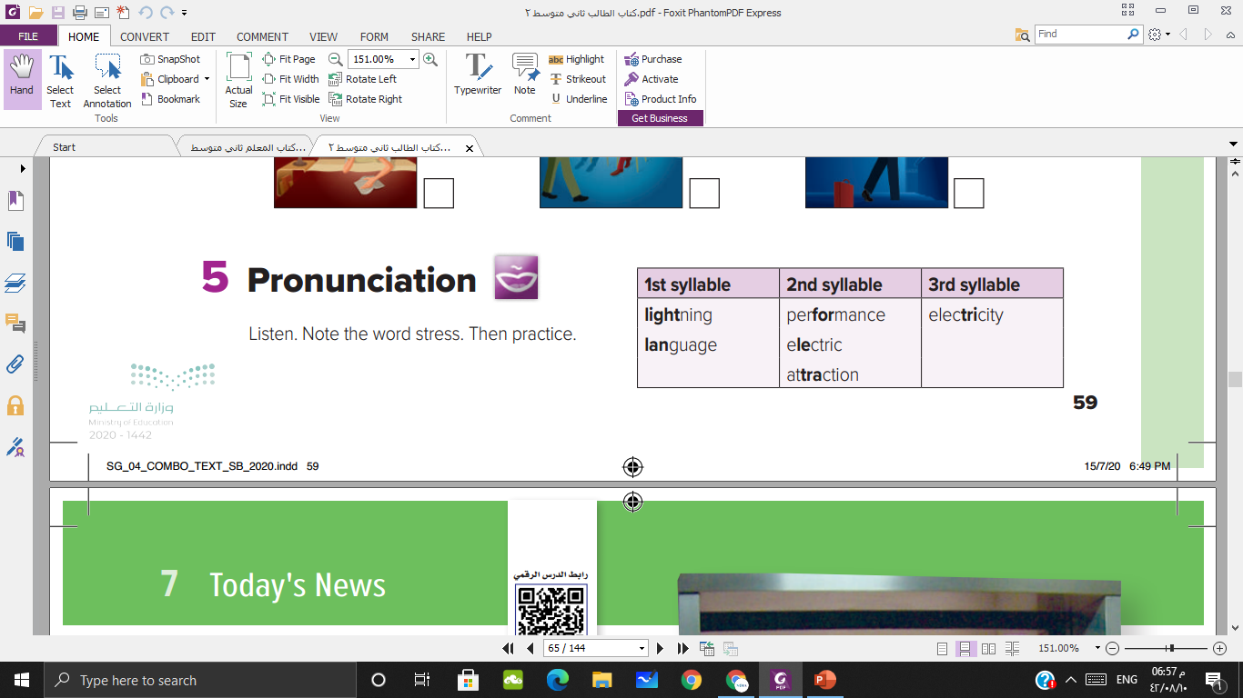

Slide 12



Slide 13

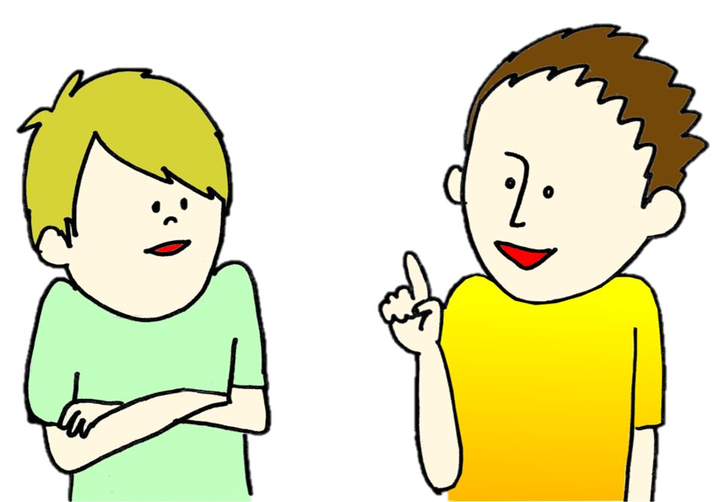





1
6
2
7
⇒
3
8
4
9
5
10
tekhnologic
She was …… eating when her friend arrives
( was – were )
We …… leaving the house when the telephone rung
( was – were )
I was studying when my mother …….
( calling – called )
( Was – Were ) he taking a test?
( Was – Were ) they doing their homework?
They / swim / rain / start
Nada / sleep / the father / call
Was he …… ( sleeping – slept )?
Was he sleeping?
Yes, ………………..
Were you studying?
No, ….………………..

Slide 14
