Slide 1


Slide 2

Monday 11/10/1444 H
Talk about news
Listen and comprehend short stories
Answer activates about the lesson
Pg. 130

Slide 3
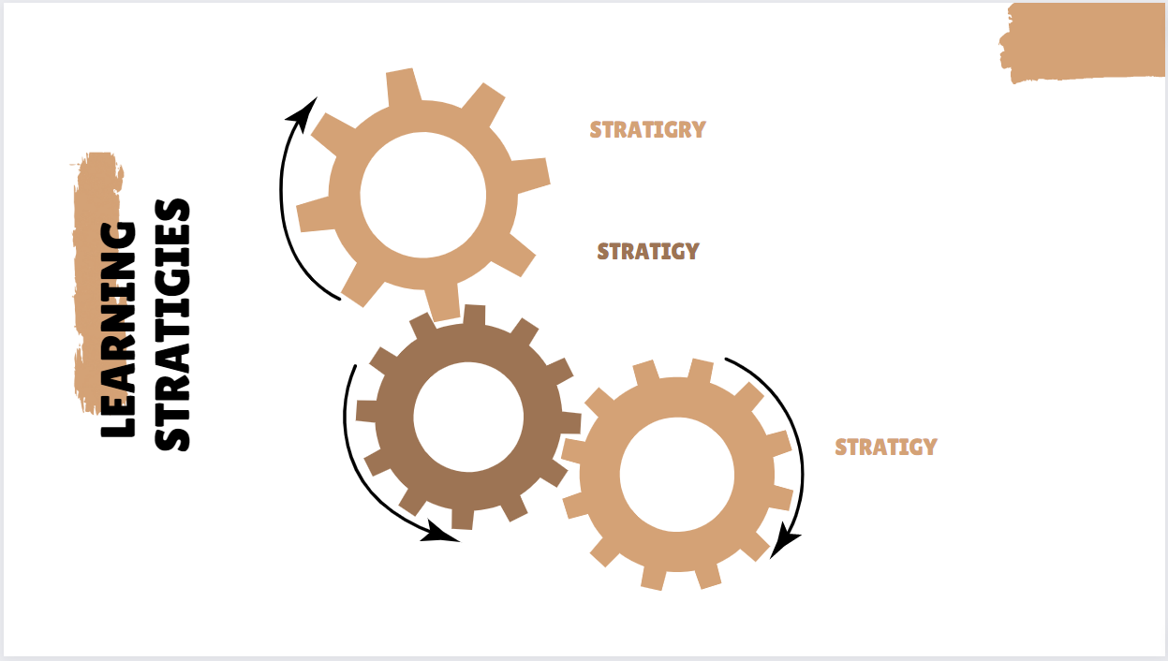
Monday 11/10/1444 H
Active discussion
Heads together
I- partner
Pg. 130

Slide 4

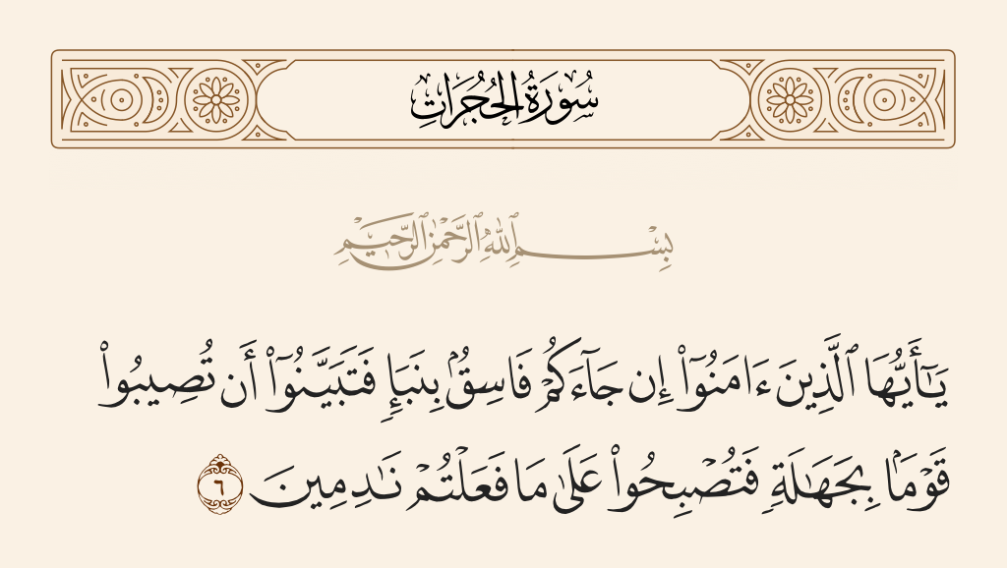
Monday 11/10/1444 H
Pg. 130

Slide 5

Monday 11/10/1444 H
Listen and discuses
Have you ever heard or read an unusual piece of news ?
1- How interested are you in the news?
2- How do you get the news?
Pg. 130

Slide 6

Monday 11/10/1444 H
Talk about news
Listen and comprehend short stories
Answer activates about the lesson
Pg. 130

Slide 7
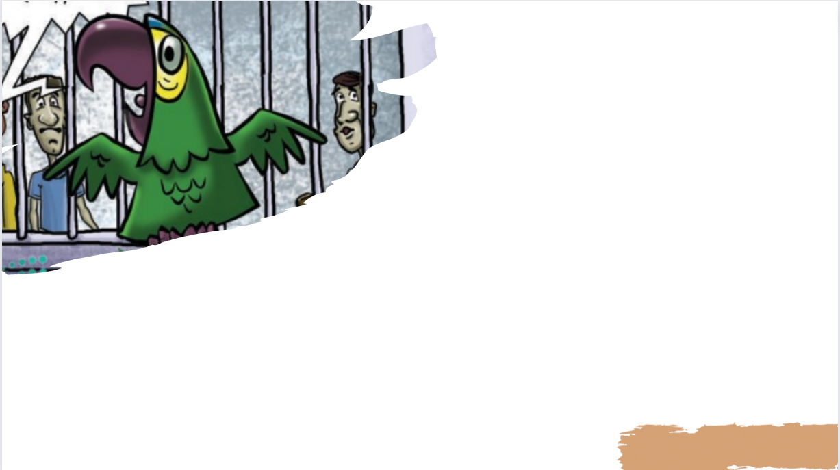
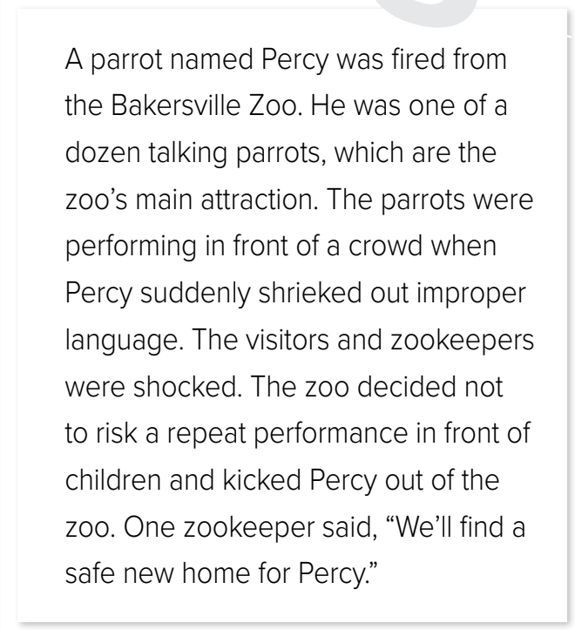

Monday 11/10/1444 H
1- Why do you think the parrot used bad language when he spoke?
2- Where do you think he was when he said it?
3-What do you think happened to him when he said those words?
4-Why do you think this is an unusual news story?
Pg. 131

Slide 8
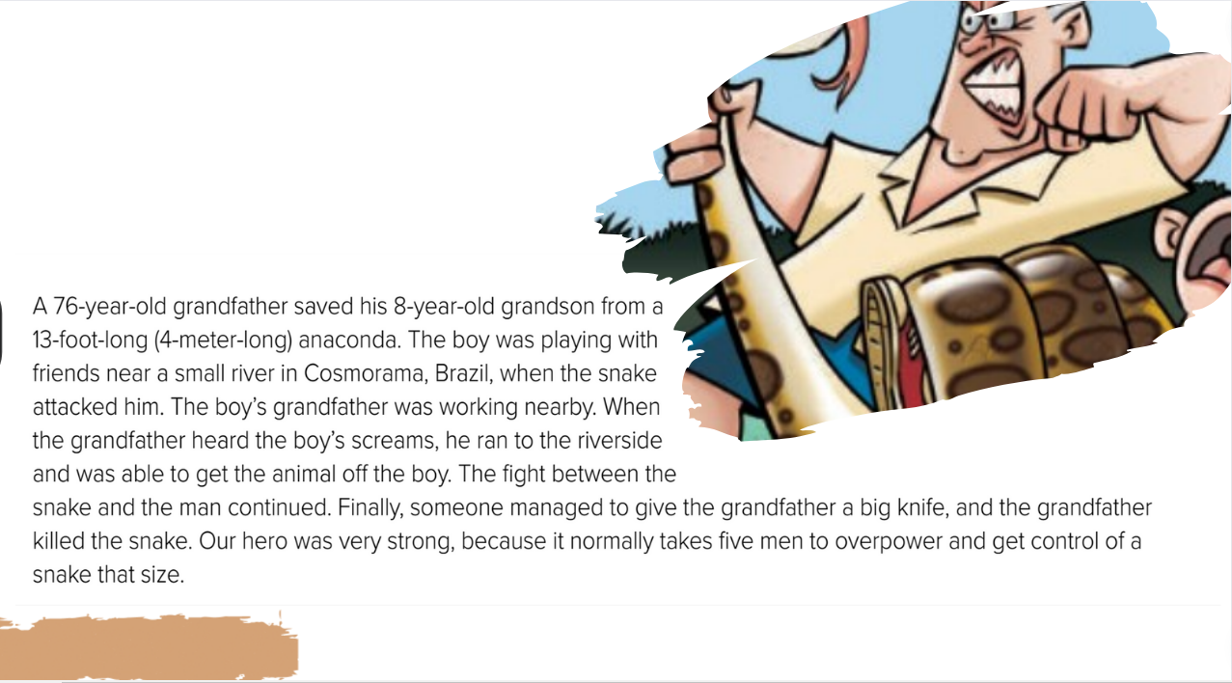
Monday 11/10/1444 H
1- Where this story takes place?
2-Who are the two people?
3- What kind of snake is it?
4-What do you think happened in this story that makes it unusual?
Pg. 131

Slide 9
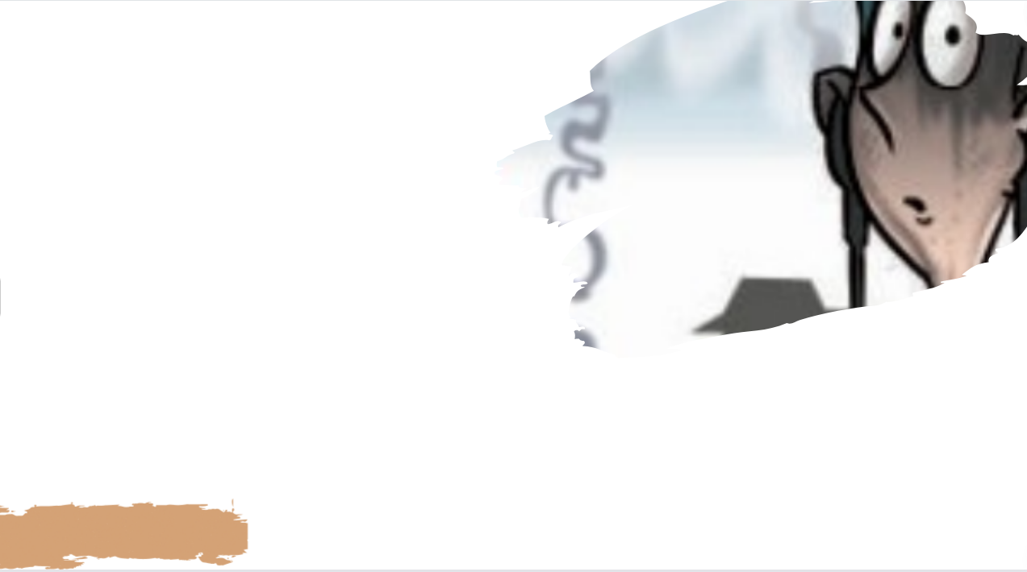
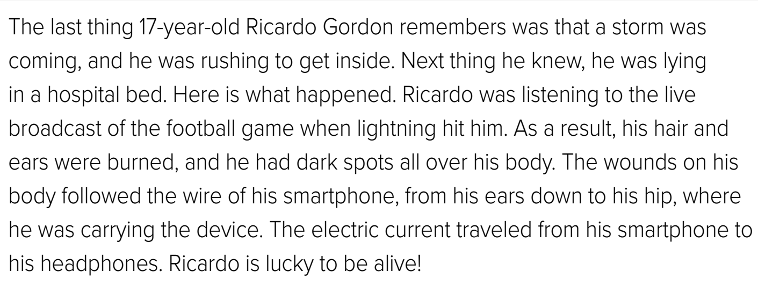
Monday 11/10/1444 H
1-What was the boy doing?
2-How does he look?
3-What happened to him?
4-What happened in this story that makes it unusual?
Pg. 131

Slide 10
Monday 11/10/1444 H
Talk about news
Listen and comprehend short stories
Answer activates about the lesson
Pg. 130

Slide 11

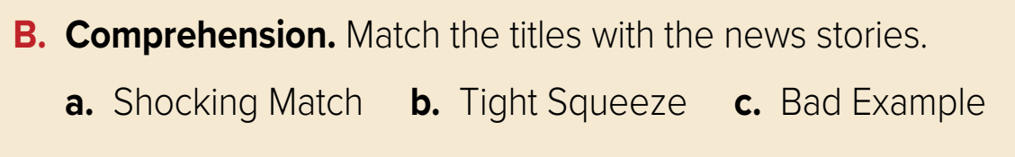
Monday 11/10/1444 H
a. the story about Ricardo Gordon
b. the story about the snake and the grandfather
c. the story about the parrot
Pg. 131

Slide 12

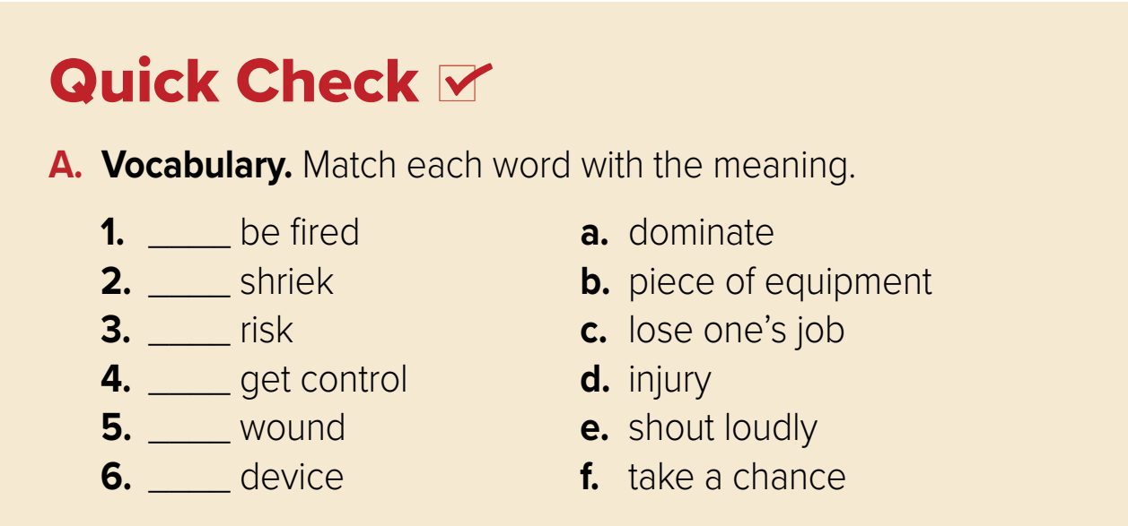
Monday 11/10/1444 H
C
e
f
a
d
b
Pg. 131

Slide 13
Monday 11/10/1444 H
C. Answer about the stories.
What did Percy do wrong?
What was the grandson doing when the snake appeared?
What was Ricardo doing when he was struck by lightning?
1. He used bad language.
2. He was playing with friends when the snake appeared.
3. He was listening to the football game on his smartphone.
Pg. 131

Slide 14
Monday 11/10/1444 H
Talk about news
Listen and comprehend short stories
Answer activates about the lesson
Pg. 130

Slide 15


Monday 11/10/1444 H
Homework
Workbook
Pg.249

Slide 16
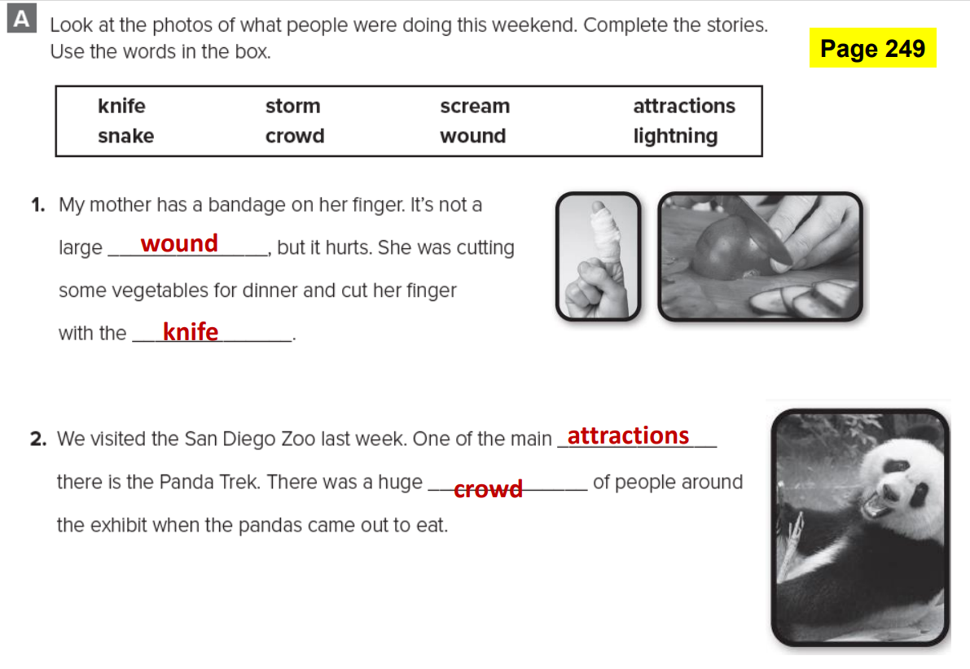
Monday 11/10/1444 H
Pg. 249

Slide 17
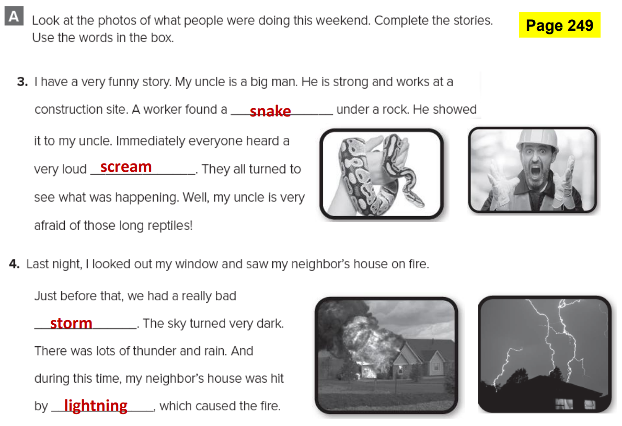
Monday 11/10/1444 H
Pg. 249

