Slide 1


Slide 2
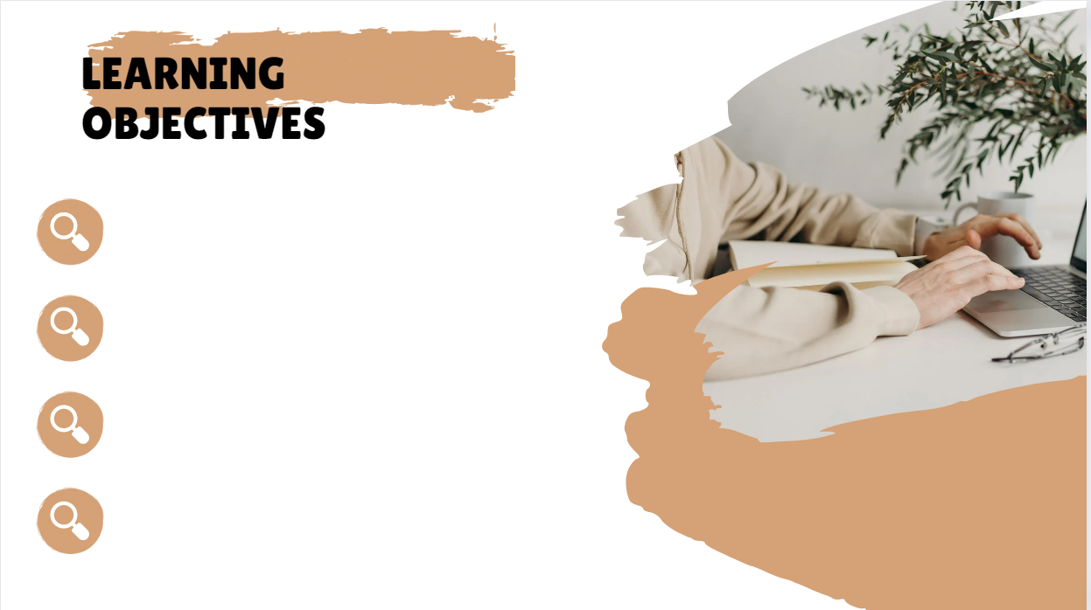
Practice a conversation.
Answer questions about a conversation.

Slide 3
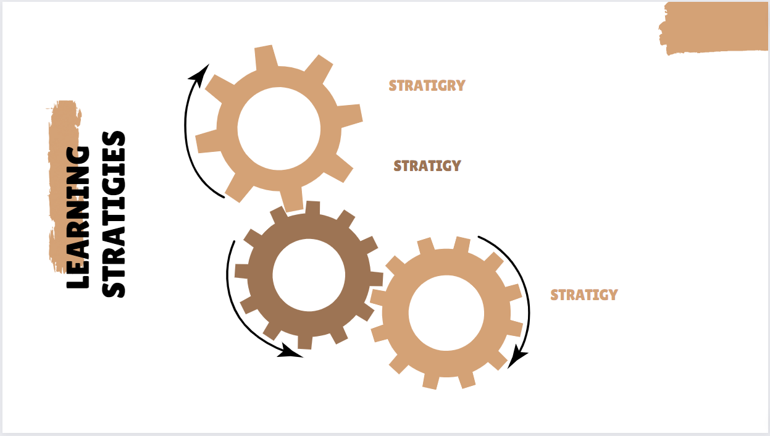
Active discussion.
Heads together.

Slide 4

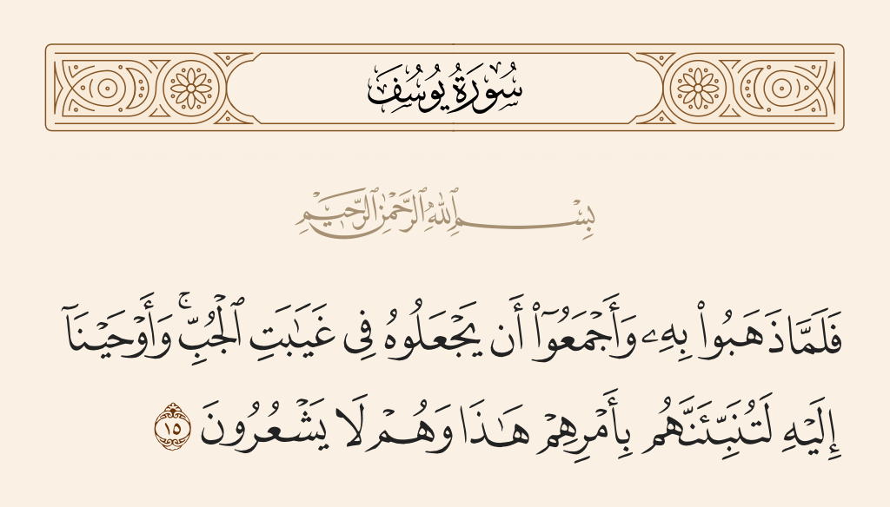
Wednesday 13/10/1444 H
Pg. 132

Slide 5

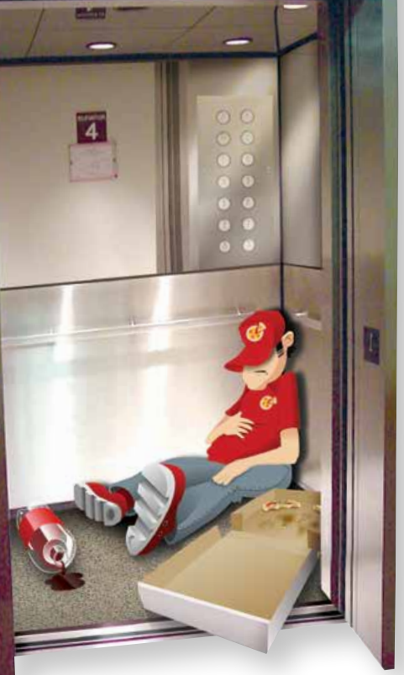
Wednesday 13/10/1444 H
Q:Where is the man?
Q:What does he have in the elevator with him?
Q:What’s he doing in the elevator?
Q:Why do you think he is sleeping in the elevator?
Pg. 132

Slide 6
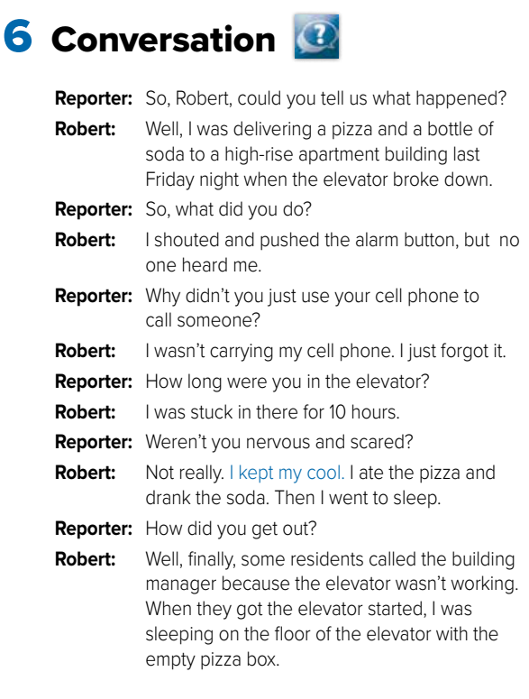

Wednesday 13/10/1444 H
Pg. 132

Slide 7

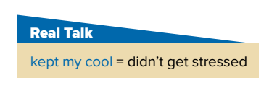
Wednesday 13/10/1444 H
Pg. 134

Slide 8
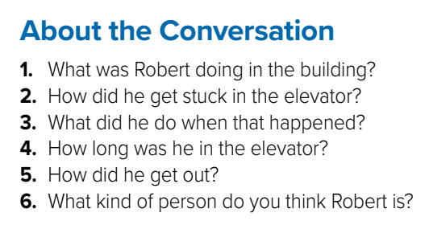
Wednesday 13/10/1444 H
6-He is a calm person who doesn’t get upset easily.
Pg. 132

Slide 9
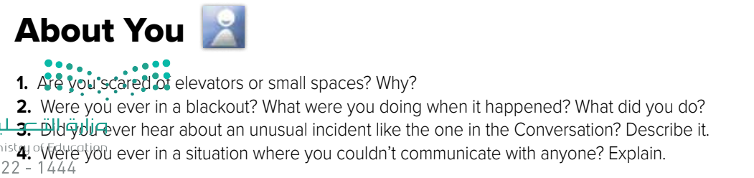
Wednesday 13/10/1444 H
Pg. 134

Slide 10


Wednesday 13/10/1444 H
Homework
Workbook
Pg.251 (D)

Slide 11
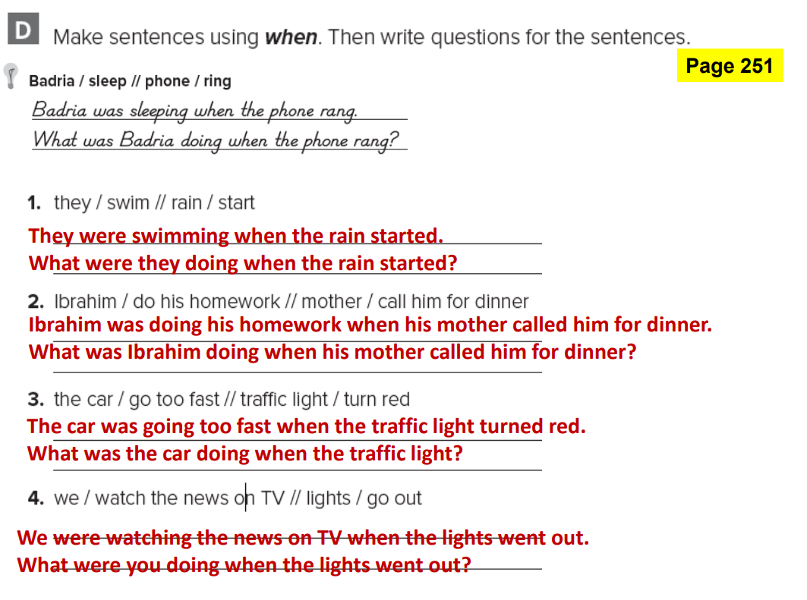
Pg.251

