Slide 2
Thursday 21/10/1444 H
Suggest a title for a summary.
Follow steps to write a summary.
Attach a sequence of events to find a story.
Create a chain diagram from a story.

Slide 3
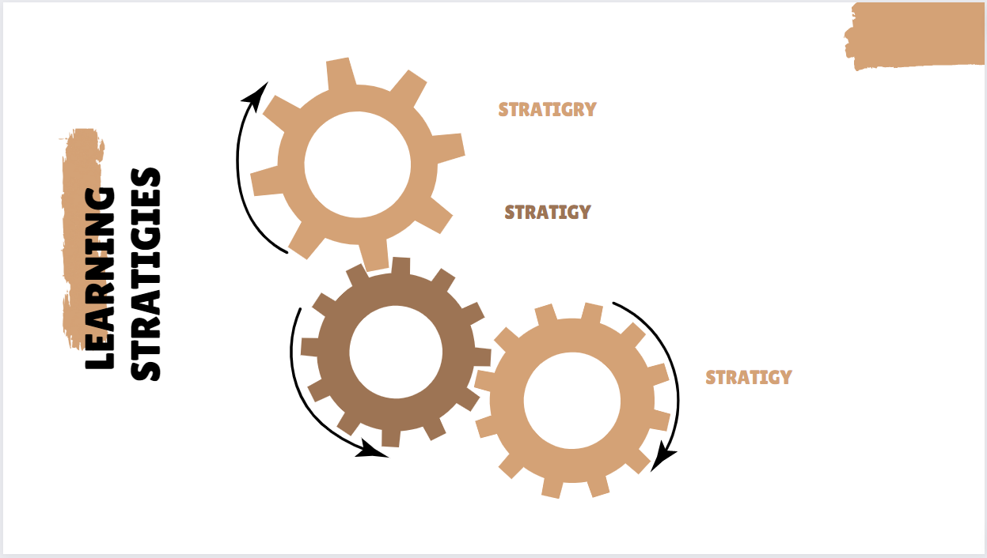
Thursday 21/10/1444 H
Active discussion
Heads together.

Slide 4
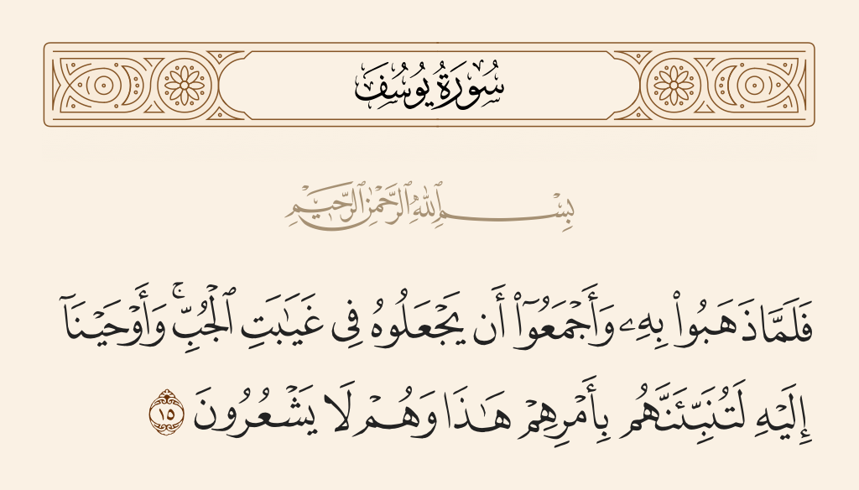
Thursday 21/10/1444 H
Pg.136

Slide 5
Thursday 21/10/1444 H
Pg.136

Slide 6
Thursday 21/10/1444 H
Pg.136

Slide 7
Pg.136

Slide 8
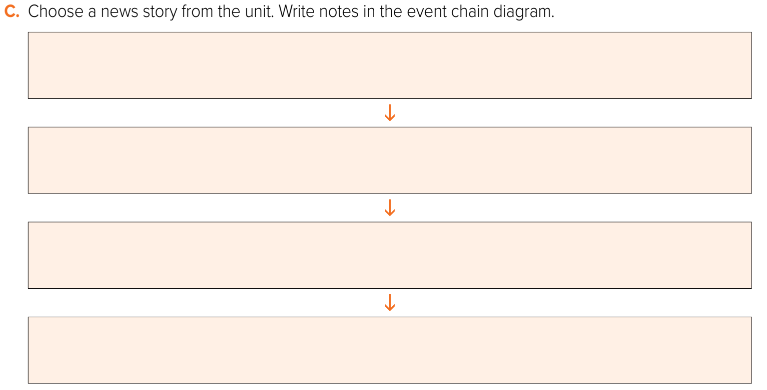
Thursday 21/10/1444 H
Robert was delivering a pizza
The elevator broke down and he was trapped inside
Robert didn’t panic. He ate the pizza and fell asleep
The building manager came to fix the elevator and he found Robert asleep inside
Pg.136

Slide 9
Sleep in the Elevator Robert was delivering a pizza. The elevator broke down and he was trapped inside. Robert didn’t panic. He ate the pizza and fell asleep. Then the building manager came to fix the elevator and he found Robert asleep inside.
Pg.136

Slide 10
Homework
Workbook
Pg.250 (F)

Slide 11
Money Fell From the Sky
People were walking and others were driving along Main Street when money started to fall from the sky. Cars stopped. People stopped. Everyone was looking up when someone shouted, “It’s not really money!” I was catching one of the bills when I heard this person start to shout. I looked closely at the bill. It wasn’t money. It was an advertisement. The furniture store at the corner was having a sale. They used this for publicity. Two men were standing on the roof, and they were dropping advertisements onto the street.
Pg.252

