Slide 1
Oral examinations
2nd semester

Slide 2
2nd grade
1
2
3
4
5
6

Slide 3
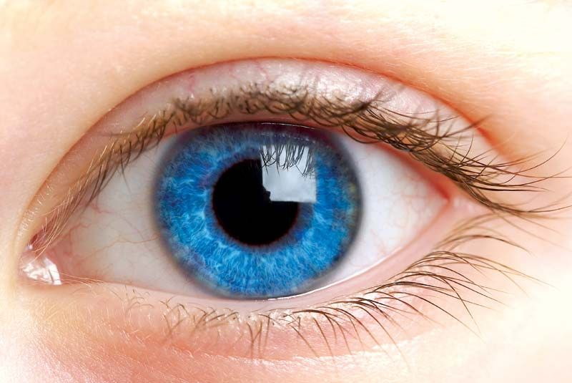

What did you do last night ?
How do you feel before the exam ?
What’s this ?
What do you do on your free time ?
What do you usually shop for ?

Slide 4
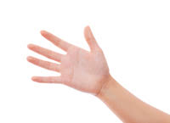
What did you do last night ?
How do you feel when you wake up ?
What’s this ?
What do you do on your free time ?
What do you usually shop for ?

Slide 5
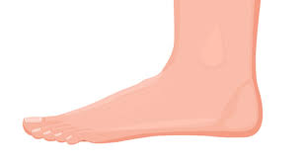
What did you do last night ?
How do you feel after 11 p.m. ?
What’s this ?
What do you do on your free time ?
What do you usually shop for ?

Slide 6

What did you do last night ?
How do you feel after exercising ?
What’s this ?
What do you do on your free time ?
What do you usually shop for ?

Slide 7
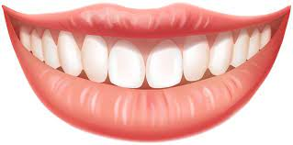
What did you do last night ?
How do you feel after a meal ?
What’s this ?
What do you do on your free time ?
What do you usually shop for ?

Slide 8
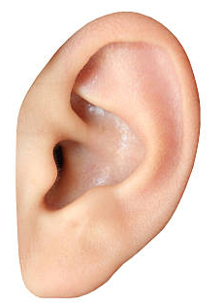
What did you do last night ?
How do you feel after wining a game ?
What’s this ?
What do you do on your free time ?
What do you usually shop for ?

