Slide 1

U 2
It’s a bargain
Grammar

Slide 2

Use possessive adjectives and possessive pronouns.
Ask questions by using “whose”.
Differentiate between one and ones.
Use “too” correctly.
Listen to complete information in an ad.
Pronounce Linking adjacent sounds.

Slide 3



Slide 4
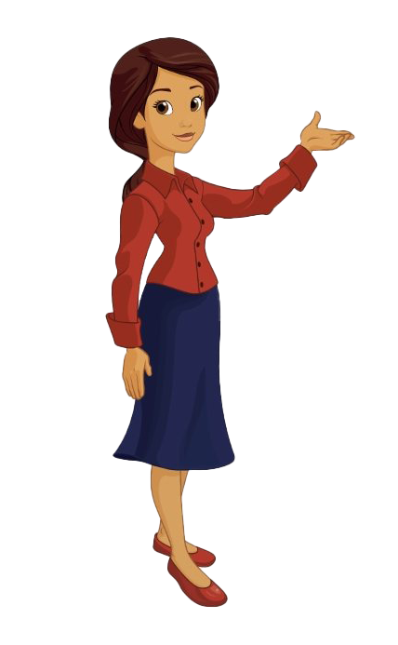
Do you remember my name?
My name is Nora

Slide 5
What’s is your name?
My name is ……

Slide 6
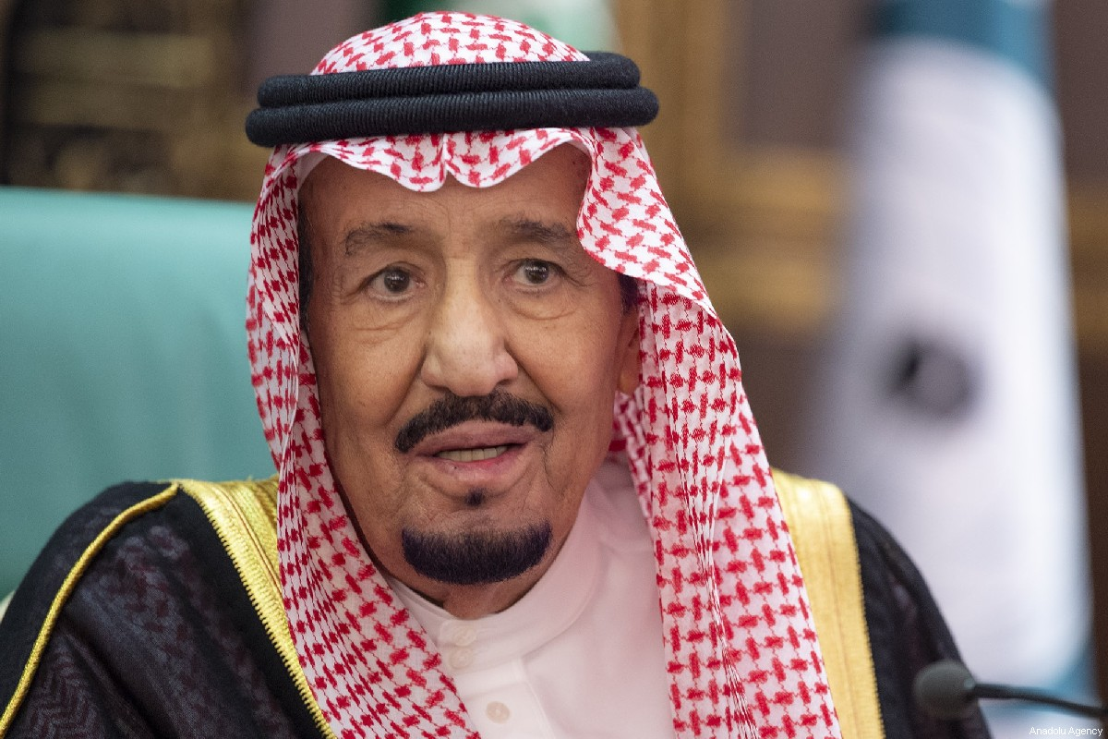
What is his name?
His name is King Salman

Slide 7

What is her name?
Her name is Reema Bent Bander

Slide 8
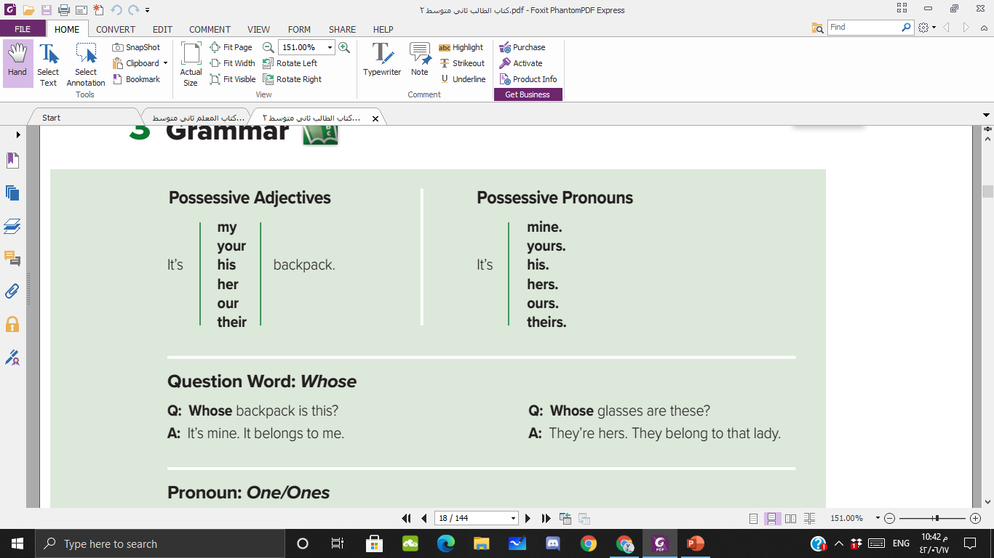


Slide 9


Slide 10

Bring me an item !

Slide 11
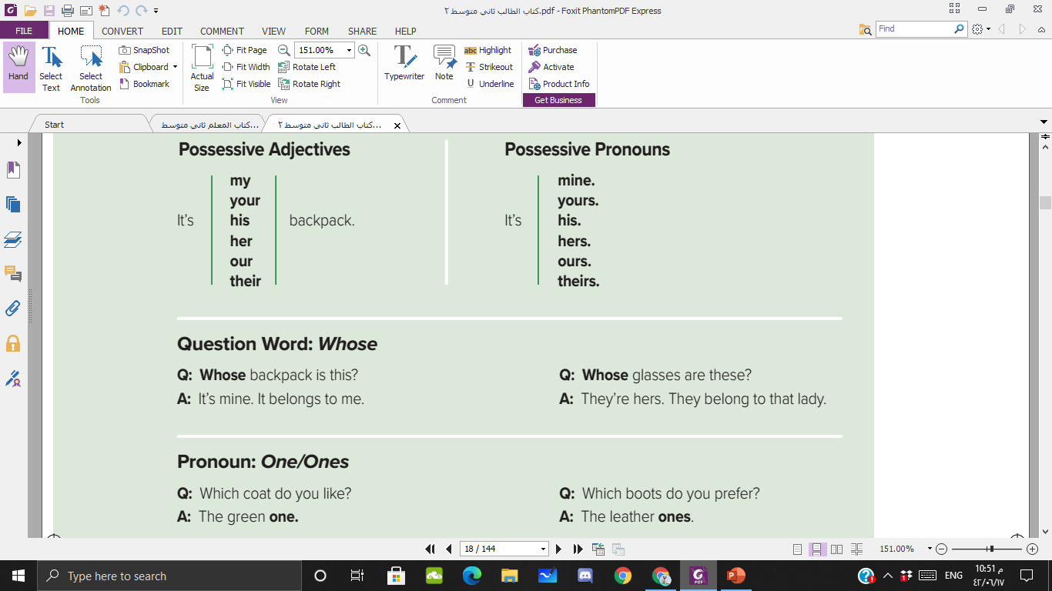

Slide 12
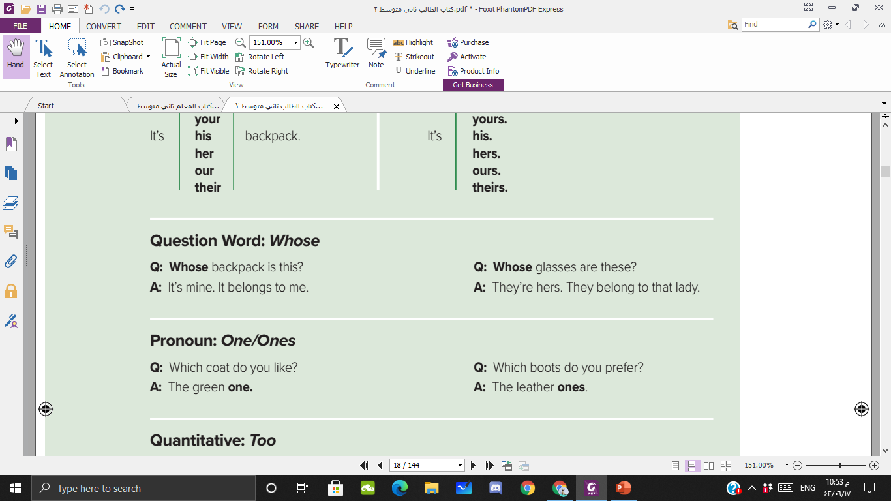


Slide 13
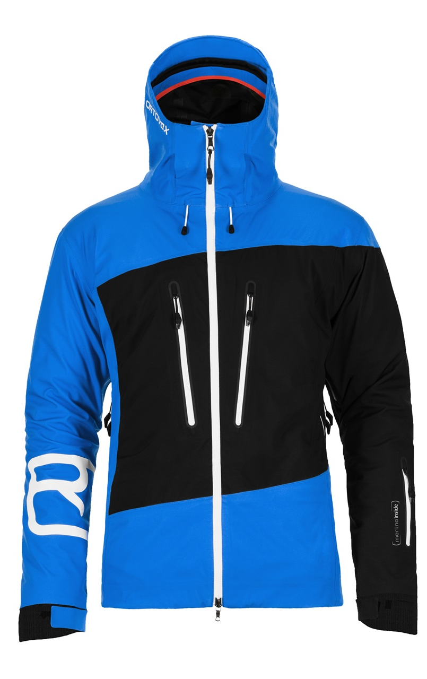
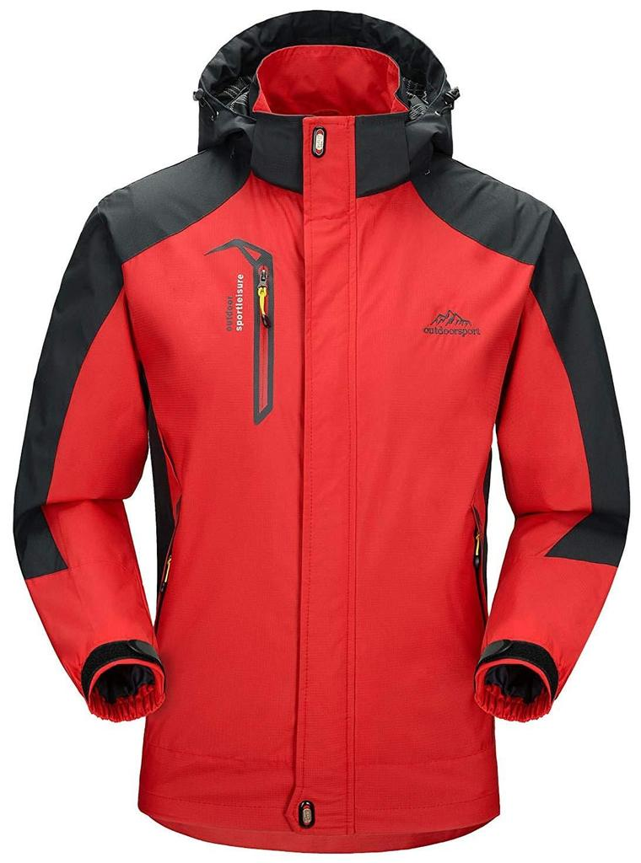
This jacket is too small
This jacket is too big

Slide 14

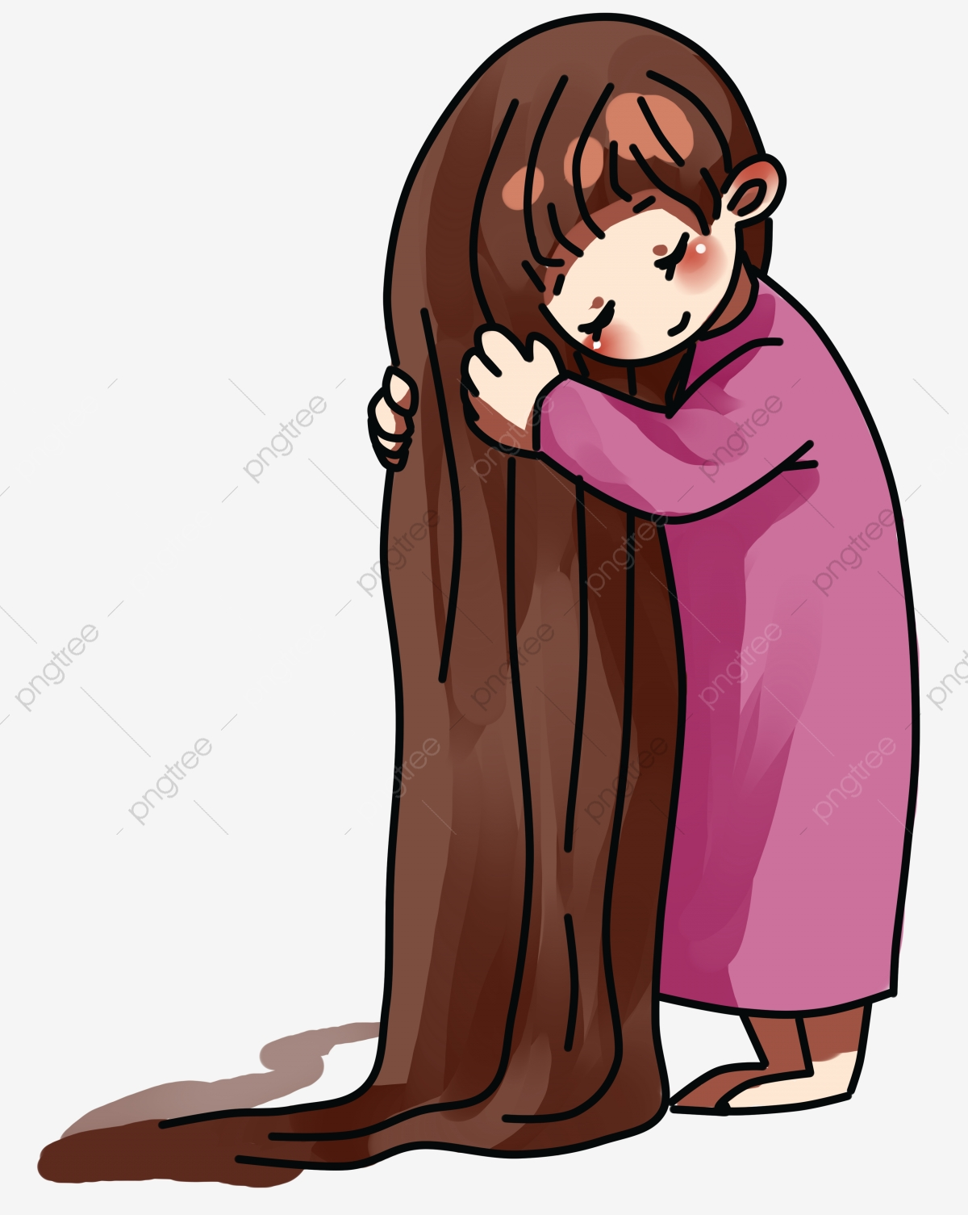
This hair is too long
This jacket is too short

Slide 15
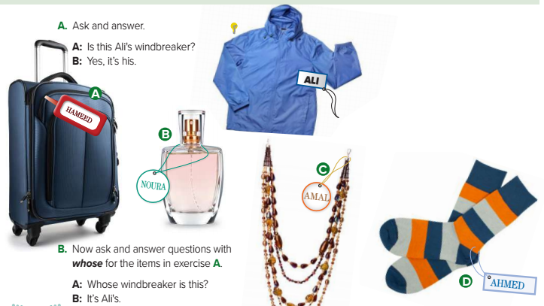
Windbreaker
Necklace
Bag
Socks
Perfume

Slide 16
Whose bag is this?
Whose necklace is this?
Whose perfume is this?
Whose socks are these?

Slide 17
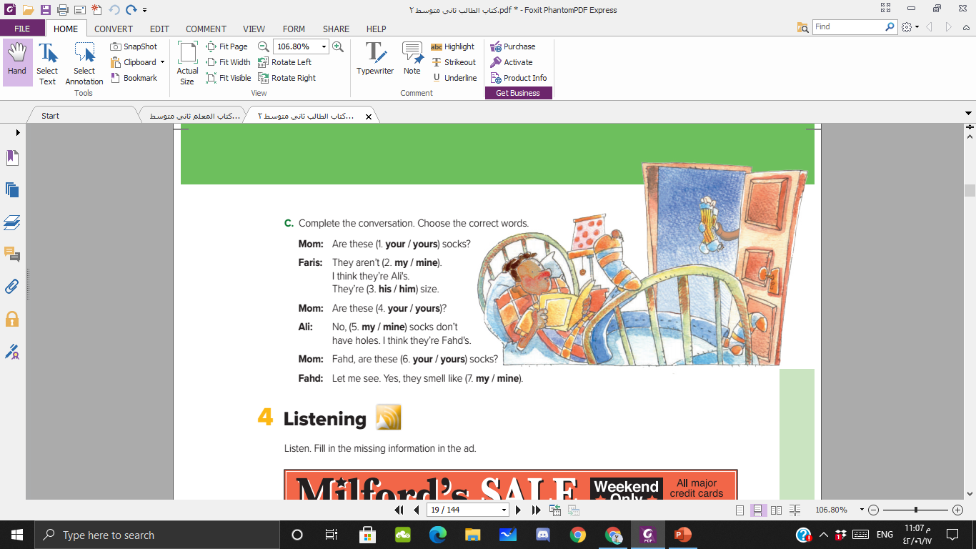

Slide 18
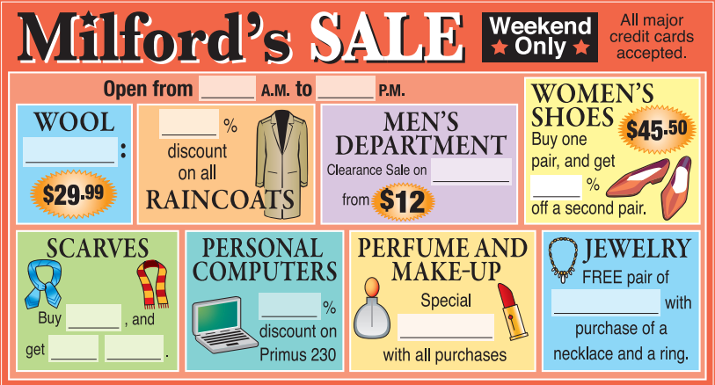

10
What do you think goes before a.m. and p.m.? (a number) Before a % sign? (a number)
After an adjective like special? (a noun) Do you think a plural noun or a singular noun goes after pair of? ( a plural noun)
9
20
sweaters
shirts
50
25
earrings
one
gift
One free

Slide 19
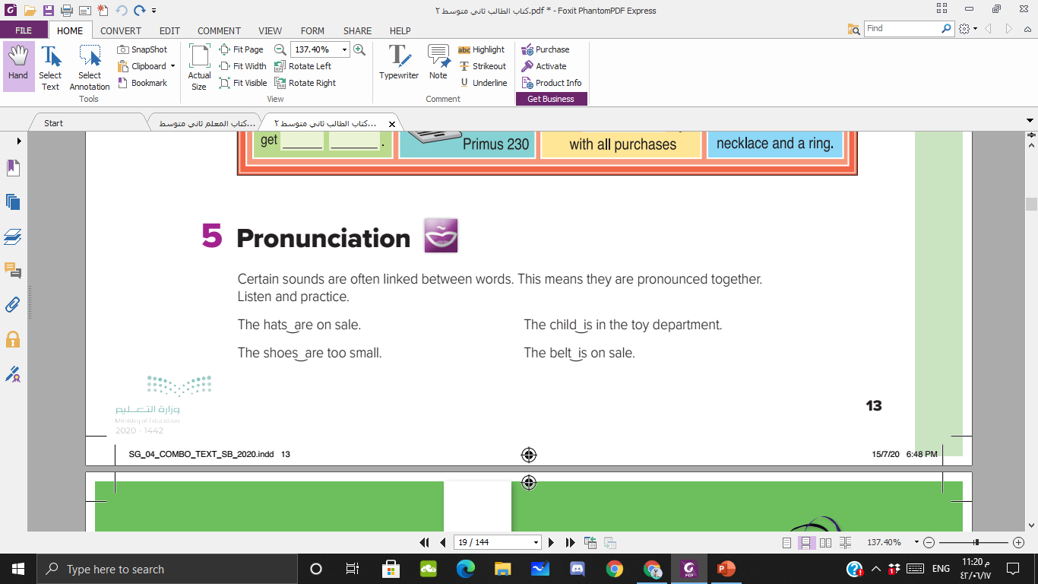

Slide 20

P 94-95

