Slide 1
Unit 4 Grammar
P 28 – 29
Tr. Nora Khalid

Slide 2
Your mood

Slide 3
Objectives
01
02
03
04
Going to
Position of adjective
listening
Pronunciation
Future with Be Going To: affricative, negative, yes/no questions, short answers
Use the correct Position of Adjectives
Listen for specific
information
/æ/ and /ɒ/

Slide 4

Where are you going to go on weekend?

Slide 5

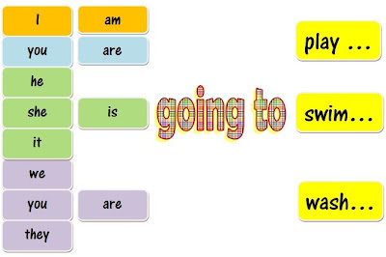

Slide 6
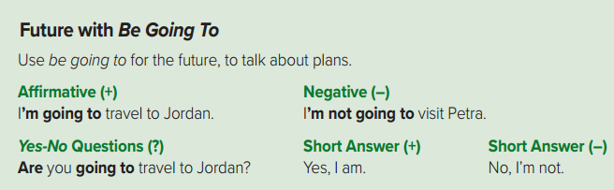


Slide 7
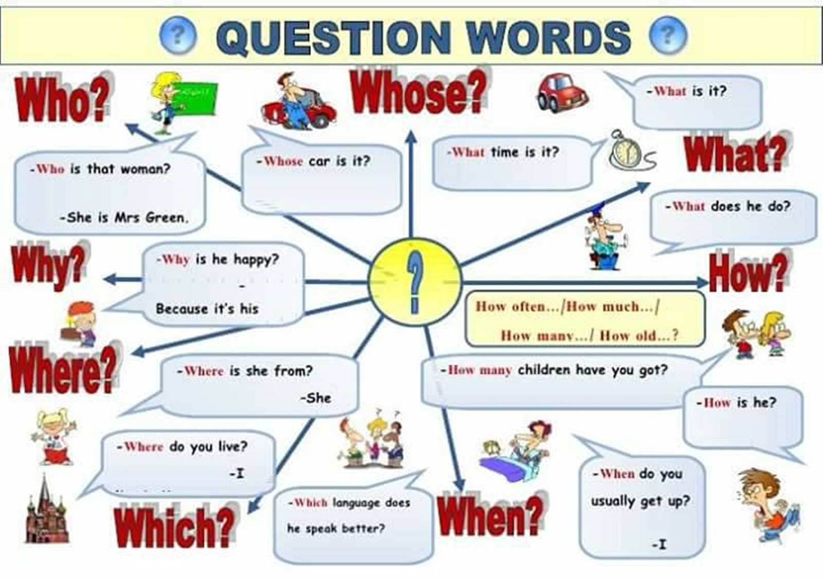

Slide 8
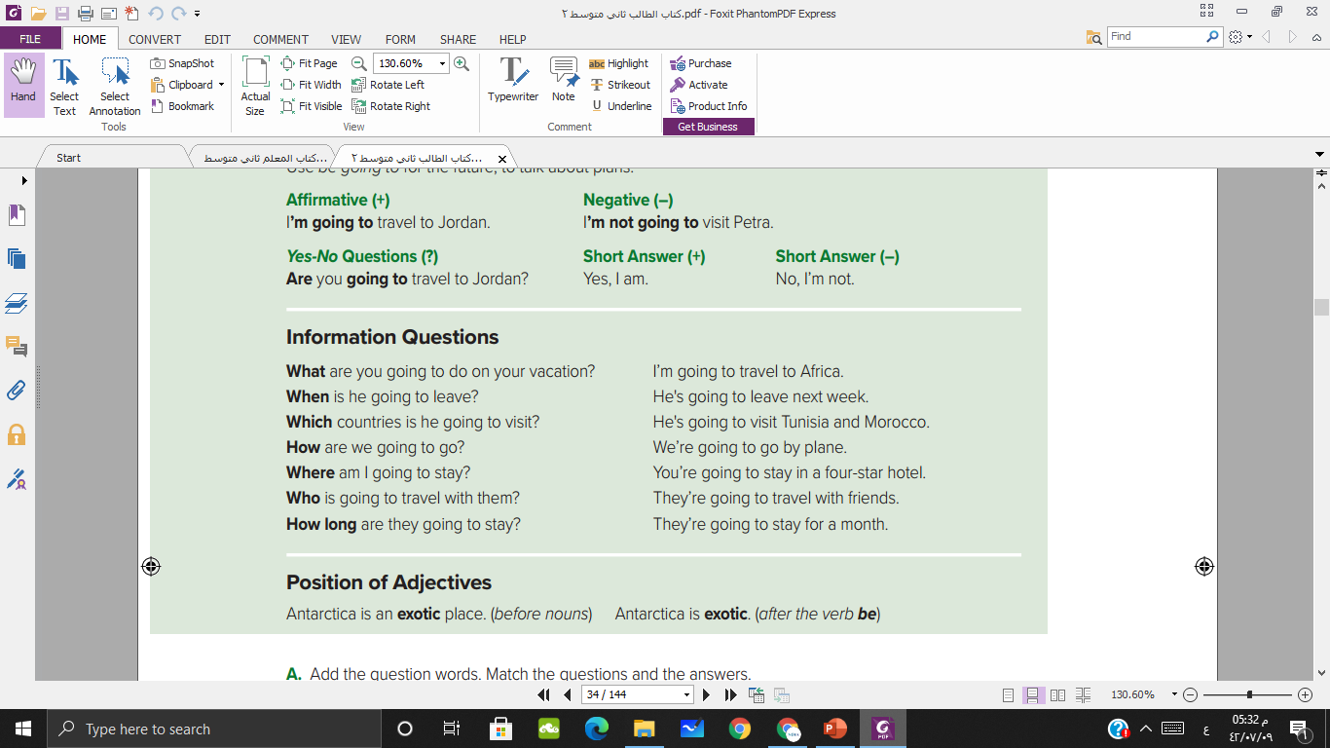

Slide 9
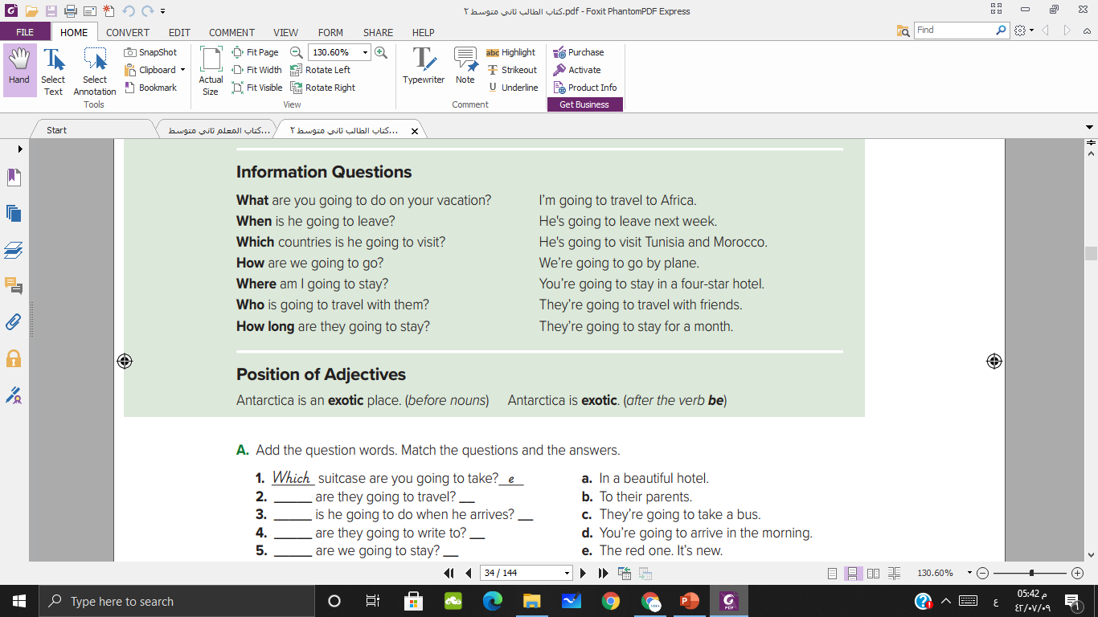
She
is
smart
She
is
a
smart
student

Slide 10
The hotel
is
quite
The hotel
is
a
quite
place

Slide 11
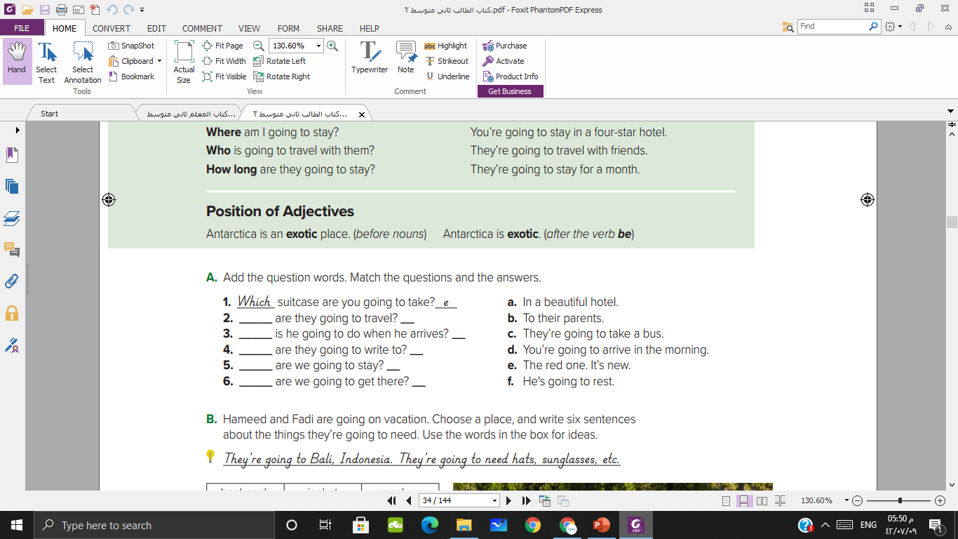
How
e
What
f
Who
b
Where
a
When
d

Slide 12
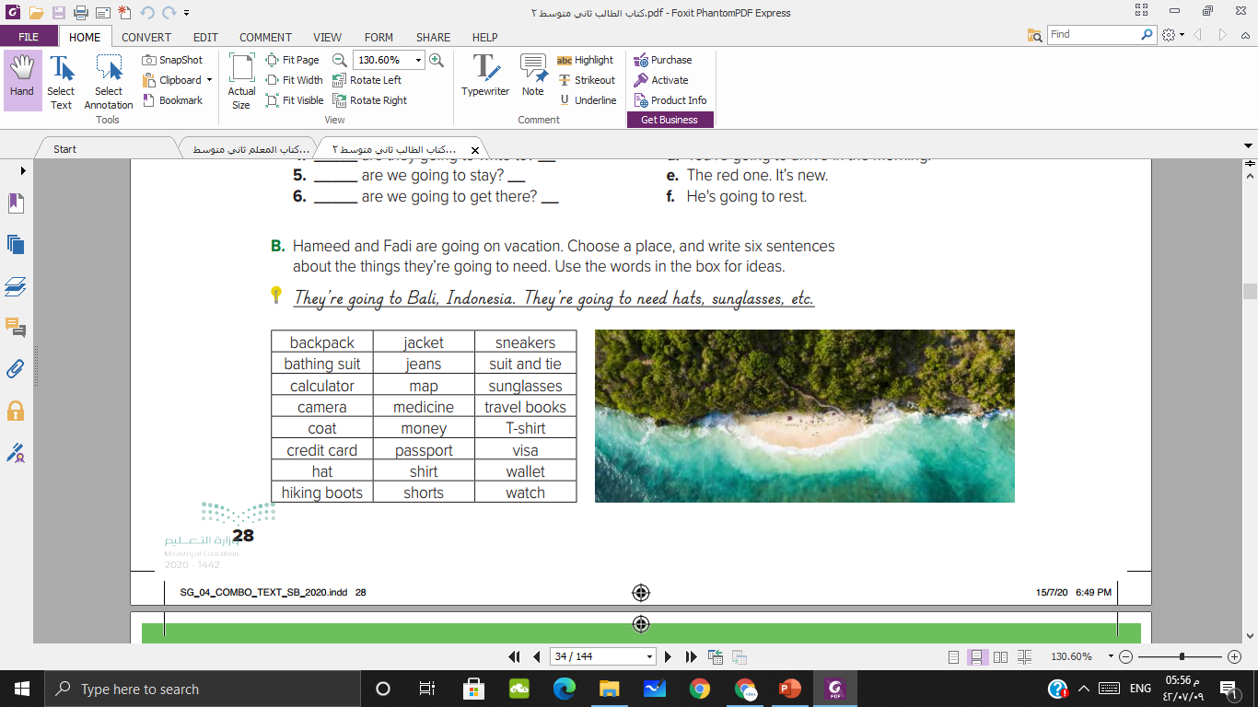
Hameed and Fadi are going to go to Bali. They’re going to need cameras to take pictures. They’re going to need a credit card.
They’re going to need a passport. They need to get into Indonesia. They’re going to need a map. They want to walk around the island. They’re going to need sneakers and jackets.

Slide 13
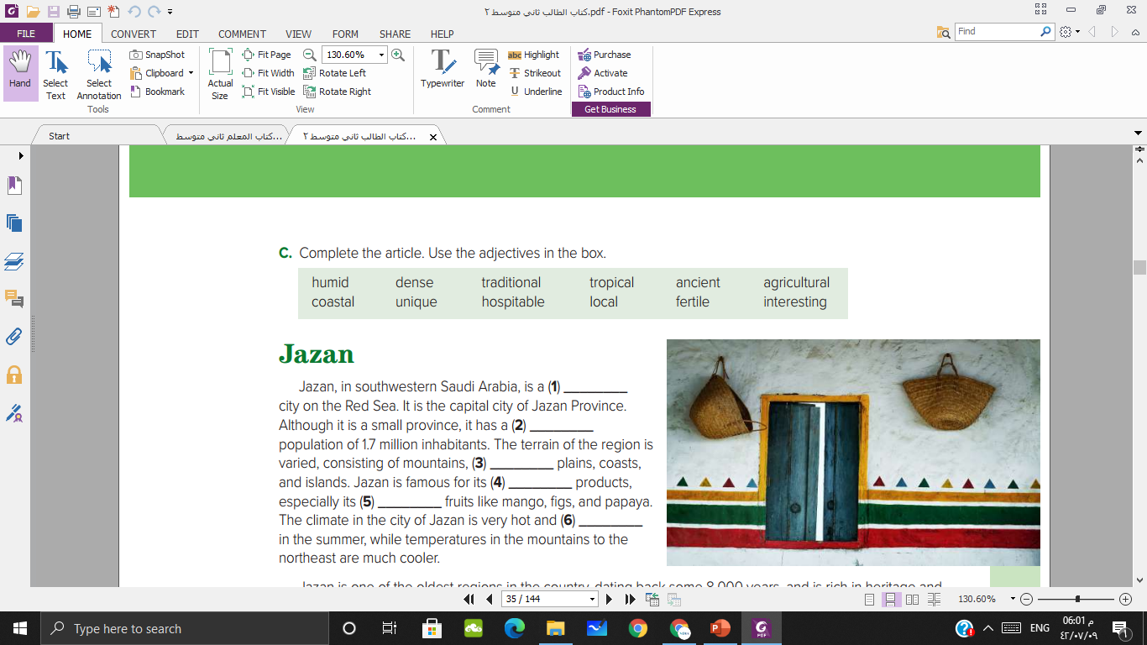

coastal
dense
fertile
agricultural
tropical
humid
Notes:
Ask students about the picture 1- the city 2- the location
Figure out the meaning of the new adjectives then go through the exercise

Slide 14
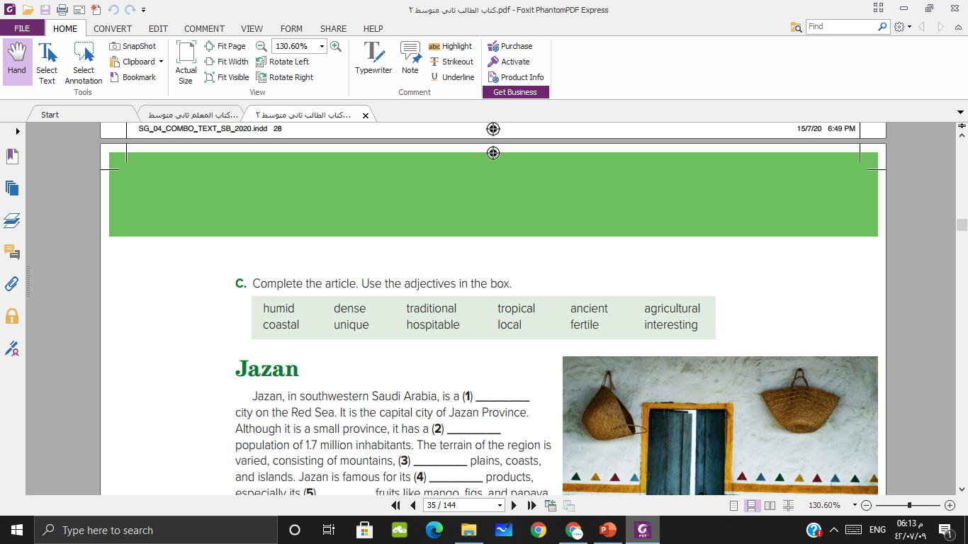
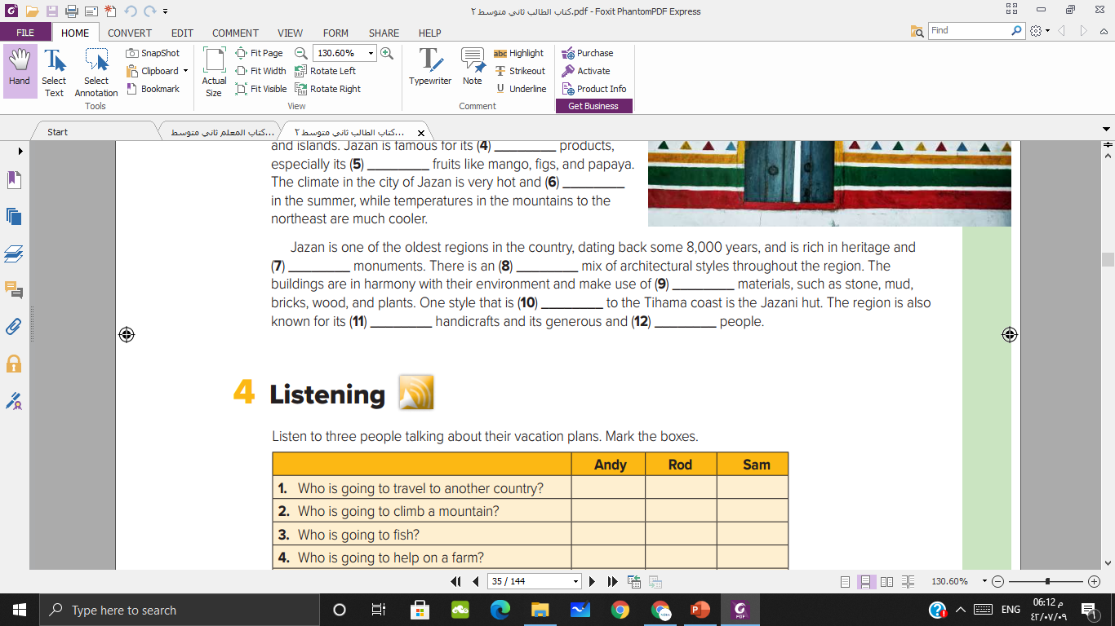
ancient
interesting
local
unique
traditional
hospitable
Notes:
Ask students about the picture 1- the city 2- the location
Figure out the meaning of the new adjectives then go through the exercise

Slide 15
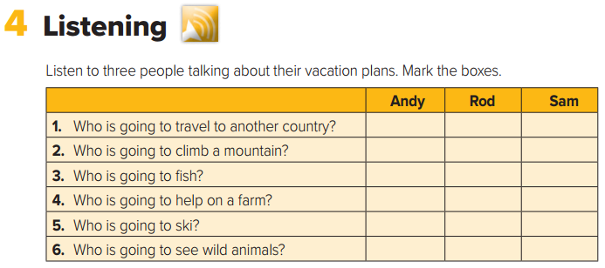


Slide 16
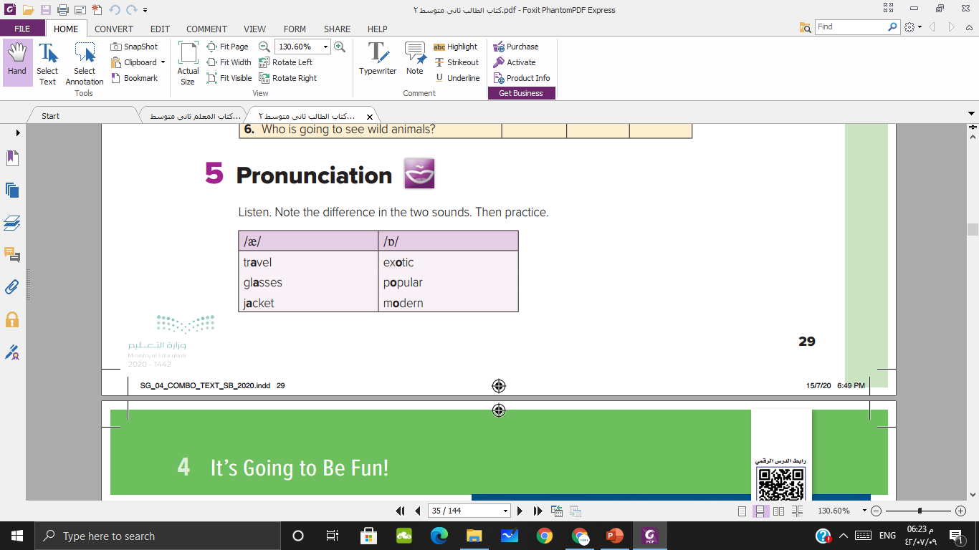

Slide 17
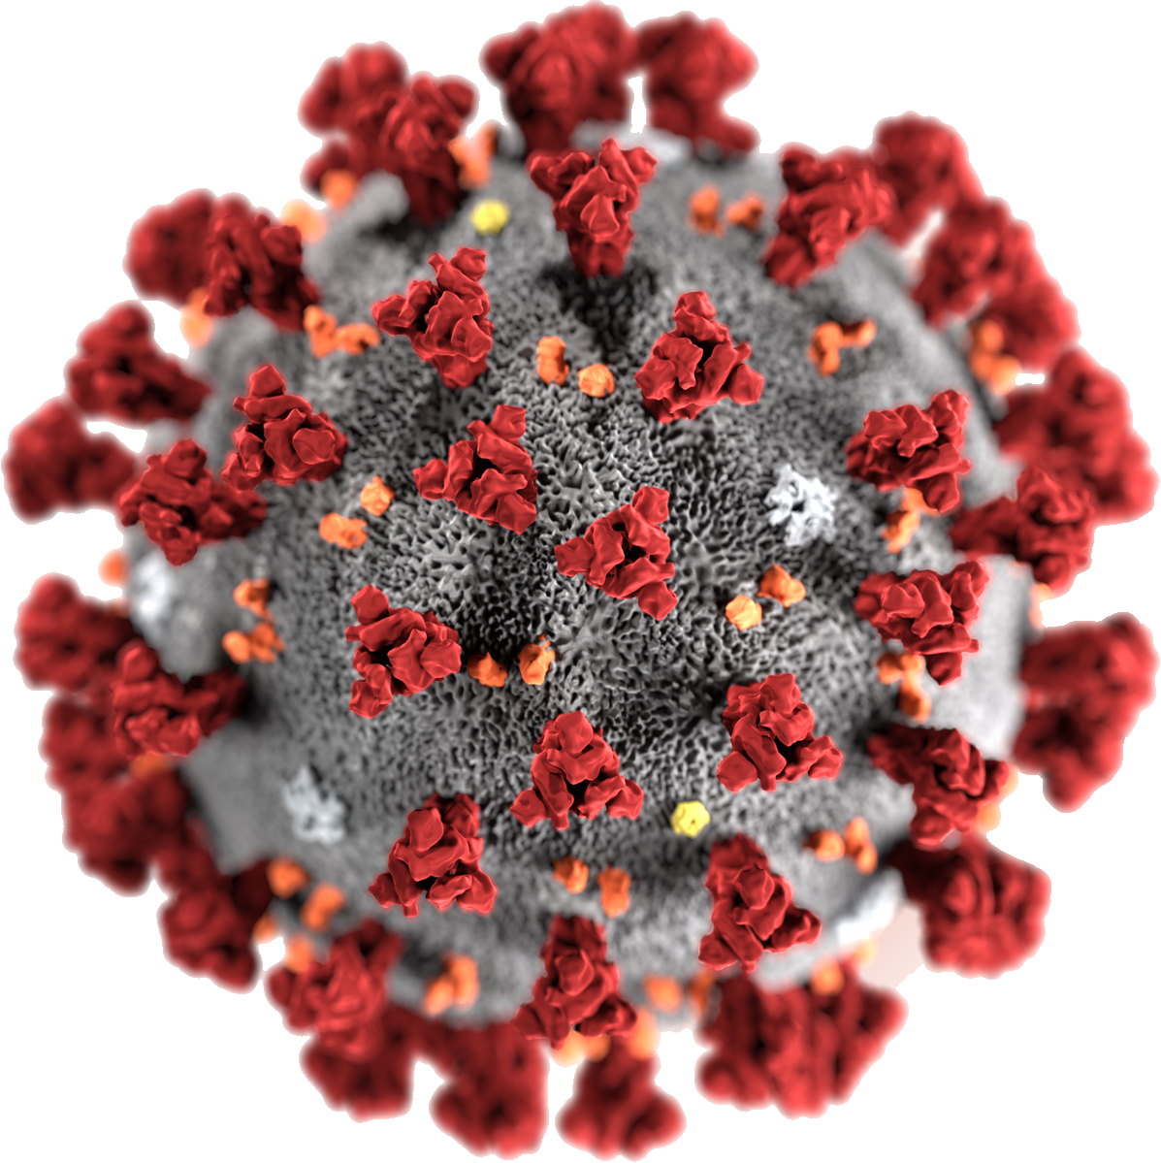
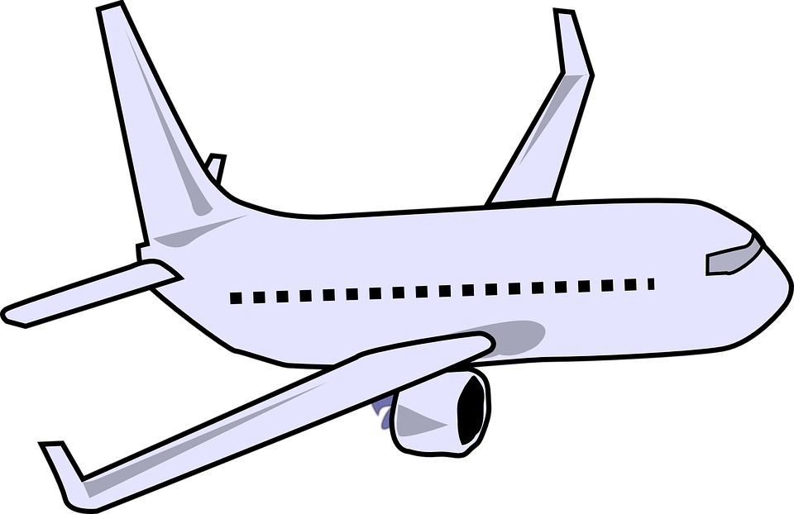

Notes:
Affective objective: we are not going to travel because of Corona virus

Slide 18

https://learningapps.org/view17690430

Slide 19

Homework p 102-103

Slide 20
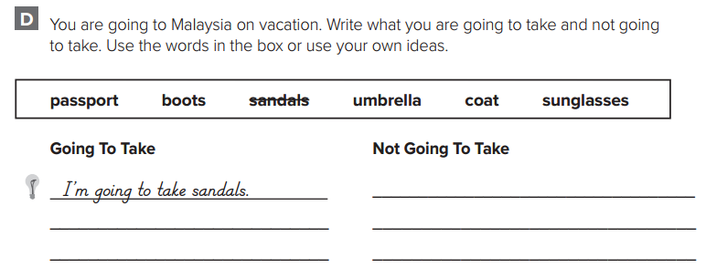
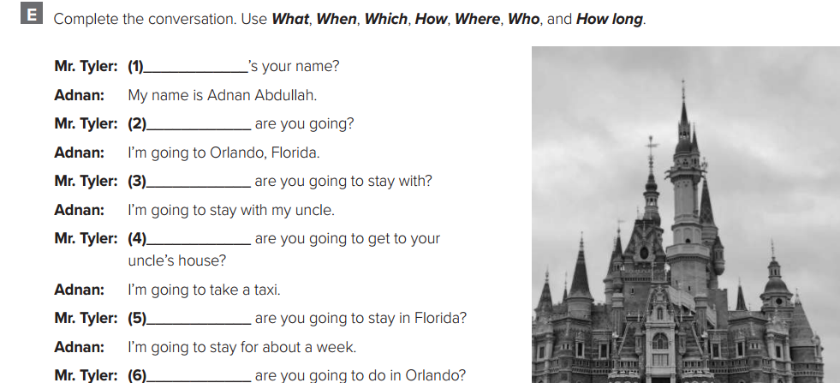

Slide 21

Have a nice day

