Slide 1
Super Goal 4

Slide 2
Unit 4

Slide 3
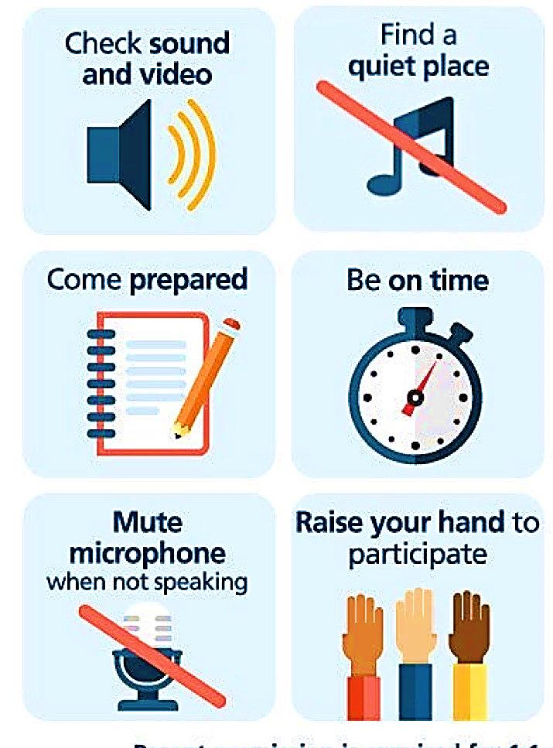
Online Classroom Rules

Slide 4

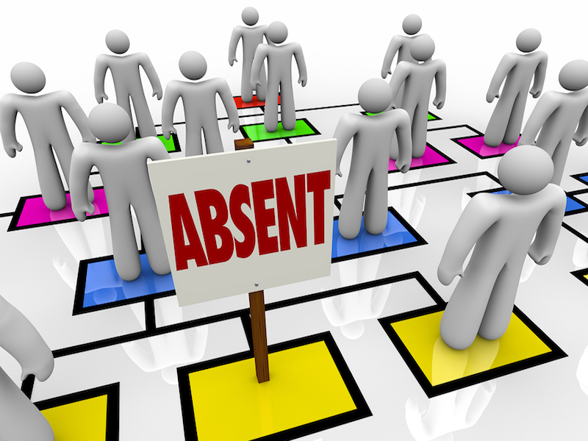

Slide 5
revision
https://wordwall.net/resource/10873591

Slide 6
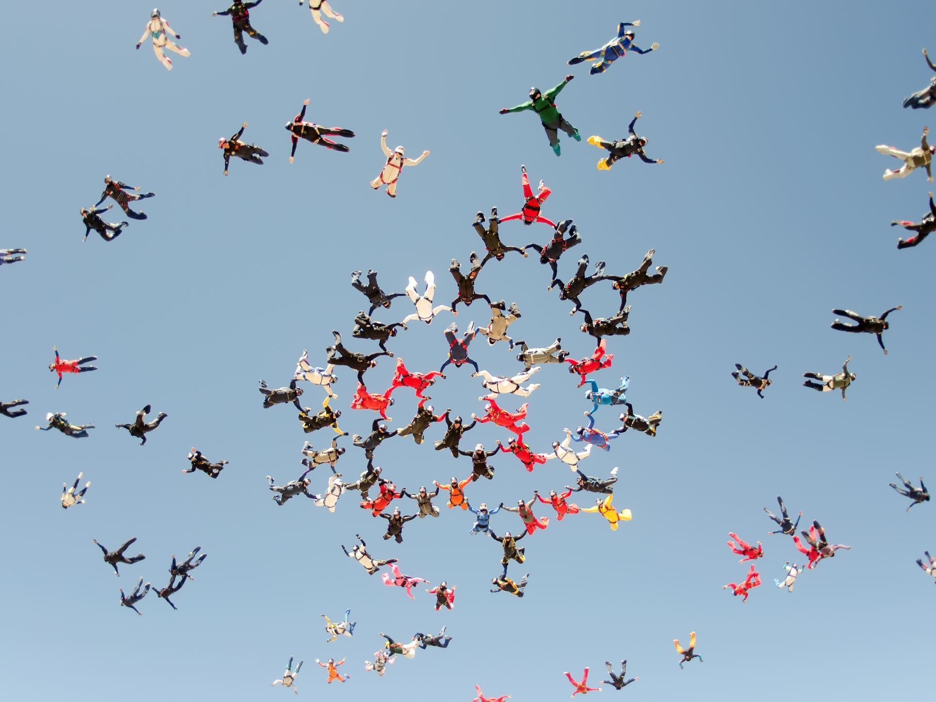
The objectives of the lesson :
At the end of this session, you will be able to :
Answer questions about coversation
Practice the conversation
Introduce suggestions about vacation
places

Slide 7
Warm up
https://youtu.be/_J6SysVkR9g

Slide 8
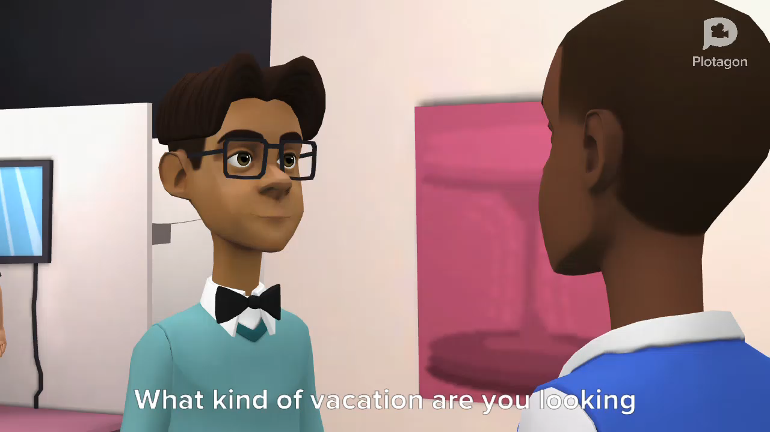

Slide 9
Some vocabulaies
Exotic = weird and new
Ecological = environmental
Allergic to mosquitos
Treetop resort
Rain forest
Alp

Slide 10
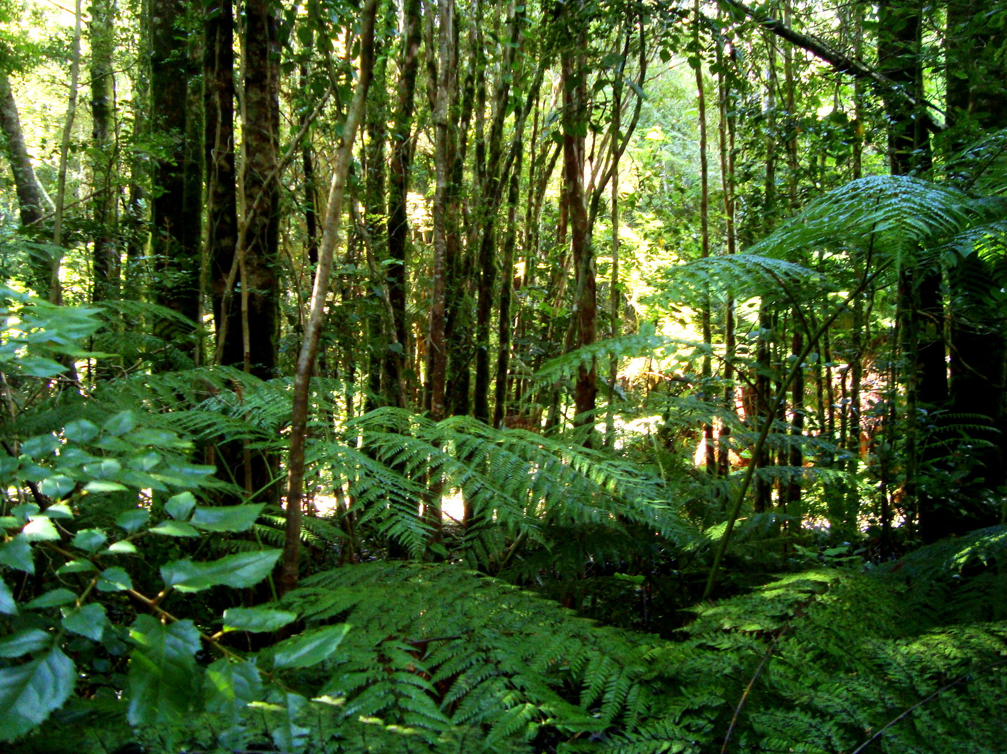
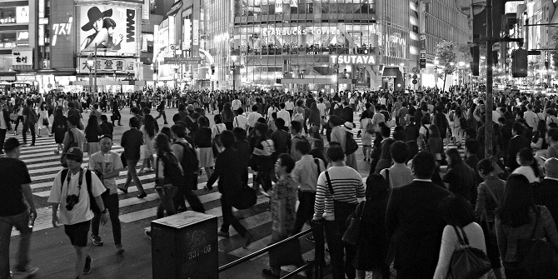
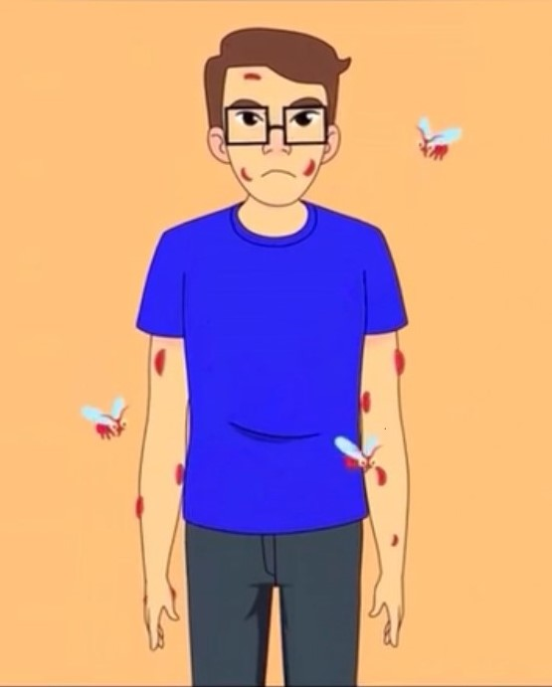
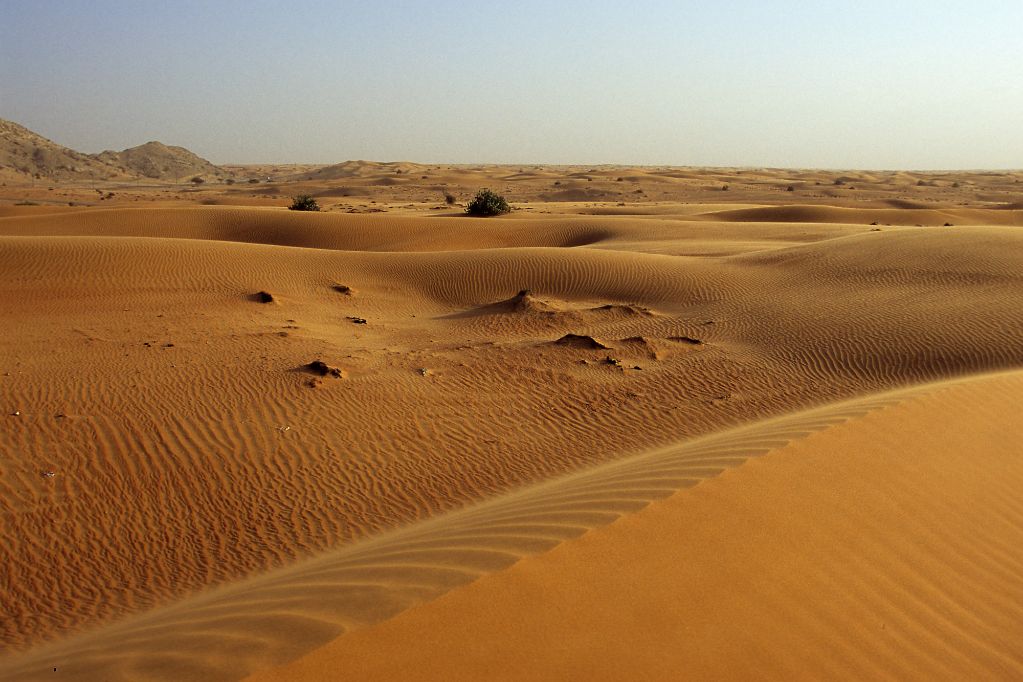
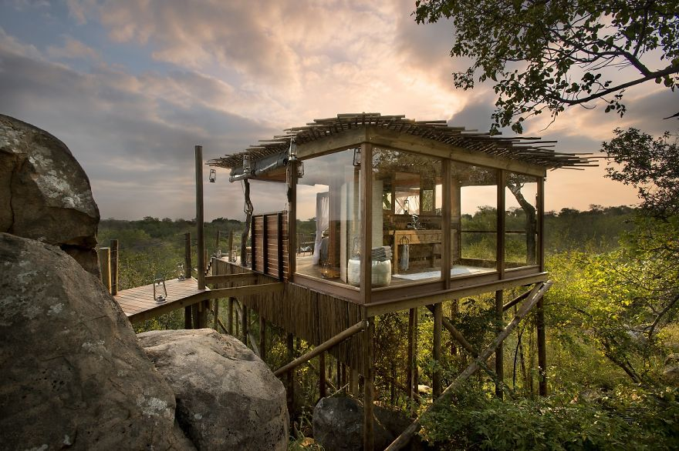
Crowded
Arabian Desert
rainforest
Allergic to mosquitos
Treetop resort

Slide 11

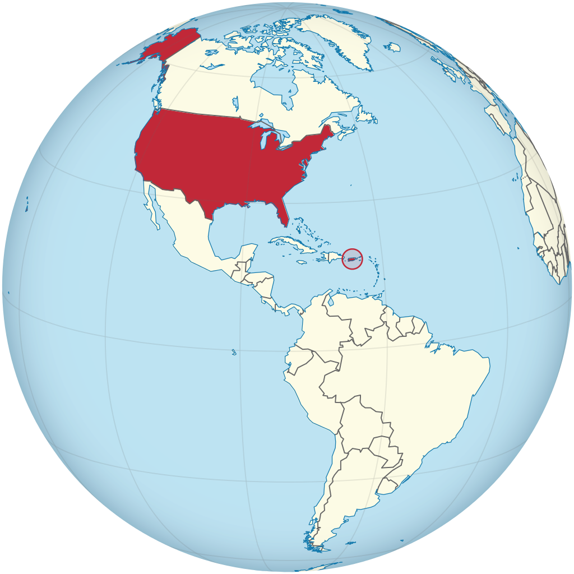
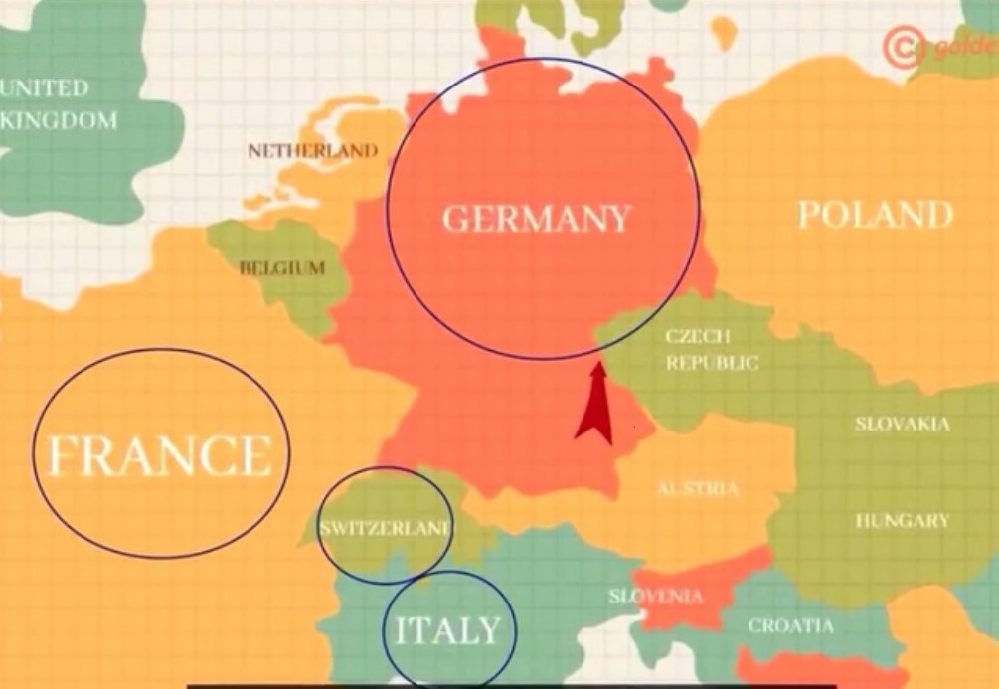
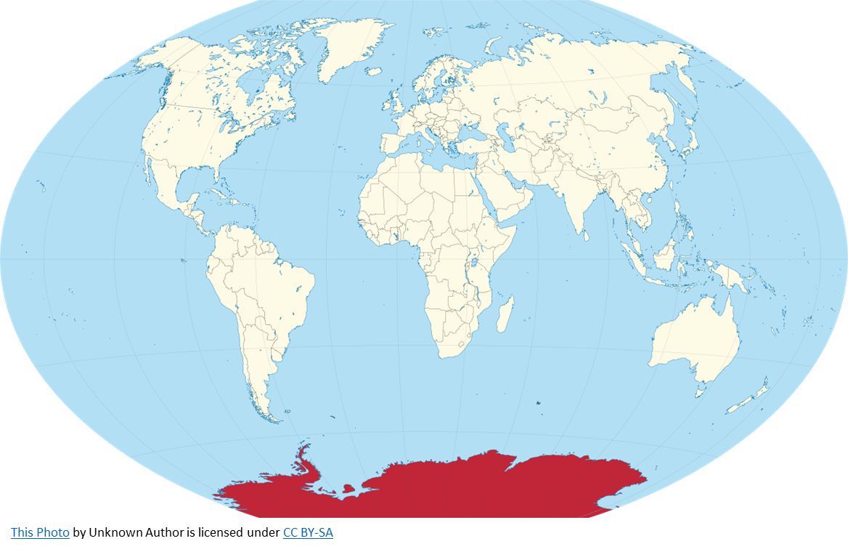
countries
Europe
Antarctica
New Zealand
Costa rica

Slide 12
Which places are they talking about?
What are the good and bad points of visiting each place?
Where are mosquitoes going to be a problem?
Where do you think the traveler wants to go?

Slide 13
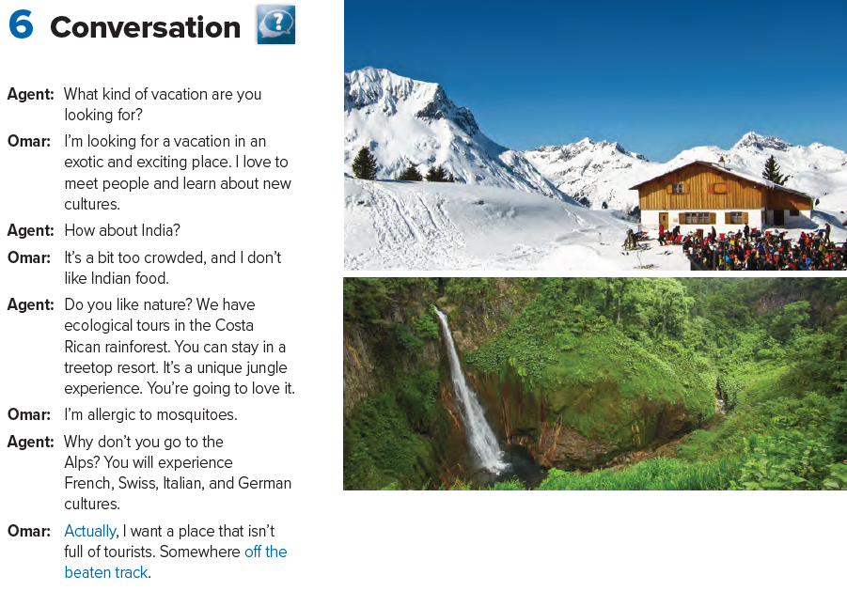


Slide 14
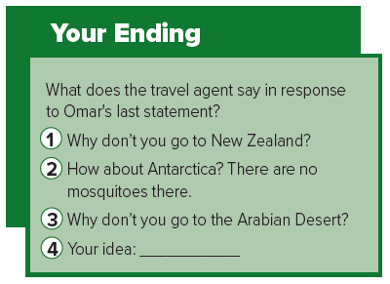

Slide 15
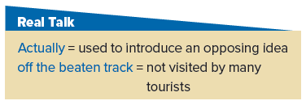

Slide 16
Quick check
https://wordwall.net/resource/10874034

Slide 17
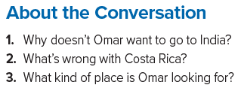
1. Omar doesn’t want to go to India because it’s a bit too crowded, and he doesn’t like the food.
2. He’s allergic to mosquitoes.
3. He’s looking for a place that is off the beaten track.

Slide 18



Slide 19
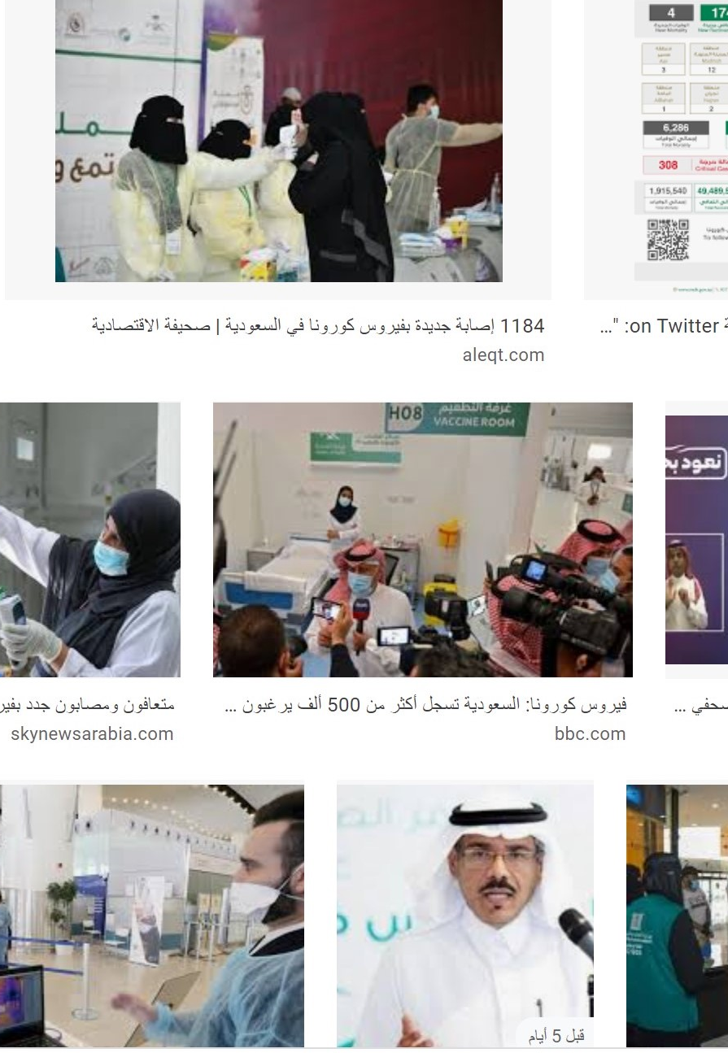
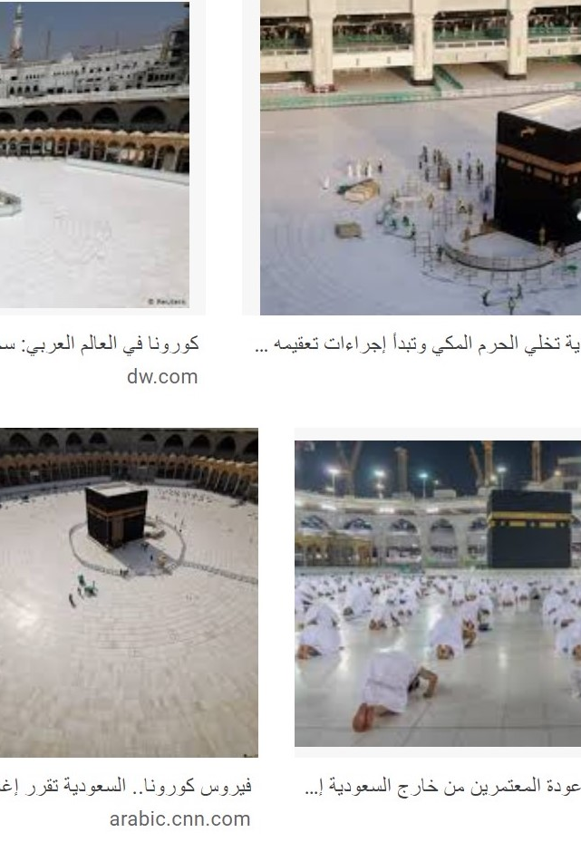

Slide 20


Slide 21
Enrichment
https://youtu.be/3EUyY4JTIXw
https://wordwall.net/resource/10873832

Slide 22

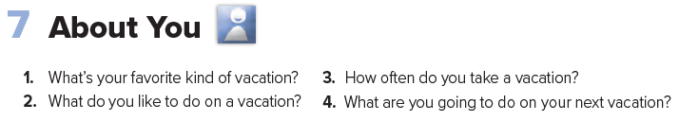
Homework

Slide 23
