Slide 1

Unit 16
What did you do last week?
Listen & Discuss

Slide 2
بسم الله الرحمن الرحيم
Day:
Date:

Slide 3
Objectives
01
State leisure activities , entertainments , and chores
02
Describe pastime activities
03
Use new words correctly

Slide 4
Warm up
What did you do yesterday? Last week? Last month?
Where did you go yesterday? Last week? Last month?

Slide 5
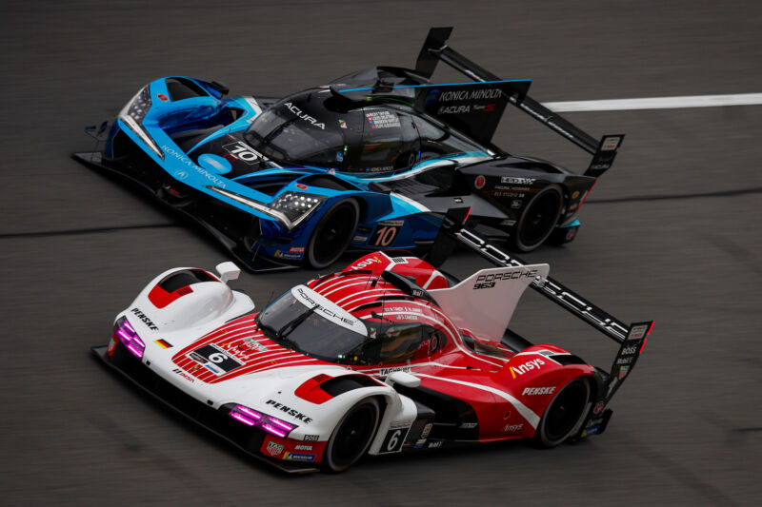
Vocabulary
Car race

Slide 6
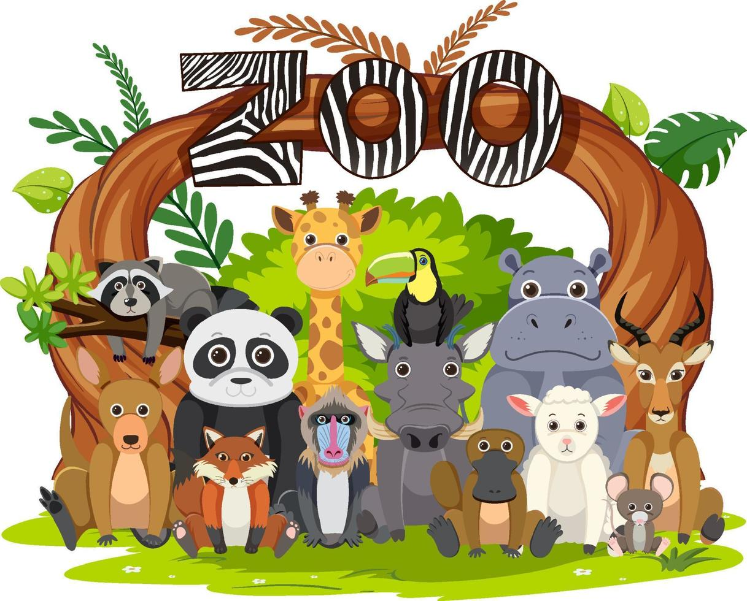
Vocabulary
Zoo

Slide 7
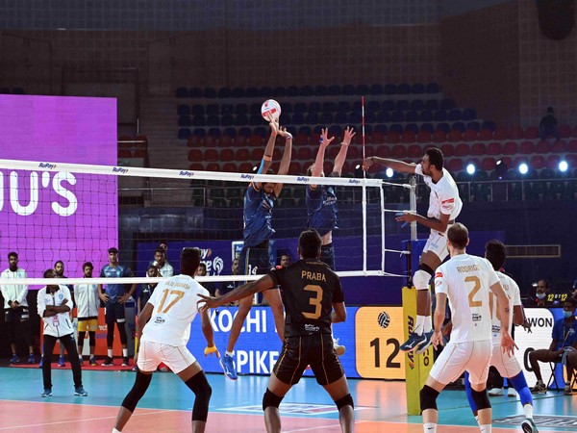
Vocabulary
Volleyball

Slide 8
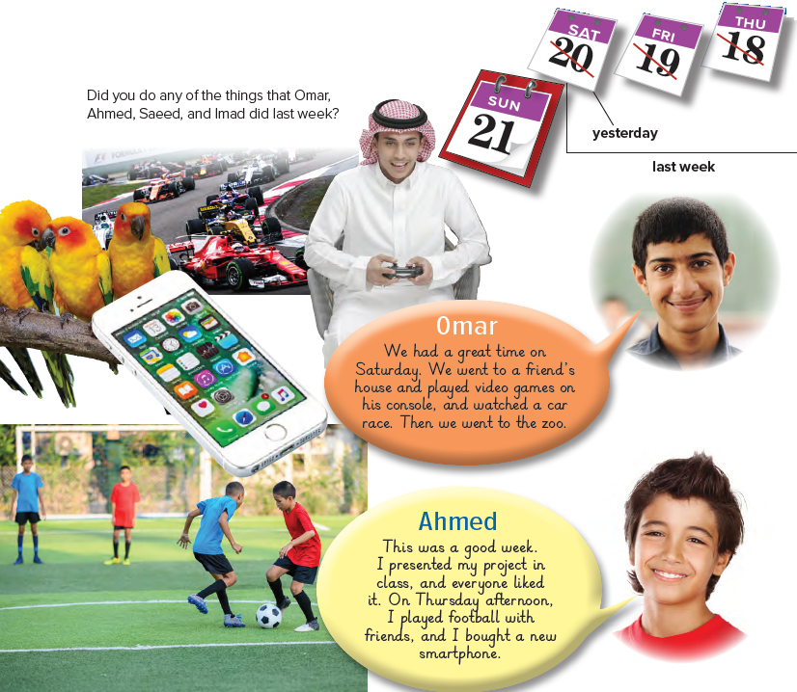

Listen & Discuss
Page 140

Slide 9
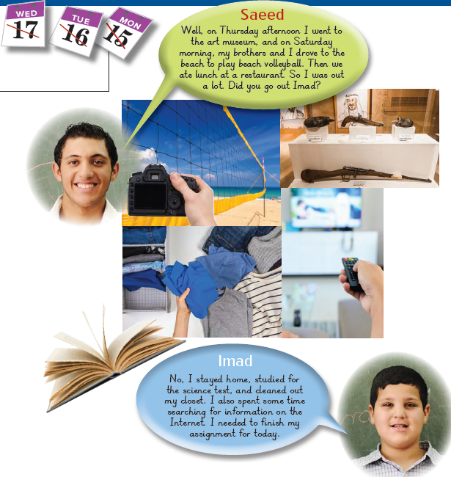
Page 141

Slide 10
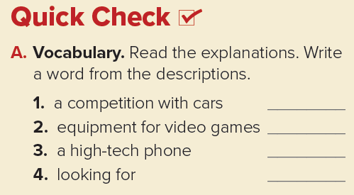
Car race
Console
Smartphone
Searching
Page 141

Slide 11
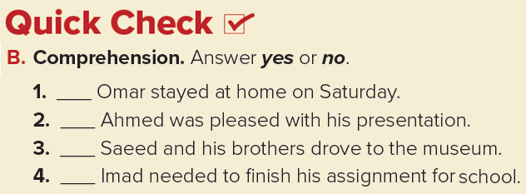
no
yes
no
yes
Page 141

Slide 12
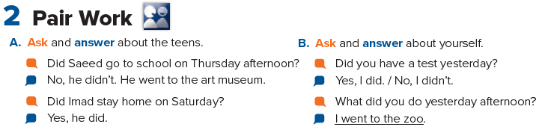
Page 141

Slide 13
Homework
Page 253

Slide 14
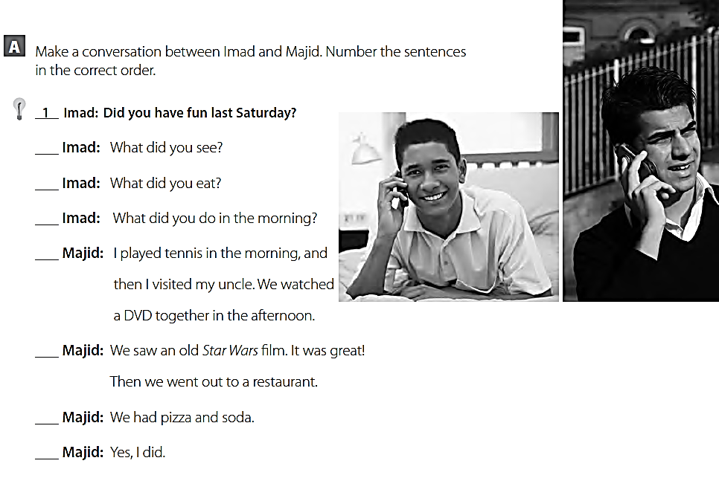
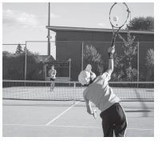
5
7
3
4
6
8
2

Slide 15
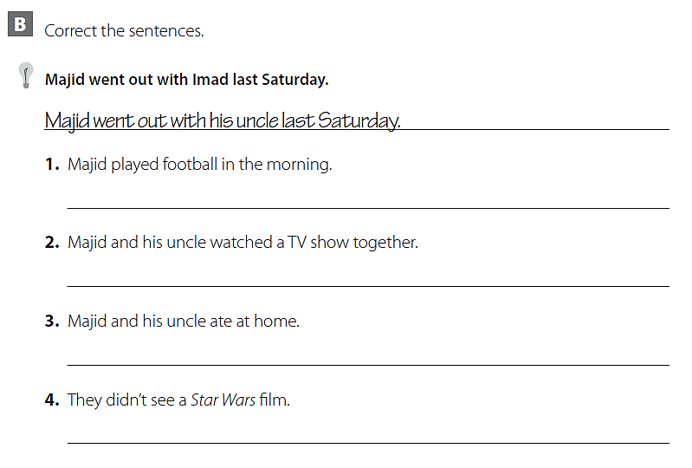
Majid played tennis in the morning.
Majid and his uncle watched a DVD together.
Majid and his uncle went out to a restaurant.
They saw a Star Wars film.

Slide 16
THANK YOU

