Slide 1
Unit 16
What did you do last week?
Grammar

Slide 2
بسم الله الرحمن الرحيم
Day:
Date:

Slide 3
Objectives
01
Form positive and negative sentences on the past
02
Determine regular and irregular verbs
03
Use time expressions in the past correctly
04
Answer questions after listening
05
Practice pronunciation correctly

Slide 4
Warm up
What did we learn yesterday?

Slide 5
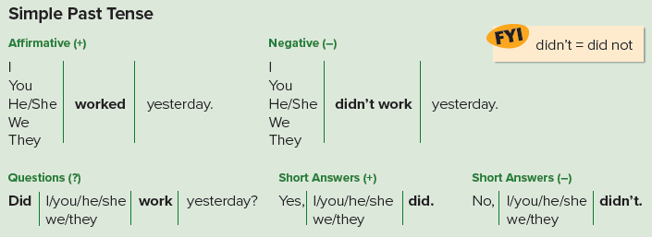
Page 142

Slide 6
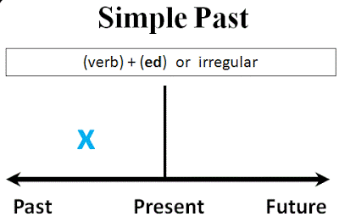
S + V (-ed // irregular ) + O

Slide 7
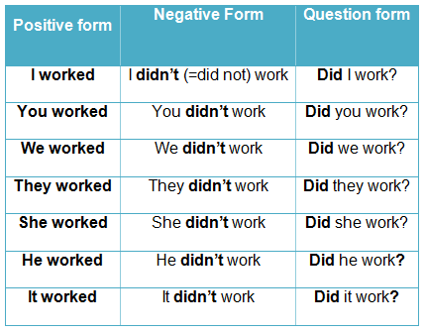

Slide 8
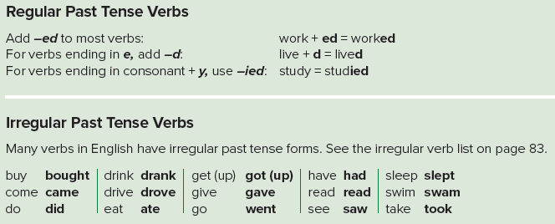
Page 142

Slide 9
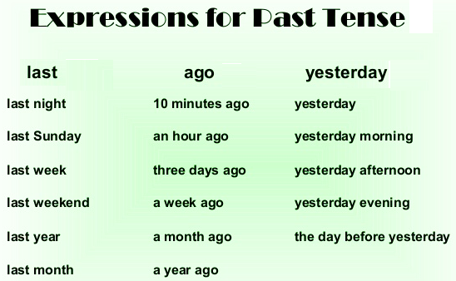
Page 142

Slide 10
Example
She studied math yesterday.
She didn’t study math yesterday.
Did she study math yesterday?

Slide 11
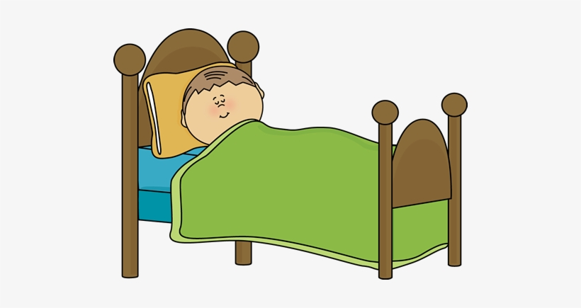
Example
He slept early last night.
He didn’t sleep early last night.
Did he sleep early last night?

Slide 12
Practice

Slide 13
Sample answers:
He didn’t do the laundry.
He took a walk.
Page 142

Slide 14
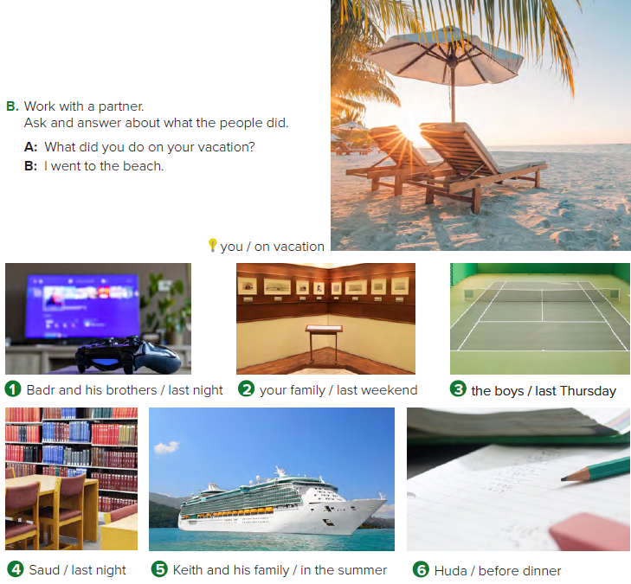
1. A: What did Badr and his brothers do last night?
B: They watched television/TV.
2. A: What did your family do last weekend?
B: We/They went to the museum.
3. A: What did the boys do last Thursday?
B: They played tennis.
Page 143

Slide 15
4. A: What did Ron do last night?
B: He went to the library./He read.
5. A: What did Keith and his family do in the summer?
B: The went on a cruise/to an island.
6. A: What did Huda do before dinner?
B: She did her homework.
Page 143

Slide 16
1. He went out with James.
2. They went to Gourmet’s, a restaurant near the lake.
3. They talked about James’s new car.
4. They went out on Thursday night.
5. No, he didn’t.
Page 143

Slide 17
Page 143

Slide 18
Homework
Page 254

Slide 19
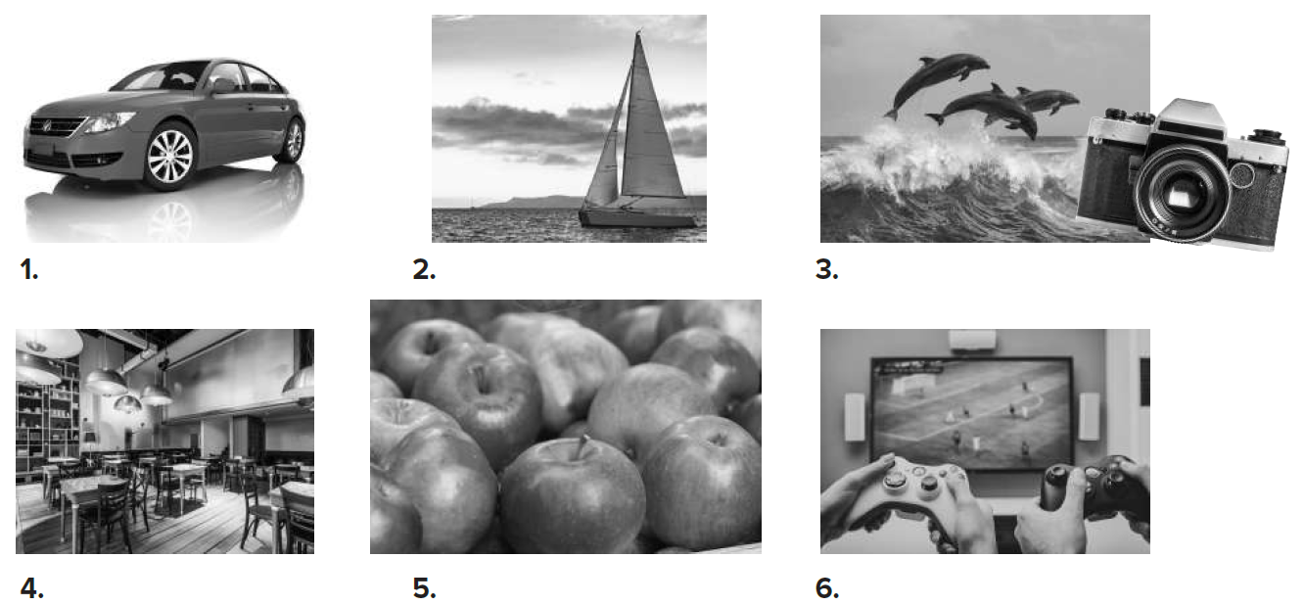
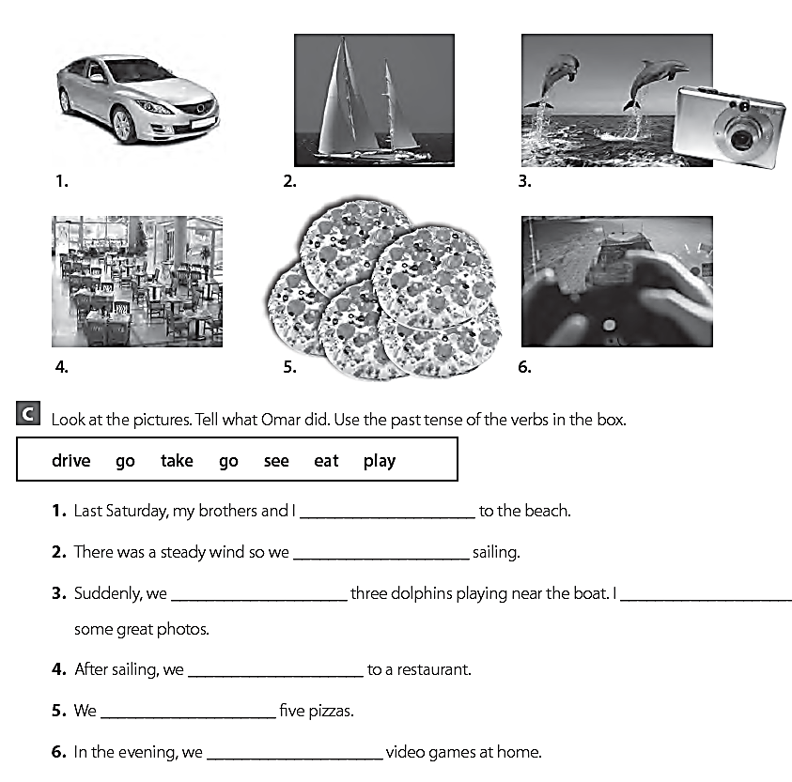
drove
went
saw
took
went
ate
played

Slide 20
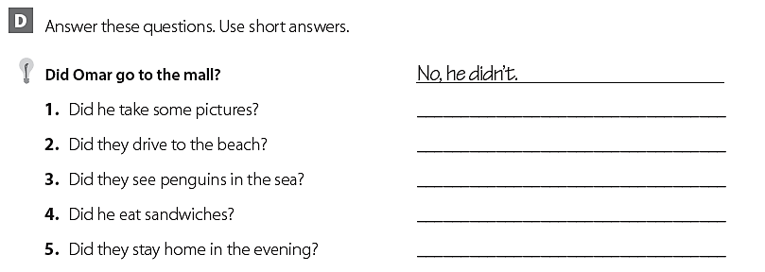
Yes, he did.
Yes, they did.
No, they didn’t.
No, he didn’t.
Yes, they did.

Slide 21
THANK YOU

