Slide 1
Unit 16
What did you do last week?
Form, meaning & Function

Slide 2
بسم الله الرحمن الرحيم
Day:
Date:

Slide 3
Objectives
01
Revise present tense rules
02
Revise past tense rules
03
Compare present tense to past tense

Slide 4
Page 147

Slide 5
Practice

Slide 6
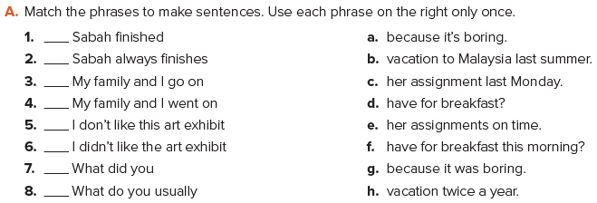
c
e
h
b
a
g
f
d
Page 147

Slide 7
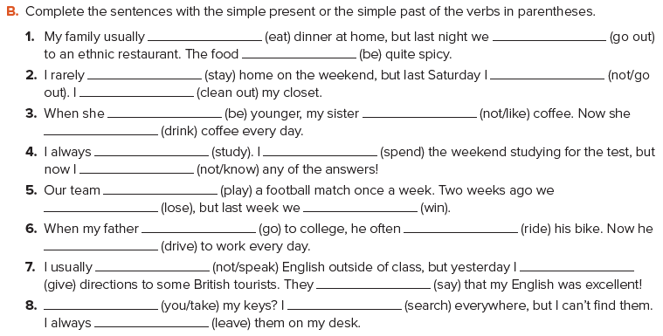
eats
went out
was
stay
didn’t go out
cleaned out
was
didn’t like
drinks
study
spent
don’t know
plays
lost
won
went
rode
drives
don’t speak
gave
said
Did you take
searched
leave
Page 147

Slide 8
Homework

Slide 9
THANK YOU

