Slide 1

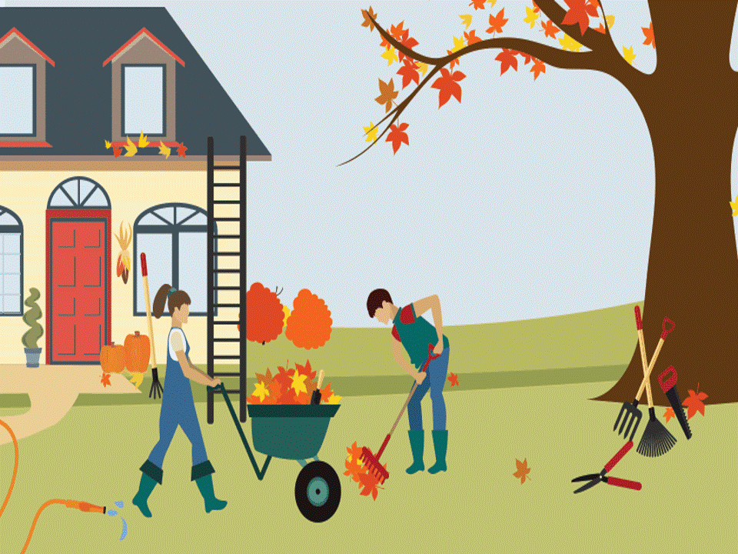
Good Morning 🌤

Slide 2
Today:
Date:
Thursday
21-10-1444

Slide 3

Check HomeWork:

Slide 4
Quick Review:
Q: What is the title of the last unit that we finished studying?
Let’s Celebrate
What are going to wear there?
Then and Now

Slide 5
Super Goal 1
Unit:16
Lesson:1
(Listen and Discuss)

Slide 6
What Did You Do Last Week ?

Slide 7
Open your book: P: 140 and 141
Objectives:
State leisure activities, entertainments, and chores
Describe pastime activities

Slide 8
Warm Up:
Q1: What did you do Last week?
Q2: Where did you go Last week?

Slide 9
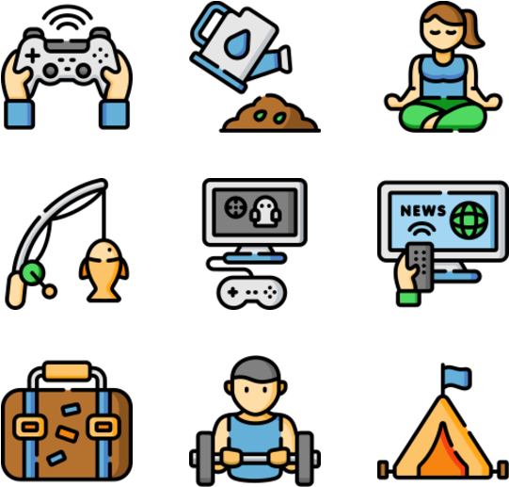
What can you see?
What activities did you do ?

Slide 10
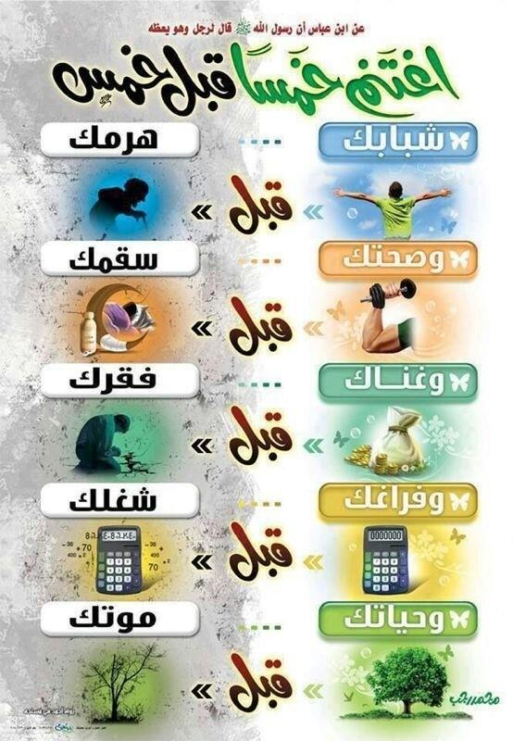

If we want to link our lesson today with Islamic religion, we can listen to this:

Slide 11
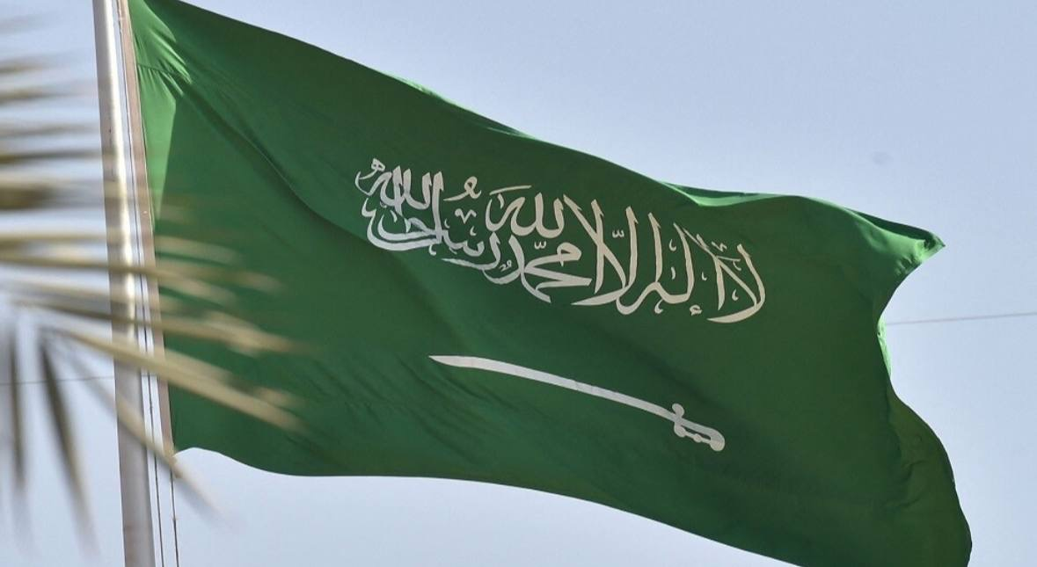
When we want to link our lesson with our homeland, we can say that: Saudi Arabia has developed a lot and has many interesting places, which helps people to go out during weekdays and enjoy their time, and the most famous of these places: the Riyadh season

Slide 12
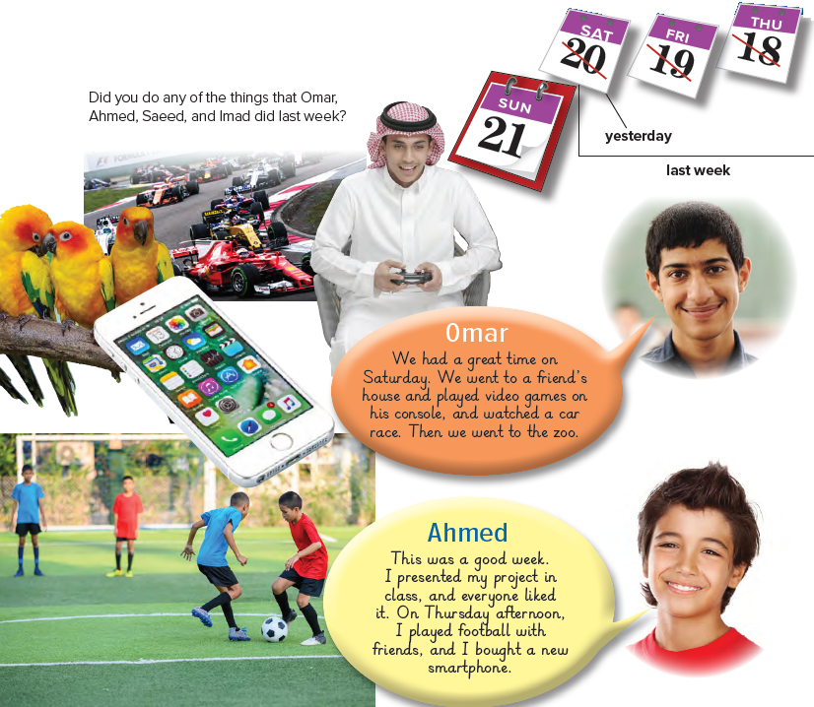
1- listen and Discuss:
Before Listen:
Q1: How Many boys do you see ?
Q2: What are their names?

Slide 13

1- listen and Discuss:
During Listening:
Q1: How Many boys do you see ?
Q2: What are their names?

Slide 14

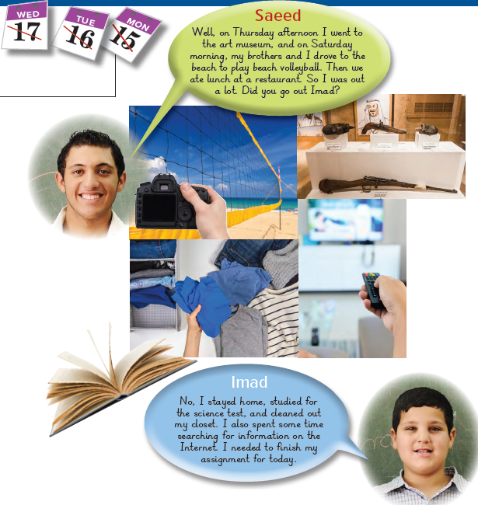
During Listening:
Q1: How Many boys do you see ?
Q2: What are their names?

Slide 15
Who can tell me the all days of the week in order:

Slide 16
Q1: What day did Omar went to friend’s house?
Q2: Was Omar happy?
Q3: What day did Ahmed bought a new smartphone?
Q4: Where did Ahmed present the project?
Q5: When Saeed went to the art museum?
Q6: Did Imad stay at home or did he go out?

Slide 17
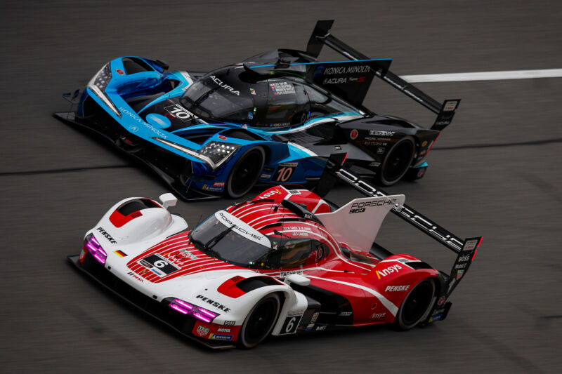
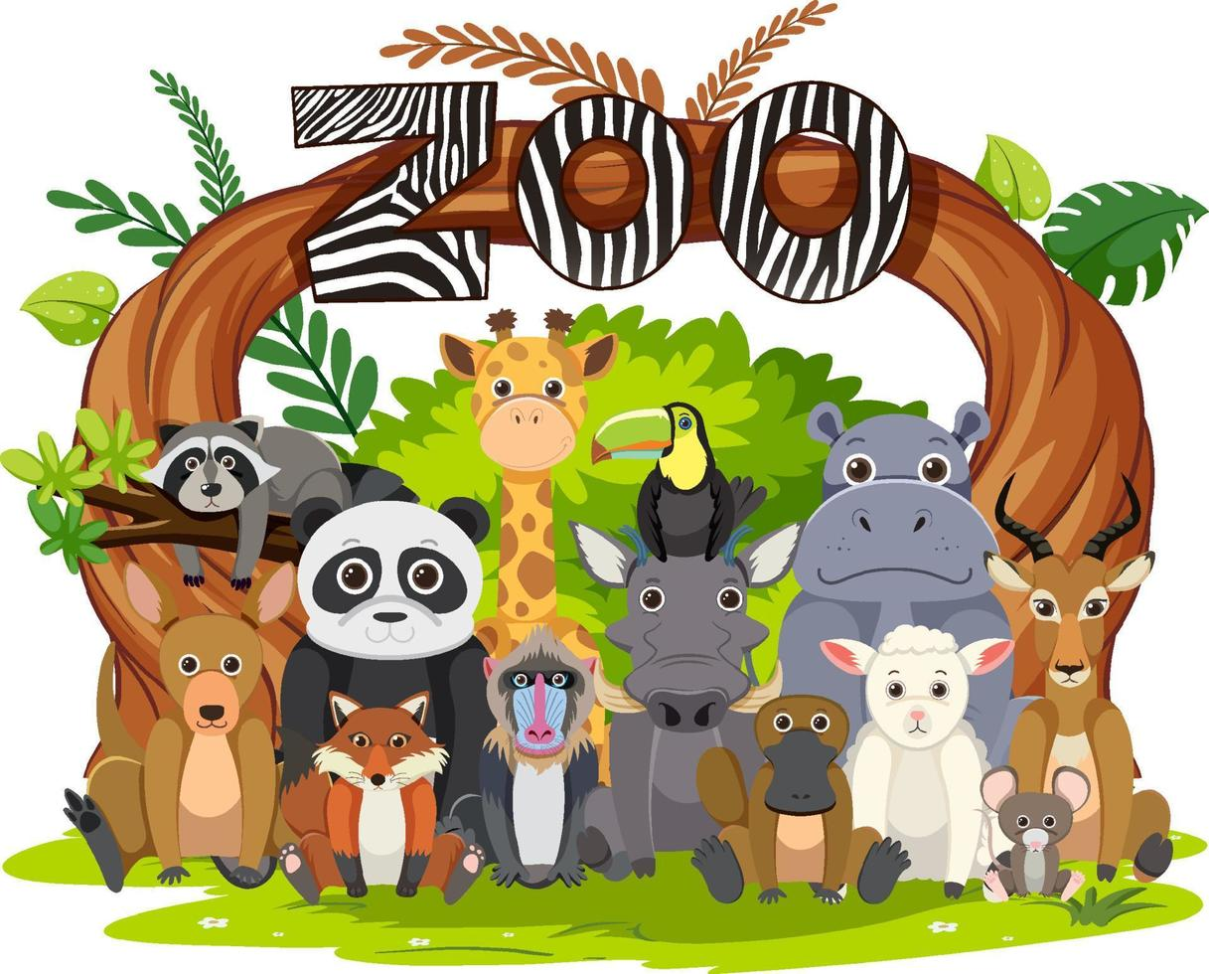
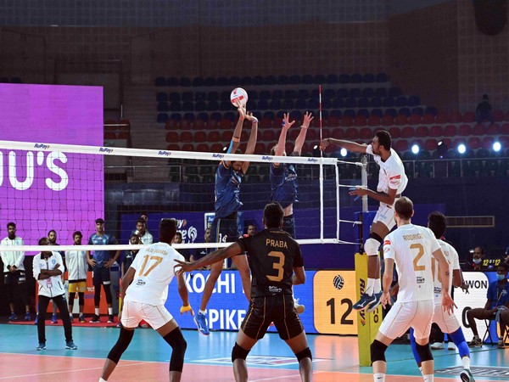
New Vocabulary:
Car Race
Zoo
Volleyball

Slide 18
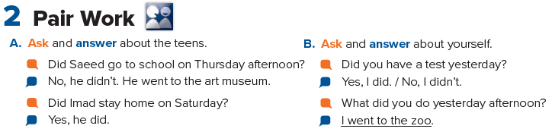

Slide 19
Fun
Time!

Slide 20
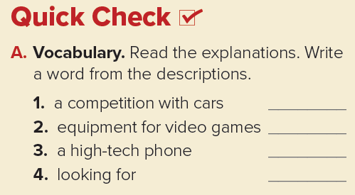
Car race
Console
Smartphone
Searching

Slide 21
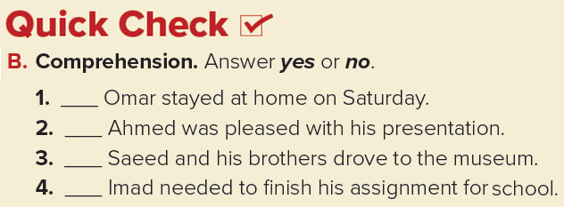
no
yes
no
yes

Slide 22


We Must not forget to enter the Madrasati platform and the Ain channel, Because it is important for the student

Slide 23

Exercise A and B
P:253

Slide 24
Thank You
Everyone 🌸

Slide 25

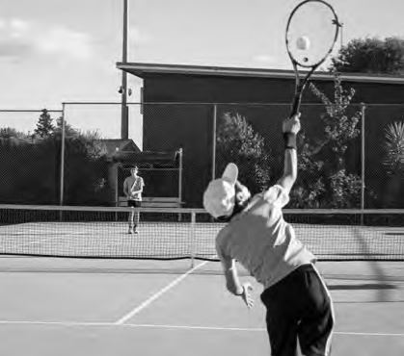
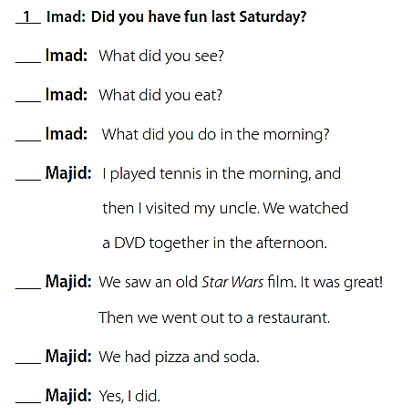
5
7
3
4
6
8
2

Slide 26


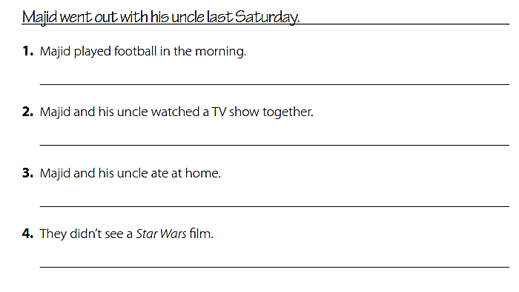
Majid played tennis in the morning.
Majid and his uncle watched a DVD together.
Majid and his uncle went out to a restaurant.
They saw a Star Wars film.

