Slide 1

Then and now
Unit 15
Grammar

Slide 2
بسم الله الرحمن الرحيم
Day:
Date:

Slide 3
Learning Objectives
Use simple past of the verb “ Be ”
Use the verb “ born ” in questions and statements
Complete information after listening
Practice pronunciation of “was” & “were”
1
2
3
4

Slide 4
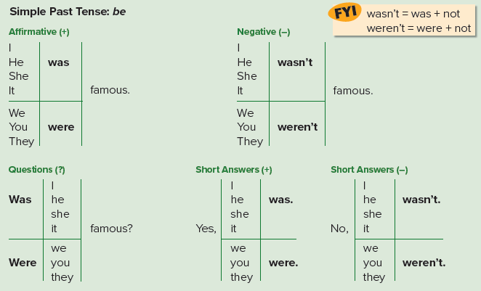
Page 134

Slide 5
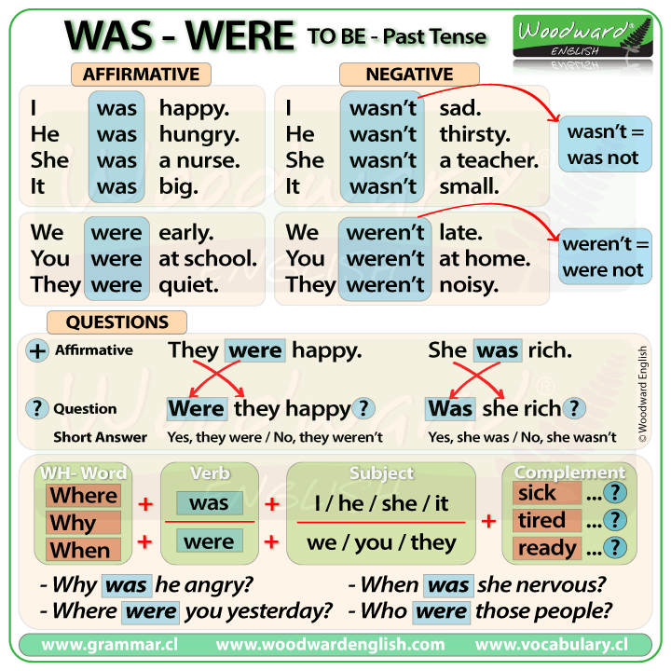

Slide 6

Practice

Slide 7
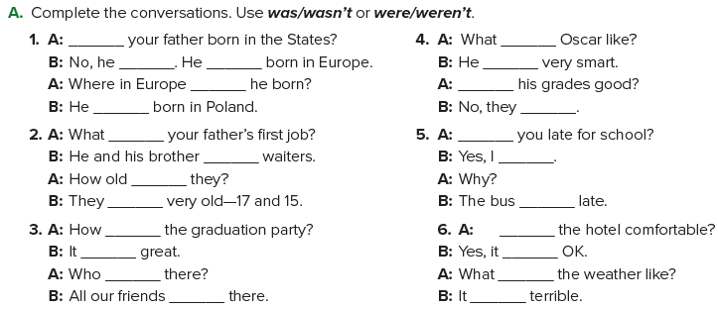
was
was
wasn’t
was
was
was
Were
was
weren’t
was
Were
were
was
were
weren’t
was
was
Was
was
was
was
was
were
was
Page 134

Slide 8

Page 134

Slide 9
Practice

Slide 10
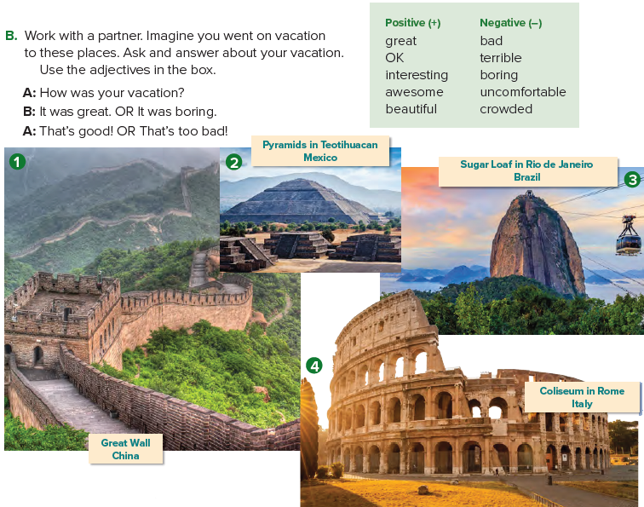
Page 135

Slide 11
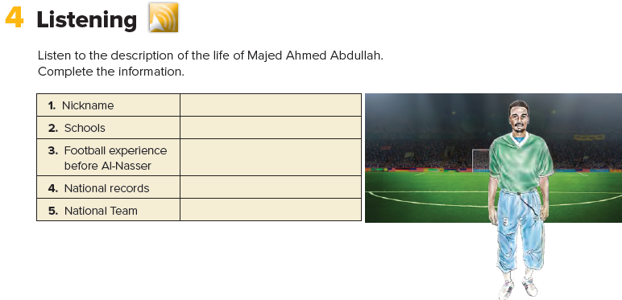

Arabian Pelé
Al-Jazaeria Elementary School, Al-Motawasta Al-Thania High School
goalkeeper for his school and neighborhood team, formed a team with his friends when he was in high school
two
Under 17 National Team in 1977, Senior National Team in 1978 for 16 years
Page 135

Slide 12
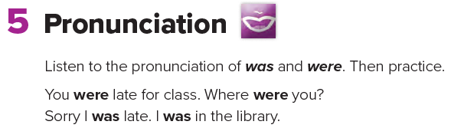


Slide 13
Homework
Page 250

Slide 14
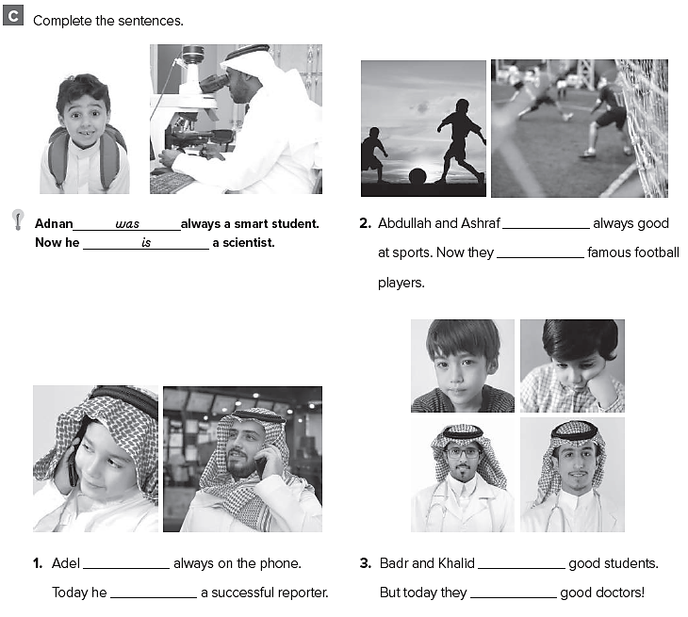
were
are
weren’t
weren’t
are
were

Slide 15
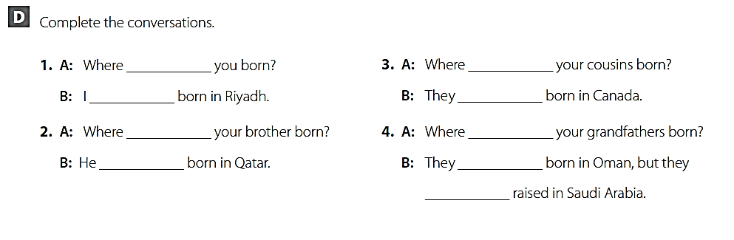
were
were
was
were
was
were
was
were
were

Slide 16
Thank you

