Slide 1

Unit 12
Culture Shock
Lesson 2
Grammar

Slide 2



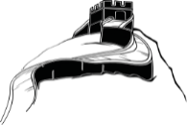







بسم الله الرحمن الرحيم
Day:
Date:

Slide 3




Learning Objectives
Formulate infinitive following certain verbs
State customs using " verb + noun/pronoun + inf "
Use expressions of advice
Build sentences using gerund as a subject

Slide 4
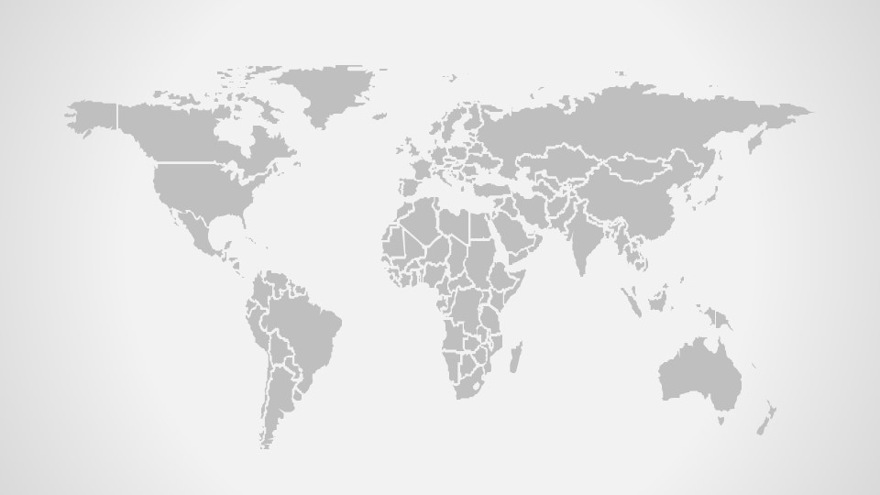
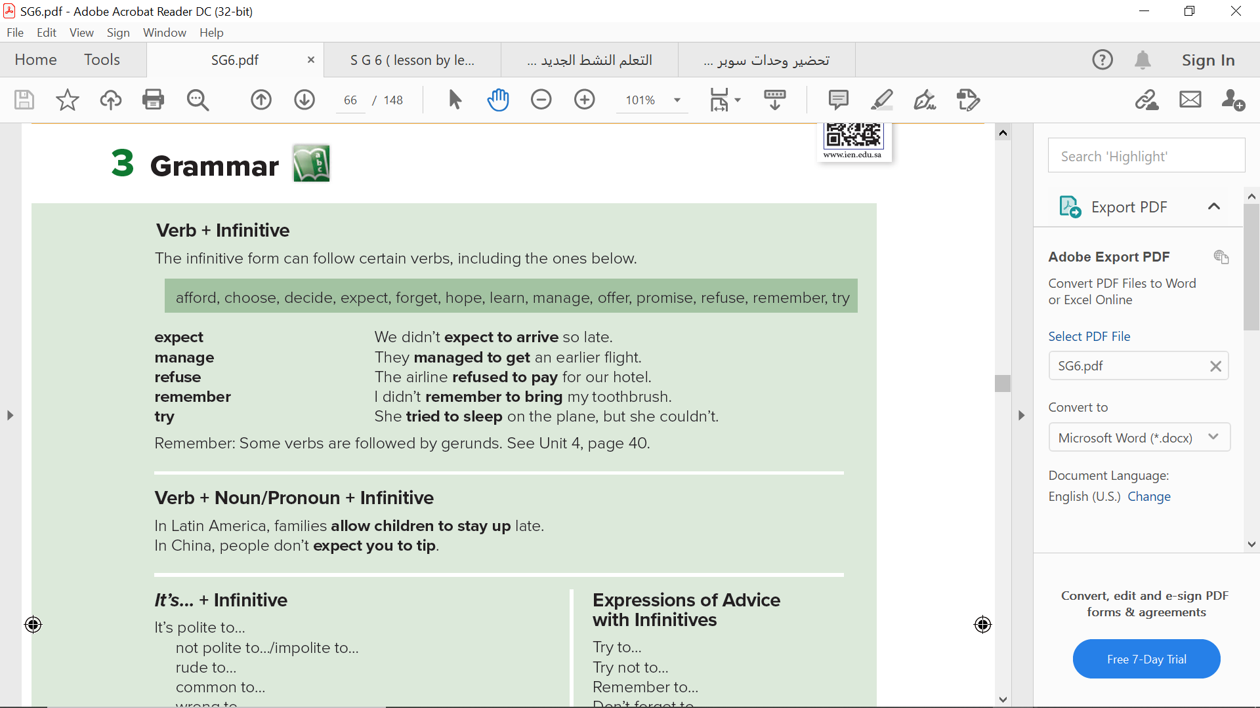
Page 126

Slide 5
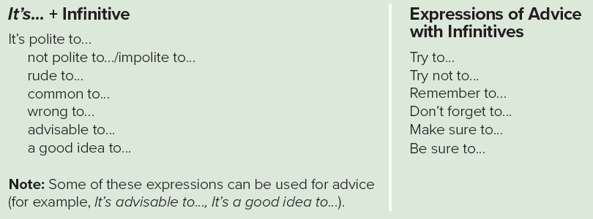
Page 126

Slide 6
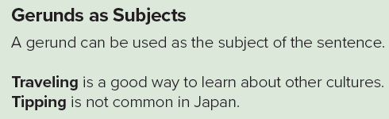
Page 126

Slide 7






Practice

Slide 8
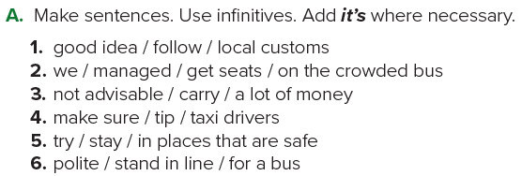
1. It’s a good idea to follow local customs.
2. We managed to get seats on the crowded bus.
3. It’s not advisable to carry a lot of money.
4. Make sure to tip taxi drivers.
5. Try to stay in places that are safe.
6. It’s polite to stand in line for a bus.
Page 126

Slide 9
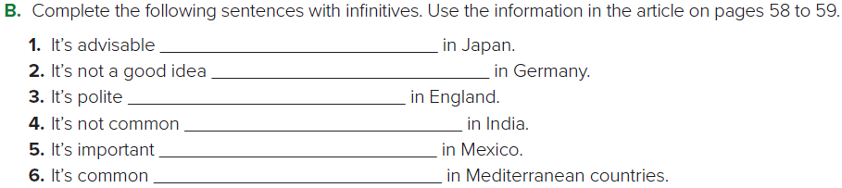
to exchange business cards
to be late for an appointment
to say sorry
to wear shoes in the house
to use university graduates’ titles
to eat dinner late
Page 127

Slide 10
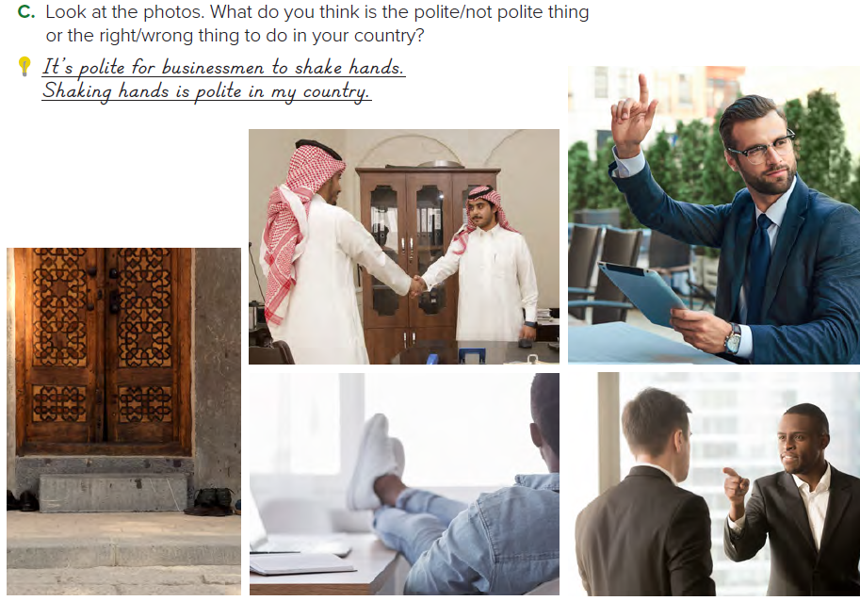
Sample Answers :
It’s polite to remove your shoes at a mosque.
Removing your shoes at a mosque is the polite thing to do.
It’s impolite to shout at the waiter.
Raising your hand is the right thing to do.
Page 127

Slide 11
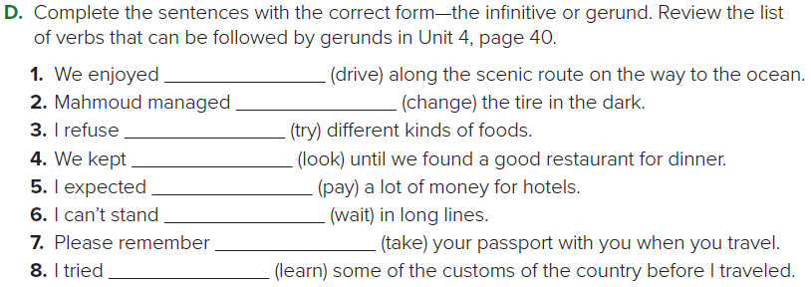
driving
to change
to try
looking
to pay
waiting
to take
to learn
Page 127

Slide 12
Home Work
Workbook page 246

Slide 13
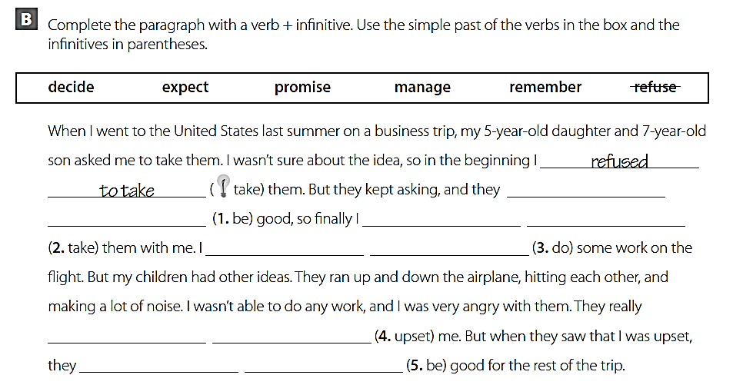
promised to
be
decided to
take
expected to
do
managed to
upset
remembered to
be

Slide 14
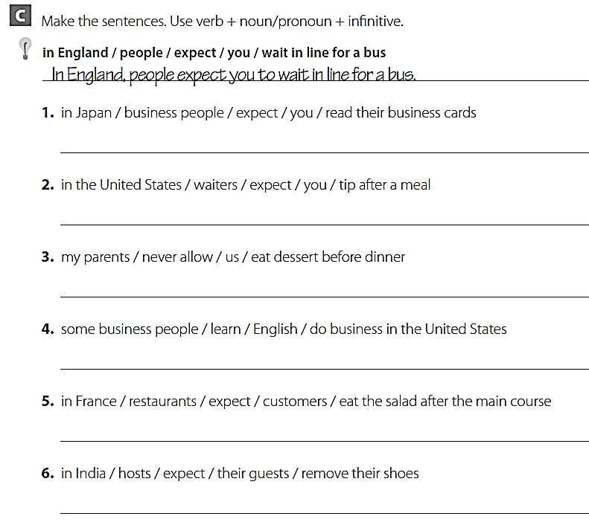
In Japan, business people expect you to read their business cards
In the United States, waiters expect you to tip after meal.
My parents never allow us to eat dessert before dinner
Some business people learn English to do business in the United States
In France, restaurants expect customers to eat the salad after the main course
In India, hosts expect their guests to remove their shoes.

Slide 15






USA
PERU
EUROPE
AUSTRALIA

