Slide 1

Unit 12
Culture Shock
Lesson 4
Conversation

Slide 2











بسم الله الرحمن الرحيم
Day:
Date:

Slide 3




Learning Objectives
listen for specific information in a conversation
practice using real talk phrases
Express surprise
answer questions about the conversation

Slide 4

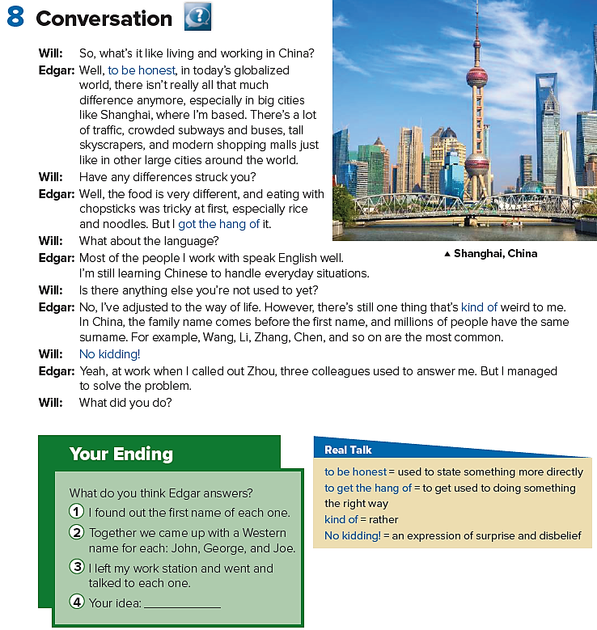
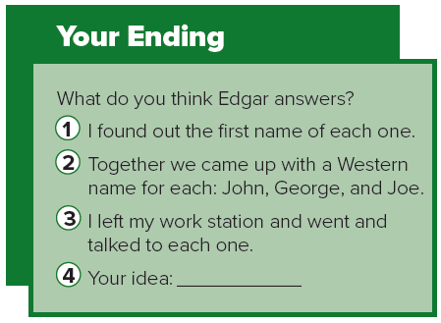

Page 129

Slide 5
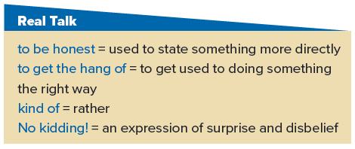
Page 129

Slide 6
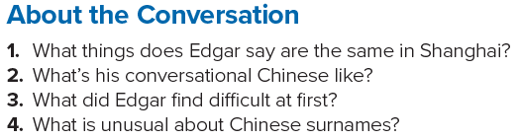
1. There’s a lot of traffic, crowded buses, tall buildings, and modern shopping malls.
2. He’s still learning Chinese for everyday situations.
3. Eating with chopsticks was difficult for him at first.
4. The surnames come before the first names, and millions of people have the same surname.
Page 129

Slide 7
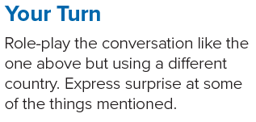
Page 129

Slide 8





Home Work
Workbook page 248

Slide 9
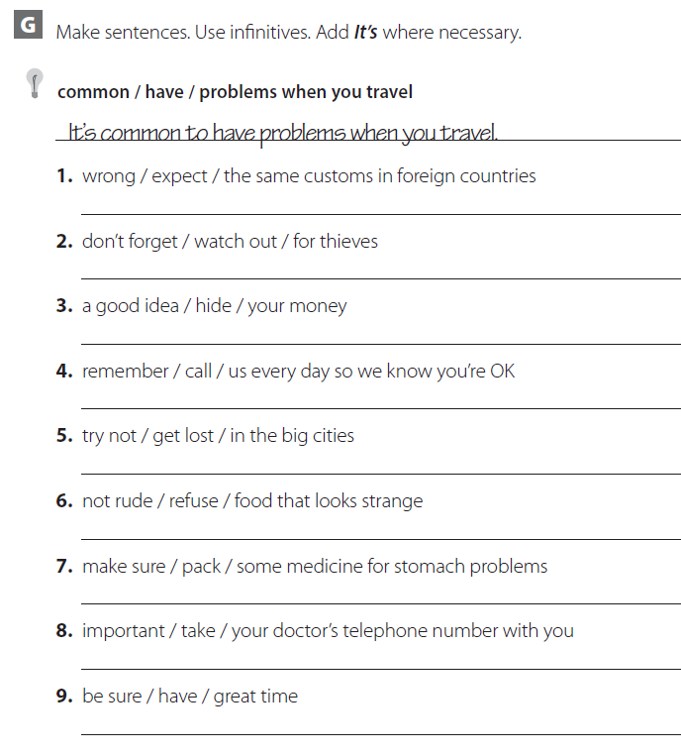
It’s wrong to expect the same customs in foreign countries
Don’t forget to watch out for thieves
It’s a good idea to hide your money
Remember to call us every day so we know you’re OK
Try not to get lost in the big cities
It’s not rude to refuse food that looks strange
Make sure to pack some medicine for stomach problems
It’s important to take your doctor’s telephone number with you
Be sure to have great time

Slide 10
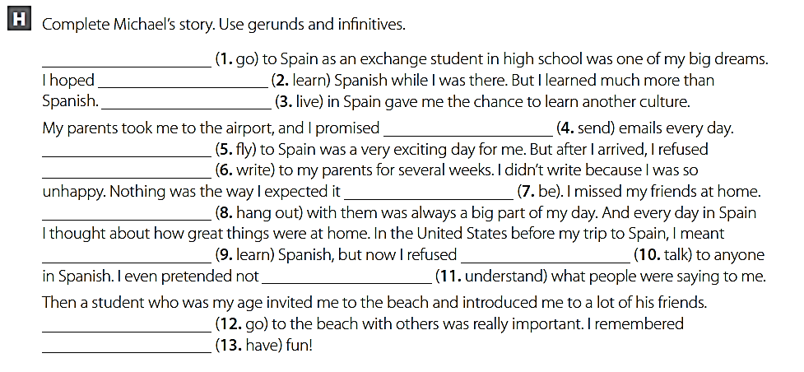
going
to learn
living
to send
flying
to write
to be
hanging out
to learn
to take
to understand
Going
to have

Slide 11






USA
PERU
EUROPE
AUSTRALIA

