Slide 1
Unit 12
Culture Shock
Lesson 7
Revision

Slide 2
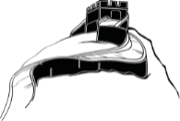
بسم الله الرحمن الرحيم
Day:
Date:

Slide 3
Choose the correct answers:
1. We didn’t expect ( arriving – arrives – to arrive ) late
2. Please remember to ( bring –brings –bringing) your passport.
3. Be sure ( to check – checking –checks ) his temperature.
4. ( Tips –Tipping –to tip ) is not common in China.
5. After she had ( go –goes –gone ) to the restaurant, she exchanged some money.
6. Our flight had already ( leave- leaving –left).
7. Have you ever ( eat –ate –eaten ) Sushi?
8. He had washed the car before it ( rains – raining – rained)
9. She is used to ( drink – drinking –drinks ) coffee every morning.
10. I am not used to ( speaking –speak –speaks ) Latin.

Slide 4
Correct the mistakes:
1. It is rude to wearing shoes inside the house.
It is rude to wear shoes inside the house.
Travel is a good way to learn about cultures.
Traveling is a good way to learn about cultures.

Slide 5
Correct the mistakes:
We use to walk to school.
We used to walk to school
4. She had already leaves.
She had already left.

Slide 6
Match words with their meaning
5
1- flexible |  | a- beliefs about what right or wrong
2- frustrating |  | b- able to change in different situations
3- homesick |  | c- level or phase
4- stage |  | d- annoying
5- values |  | e- missing home and family
1
4
2
3

Slide 7
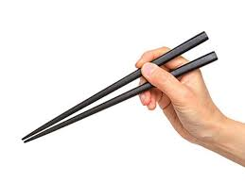
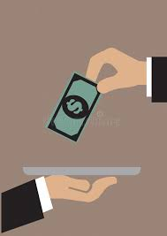
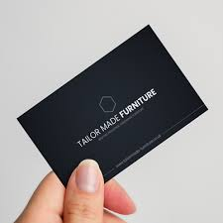
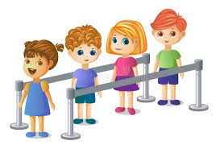
Match words with pictures
Standing in line –chopsticks – bowl –tip –business card
chopsticks
Business card
tip
Standing in line

Slide 8
The End

