Slide 1

Making Choices
Unit 5

Slide 2
Listening - Conversation
Objectives
State effects of an issue after listening to audio script
Produce consonant clusters
3. Practice a conversation
4. Answer the questions
5. Present effects of actions

Slide 3
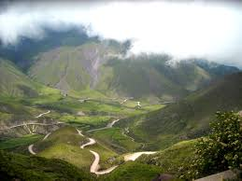
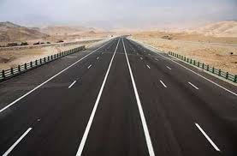

What is the difference between the 2 pictures?
Which route is better for the environment?

Slide 4
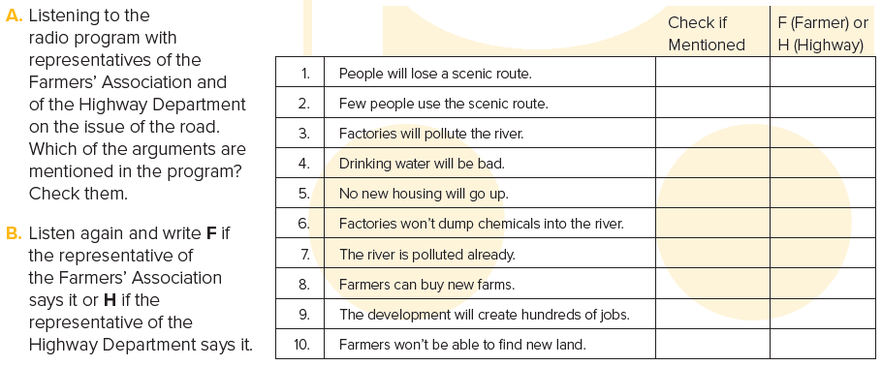


Slide 5

P. B. p. 118
F
F
F
H
H
H

Slide 6
Discuss whether you support the Farmers’ Association or the Highway
Department.
Give reasons for your position?

Slide 7
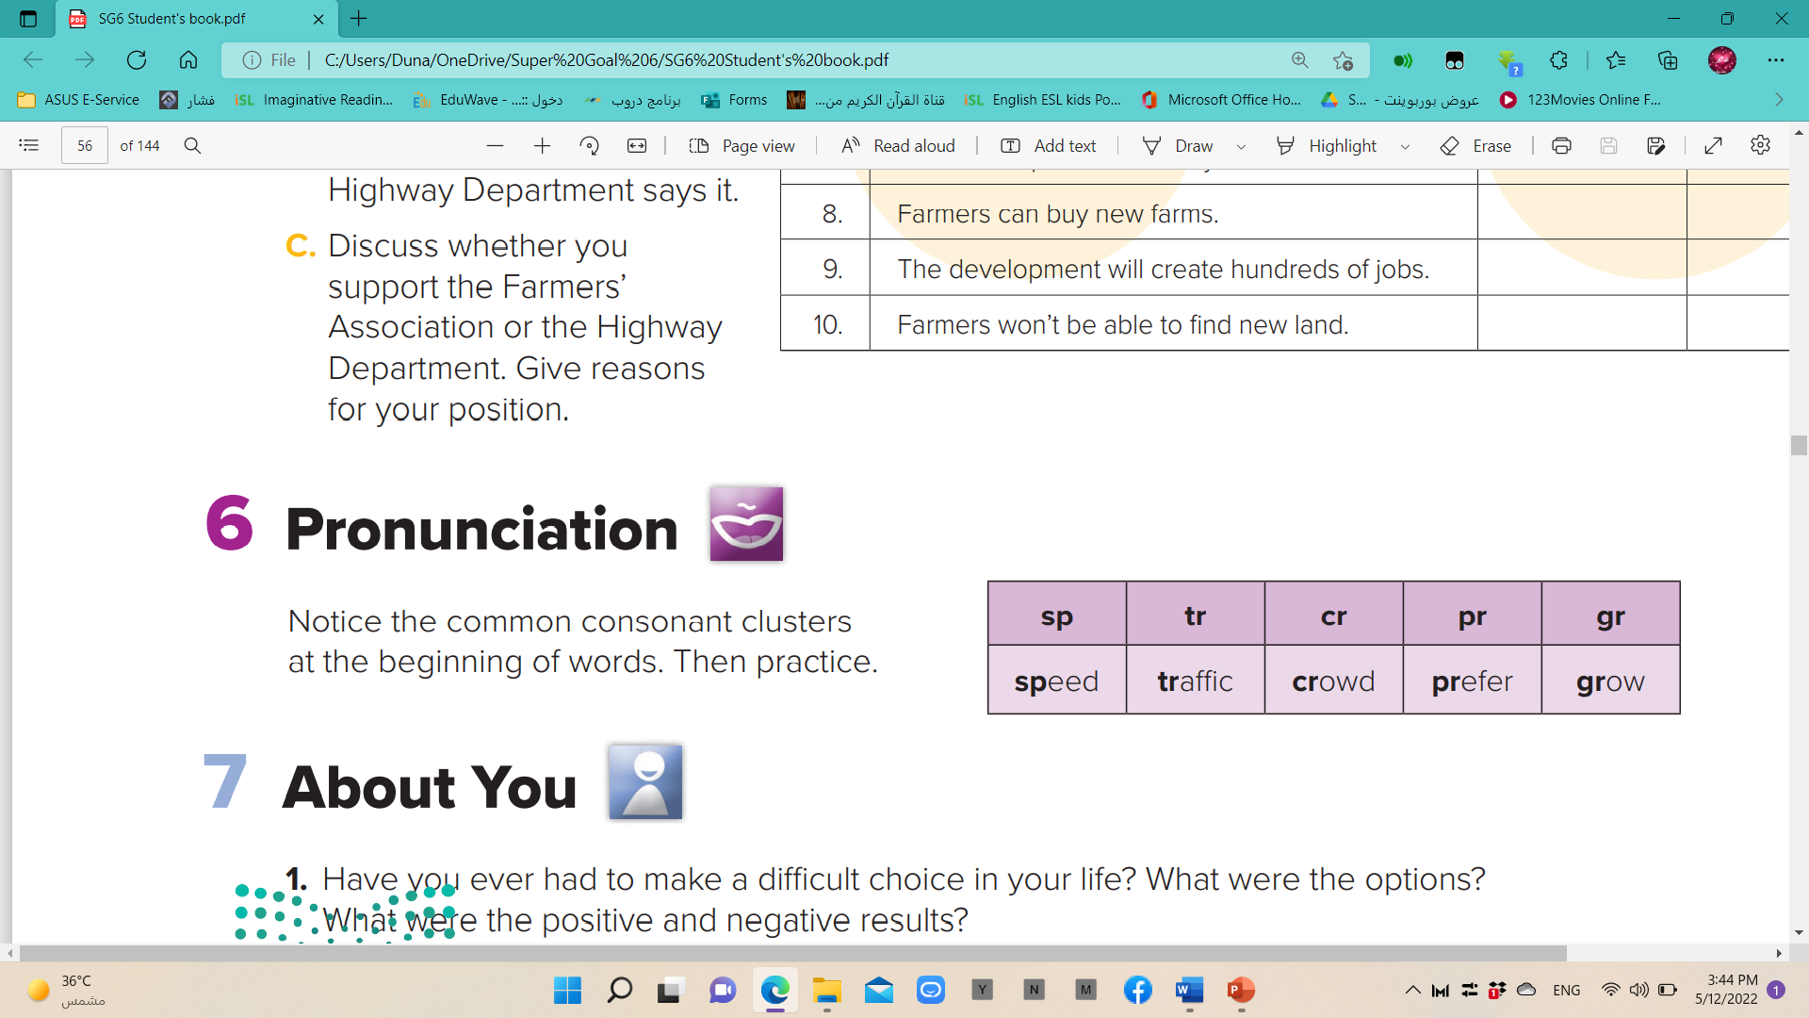
P. B. p. 118

Slide 8

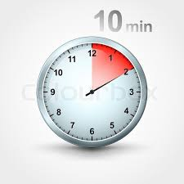
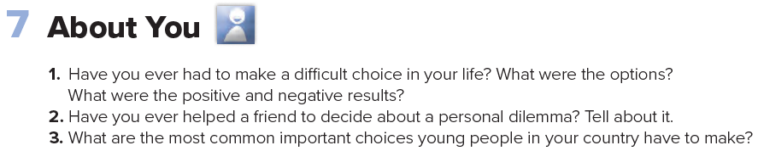
P. B. p. 118

Slide 9
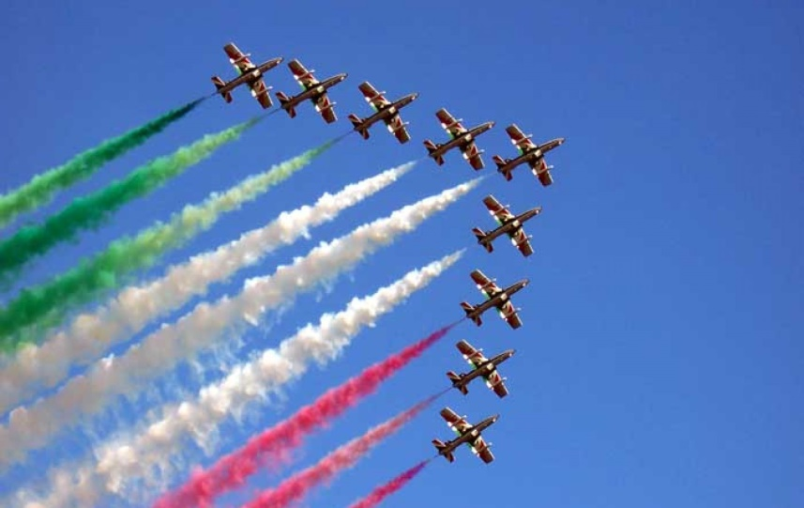
What is an airshow?
What do you know about airshows?
Have you ever been to one?
Would you like to see it?

Slide 10


Slide 11

Conversation
How many people are talking?
What are they talking about?

Slide 12
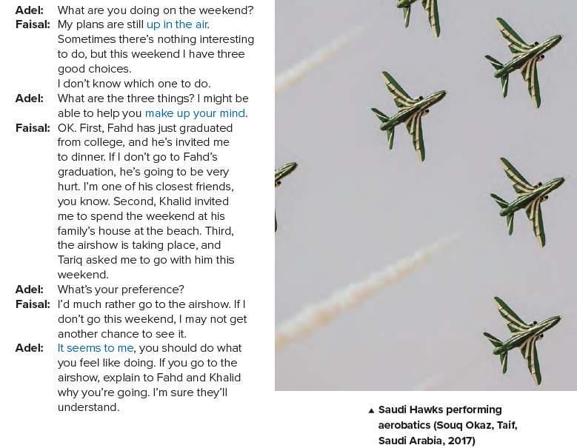
P. B. p. 119

Slide 13

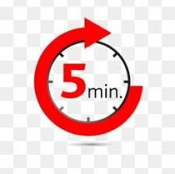

Slide 14
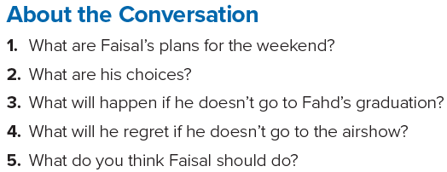
P. B. p. 119

Slide 15
1. Faisal’s plans are not certain.
2. His choices are to go to Fahd’s graduation dinner, to spend the weekend at Khalid’s family’s house at the beach, or to go to the
airshow with Tariq.
3. Fahd will be hurt.
4. He may not get another chance to see it.
5. He …………..

Slide 16
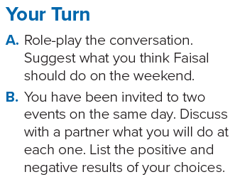

Slide 17


