Slide 1

Making Choices
Unit 5

Slide 2
Writing
Objectives
Use gerunds and phrases in writing.
2. Extract gerunds from a written text

Slide 3


Slide 4

Gerunds
1. as a subject: cooking is hard
2. After certain verbs :
love / hate / start / imagine
3. After prepositions:
before/ after/ for
4. After some expression:
can’t stand/ how about / feel like /
not worth
5. After go: I go swimming every week.

Slide 5
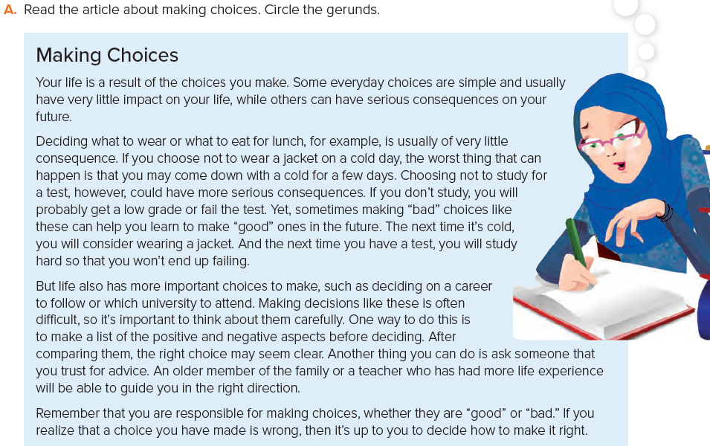

P. B. p. 56

Slide 6

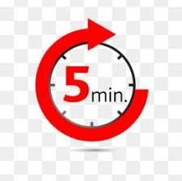
https://youtu.be/58GjdEwZgLg

Slide 7
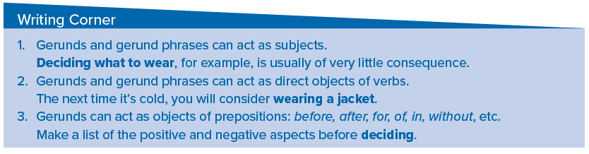

Slide 8


Slide 9
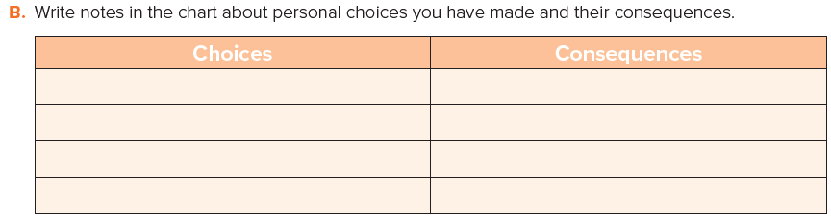
Told a classmate a family
secret
She spread it

Slide 10
C
Write about choices that you have made and their positive or negative consequences.
Who has influenced your choices? What have you learned from the “bad” choices?

Slide 11
6
My mom found out and she was very mad at me and wouldn’t talk to me for a week.
Once, I told a classmate about some problems we had at home; even though my mom warned me not to tell anyone.
2
8
Since then, I choose my friends and confidant very carefully.
4
I was sure she’d keep the secret.
1
Sometimes, it’s very hard to take a decision and stand by it.
3
But she was my friend and I loved her.
7
I was so shocked and ashamed. I learned that just because people seem nice and friendly it doesn’t mean they’re trust worth.
5
Unfortunately, she told everyone.

Slide 12
Sometimes, it’s very hard to take a decision and stand by it. Once, I told a classmate about some problems we had at home; even though my mom warned me not to tell anyone. But she was my friend and I loved her. I was sure she’d keep the secret. Unfortunately, she told everyone. My mom found out and she was very mad at me and wouldn’t talk to me for a week. I was so shocked and ashamed I learned that just because people seem nice and friendly it doesn’t mean they’re trust worth. Since then, I choose my friends and confidant very carefully.

Slide 13

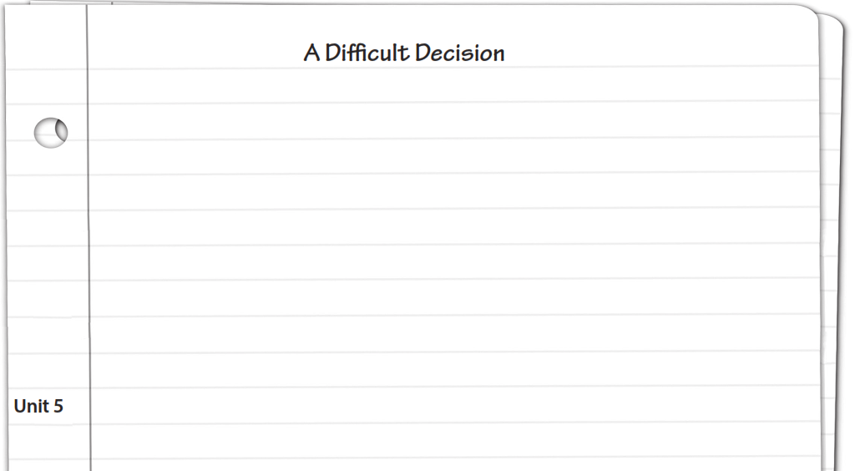
Sometimes, it’s very hard to take a decision and stand by it. Once, I told a classmate about some problems we had at home; even though my mom warned me not to tell anyone. But she was my friend and I loved her. I was sure she’d keep the secret. Unfortunately, she told everyone. My mom found out and she was very mad at me and wouldn’t talk to me for a week. I was so shocked and ashamed I learned that just because people seem nice and friendly it doesn’t mean they’re trust worth. Since then, I choose my friends and confidant very carefully.

Slide 14

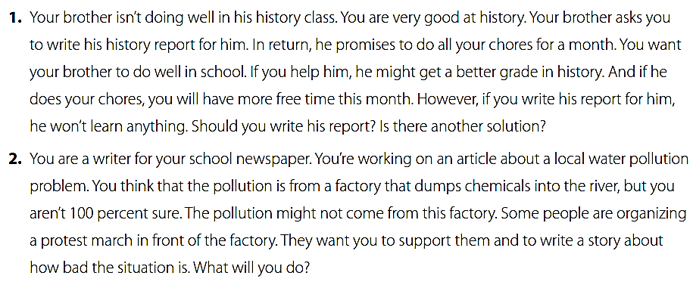

W. B. p. 120

Slide 15
W. B. p. 122
Choose one situation.
List some ideas for and against your choice.
I’d like to support people who help the environment.
If I march with them, I will tell them that I have to write the article about the truth.
If I see that there is pollution, I will write about that.
If I don’t see pollution, I will write about that.
A reporter’s job is to be honest and report what is happening.

Slide 16


