Slide 1

UNIT 7
Writing
P 62
Tr. Nora Khalid

Slide 2

Use subject and object pronouns.
Use possessive objectives.
Write about a celebrity in Ss country.
Objectives

Slide 3
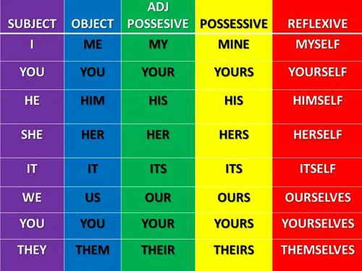

Slide 4
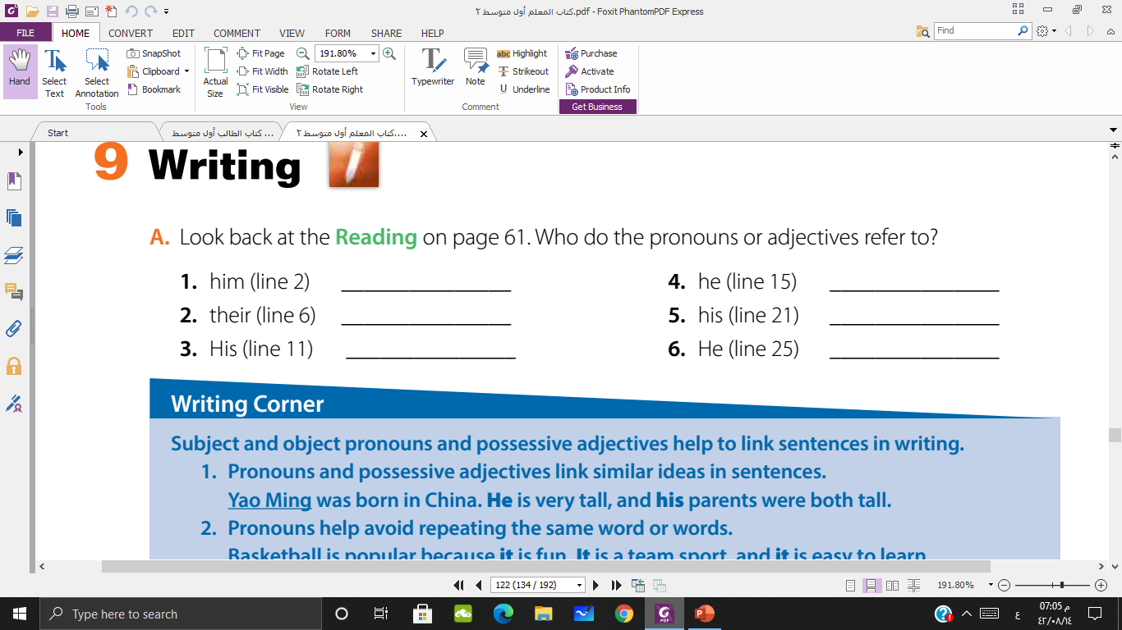
Yao Ming
Yao Ming
His parents
Yao Ming
Yao Ming
Yao Ming

Slide 5
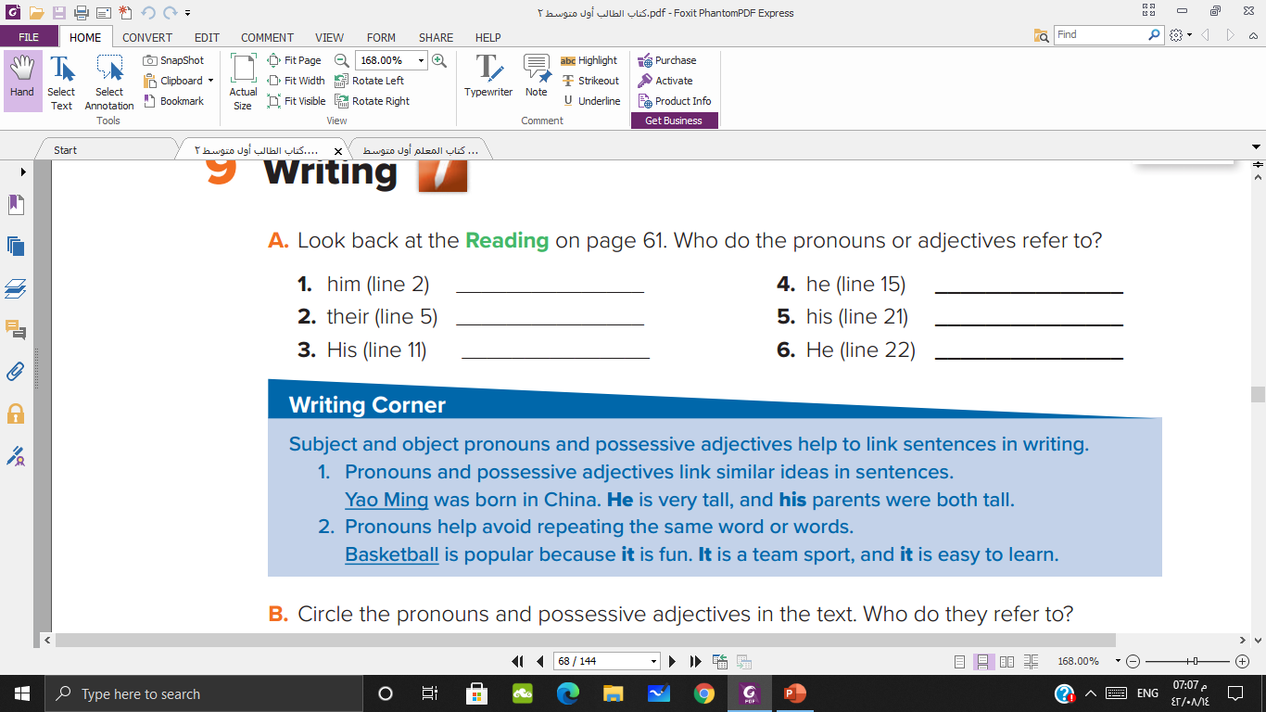

Slide 6
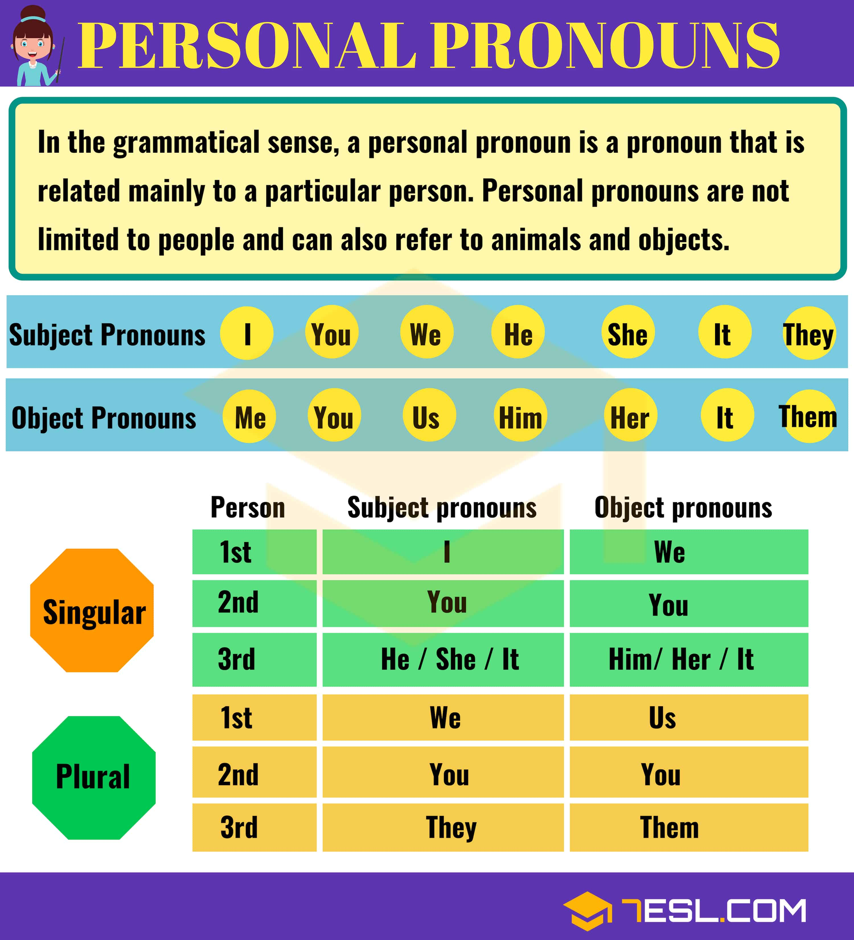

Slide 7
Basketball is popular because basketball is fun. Basketball is a team sport, and basketball is easy to learn.
Basketball
it
It
it

Slide 8
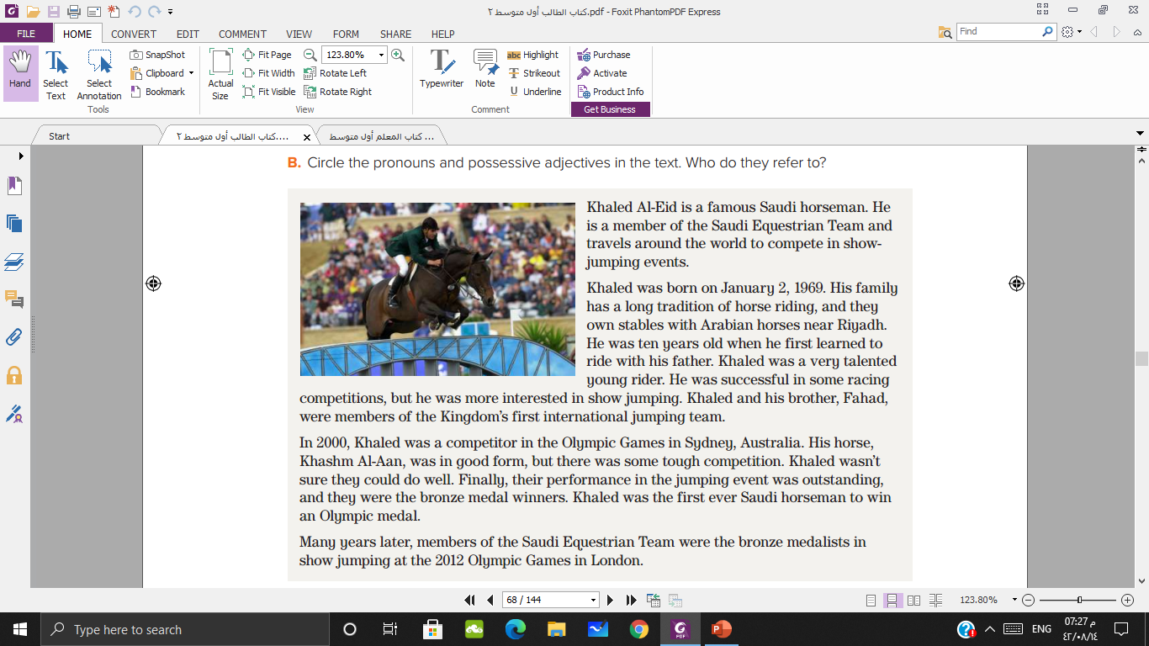

Slide 9
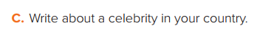


Slide 10


