Slide 1
Unit 7 Reading p 61
Tr. Nora Khalid

Slide 2
Objectives:
Read a text about a basketball player using chronology of events strategy.
Answer some questions about the text.

Slide 3
What’s your favorite sport?

Slide 4
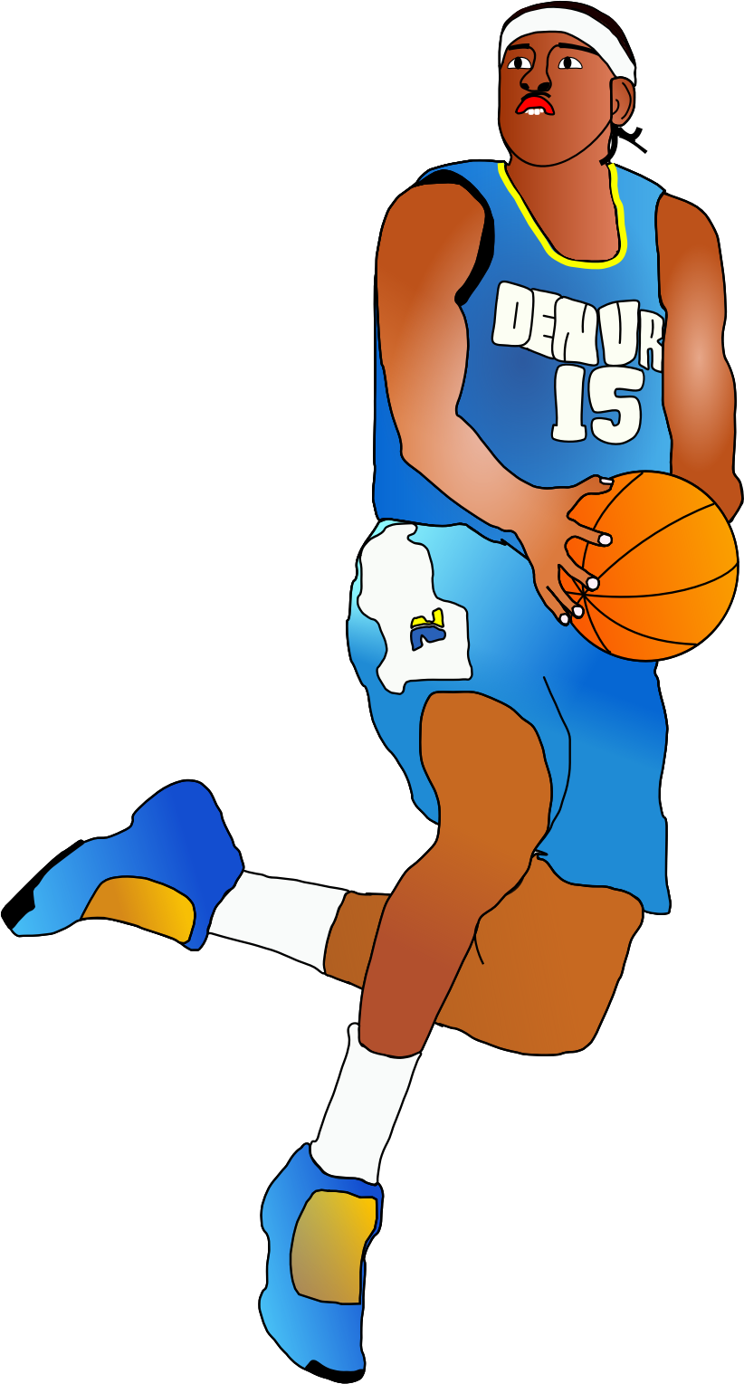

What’s this sport?

Slide 5
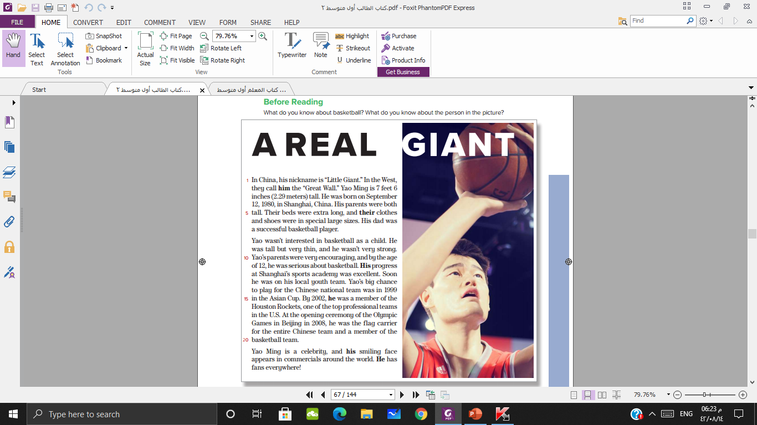



The title
The paragraphs

Slide 6
The country
The player

Slide 7

This is a biography about prophet Mohammed peace upon him
a biography of a person’s life is usually ordered by time.

Slide 8
A biography

Slide 9
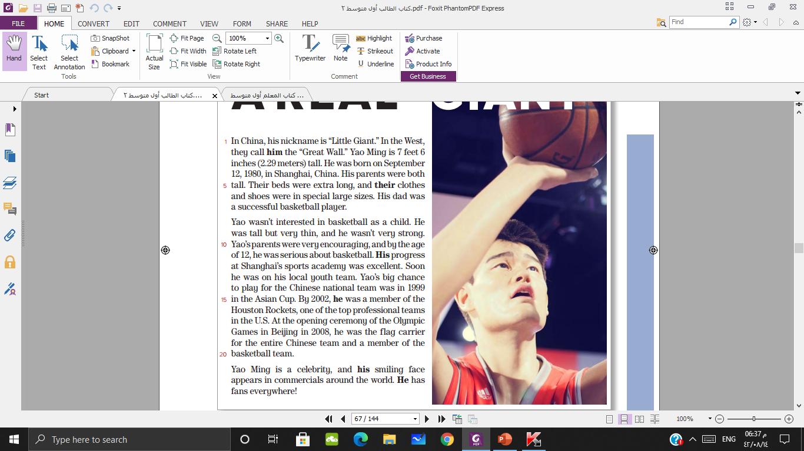
List the dates with the events
He was born
Playing with the national team
Member of a great team in US
Flag carrier for Chinese at Olympic

Slide 10
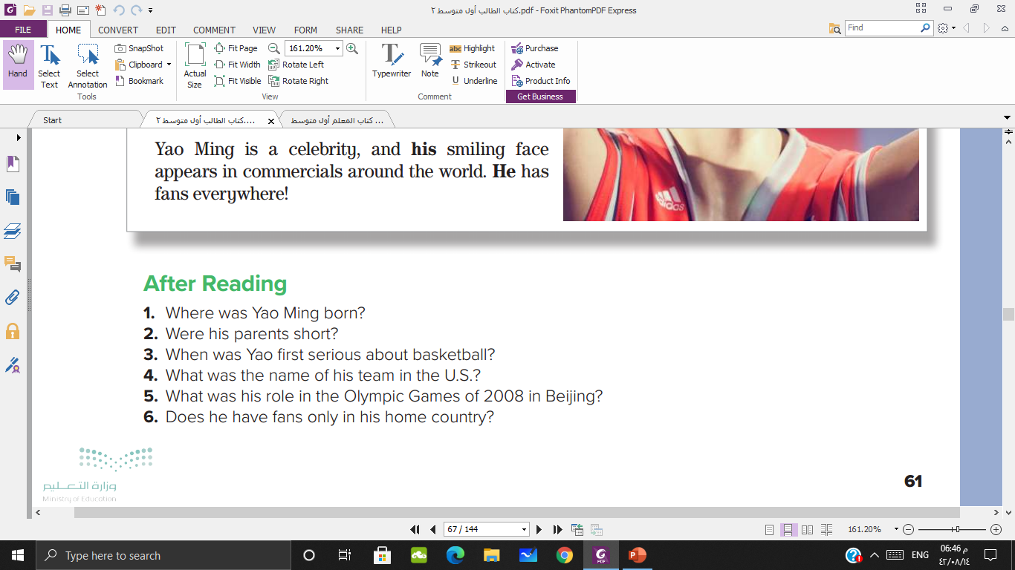
Shanghai, China
No, they were tall.
By the age of twelve
The Houston Rockets
The flag carrier for the Chinese team
No, he has fans everywhere

Slide 11



