Slide 1
Unit 4 What Would You Do? Listen & Discuss
Mega Goal 2.3
Done by: Entisar Al-Obaidallah

Slide 2
Lesson Objectives
Discuss
Destinguish
01
02
Complete
Answer
03
04
the situation in each dilemmas
between the meanings of "moral" and "ethical."
The sentences with the correct word
Some questions about the text

Slide 3
Warm up
WHAT would you do?

Slide 4
Warm up

Slide 5
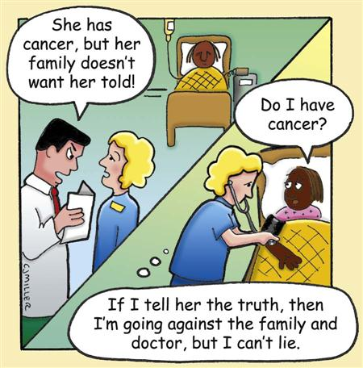
Warm up
What would you do
if you were the nurse?

Slide 6
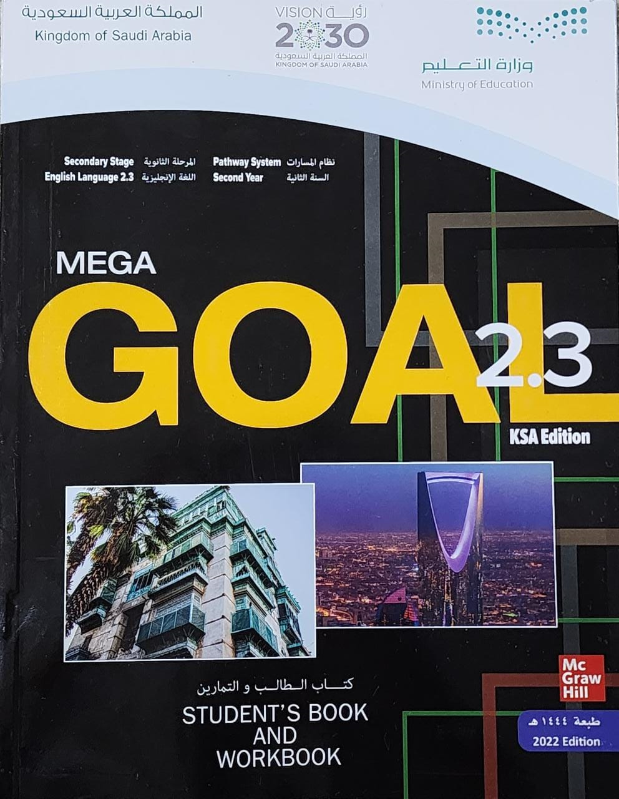
Book Open
pages.( 48- 49)

Slide 7
Pre-reading questions

Slide 8
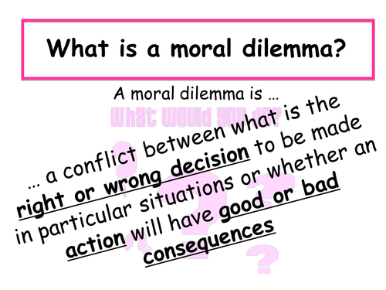
What is the meaning of
a moral dilemma?

Slide 9
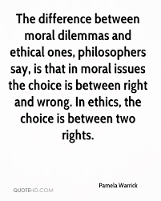
What is the difference between Moral dilemma and Ethical one?

Slide 10
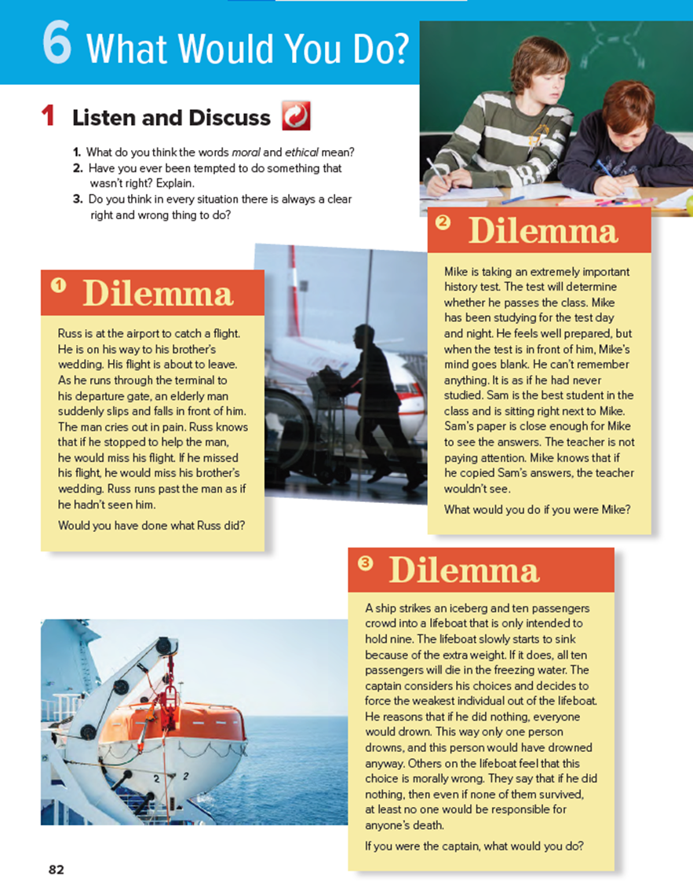
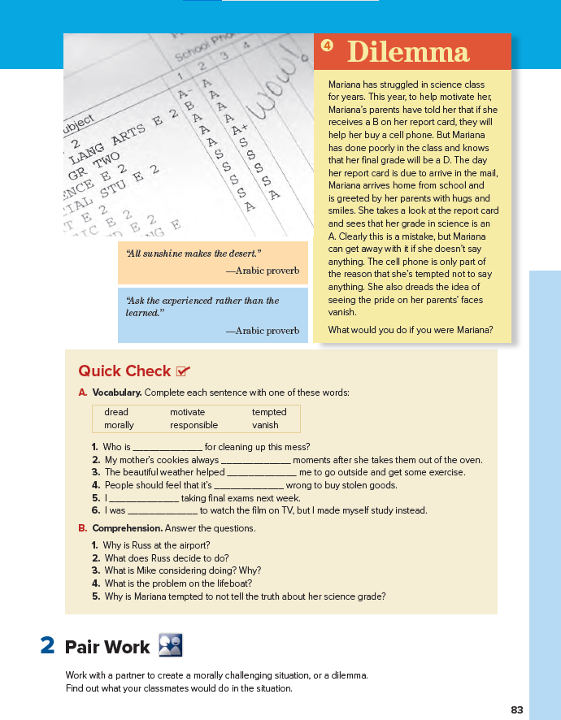
Book Open
Read along as you listen
pages.( 48 - 49 )

Slide 11
Would you have done what Russ did?

Slide 12
What would you do
if you were Mike?

Slide 13
What would you do
if you were captain?

Slide 14
What would you do
if you were Marina?

Slide 16
Find a word means….
the main building at an airport
Terminal

Slide 17
Find a word means….
a large block of frozen water floating in the ocean
Find a word means….
to go down underwater
Find a word means….
to die underwater, because of being unable to breathe
iceberg
to sink
to drown

Slide 18
Find a word means….
to try hard to do something that is very difficult
struggled

Slide 19
Find the names of the characters
R
V
H
R
I
U
Y
M
Russ
Mariana
Mik
S
R
U
M
S
S
J
i
J
R
k
M
E
e
E
G
B
K
o
M
A
R
I
A
N
A

Slide 20
Book Open
Page ( 49 )

Slide 21
What is the meaning of this proverb?
It means that : we should never give up, but accept the fact that success always needs some difficulty preceding it to be sure you’re heading in the right direction.
What does it mean in Arabic?
لا يأس مع الحياة ولا حياة مع اليأس

Slide 22
What is the meaning of this proverb?
It means that : Experience is more important than knowledge.
What does it mean in Arabic?
اسأل مجرب ولا تسأل طبيب

Slide 23
responsible
vanish
motivate
morally
dread
tempted

Slide 24
1. He’s flying to his brother’s wedding.
2. He does not help the man but hurries to catch his flight.
3. He is considering cheating on his test because he can’t remember the answers.
4. There is only enough space for nine passengers.
5. Because then she will be able to buy a cell phone and her parents will be proud
of her

Slide 25
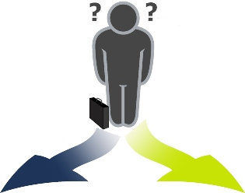
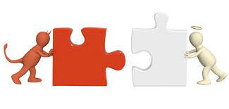
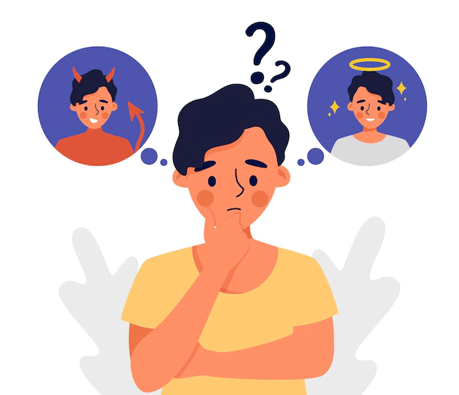
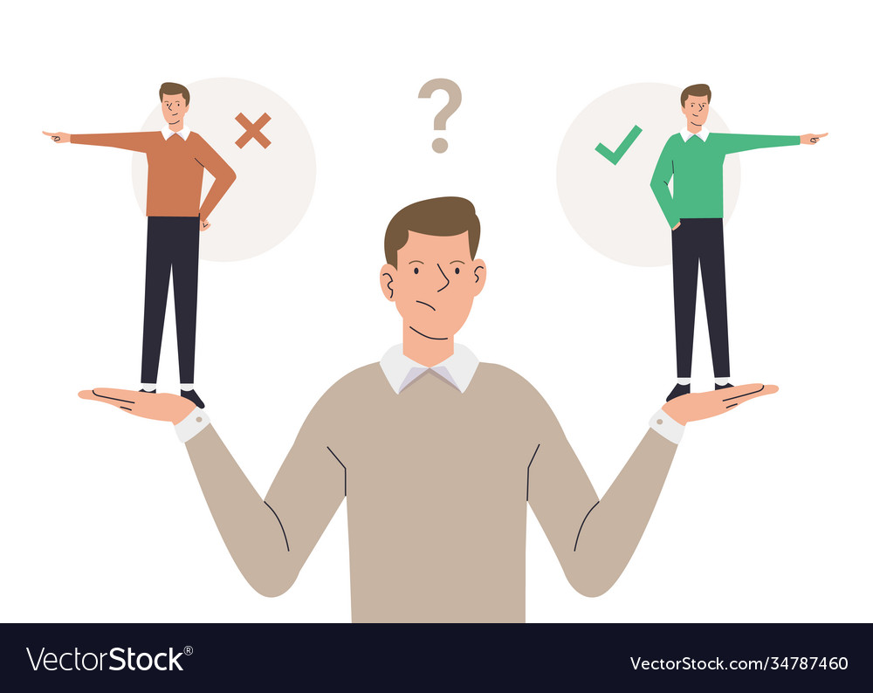

Slide 26
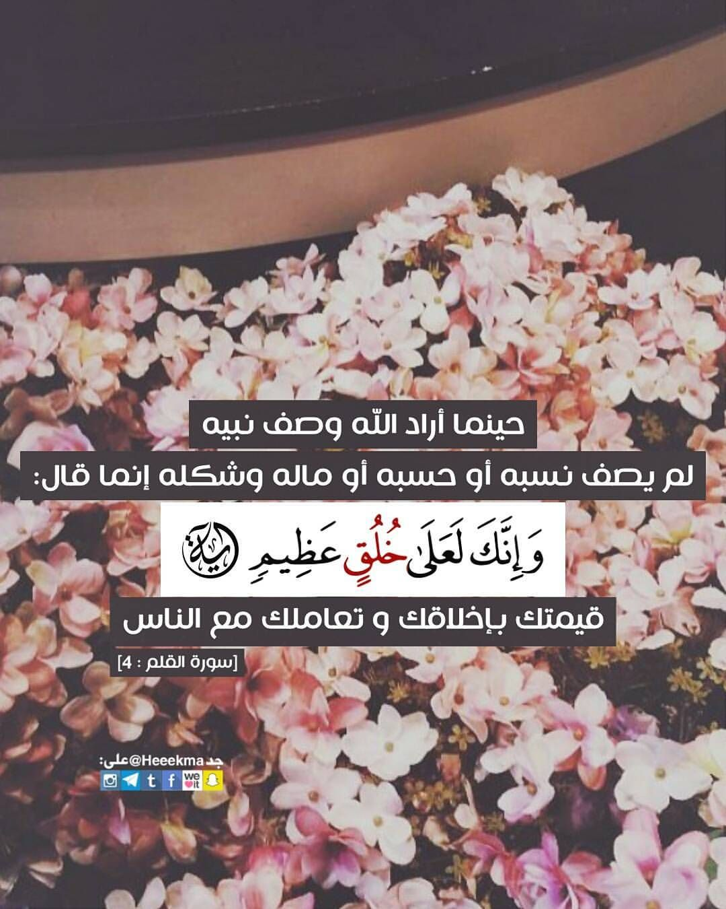

Slide 27
Homework
Workbook page ( 111 ) , exercise ( A-B )

Slide 28
Thanks!

