Slide 1

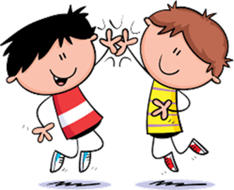

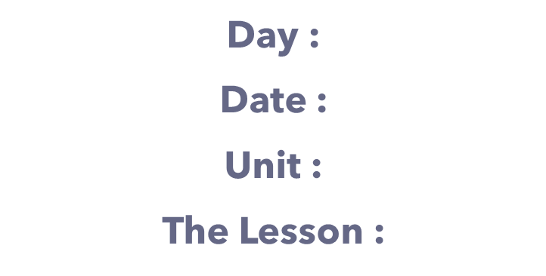



Slide 2


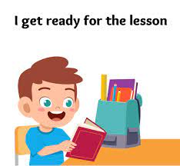

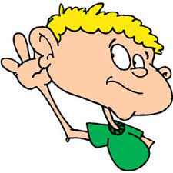

class rules
Listen to the teacher's explanation

Slide 3

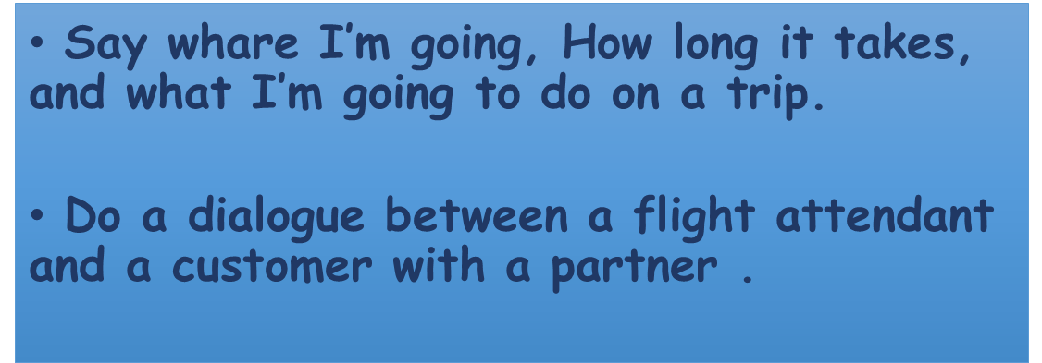

Slide 4


Slide 5




Slide 6


Slide 7








Slide 8


Where are you going ?
I’m going to Vancouver.
How long does it take to get there ?
It takes about 15 hours.
What are you going to do there ?
I’m going to go sightseeing.

Slide 9

Where are you going ?
I’m going to Dubai.
How long does it take to get there ?
It takes about 2 hours.
What are you going to do there ?
I’m going to shop .

Slide 10


Slide 11
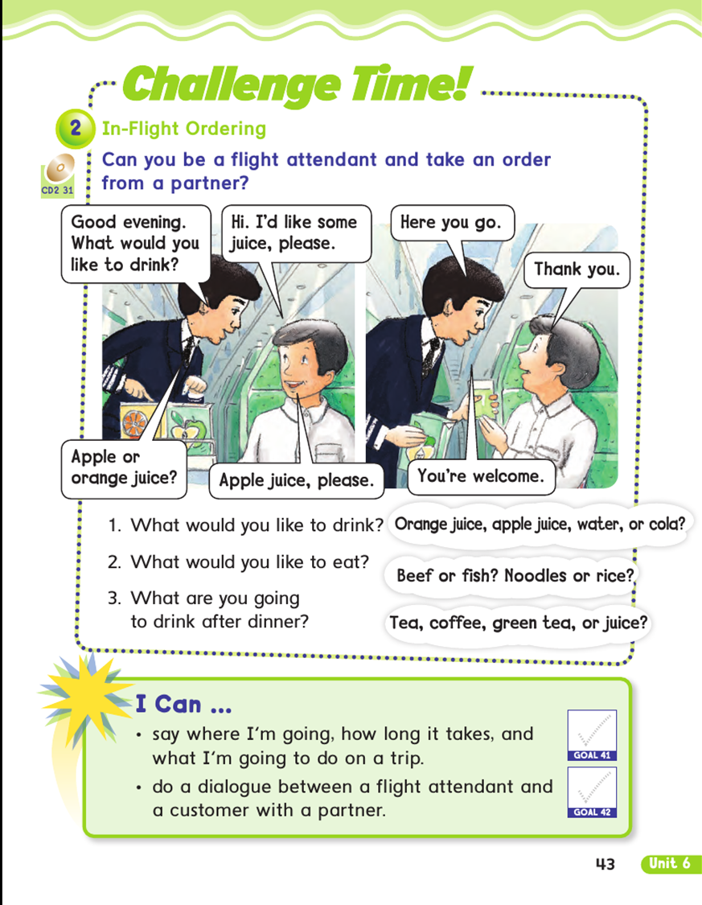



Slide 12
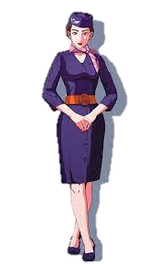
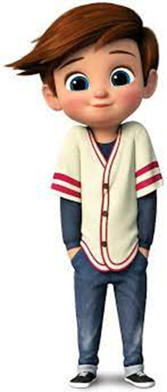
What would you like to drink ?
Hi, I’d like some juice, please
Apple , or orange?
Apple juice, please
Here you go .
Thank you
You’re welcome .

Slide 13





مسابقةالنجوم
star contest

Slide 14


Where ( are - is ) you going to ?
are
is

Slide 15

I ( is - am ) going to Abha .
is
am

Slide 16


Slide 17



