Slide 1
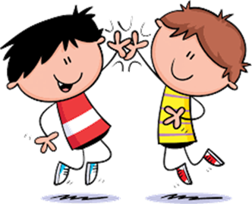
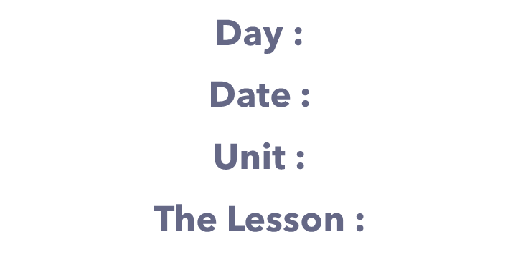

Slide 2
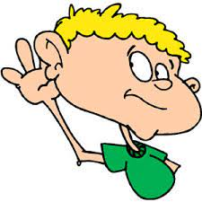
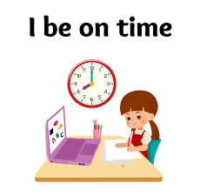
class rules
Listen to the teacher's explanation

Slide 6
Small

Slide 7
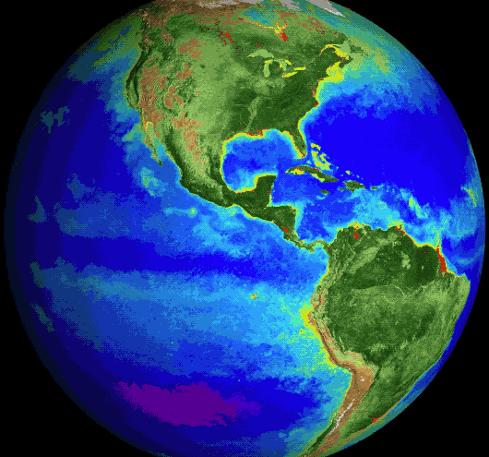
Globe

Slide 8
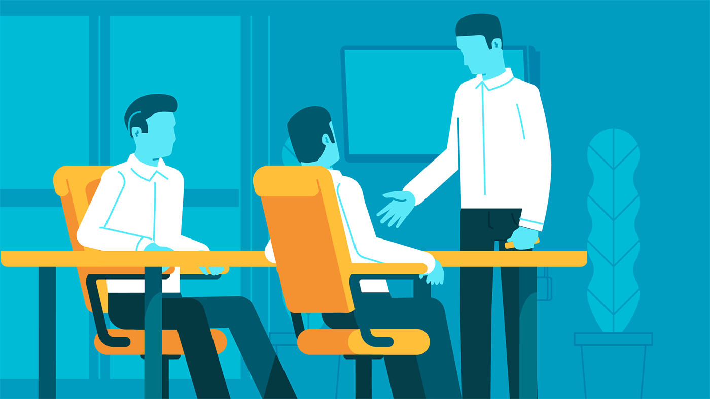
Business

Slide 9
Leader

Slide 10
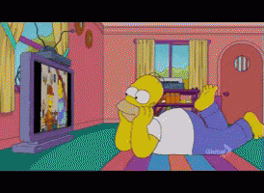
Watch

Slide 11
Vision 2030

Slide 14
Very hungry
Very thirsty
So cute
Very sleepy

Slide 15
Why did you … ?
Because It’s …
Because I was …

Slide 16
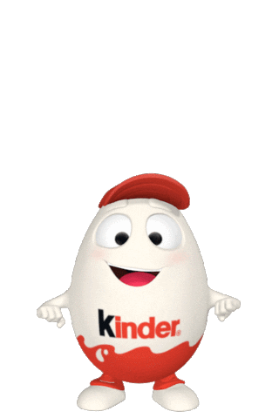
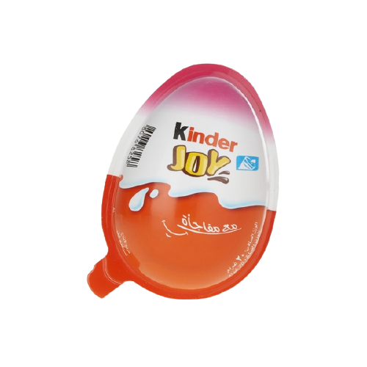
لعبة
ابدأ

Slide 17
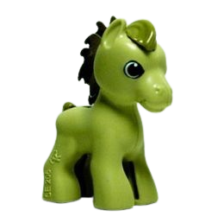
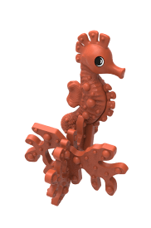

Slide 18
Why did you eat all the soup ?
Because I was ...............................
so cute
very hungry
very sleepy

Slide 19
And Why did you sleep in my bed ? Because I was ...............................
very thirsty
so cute
very sleepy

Slide 20
And Why did you sleep in my bed ? Because I was ...............................
very thirsty
very sleepy
very hungry

Slide 21
Why did you take my panda?
Because it's ...................................
so cute
very hungry
very sleepy

Slide 24
H.W Page : 115+116

