Slide 1
Super Goal 2
Unit 16
Have You Ever….?
Listen and Discuss
Page : 138

Slide 2
Objectives :
Describe pictures.
Talk about personal and weird experiences.
Answer questions.

Slide 3
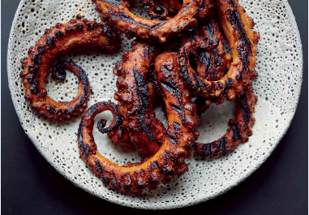
Warm up !
Have you ever eaten an octopus?

Slide 4
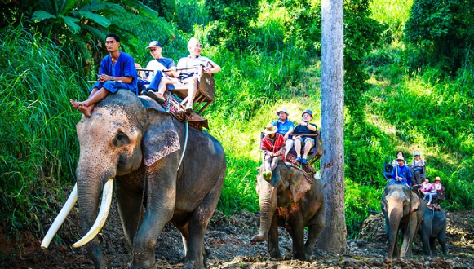
Have you ever ridden an elephant ?

Slide 5
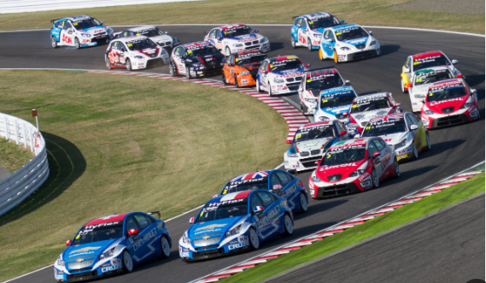
Have you ever been in a car race?

Slide 6

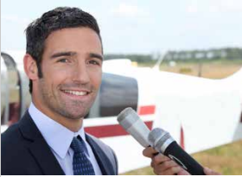
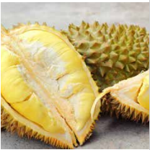
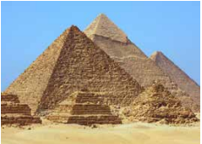
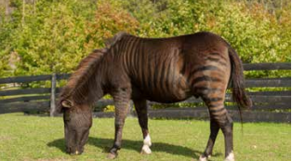

Slide 7

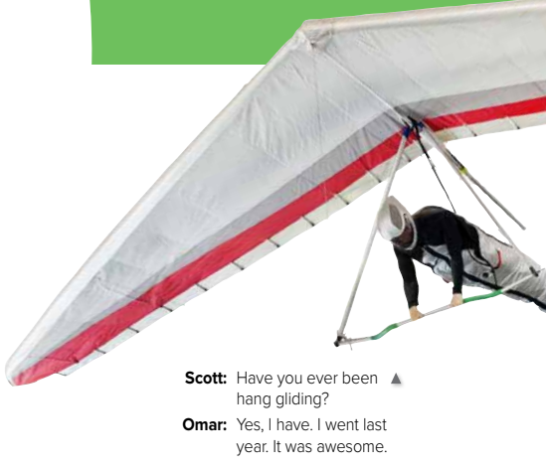


Slide 8

Who is in the picture?
What does he do?

Slide 9
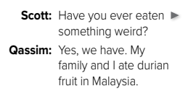
What is the fruit in the picture?
Have you ever eaten any weird fruit?

Slide 10

Where did Adnan ride a camel?
Do you think he enjoyed it ?

Slide 11

What about you? Have you ever seen an unusual animal?

Slide 12
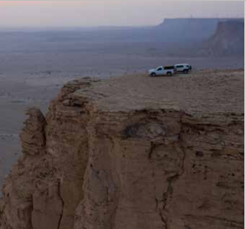
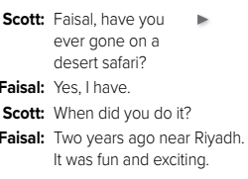
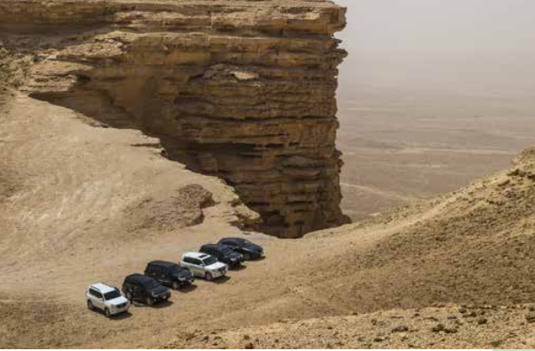
Where did Faisal go?
When did he go?

Slide 13
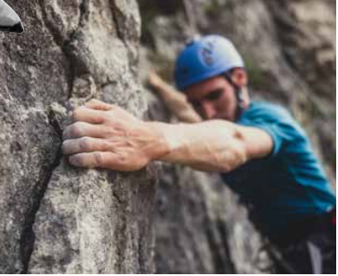
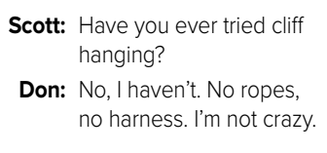
Does Don do cliff hanging?
Why?

Slide 14
How does each question begin?
Have you ever…
What came after the verb ever?
past participles
EG: been, flown, eaten, ridden, seen.
This will be our lesson tomorrow!

Slide 15
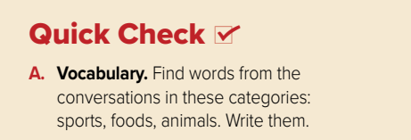
Animals | Foods | Sports
camel | durian fruit | hang gliding
zorse |  | cliff hanging
zebra |  | desert safari
horse

Slide 16
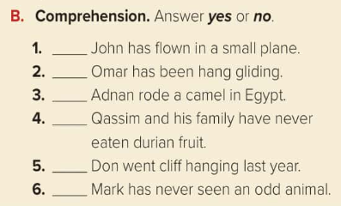
No
Yes
Yes
No
No
No

Slide 17
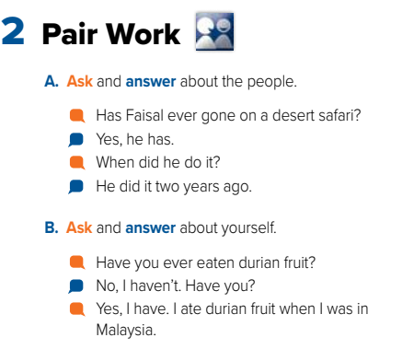

Slide 18
Home work,
Page 253
Have a nice day!

