Slide 1
Super goal 2

Slide 2
Revision
What did you do yesterday?

Slide 4
67+68

Slide 5
Our objectives
Produce –ed sounds
Find information through audio material
Practice the conversation.
Answer questions about the conversation.
Answer some personal questions.

Slide 6
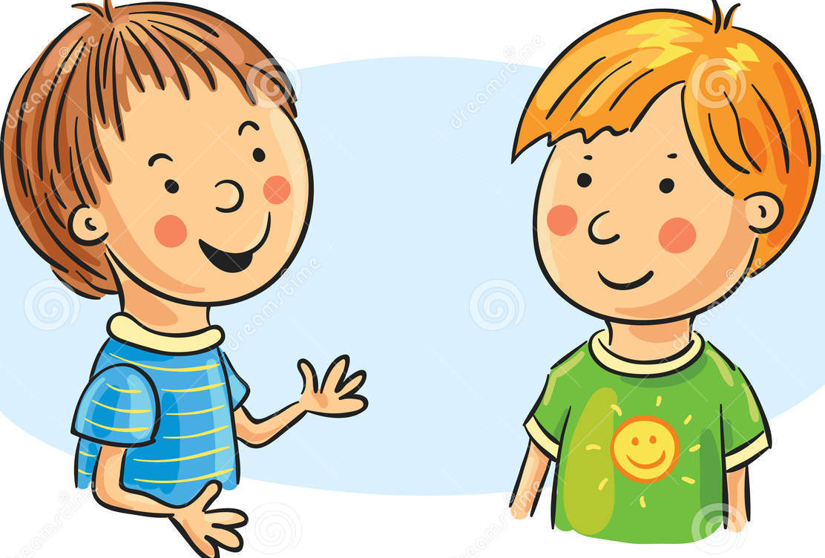
67
1. He went out with James.
2. They went to Gourmet’s, a restaurant near the lake.
3. They talked about James’s new car.
4. They went out on Thursday night.
5. No, he didn’t.

Slide 7
67

Slide 8
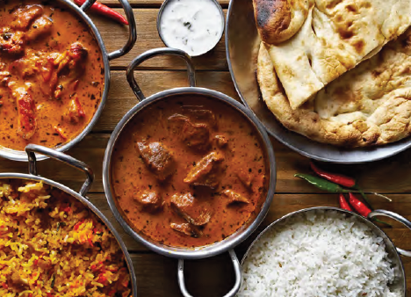
68
What kind of food is in the picture?
What do you know about Indian food?

Slide 9
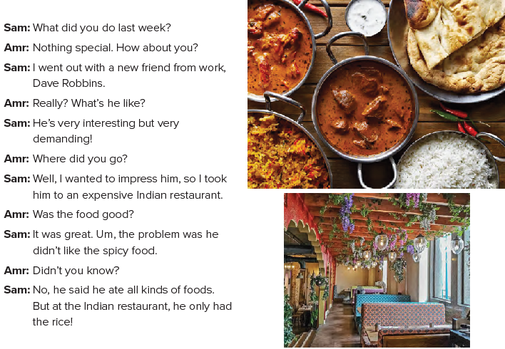
68
Is Dave Robbins an old friend of Sam’s?
(No, he is a new friend.)
What kind of restaurant did they go to?
(an Indian restaurant)
Find the following
restaurant
Dave
place
nationality
name
Indian

Slide 10
68
1. He went out with a new friend, Dave Robbins.
2. He was interesting but demanding.
3. He took him to an Indian restaurant.
4. The food was great, but it was spicy.
5. No, he didn’t.
6. He only ate rice.

Slide 11
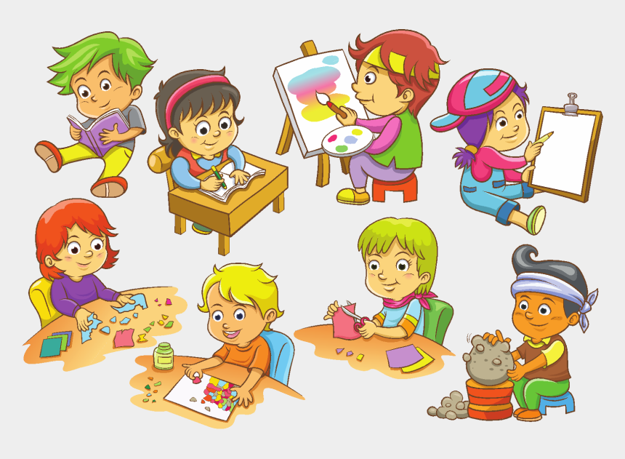
68
Did you study yesterday?
Did you watch TV last night?

Slide 12
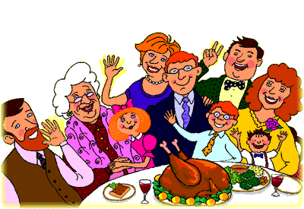
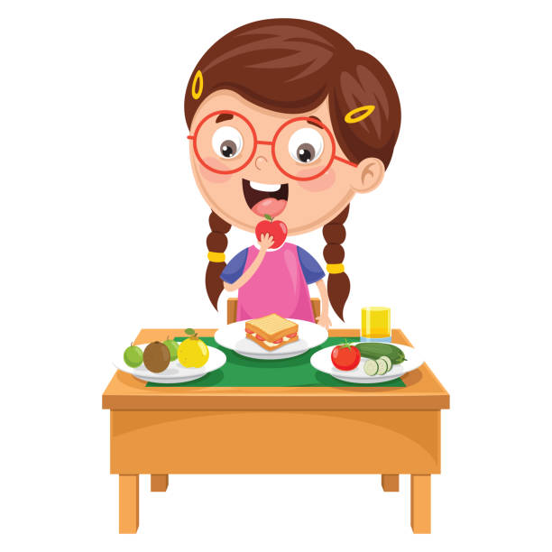
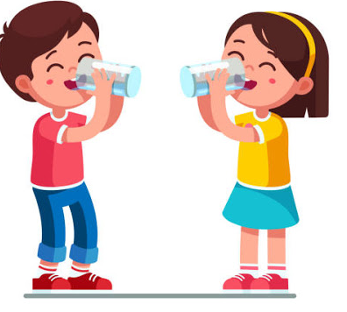
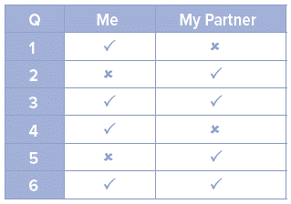
68
Make a chart with the numbers of the questions.
You should put a tick for questions you were able to answer
and an “x” for those you can’t remember.

