Slide 1


Slide 2


Slide 3


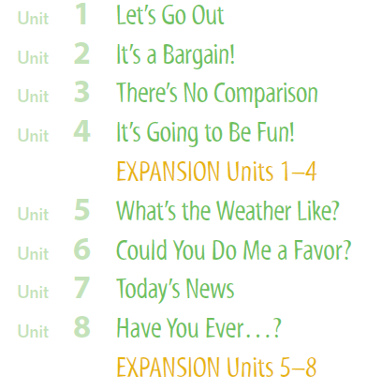

Slide 4

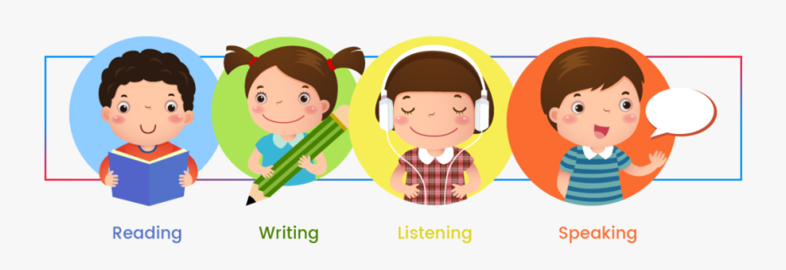

Slide 5

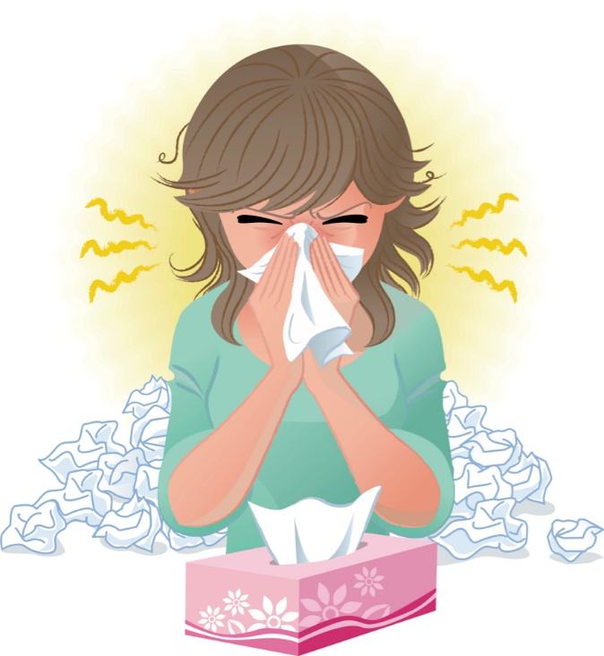


Covid 19
☺Avoid gathering !
☺We must wear a mask before
going out.
☺Social distancing is not a
choice, it is a must!
☺Keep a distance of 2 meters
to avoid accountability
☺wash hands constantly.

Slide 6


Slide 7


Slide 8








Today: Thursday
Date:
26-8-1442 H
April 8th \ 2021
everyone,
How is everything going?

Slide 9





ارجو الالتزام بعدم كتابة أي تعليقات غير لائقة بالأدب العام. علماً بأنه أي محادثة نصية او كتابية مسجلة تحت اسمك ورقم هويتك
وعلية سيتم معاقبة من لم تلتزم بالذوق العام والسلوك الحسن خلال تواجدك في المنصة او الفصول الافتراضية.
وذلك برفع شكوى وبلاغ رسمي ضدك بما تم كتابته او قولة والتواصل مع ولي الأمر والمسؤولين لاتخاذ الاجراء اللازم مع المخالفة.
ونتمنى وضع صوره في ملفك التعريفي لائقة بالمنصة التعليمية

Slide 10

off

Slide 11



☺
♥
Use linking words and phrases in writing
Write notes about exciting life of a character
present information about extreme sport or activity
Search specific information in a written text

Slide 12






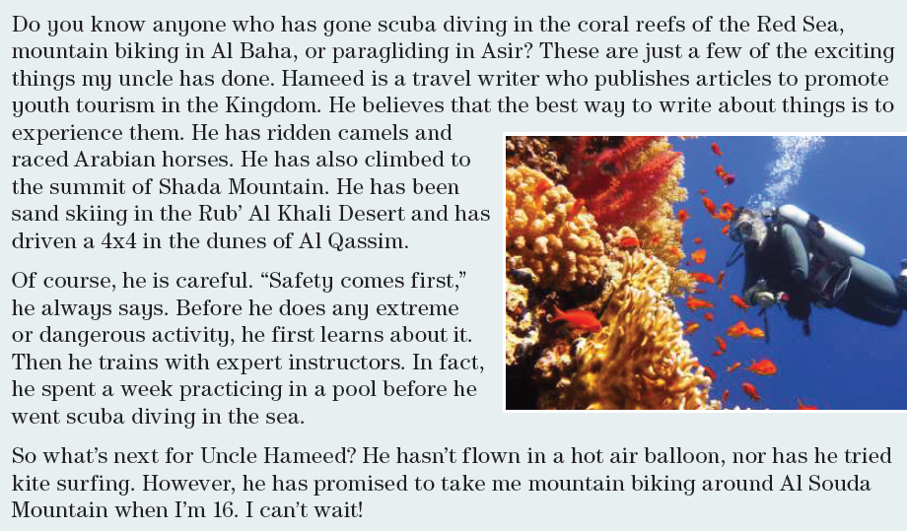
Page 70
What does Hameed do? (travel writer)
Why does he do exciting activities? (so he can write about the experience)
What exciting activities has he done?
(scuba diving, mountain biking, paragliding, camel riding, horse racing, mountain climbing, sand skiing, driven a 4x4 in the desert)
What is Hameed’s motto? (“Safety comes first.”)
Circle the linking words and phrases.
Paragraph 1: or, and, also, and
Paragraph 2: Of course, Before, or, first, Then, In fact, before
Paragraph 3: nor, However, when

Slide 13
Page 7

Slide 14
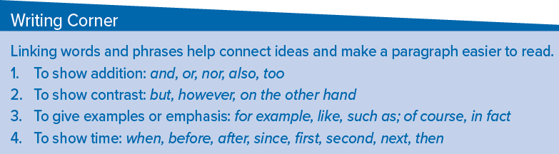
Page 70

Slide 15
Page 70
also is usually placed before the main verb or after the verb be.
Too is usually placed at the end of the sentence.
For example:
I’ve been to Spain. I’ve also been to Turkey.
I’ve been to Spain. I’ve been to Turkey too.
or connects positive alternatives.
Nor connects negative alternatives when the first one is introduced by a negative such as not, never, or neither.
When we use nor, the subject and object change places as in question form.
For example:
Have you ever ridden a camel or tried sand skiing?
I’ve never ridden a camel, nor have I tried sand skiing.

Slide 16
Page 70
however, and on the other hand are used to express contrast to a previous statement.
Unlike but, which goes in the middle of a sentence, they usually go at the beginning of a sentence and are followed by a comma.
For example:
He has gone snow skiing, but he hasn’t gone sand skiing.
He has gone snorkeling. However, he hasn’t gone scuba diving.
He likes fishing. On the other hand, he rarely eats fish.
of course and in fact are used to give emphasis.
They are usually followed by a comma.
For example:
He likes skateboarding. Of course, he always wears a helmet.
He has traveled around the world. In fact, he has visited 63 countries.

Slide 17
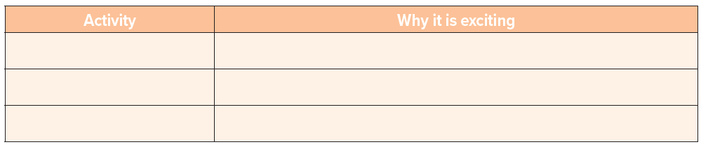
Page 70
So much fun – walked in the dessert- top experience for our family
camel riding
the greatest thing I ever do in my life –
teach you patience and how to be positive
mountain climbing
mountain biking
Amazing - your whole body benefits from the exercise

Slide 18
Page 70
These are the exciting things Fatima has
done. Fatima has ridden camels and raced Arabian
horses. She has also climbed to Soda Mountain.
Of course, he is careful. “Safety comes first,”
She always says. Before he does any extreme
or dangerous activity, he first learns about it.
Then he trains with expert instructors.

Slide 19


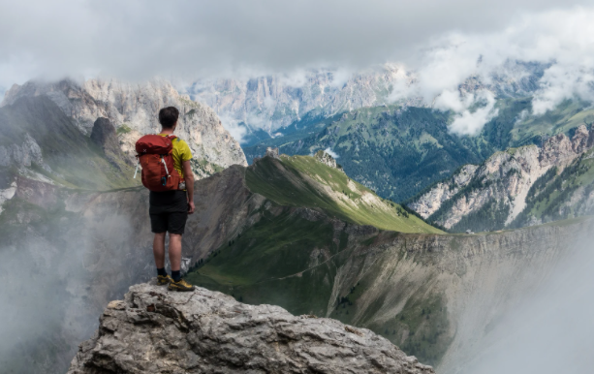

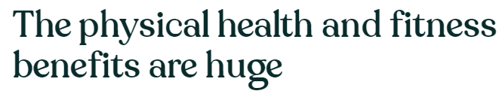
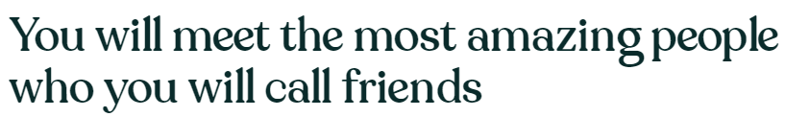
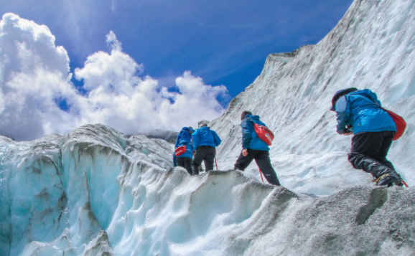
Page 70

Slide 20








Assign page 122 for practice writing
Ex H

Slide 21


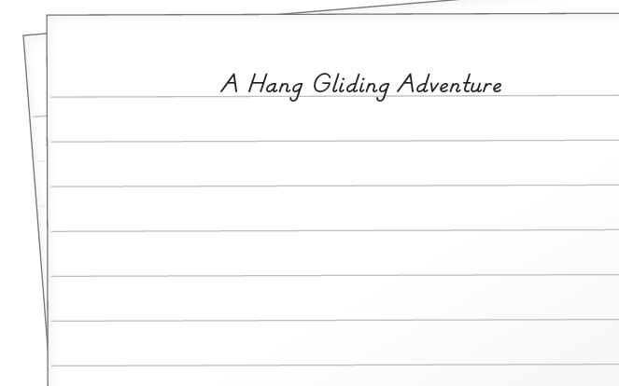
Page 122
I can imagine that I have a hang glider, and the wind is blowing a lot. I run down the hill and the hang glider lifts me from the ground. And suddenly, I’m flying. I can see my whole town. I fly over my house. Then little by little, I get closer to the ground, and I gently land.

Slide 22


أتمنى الاهتمام بمتابعة الدروس في قتوات عين الرسمية من وزارة التعليم
T.Noureyah Alghamdi
The end

Slide 23

