Slide 1


Slide 2
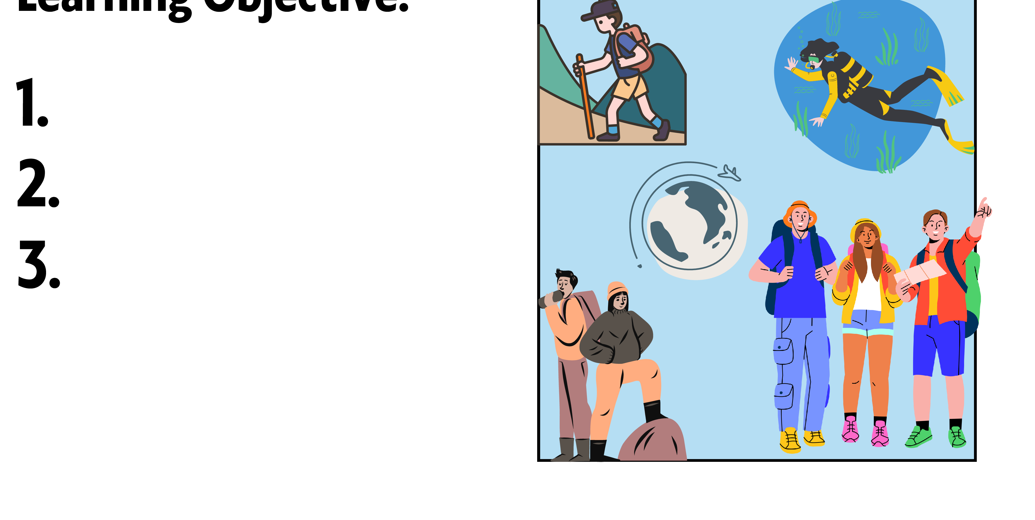

Learning Objectives:
Share some experiences
Practice a conversation
Answer questions about a conversation

Slide 3

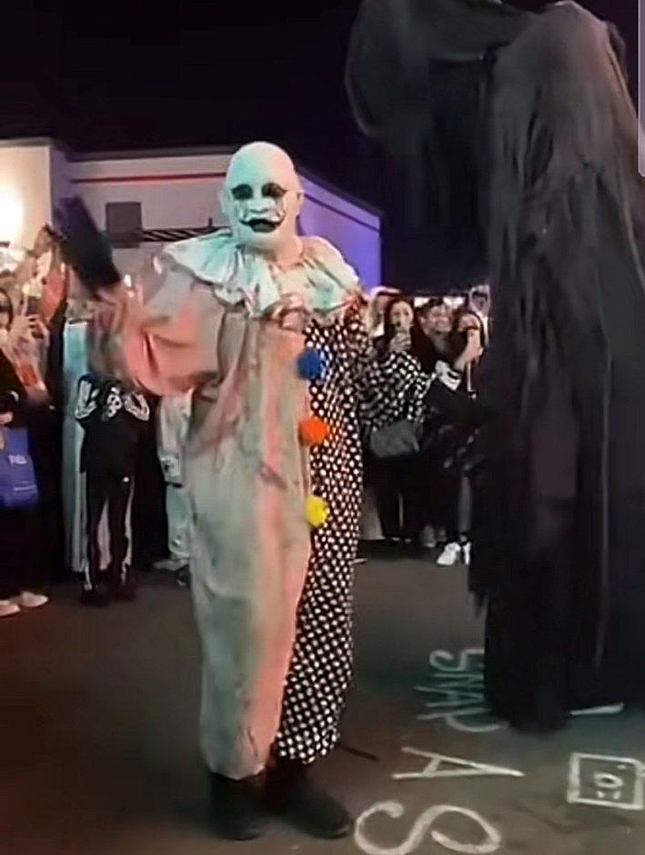
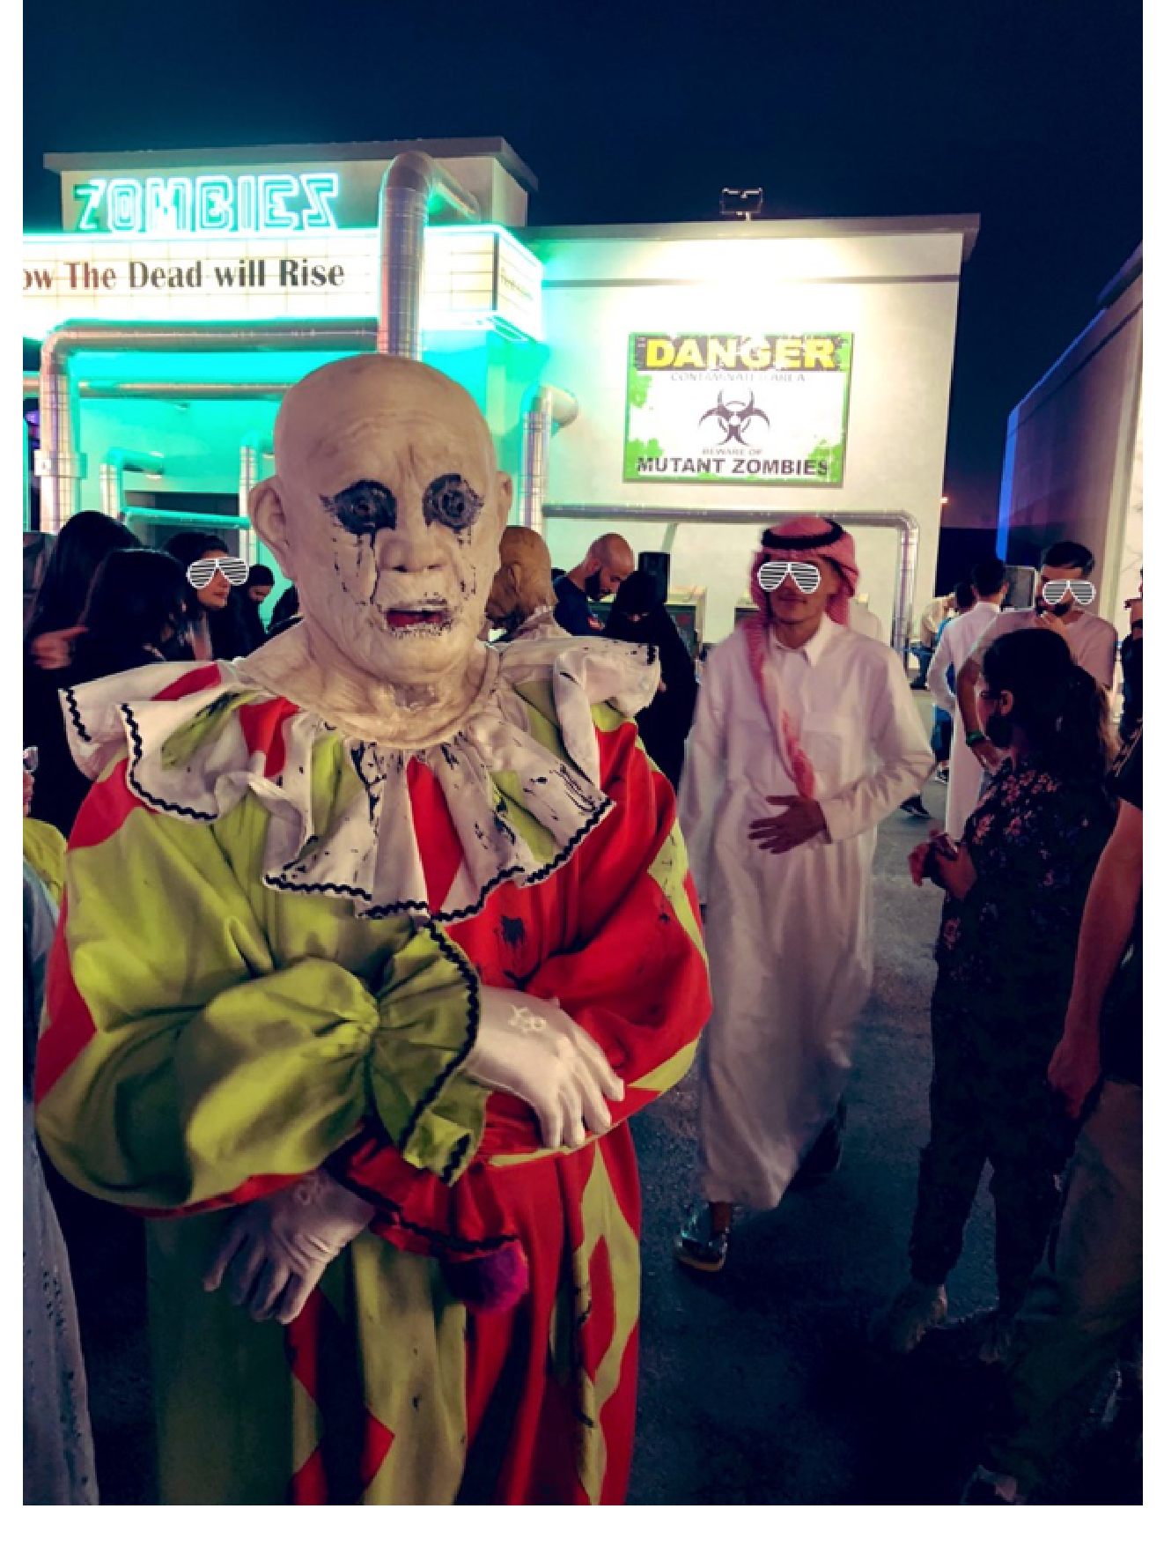
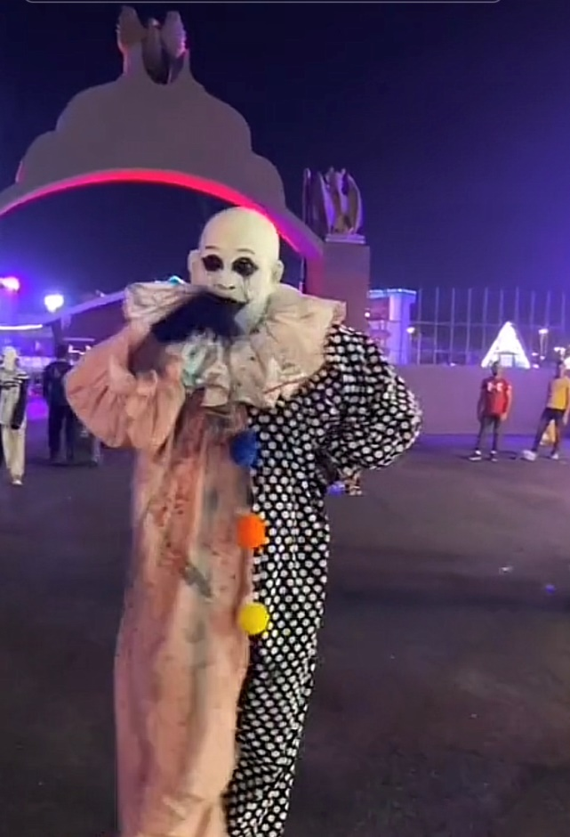

Slide 4

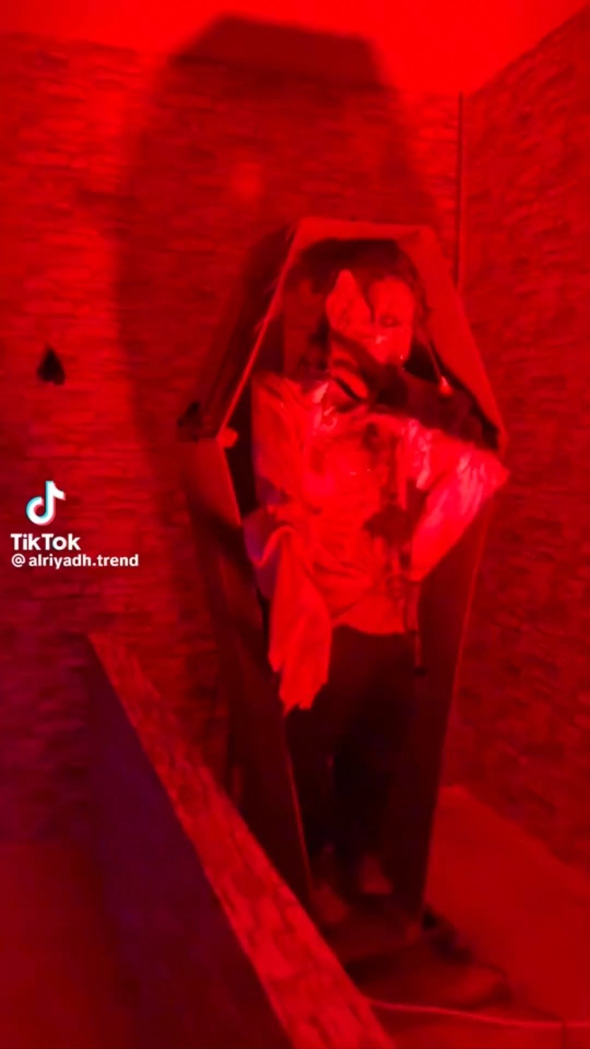
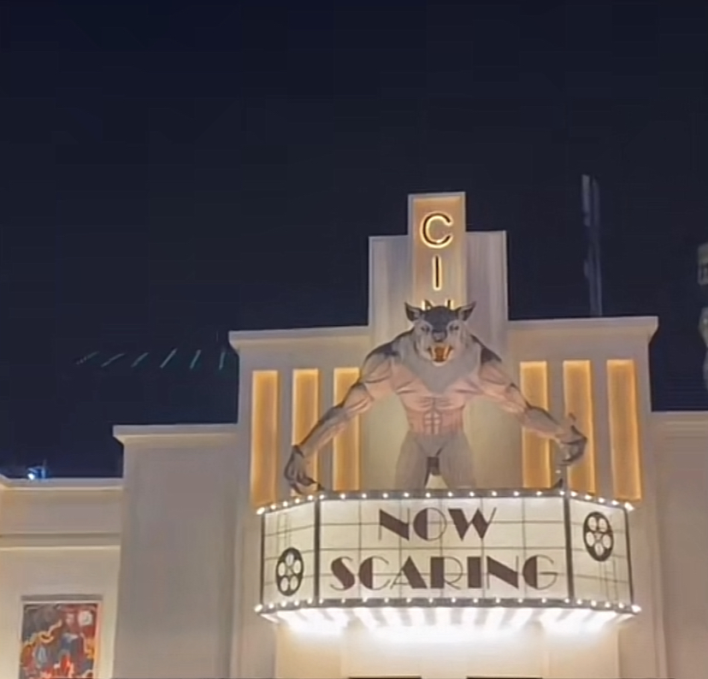

Slide 5
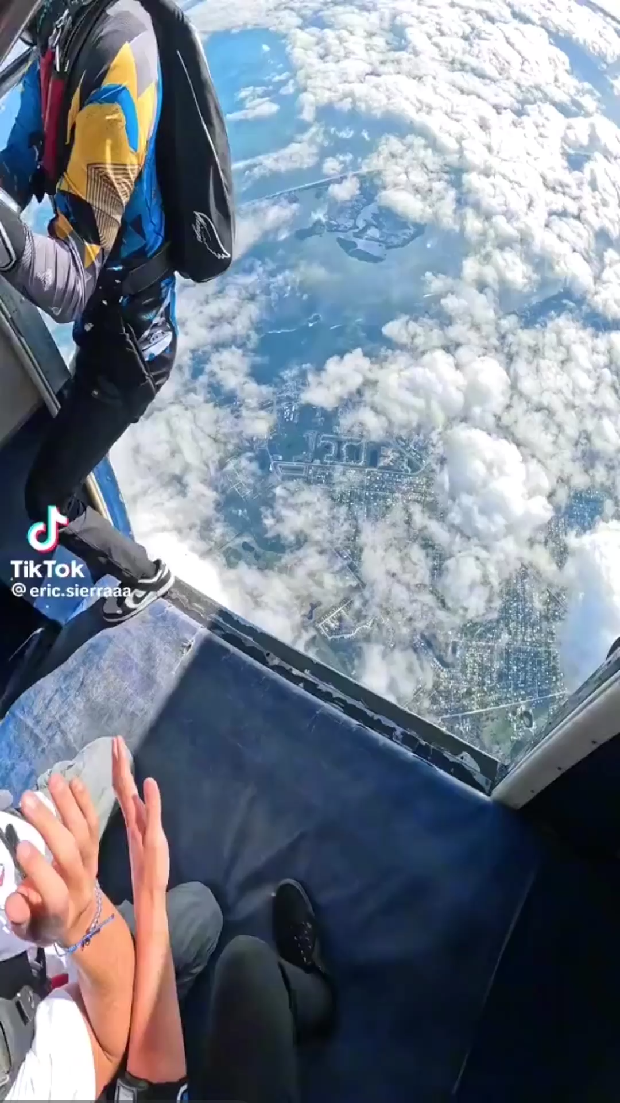
Do you want to try these types of experiences?

Slide 6

What is the most dangerous experience you’ve ever had?

Slide 7
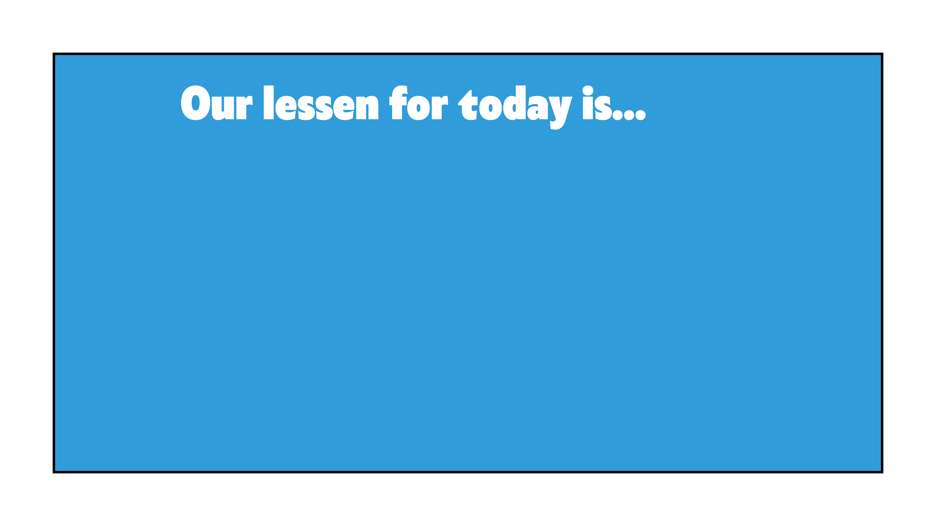
EXITING LIFE

Slide 8
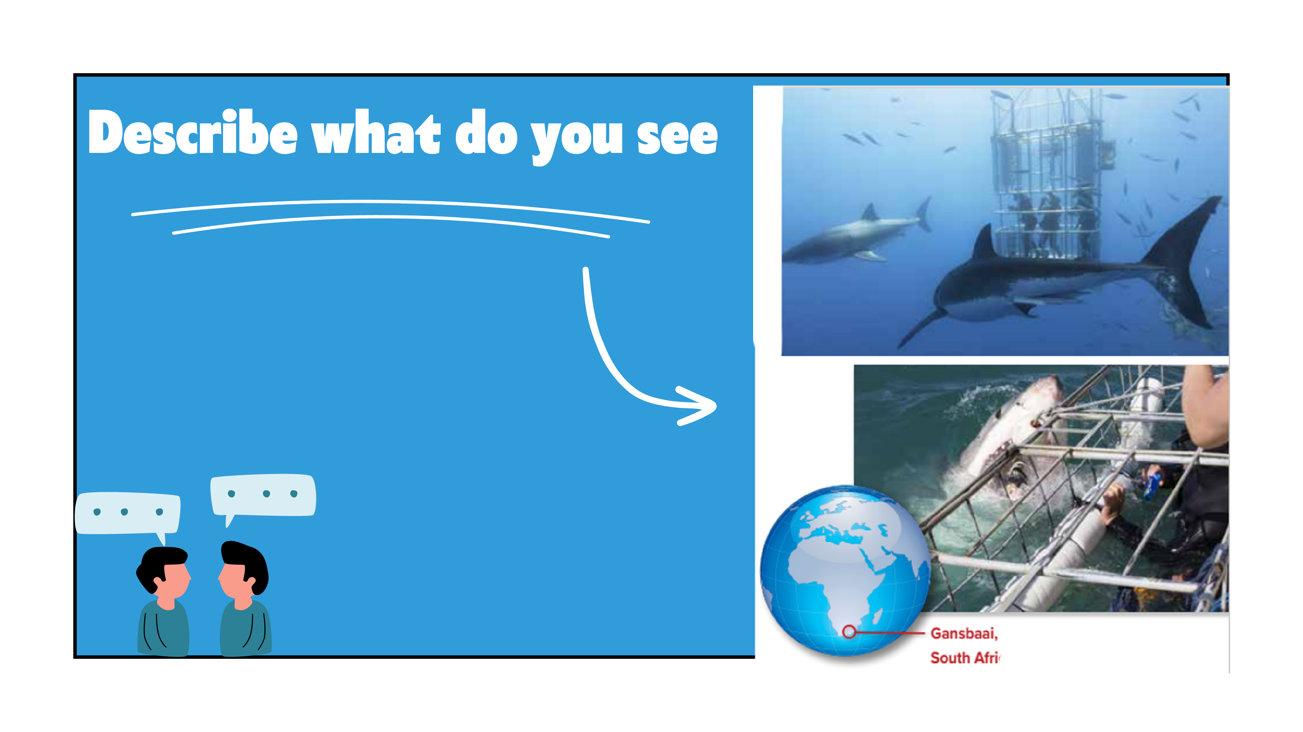
Would you like to have this kind of experience?

Slide 9
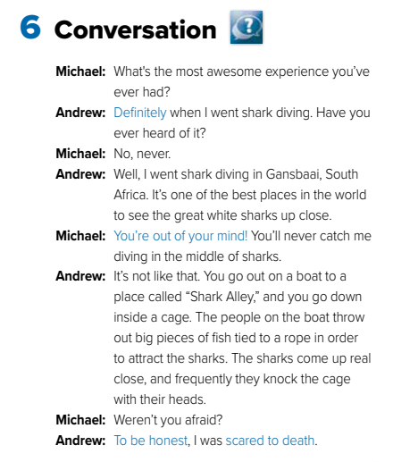


Pg.142

Slide 10

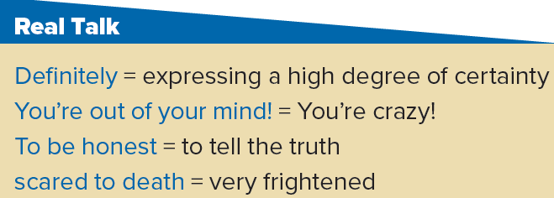

Slide 11

Pg.142

Slide 12

1. Where did Andrew go on his vacation?
He went shark diving in Gansbaai, South Africa.
2. What kind of experience was it?
It was an awesome experience, but it was scary.
3. How do they attract the sharks?
People throw out big pieces of fish.
4. Was he scared?
Yes, he was. Andrew says he was scared to death.
5. What does Michael think?
Michael thinks that Andrew is crazy.

Slide 13
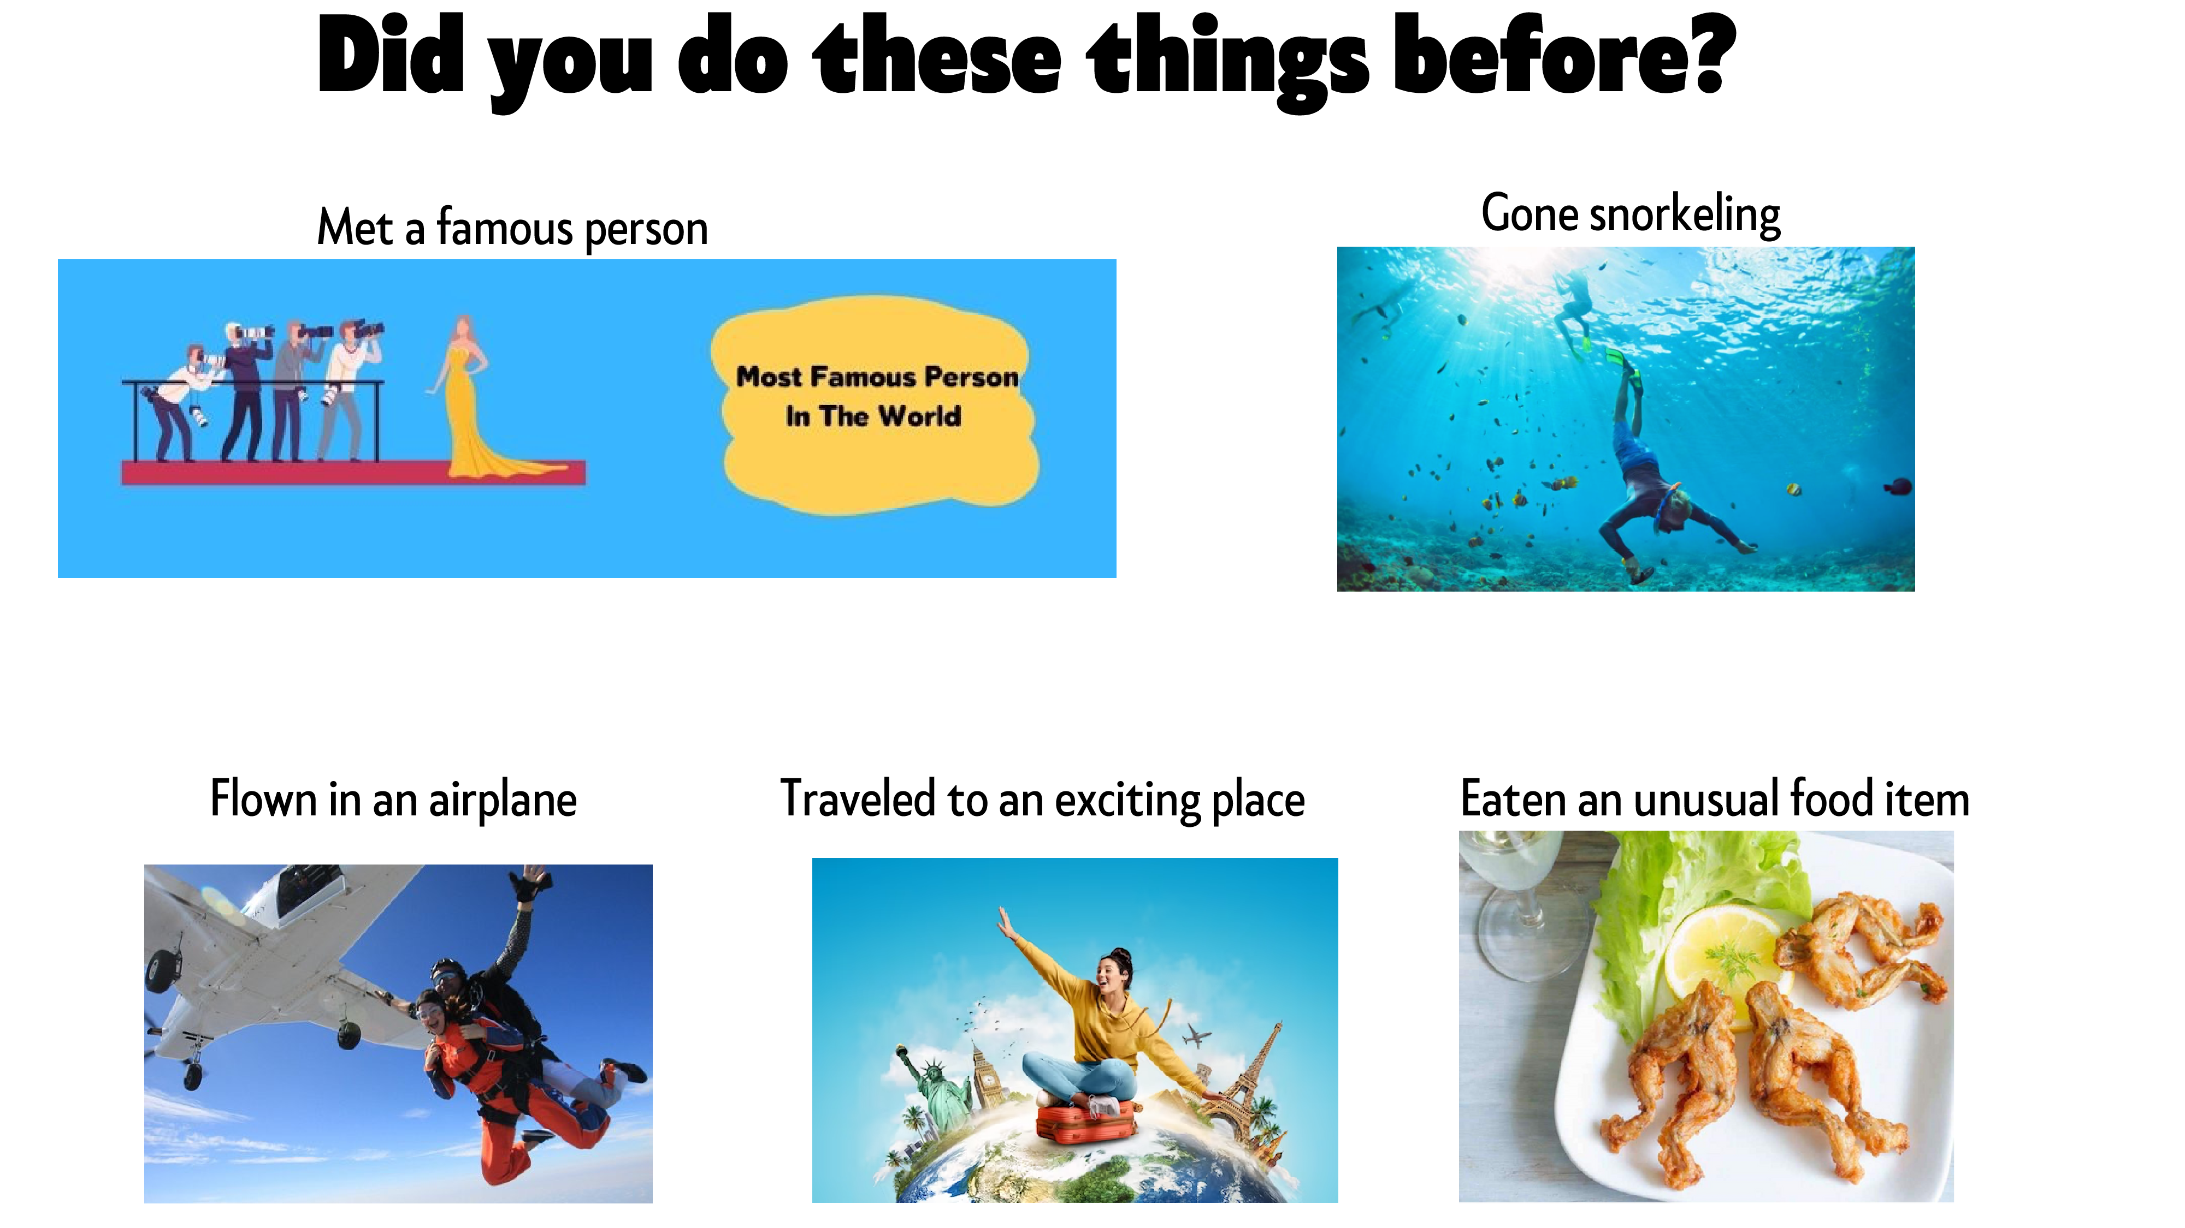

Slide 14
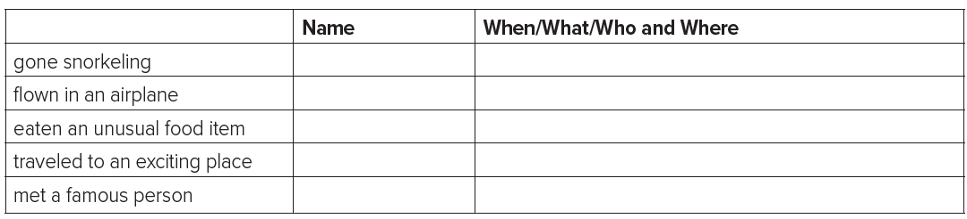

Slide 15

255

Slide 16


