Slide 2
Sunday 1-11-1444H
Preview irregular past participle forms.
Compare present perfect to simple past.
Listen to specific information.
Pg.140

Slide 3
Sunday 1-11-1444H
Active discussion
Role play
Pg.140

Slide 4
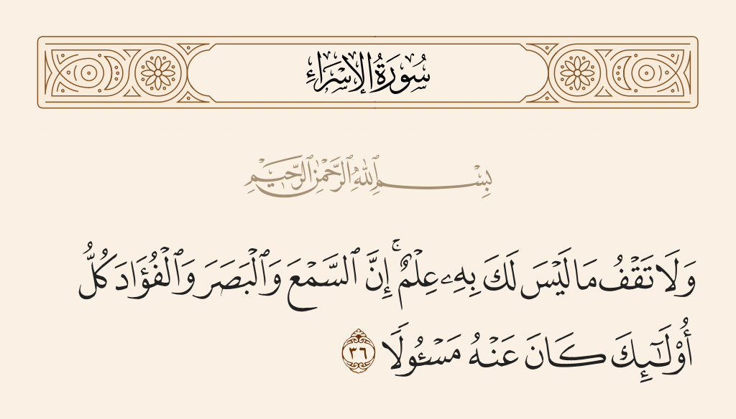
Sunday 1-11-1444H
Pg.140

Slide 5
Sunday 1-11-1444H
Pg.140

Slide 6
Sunday 1-11-1444H
Pg.140

Slide 7
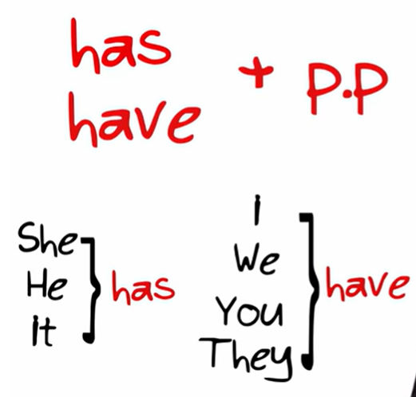
Sunday 1-11-1444H
Pg.140

Slide 8
Sunday 1-11-1444H
Pg.140

Slide 9
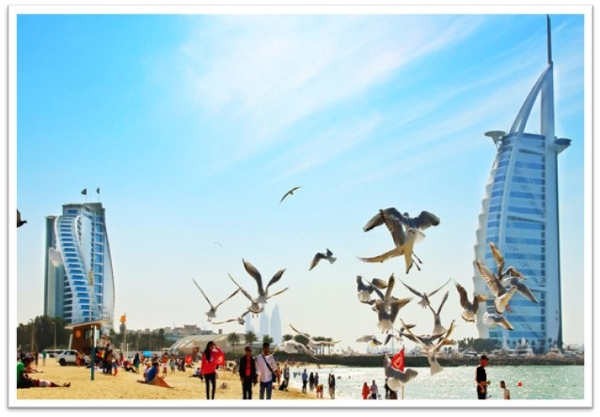
Sunday 1-11-1444H
Was
I
have
been
to Dubai.
I haven’t been to Dubai.
Have you been to Dubai?
Pg.140

Slide 10
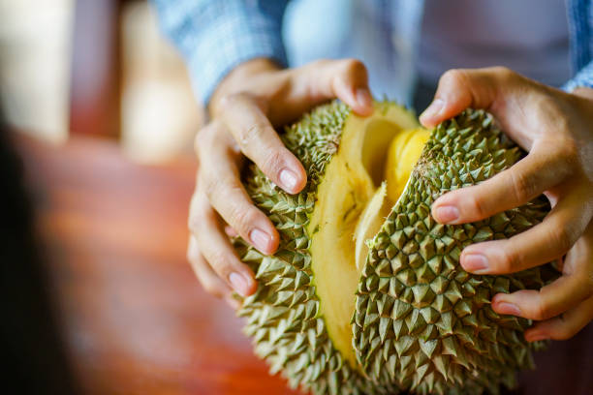
Sunday 1-11-1444H
Eat
He
durian fruit.
He
has
eaten
He hasn’t eaten durian fruit.
Has he eaten durian fruit?
Pg.140

Slide 11
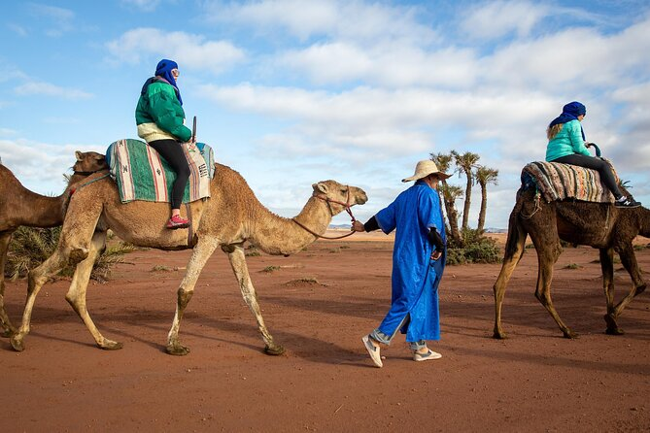
Sunday 1-11-1444H
Ride
She
has
She
ridden
a camel.
She hasn’t ridden a camel.
Has she ridden a camel?
Pg.140

Slide 12
Sunday 1-11-1444H
Pg.140

Slide 13
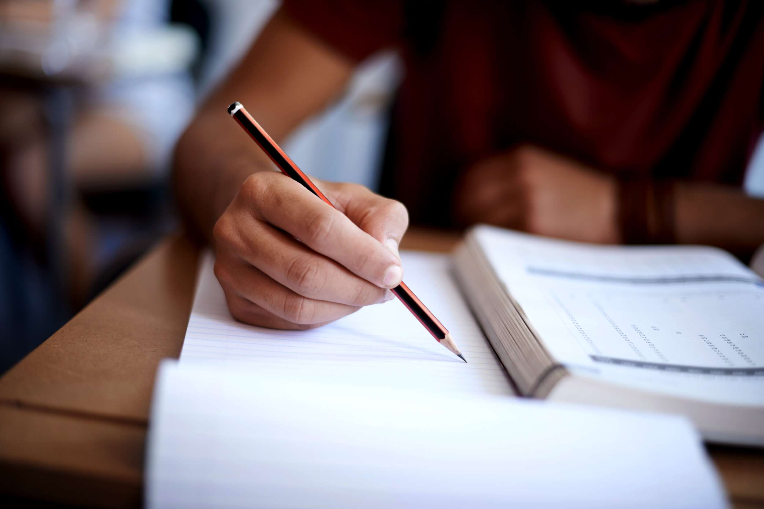
Sunday 1-11-1444H
I did my homework 2 hours ago.
I have done my homework.
Pg.140

Slide 14
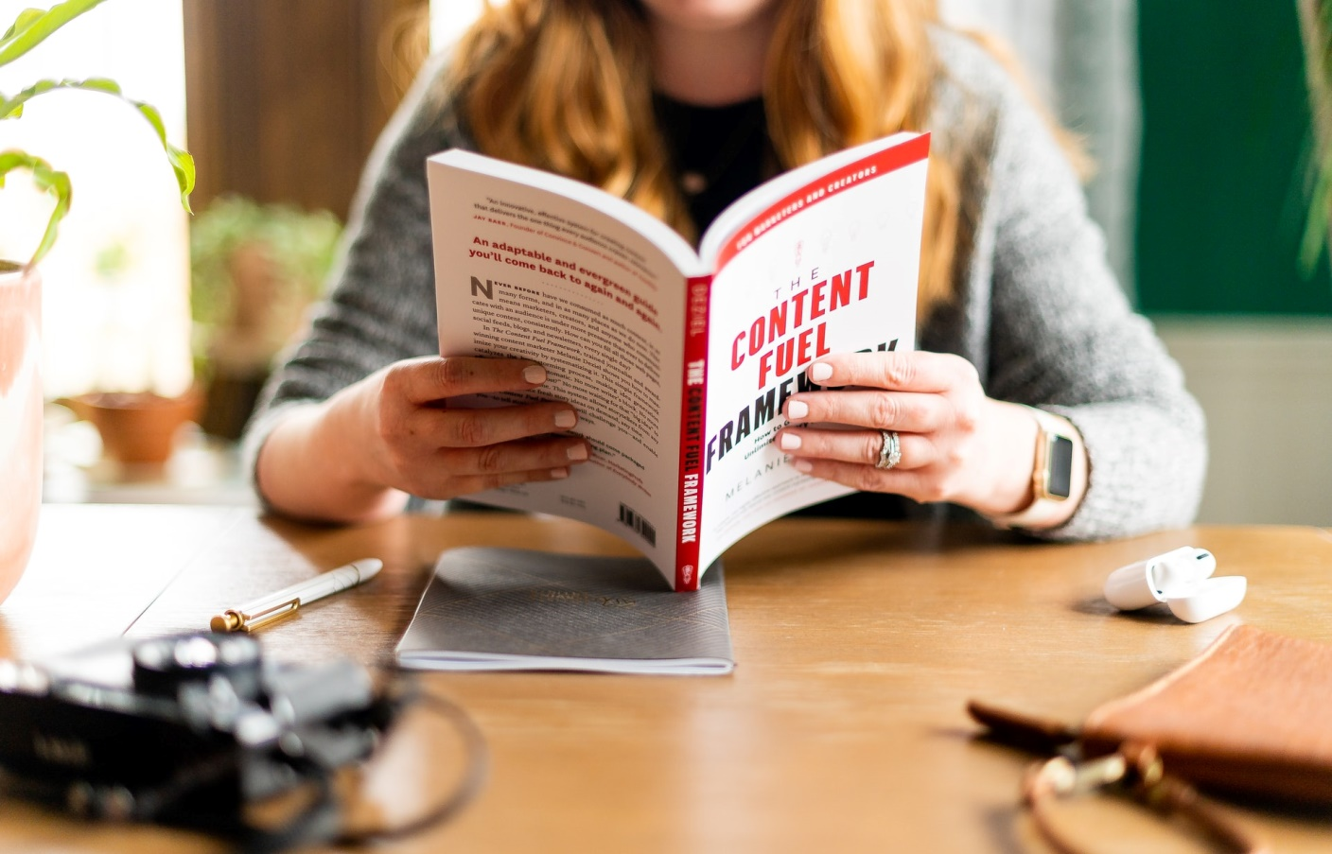
Sunday 1-11-1444H
I read three chapters yesterday.
I have read three chapters.
Pg.140

Slide 15
Sunday 1-11-1444H
What is the tense of the following sentence?
She wrote an article about traveling, last week.
Past simple
Change the tense.
She has written an article about traveling.
Present perfect
Pg.140

Slide 16
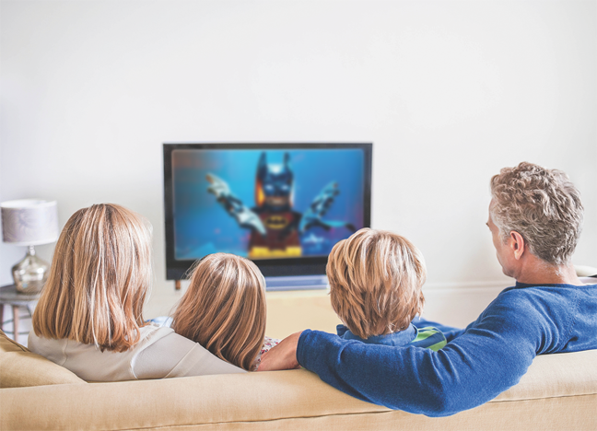
Sunday 1-11-1444H
What is the tense of the following sentence?
We have seen this movie recently.
Present perfect
Change the tense.
We saw this movie yesterday.
Past simple
Pg.140

Slide 17
Sunday 1-11-1444H
Complete the conversations. Then practice with a partner.
A: Have you ever _____ a snake?
B: No, I _______. Have you?
A: Yes, I _____ one in the desert.
B: Were you frightened?
2. A: I _____ ants in Mexico years ago.
B: What did they taste like?
A: They _____ spicy.
seen
haven't
saw
ate
were
Pg.140

Slide 18
Sunday 1-11-1444H
Complete the conversations. Then practice with a partner.
3. A: _____ Nasser ever gone snorkeling?
B: Yes, he has.
A: _____ he like it?
B: No, he _______. He was scared.
4. A: I’ve never _______ in a helicopter.
B: I have. I ______ in one over the Red Sea.
A: I’d like to do that one day.
Has
Did
didn’t
flown
flew
Pg.140

Slide 19
Sunday 1-11-1444H
Pg.141

Slide 20
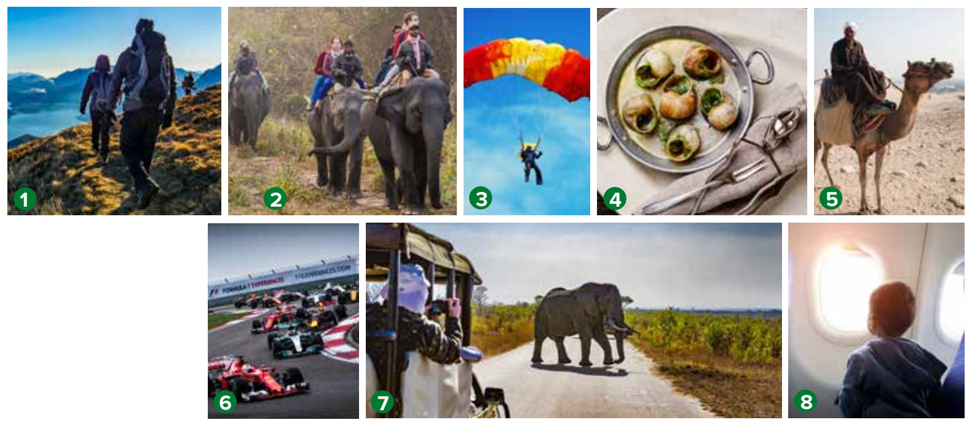
Sunday 1-11-1444H
Pg.141

Slide 21
Sunday 1-11-1444H
Pg.141

Slide 22
Sunday 1-11-1444H
Listen to the /v/ sound in have and ’ve. Then practice.
I’ve never flown in a plane.
They’ve seen a shark.
Have you climbed a mountain?
You’ve flown a plane!
What have you done?
You haven’t been to a museum?
Pg.141

Slide 23
Pg. 254

Slide 24
be
been
did
done
eat
eaten
go
went
see
seen
swam
swum
take
taken
wrote
written
Pg. 254

Slide 25
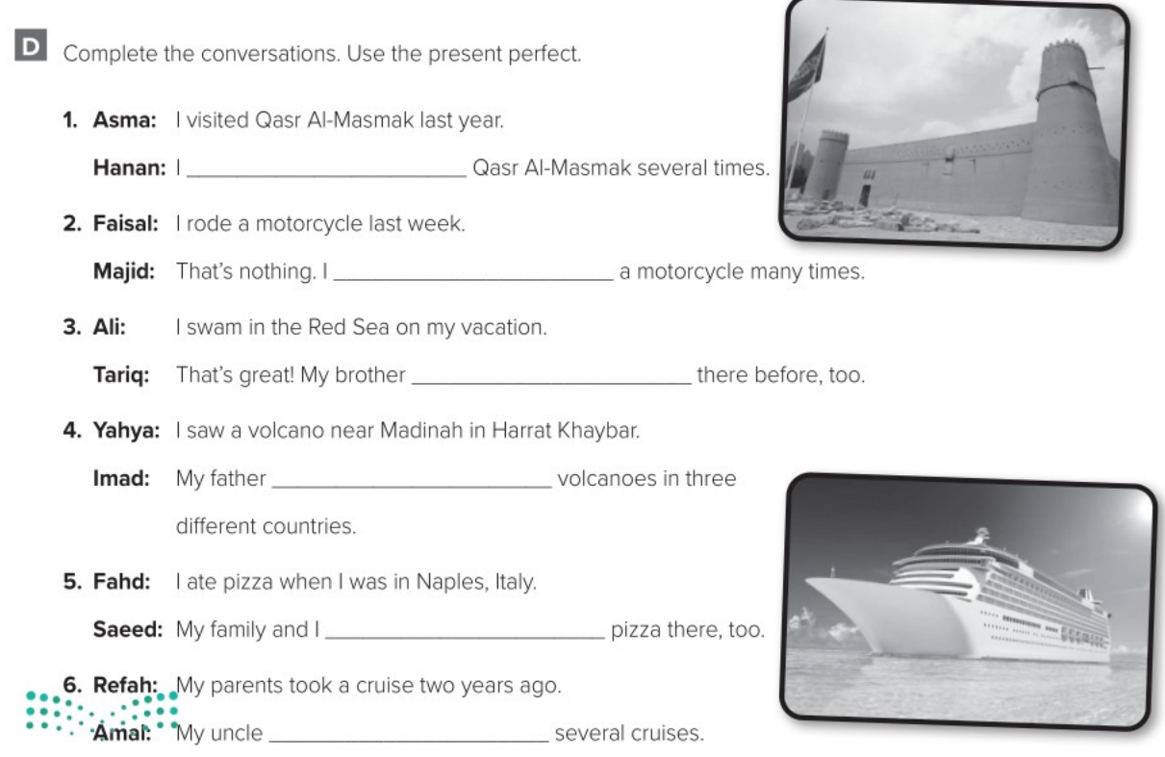
have visited
have ridden
has swum
has seen
have eaten
has taken
Pg. 254

