Slide 2
Sunday 24-10-1444H
Practice a conversation.
Answer questions about a conversation.
Pg.138

Slide 3
Active discussion

Slide 4
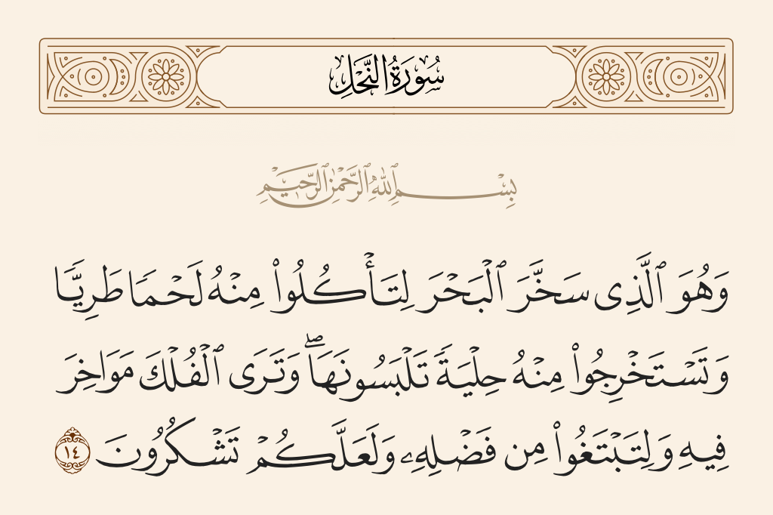
Sunday 24-10-1444H

Slide 5
Sunday 24-10-1444H

Slide 6
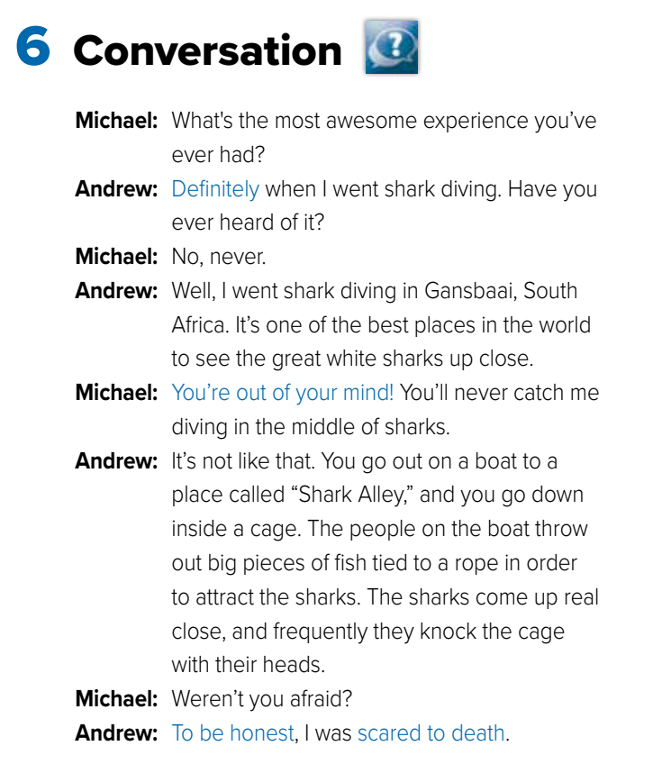
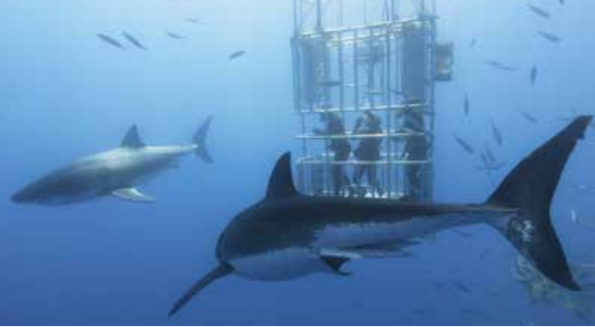
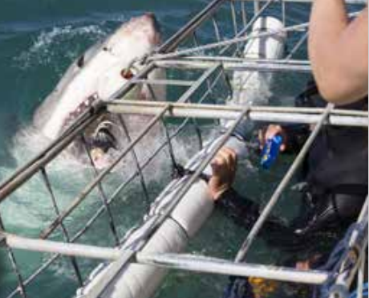
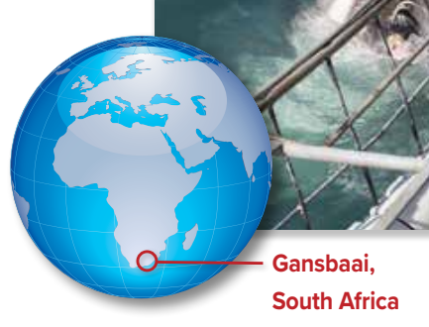
Sunday 24-10-1444H
Pg.142

Slide 7
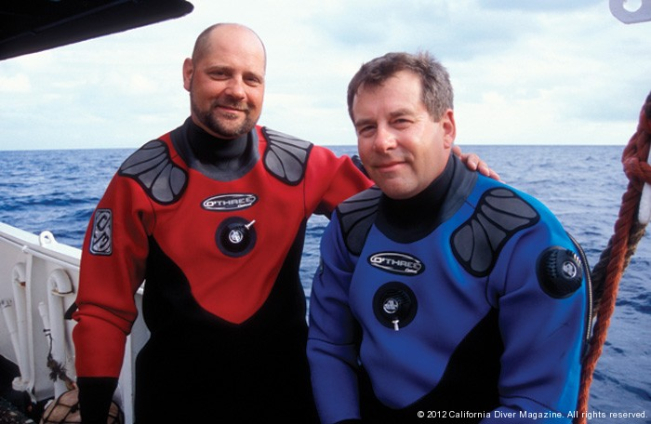
Sunday 24-10-1444H
About the Conversation
1.Where did Andrew go on his vacation?
2. What kind of experience was it?
3. How do they attract the sharks?
4. Was he scared?
5. What does Michael think?
Pg.142

Slide 8
Sunday 24-10-1444H
About the Conversation
1.Where did Andrew go on his vacation?
2. What kind of experience was it?
3. How do they attract the sharks?
4. Was he scared?
5. What does Michael think?
He went shark diving in Gansbaai, South Africa.
It was an awesome experience, but it was scary.
People throw out big pieces of fish.
Yes, he was. Andrew says he was scared to death.
Michael thinks that Andrew is crazy.
Pg.142

Slide 9
Sunday 24-10-1444H
Pg.142

Slide 10
Sunday 24-10-1444H
Pg.142

Slide 11
Pg. 255

Slide 12
Pg.255

Slide 13
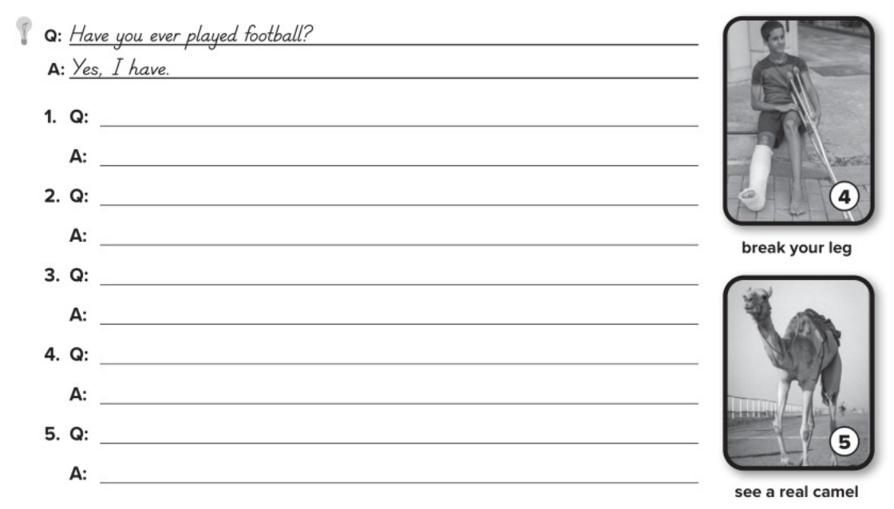
Have you ever ridden a roller coaster?
Yes, I have.
Have you ever heard a lion roar?
No, I haven’t.
Have you ever eaten Korean food?
Yes, I have.
Have you ever broken your leg?
Yes, I have.
Have you ever seen a real camel?
Yes, I have.
Pg.255

Slide 14
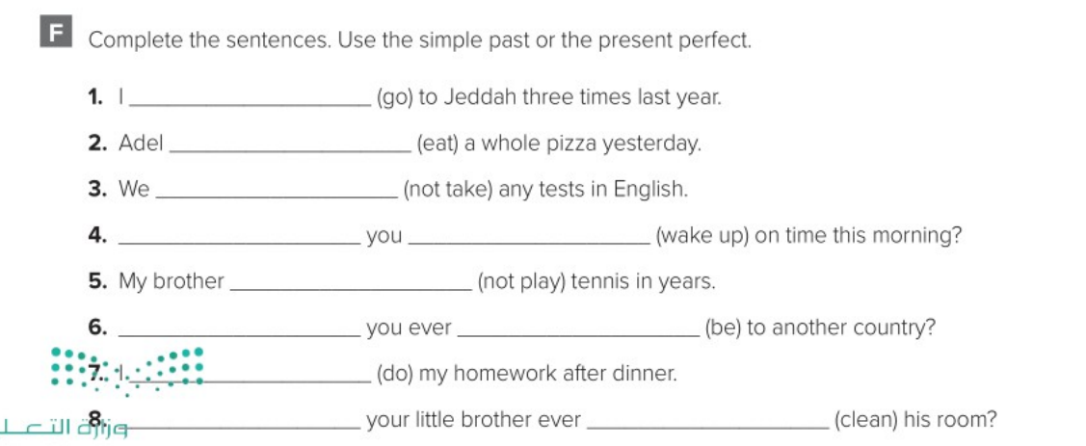
went
eaten
Haven’t taken
Did
wake up
hasn’t played
Have
been
Did
Has
cleaned
Pg.255

